Slide 1
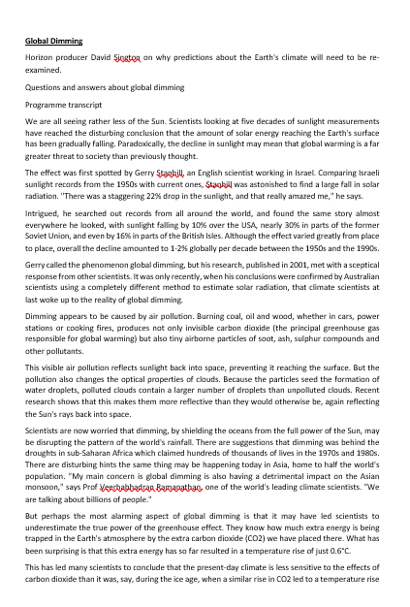
Global Dimming and Global Brightening
Demo: Read the Sheet on global dimming.
Global brightening is caused by changes in cloud cover, reflective aerosols and absorbing aerosols. While changes in cloud cover & aerosols lead to more sunlight hitting the surface, this can be compensated by the cooling effect on the atmosphere due to fewer clouds trapping less warmth and fewer absorbing aerosols absorbing less sunlight.
Global dimming is defined as the decrease in the amounts of solar radiation reaching the surface of the Earth. The by-product of fossil fuels are tiny particles or pollutants which absorb solar energy and reflect back sunlight into the space.
Homework: Research the notion of Global brightening, to what extent is the idea

Slide 2
Climate Change
Learning Objective: To be able to explain the causes of Global Climate Change.
Starter: List the causes of Climate Change.
Cause
Effect
Consequence
Solutions
A01
A02
AO3
AO4
A01
A02
AO3
AO4
A01
A02
AO3
AO4
A01
A02
AO3
AO4

Slide 3
Climate Change
Causes of Climate Change
Consequences of Climate Change
Global Temperature variations and heatwaves
Rising Sea Levels
Increasing acidity in oceans
Melting ice caps and glaciers
Thawing peat bogs
El Nino
Growth of the tropical Belt
Changing patterns of rainfall
Declining crop yields
Impact on Wildlife
Carbon Dioxide
Methane
Nitrous Oxides
Chlorofluorocarbons
Ozone

Slide 4
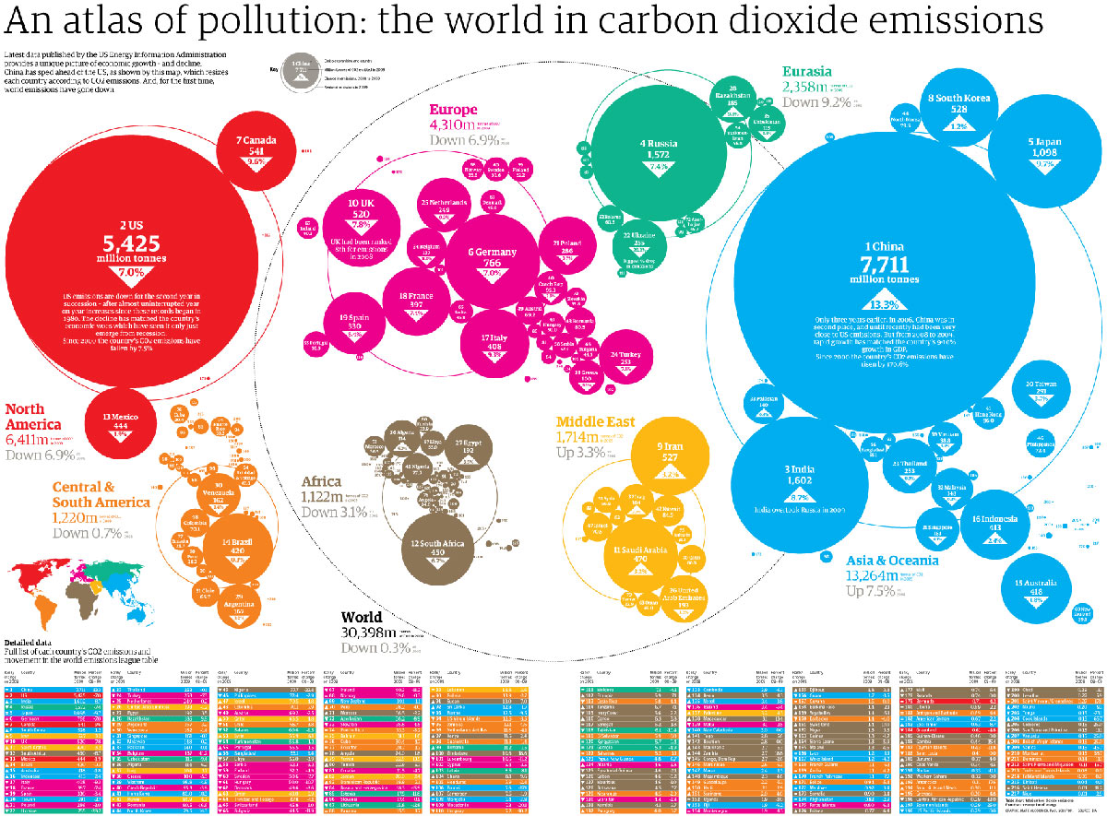
Climate Change
Demo: Who are the biggest emitters?

Slide 5
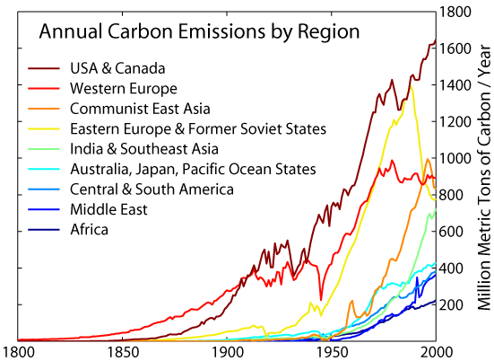
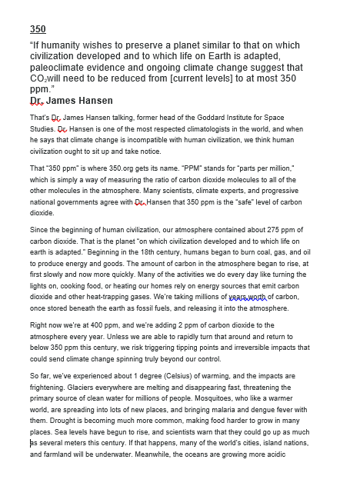
Annual Carbon emissions
Demo: Why is 350 a significant number when discussing global warming? Read the text to find out.

Slide 6
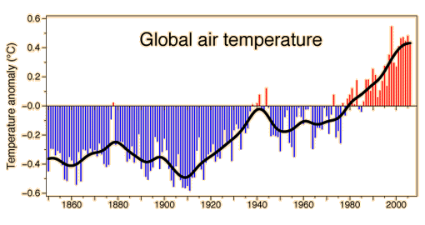
Effects – Rise in temperature
CLIMATE CHANGE - AIR

Slide 7
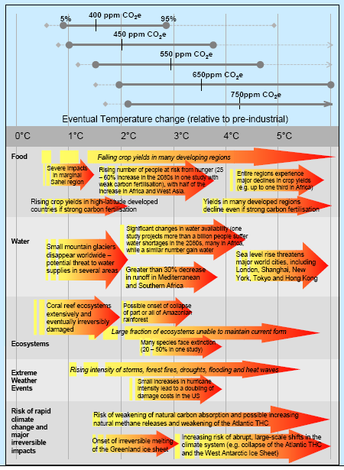
Changes in Temperature
Impacts
Food
Water
Ecosystems
Extreme Water events
Irreversible impacts

Slide 8
Research Project: Climate Change
Demo: What are the problems and solutions of climate change? Ensure to use case studies to be able to back up your arguments and statements. Ensure to gather rich data and information.
Problems |  | Solutions
Problem: | Case Study: | Problem: | Case Study:
Challenge: Ensure to be able to evaluate the problems and solutions of climate change and be able to evaluate, which is the most viable.

