Slide 1
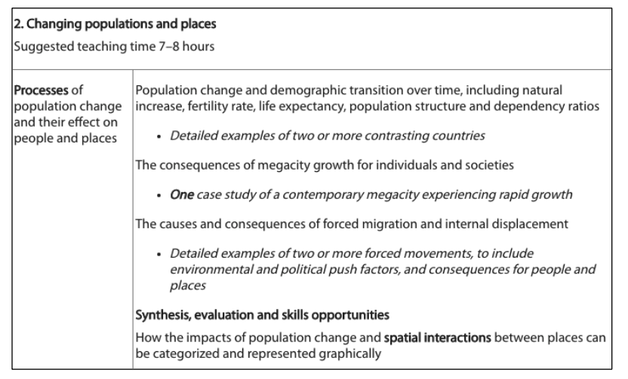

Slide 2
Changing Population and the effect on places
Learning Objective: To be able to analyse two or more contrasting countries.
Factor
AO1 Defined
Example
Dependency ratios
Starter: Define the Terms and add Examples.
High Dependency Ratio (Afghanistan)
Low Dependency Ratio (USA)
Demographic Transition over time
All Countries (Synthesis Revision Task)
Fertility Rate
FR High (Niger)
FR Low (Germany)
Life Expectancy
LE High (Japan)
LE Low (Afghanistan)
Population Structure
All Countries (Synthesis Revision Task)
Natural Increase
NI High (Mali)
NI Low (Germany)

Slide 3
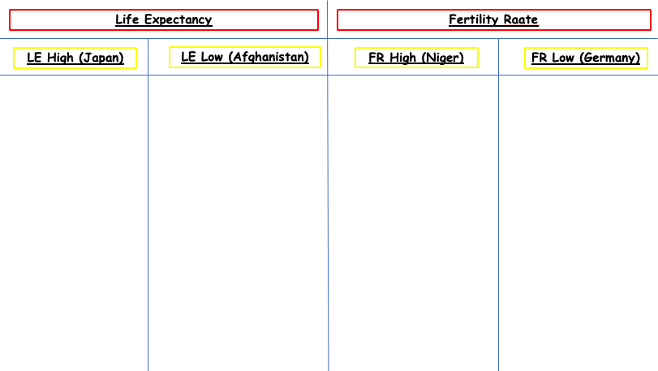
Case Study Work
Demo: Use the Reading Provided to make notes on the different countries.
Complete the reading

Slide 4
Changing Population and the effect on places
Learning Objective: To be able to analyse two or more contrasting countries.
Factor
AO1 Defined
Example
Dependency ratios
Demographic Transition over time
Fertility Rate
Life Expectancy
Population Structure
Natural Increase

Slide 5
Life Expectancy
Fertility Raate
LE High (Japan)
LE Low (Afghanistan)
FR High (Niger)
FR Low (Germany)

