Slide 1
Environmental sustainability
Learning Objective: To understand the concept of environmental sustainability and evaluate a national strategy.
STARTER: Define the term sustainability. (A01 Define)
‘…meeting the needs of the present without compromising the ability of future generations to meet their needs. This encompasses keeping population densities below the carrying capacity of a region, facilitating priorities for the use of non-renewable resources, and keeping environmental impact below the level required to allow affected systems to recover and continue to evolve’ UN

Slide 2
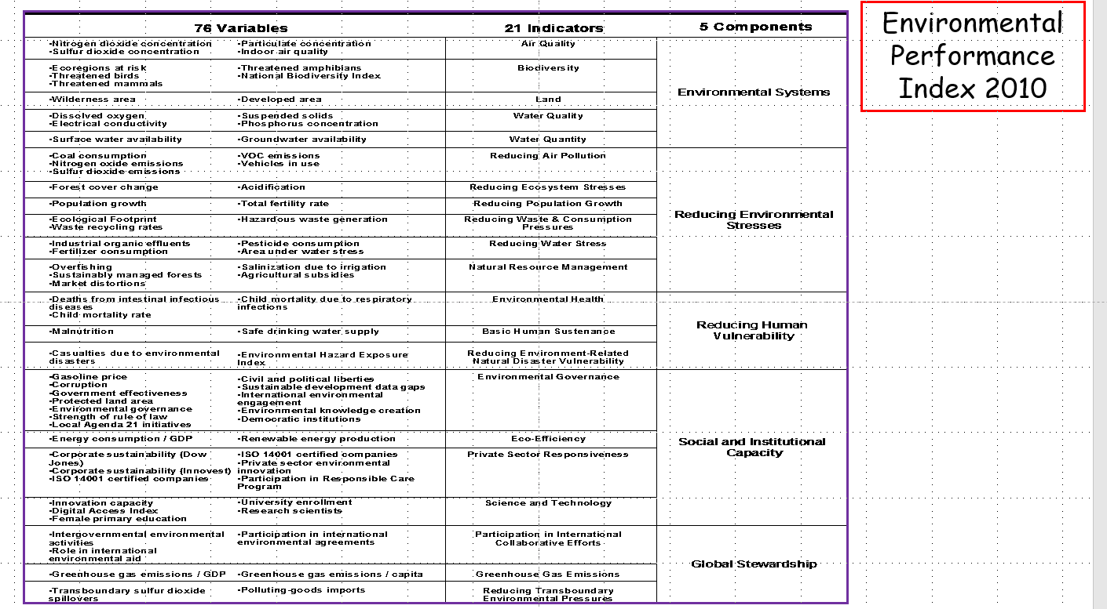
Environmental sustainability Index
Fig 1.
Demo: Describe the Global pattern of the ESI in Fig 1.
Yale/Columbia University
Supporting material
Evaluation
Doesn’t include waste management, wetlands destruction, exposure to heavy metal.
Better Environmental sustainability
Poor
Environmental sustainability

Slide 3
Development and environmental sustainability
Decision making Exercise: What 4 Factors must you take into considering when assessing the sustainability of development schemes.

Slide 4
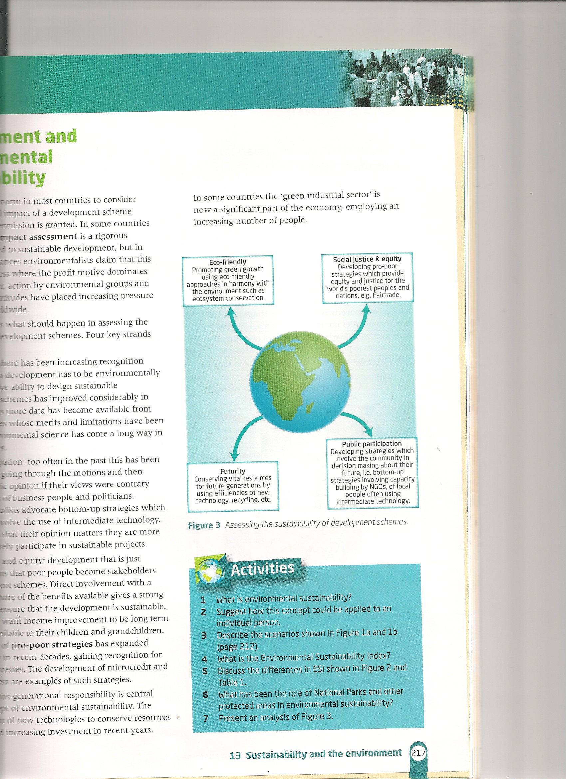
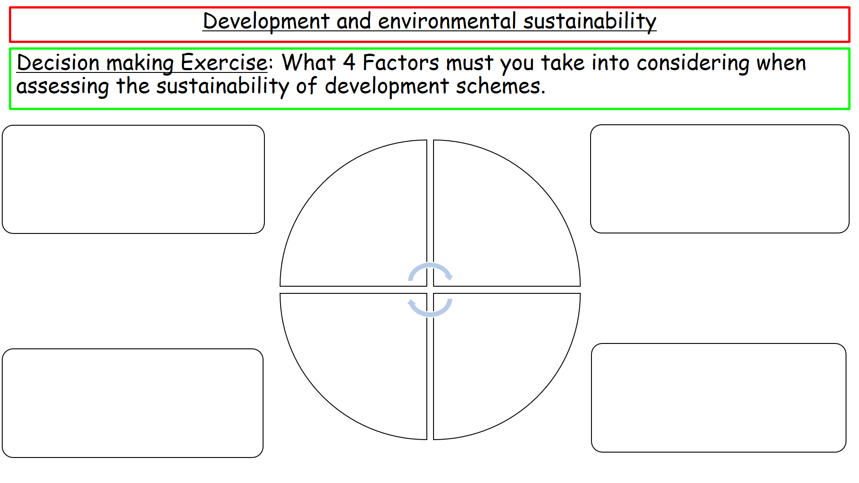
Environmental sustainability Index Rankings
Demo: Add the Four Factors used to measure sustainability of development schemes.

Slide 5
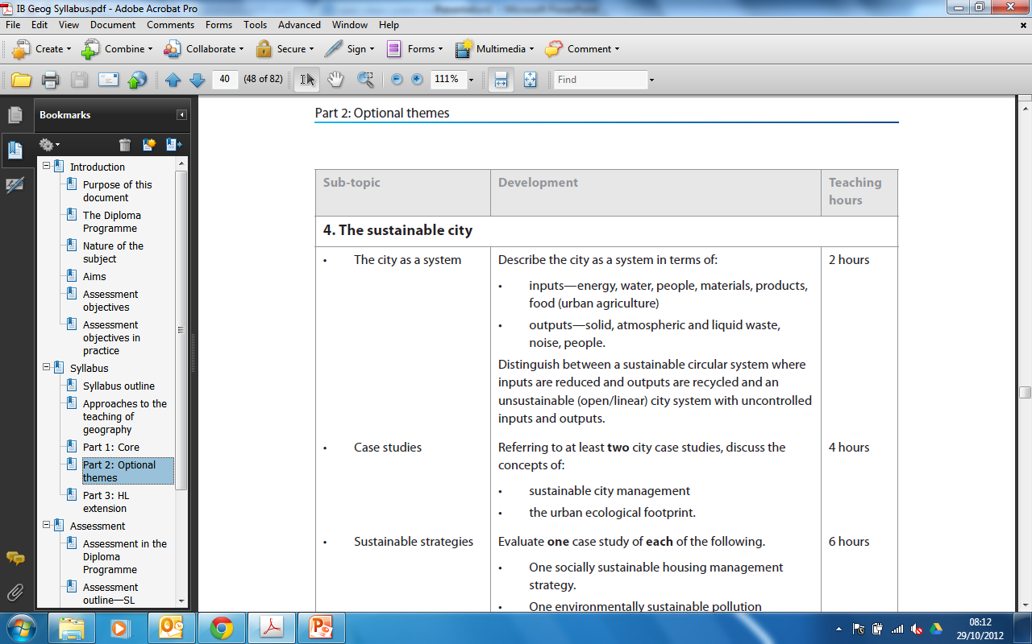
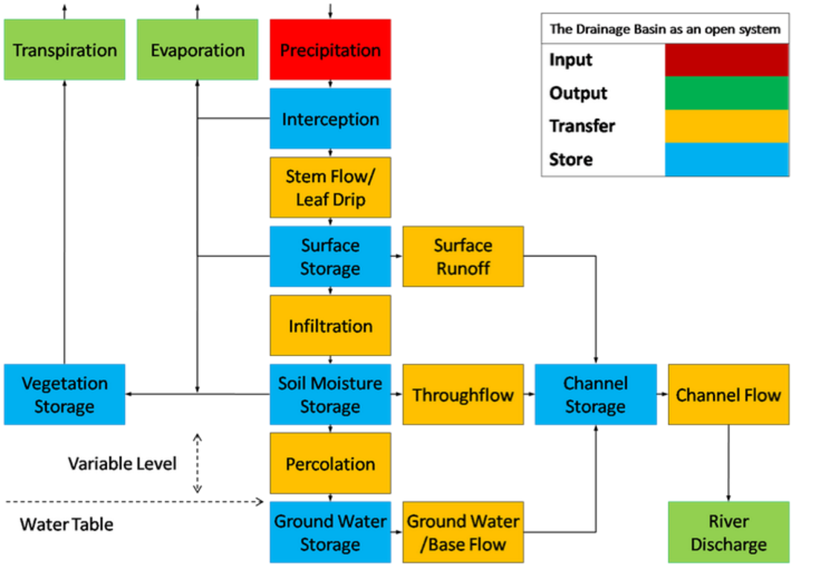
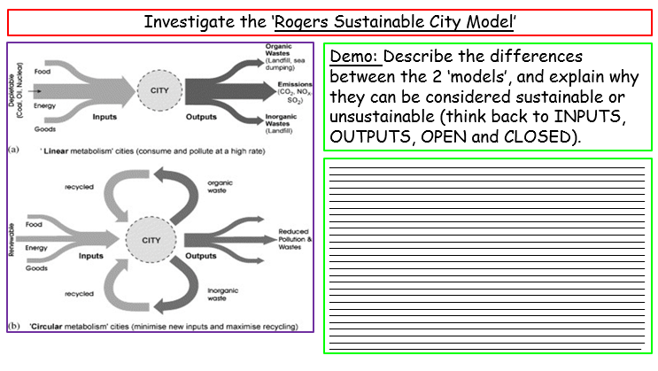
Sustainable Cities
Learning Objective: To understand the concept of environmental sustainability and evaluate a national strategy.
Learning Objective: To be able to describe the city as a system, most importantly to distinguish between circular and open/linear systems.
Demo: Define and explain the terms OUTPUT and INPUT.
Linking your Learning
Challenge: Complete your worksheet that has been provided for you.

Slide 6
Linking your Learning

Slide 7
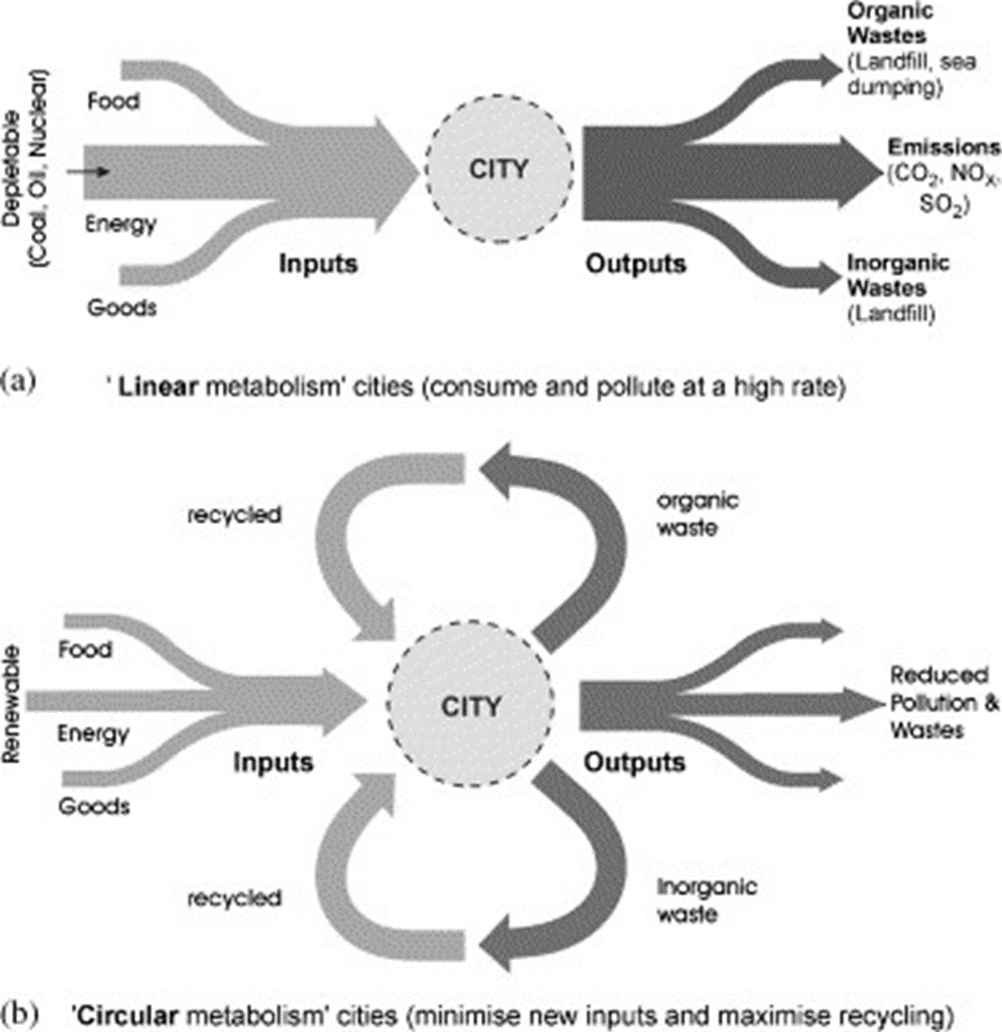
Investigate the ‘Rogers Sustainable City Model’
Demo: Describe the differences between the 2 ‘models’, and explain why they can be considered sustainable or unsustainable (think back to INPUTS, OUTPUTS, OPEN and CLOSED).
_______________________________________________________________________________________________________________________________________________________________________________________________________________________________________________________________________________________________________________________________________________________________________________________________________________________________________________________________________________________________________________________________________________________________________________________________________________________________________________________________________________________________________________________________________________________________________________________________________________________________________________________________________________________________________________________________________________________________________________________________________________________________________________________________________________________________________________________________________________________________________________________________________________________________________________________________________________________________________________________________________________________________________________________________________________________________________________________________________________________________________________________________________________________________________________________________________________________________________________________________________________________________________________________________________________________________________________________________________________________________________________________________________________________________________________________________________________________________________________________________________________________________________________________________________________________________________________________________________________________________________________________________________________________________________________________________________________________________________________________________________________________________________________________________________________________________________________________________________________________________________________________________________________________________________________________________________________________

Slide 8
What is SUSTAINABILITY?
Demo: Which system (linear or cyclical) is most likely to be more sustainable? Why? Evidence?
Writing Frame:
Markscheme:
Have you defined the two systems?
Have you stated which one is more likely to be sustainable?
Have you provided Evidence as to why that system maybe more sustainable?
Can you link this to a real life example?
An ecocity is… An ecologically healthy human settlement modelled on the self-sustaining resilient structure and function of natural ecosystems and living organisms. An entity that includes its inhabitants and their ecological impacts.
Challenge: Is a sustainable city the same as an eco-city?

Slide 9

Urban Ecological Footprint
The ecological footprint is a measure of human demand on the Earth's ecosystems, the amount of natural capital used each year. The footprint of a region can be contrasted with the natural resources it generates.
Demo: Ensure to make notes on the Ecological Handprints.
Problems
Solutions

Slide 10
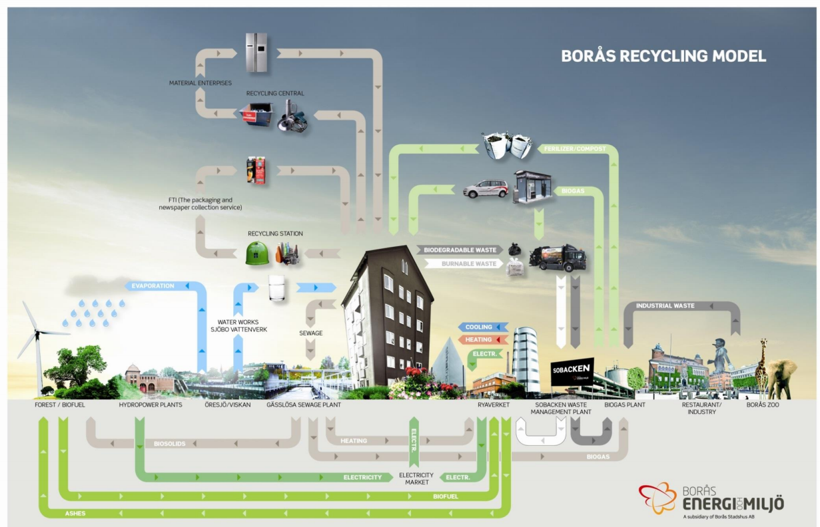

Slide 11
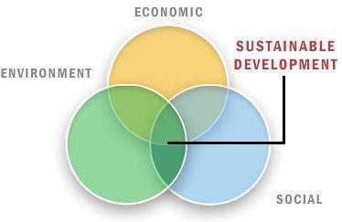
Sustainable Nation/Cities
Sustainable Development: Meeting the needs of today's population without compromising the needs of future generations. Today sustainable development is usually considered to include environmental, social and economic sustainability (see definitions below). If development includes social, economic and environmental aspects then it is considered to be sustainable development.
Stewardship: The act of overseeing the protection of something e.g. rainforests.
Conservation: The act of preserving and protecting something.
Environment: The things that surround you. In Geography when we talk about the environment we normally mean the natural things that surround you e.g. trees, rivers, mountains and lakes.
Demo:
Make sure to get the key language (definitions) down in your notes.
What does this mean and how might this be achieved?

Slide 12
Sustainable Cities
Environmental Sustainability | Economic Sustainability | Social Sustainability
Definition: Improvements in the standard of living that do not cause long-term damage to the environment that impact future generations. | Definition: Development that includes everyone, where everyone has the right of economic improvement. The development should be long-term and devoid of corruption and burdening debt. | Definition: Development that is inclusive and ensures an improvement in the standard of living for all. It should incorporate everyone and ensure equal access to healthcare, education, resources, etc. while respecting individual cultures.
What does it include: Protecting biodiversity Stopping human caused climate change Elimination of acid rain Elimination of damage to ozone layer Reduction of pollution (air, water, noise, etc.) Management of resources e.g. fish, water | What does it include: Access to finance No corruption (kleptocratic governments) No absolute poverty No extortion No nepotism Debt removal? | ,What does it include: Freedom of speech Health and safety at work Access to clean water and sanitation Access to needs i.e. water, food, shelter, clothing Access to education Access to health care Equality between sexes, religions, etc. Right to vote Access to justice Safety - no threat from crime Respect of cultures

Slide 13
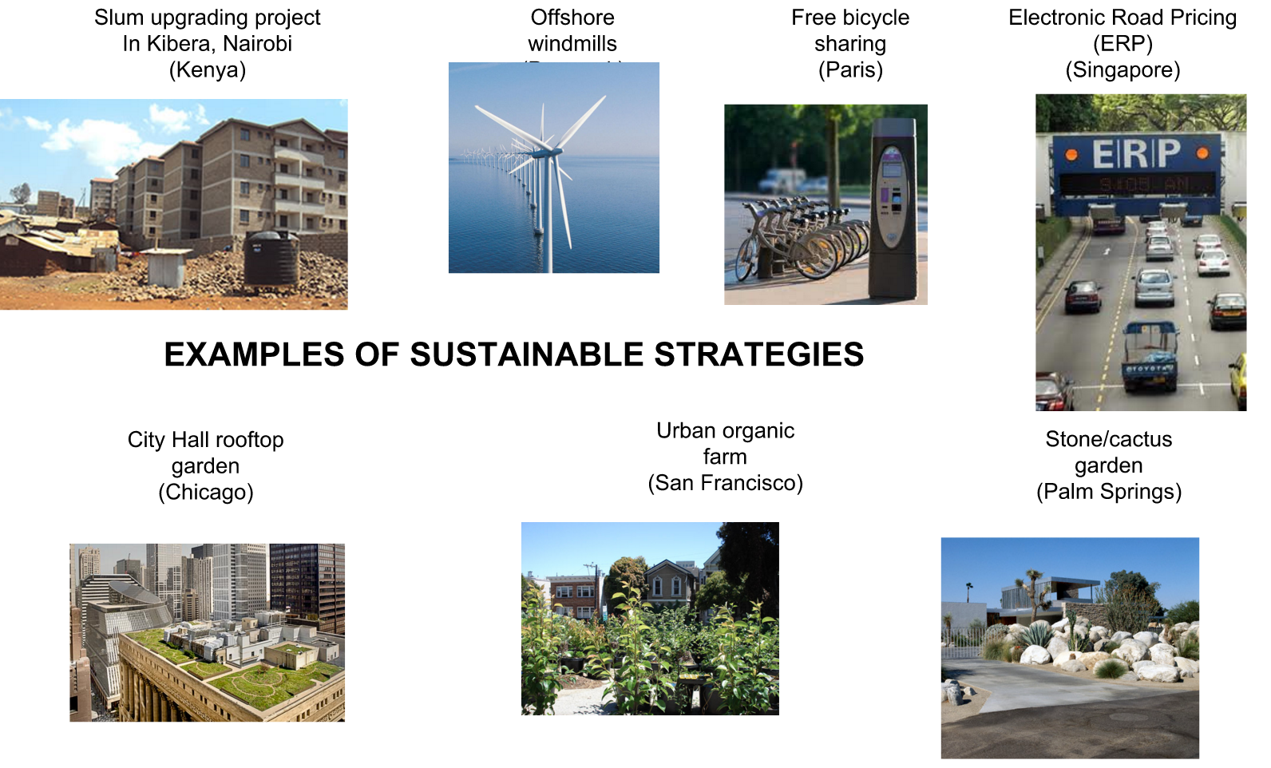

Slide 14
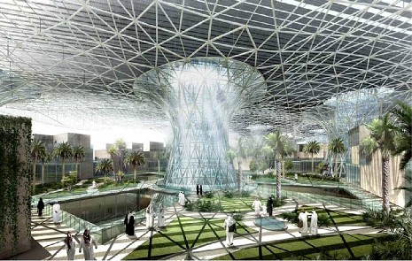
Masdar United Arab Emirates (UAE)
Demo: Watch the Video and make notes on how Masdar is creating a sustainable city.

Slide 15
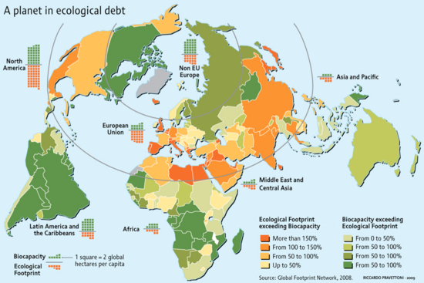
Ecological Debt

Slide 16
Environmental Performance Index 2010

Slide 17
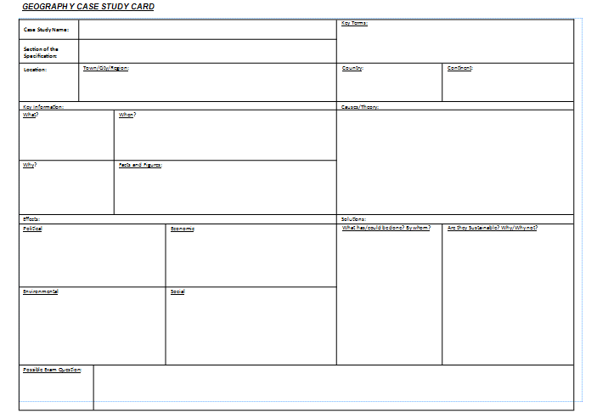
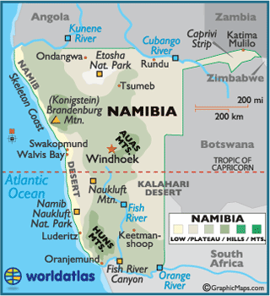
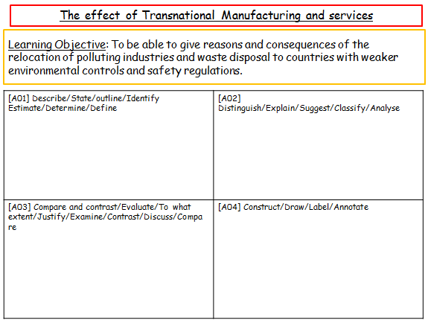
Management Strategy Namibia
Demo: Read through your Case study notes and create a case study sheet.
Challenge:
Possible Exam Question
Finished Complete your Evaluation of learning sheet

Slide 18
Management Strategy Namibia
Learning Objective: To understand the concept of environmental sustainability and evaluate a national strategy.
[A01] Describe/State/outline/Identify Estimate/Determine/Define | [A02] Distinguish/Explain/Suggest/Classify/Analyse
[A03] Compare and contrast/Evaluate/To what extent/Justify/Examine/Contrast/Discuss/Compare | [A04] Construct/Draw/Label/Annotate

Slide 19
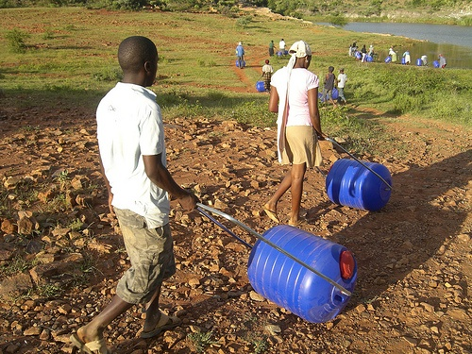
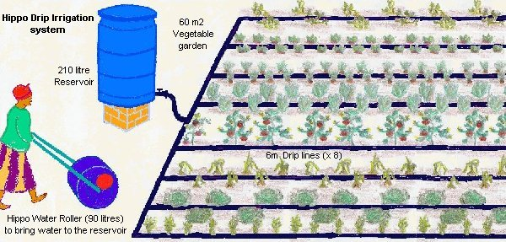
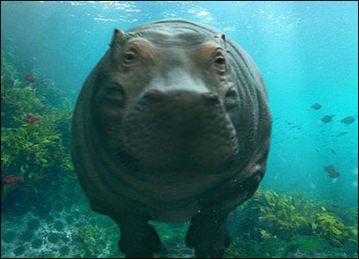
Local environmental sustainability – case study Hippos

Slide 20
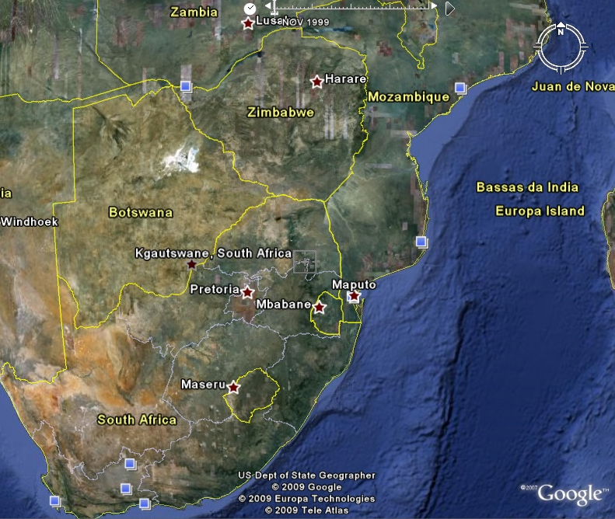
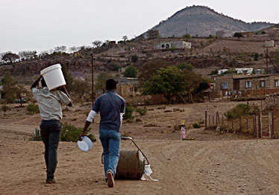
Local environmental sustainability – Case study Hippos
South Africa: Kgautswane
Kgautswane, South Africa. Rural area where 120,000 residents depend on a small number of wells to provide them with water. Not enough and only provide water once or twice a week. Have to spend as much as 7 hours a day collecting water. Community leaders responsible for organising Hippos who prioritises needs, (old, AIDS).
Problem:
Keeps children out of school
Health problems – 20l – spine / childbirth
Landmines
Need a secure water source for economic growth and poverty reduction
Solution:
Can carry more water
90kg of water now 10kg
Moves over most types of terrain

Slide 21
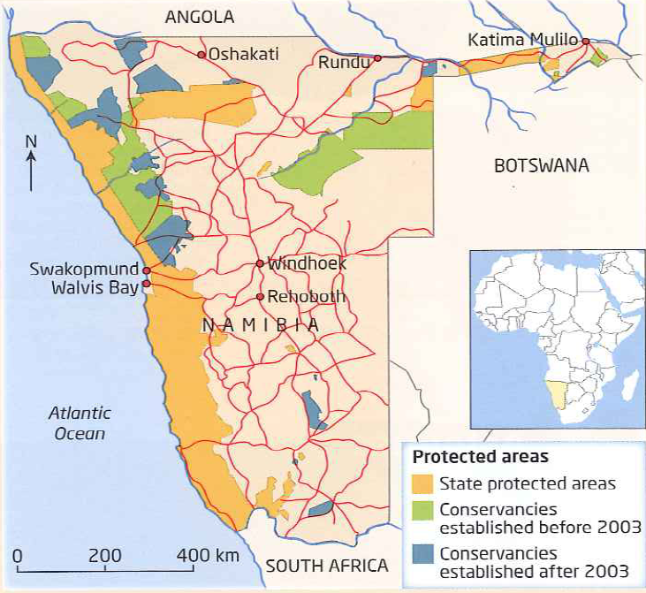
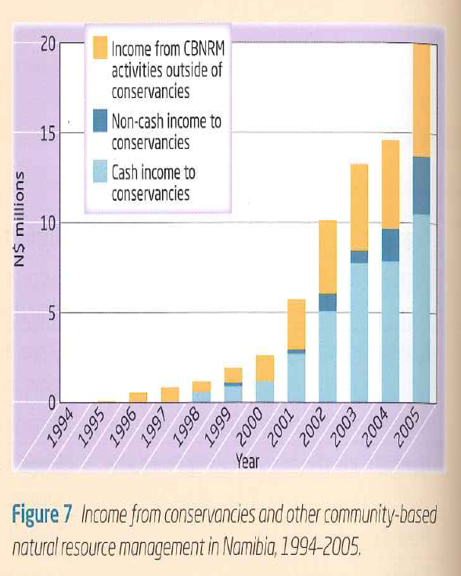
Revision Questions
Demo: Look at Fig.4. Describe the geographical location of (a)state protected areas, (b)conservancies established before 2003 and (c)conservancies established after 2003.
Challenge: Analyse the data presented in Figure 7.
Fig.4 Namibia’s community conservancies
Fig.7 Income from conservancies and other community based natural resource management in Namibia 1994-2005

Slide 22
Environmental Performance Index 2010

Slide 23
Environmental Systems
Reducing Environmental Stress
Reducing Human Vulnerability
Social and institutional capacity
Global stewardship

