Slide 1
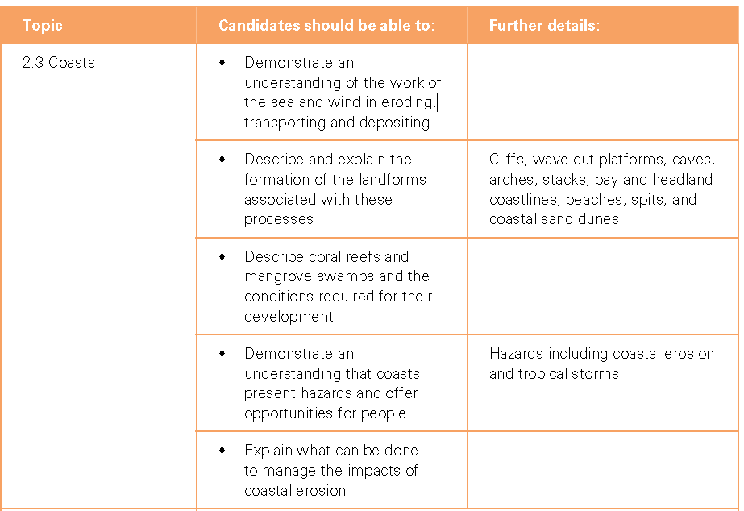
Coasts Progress Check

Slide 2
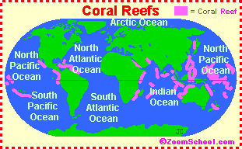
Coral Reefs
Starter: Using the sources describe where coral reefs can be found.
Learning Objective: To be able to explain the formation and importance of coral reefs and mangroves.
Source 1
Key Data/Info:
22 degrees N and 22 degrees S of the equator
60% of the world's reefs are found in the Indian Ocean and Red Sea,
25% are located in the Pacific Ocean, and 15% in the Caribbean.
Source 2

Slide 3
Coral Reefs
Coral reefs are located in three primary regions located between 22 degrees N and 22 degrees S of the equator: the Indo-Pacific, the Western Atlantic, and the Red Sea. The Indo-Pacific region stretches from southeast Asia through Polynesia and Australia, eastward across the Indian Ocean to Africa. This is the largest and richest assemblage of reefs in terms of coral and fish species present. The Western Atlantic region stretches from Florida to Brazil, including Bermuda, the Bahamas, the Caribbean, Belize and the Gulf of Mexico.
The Red Sea is the smallest of the three regions, located between Africa and Saudi Arabia. It is considered a separate region because of the high number of coral reef life found only in this area.
Based upon geographic distribution, 60% of the world's reefs are found in the Indian Ocean and Red Sea, 25% are located in the Pacific Ocean, and 15% in the Caribbean.
Source 2

Slide 4
Coral Reefs
Learning Objective: To be able to explain the formation and importance of coral reefs and mangroves.
Demo: What are Coral Reefs?
Key Language: Coral Reefs are calcium carbonate structures, made up of reef building stony carol
Demo: How are Coral Reefs formed?
The water temperature drops much below 18°C (64°F) for more than a few days. Corals also require clear waters, because they need sunlight to support the algae that live within their tissues. They are also very sensitive to particles of mud or sediment settling on them, which means that corals rarely grow close to rivers or other sources of sediment. In the sea, light is filtered out by depth, so reef-building corals can only grow in relatively shallow water. Even in the clearest oceans few reef-building corals grow below a depth of 80 to 100 m (260 to 328 ft). Although corals need nutrients, they cannot thrive in areas where there are large amounts of nutrients. Typically, microscopic organisms in the plankton, or seaweeds (macroalgae), grow to excess in nutrient-rich water and smother the corals, blocking out the light.

Slide 5
Types of Coral Reef
Demo: Complete the table using the information from the video.
Type of Reef
Fringing Reef
Barrier Reef
Patch Reef
Atoll Reef
How is it formed?
Diagram
Examples
Homework: Research and find 2 examples for each type of reef.

Slide 6
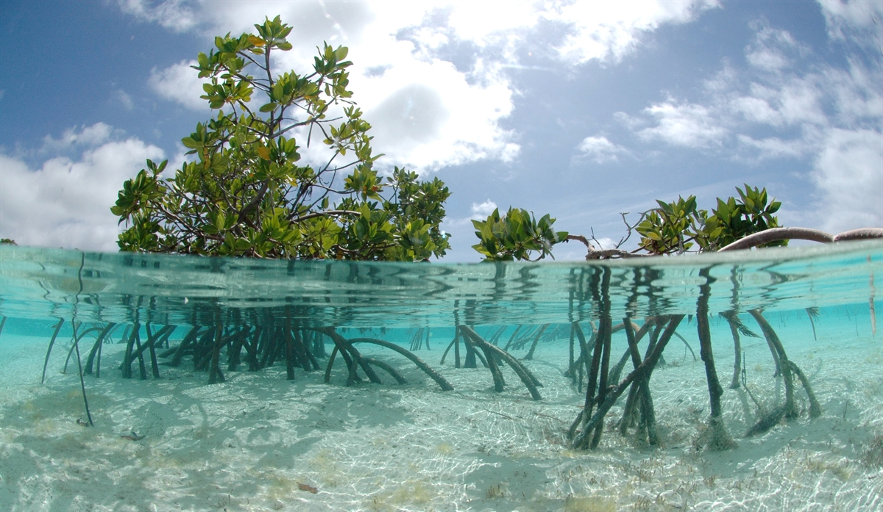
Mangroves
How does this grow?
What fact can you find?
Pages 128/129
What value do they bring?
What pressures might there be on me?

Slide 7
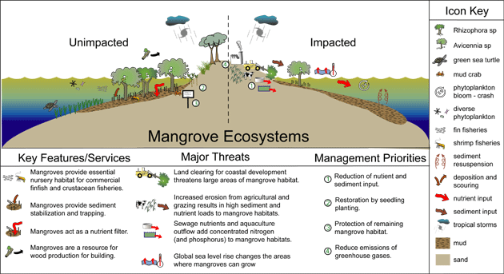
Mangroves (Threats)

Slide 8
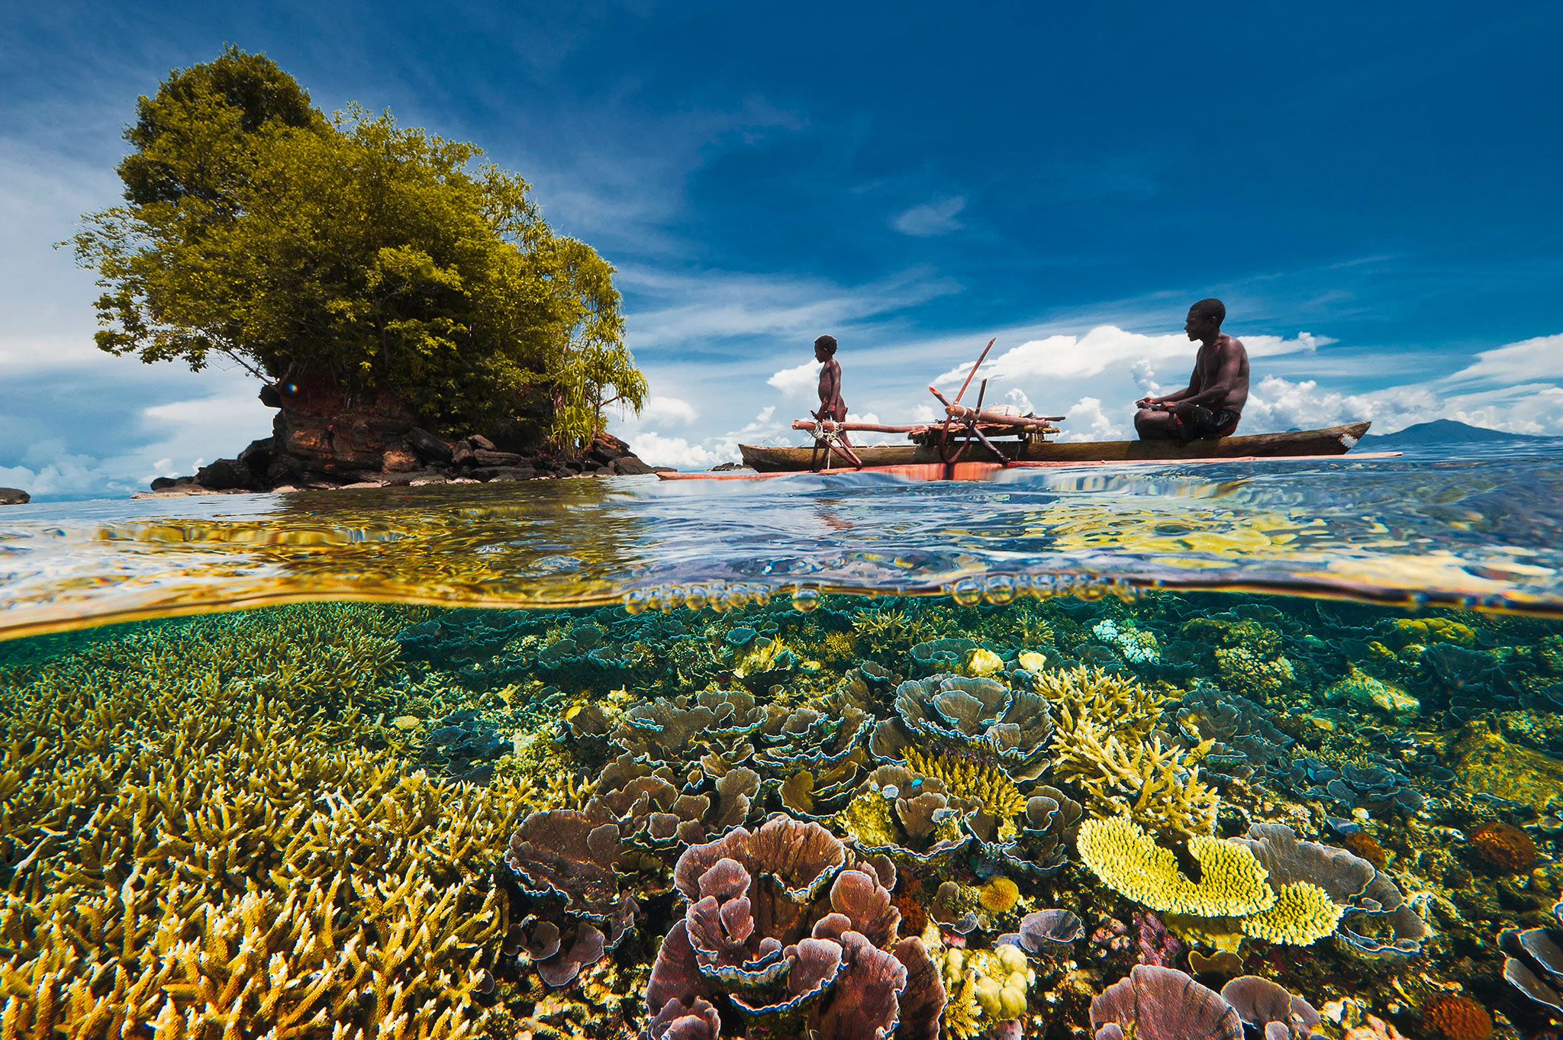
Making Links (Coral Reefs and Mangroves)
Mangroves are trees and shrubs that grow in the intertidal zone between the land and the sea, while seagrasses are the only true plants that live completely submerged in the sea. Both mangroves and seagrasses are particularly abundant and diverse in tropical waters. Many reef animals move between these ecosystems during their lives. The mangroves and seagrasses are also important for filtering and holding sediments and thus keeping the water over the coral reefs clearer.

Slide 9
Types of Coral Reef
Demo: Complete the table using the information from the video.
Type of Reef
Fringing Reef
Barrier Reef
Patch Reef
Atoll Reef
How is it formed?
Diagram
Examples

