Slide 1
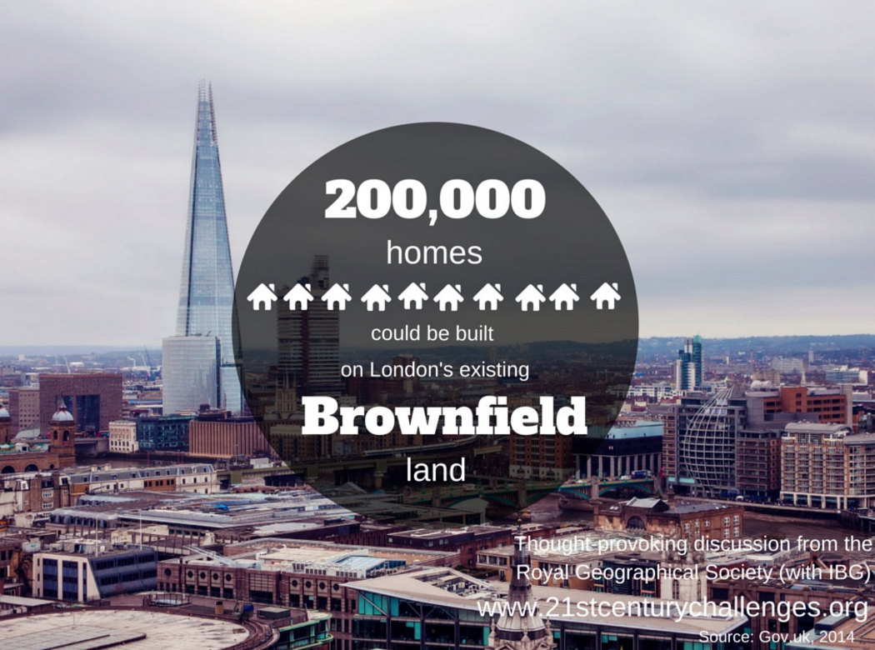
Urban Environments (Brownfield sites)
Starter: Read the article and identify what are the concerns about the redevelopment of the PowerStation?
Key Language:
Brownfield Land: Abandoned, derelict or under‑used industrial buildings and land that may be contaminated but have potential for redevelopment.
Case Study Example 1:London Olympic Park
Case Study Example 2: Battersea PowerStation, London
What are the concerns about the redevelopment of the PowerStation?
Key Terminology: Urban Stress, Urban Renewal, Urban Change,

Slide 2
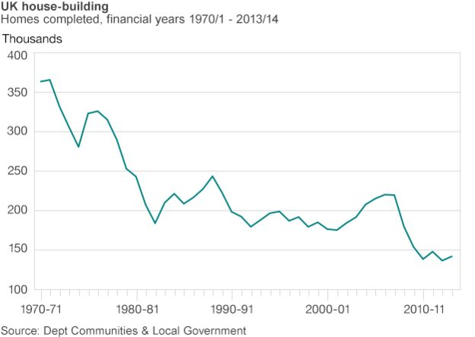
Demo: Describe the trend of UK house building. (3 marks)

Slide 3
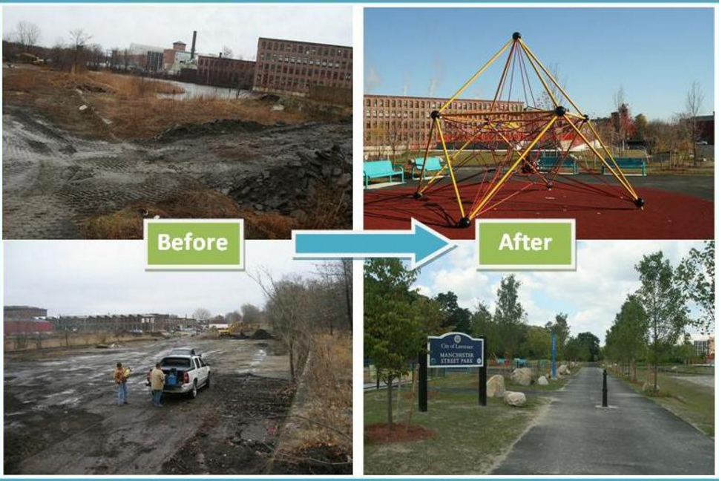
Urban Environments (Brownfield sites)

Slide 4
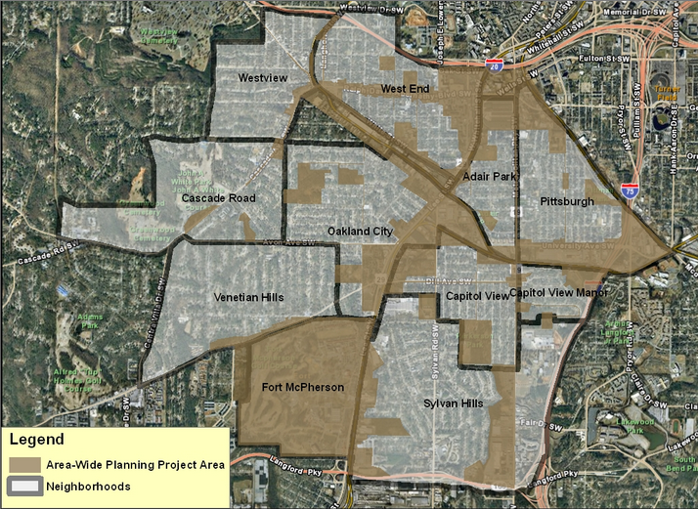
Atlanta - Brownfield sites

Slide 5
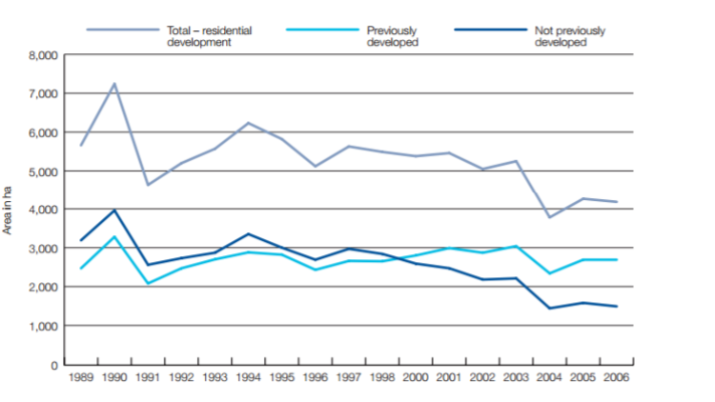
Urban Environments
Demo: Describe the trend found in the graph. (3 marks)

Slide 6
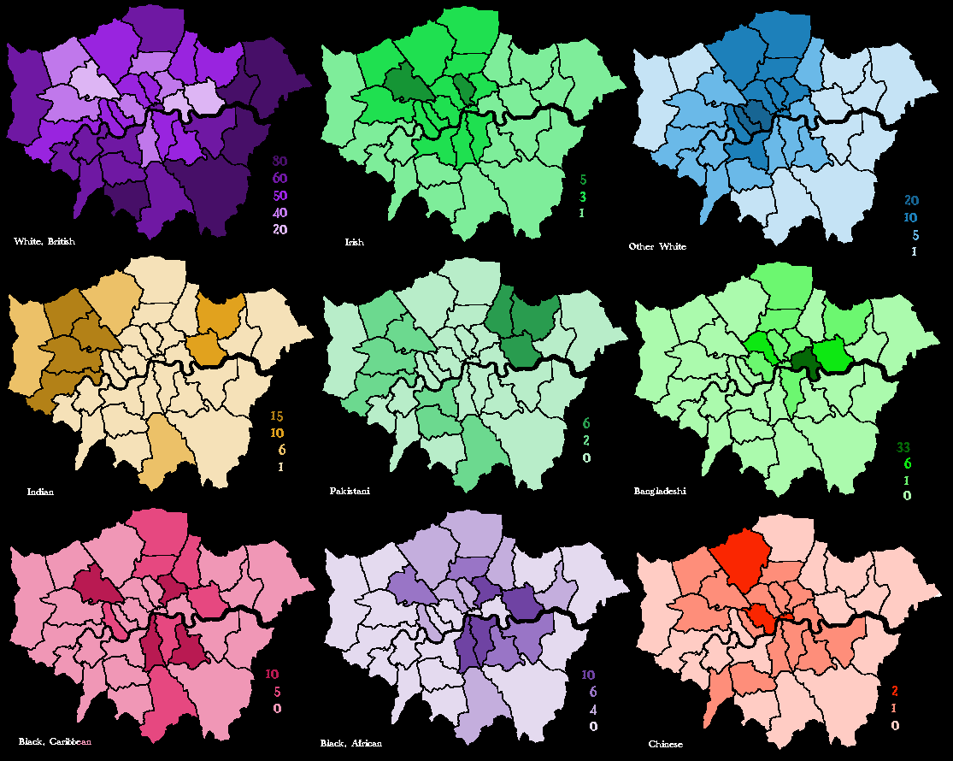
Urban Environments (Ethnicity)
Demo: Does ethnicity or race have any bearing upon where people live?
Global
Key Language:
Social Discourse
Local

Slide 7
Urban Environments (Ethnicity)

Slide 8
Urban Change (Ethnicity)
Demo: Does ethnicity or race have any bearing upon where people live?
Paper
Identity
Nationality
Paper 2 Urban Environments
London
Place/Birth
Paper 3 Identity and Multiculturalism
North to South
Internal
Key Language:
Social Discourse:
Paper 1 Population in transition
Migration
EU/International
International

Slide 9
Urban Change (Ethnicity)
Census 2011
Demo: Does ethnicity or race have any bearing upon quality of life?
London
Education
Employment
Housing
Health

Slide 10
Urban Change (Ethnicity)
Summary
Census 2011
Employment
Education
Barking and Dagenham lowest:
Ethnic Minorities tend to be disadvantaged
2000/2011
Barking and Dagenham lowest:
Ethnic Minorities tend to be disadvantaged
2000/2011
Housing
Health
Barking and Dagenham lowest:
Ethnic Minorities tend to be disadvantaged
2000/2011
Barking and Dagenham lowest:
Ethnic Minorities tend to be disadvantaged
2000/2011

Slide 11
(Case Study) Bangladeshi population in London
Demo: What urban processes might be occurring within London?
1960s – 80s: decentralization of white population to new towns
Remaining urban housing stock – old, occupied by immigrant populations: Indian, Pakistanis, Black and Caribbean, Africans and Bangladeshis.
Bangladeshis today are segregated in London Borough of Tower Hamlets : Late arrival, inability to speak English on arrival, wish to maintain cultural identity, poverty – high concentration and overcrowding
Urban processes> Urbanisation, Counter-urbanisation, centralisation, suburbanisation, gentrification, Centrifugal, Centripetal movements

