Slide 1
Welcome to IB Geography

Slide 2
Instruction: Complete only the questions that have been underlined. You have 20 minutes.
Good Luck

Slide 3
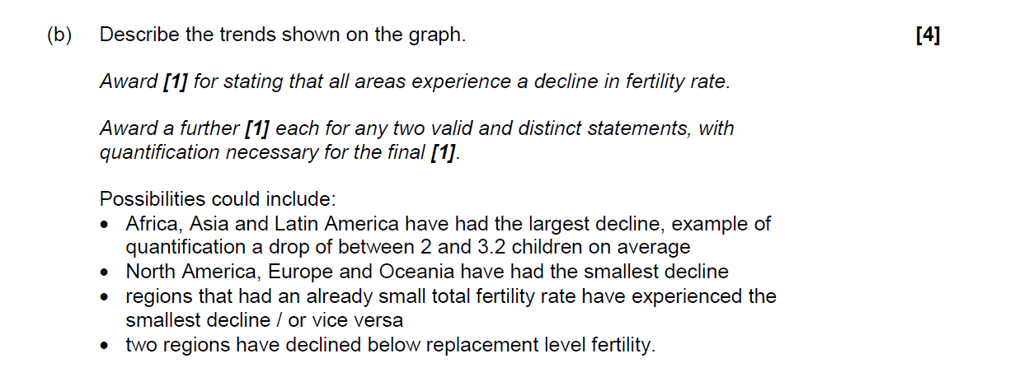
Q:(Command term) Describe the trend shown on the graph?
Trend (1) positive-stagnant-negative
Name Place in collobaration with Data

Slide 4
Q:(Command term) Identify

Slide 5
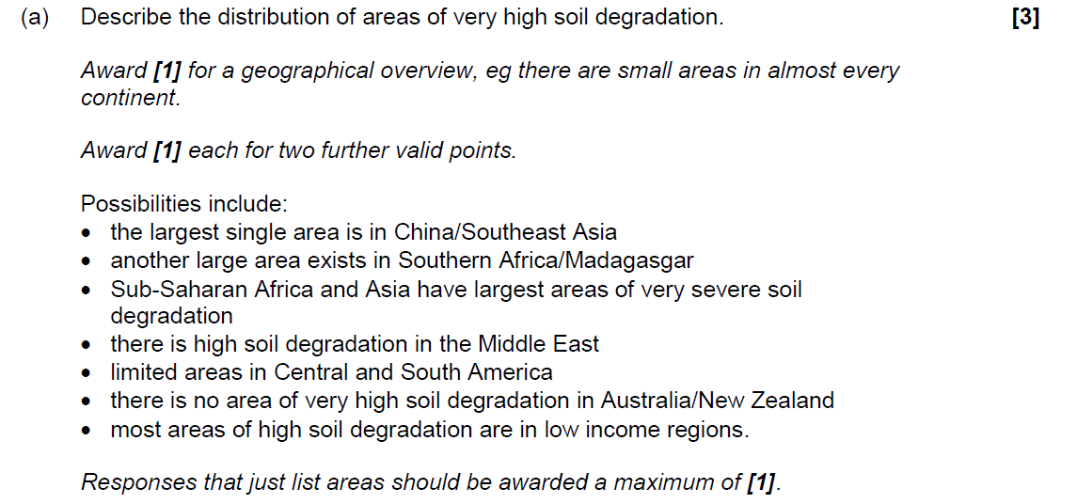
Q:(Command term) Describe the distribution of areas of very high soil degradation

Slide 6
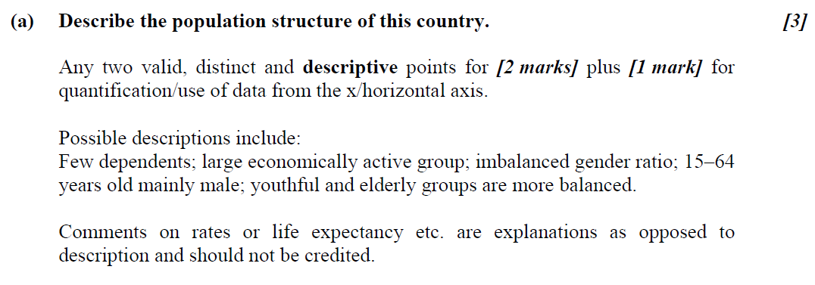
Q:(Command term) Describe the population structure of this country.

Slide 7
Q:(Command term) Identify and State

Slide 8
Q:(Command term) Describe the pattern of high physical water scarcity shown on the map.

