Slide 1
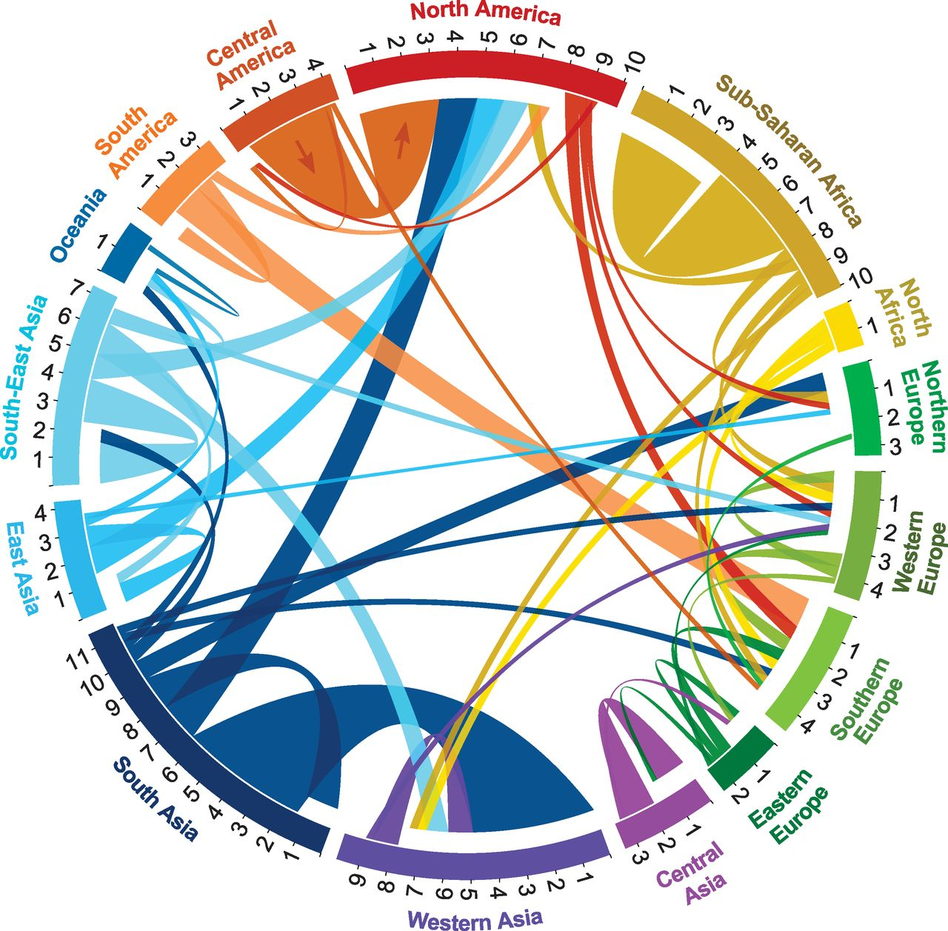
Starter1: Look at the infographic and create a title for todays lesson. Ensure to be able to justify your answer.
Starter2: What patterns can you identify?
Starter3: What model can explain this?

Slide 2
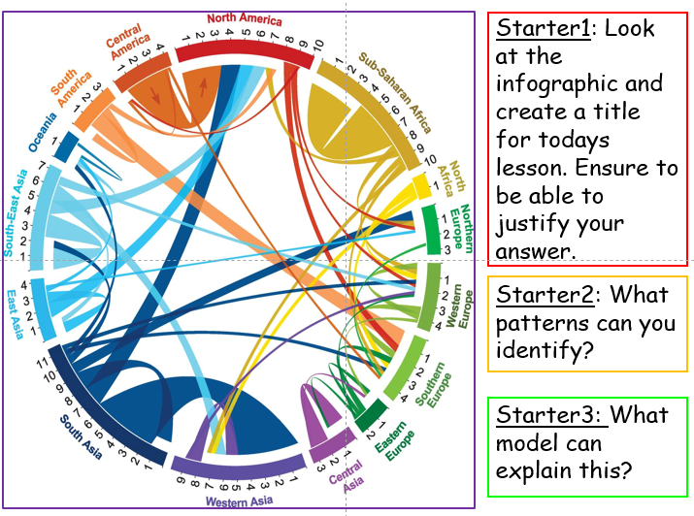
Migration Models
Learning Objective: To be able to discuss the causes of migrations, through the use of models.
Starter: Complete your starter sheet.

Slide 3
Migration Models 1 (Gravity Model)
Based on Newton’s law of Universal Gravitation
The number of people moving between places A and B is equal to the population of A multiplied by the population of B divided by the square of the distance between them.
The potential number of migrants will be bigger where the population of departure and arrival are large.
Friction of distance acts as a break.
Evaluation:
Created in the 1680s/1930s
Not specific
Based on small unconnected World

Slide 4
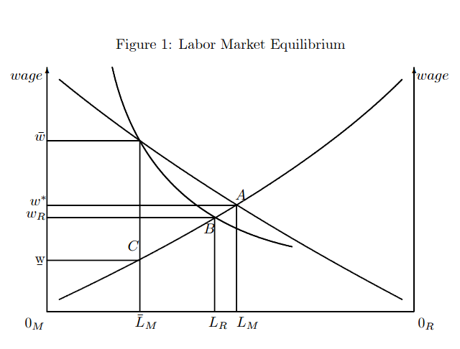
Migration Models 2 (Todaro Model)
Economic Factors are the most influencial of the push-pull factors.
Individual migrants weigh up the economic costs and benefits
Policy makers can slow rural urban migration by creating investment and new employment opportunities in rural areas.
Evaluation:
Created in the 1970s
Economist
Based on income differential between urban and rural

Slide 5
Migration Models 3 (Ravenstein’s Law)
Studied patterns of migration in the UK in the 1880s.
The model is based on a series of predictive statements.
Number 1:
Most migrants move only relatively short distances.
There is an inverse relationship between the number of migrants and distance travelled. (i.e Distance Decay)
Number 2:
People who do move long distances are largely unaware of the opportunities that are available at their destination. So they tend to move to large urban centres.
Number 3:
Migration occurs in stages.
Number 4:
People in rural areas are much more likely to migrate than those in urban centres. Based on the exponential growth of cities (Natural increase+ rural –urban migration)
Number 5:
A typical migrant is: Adults/Women are more likely tor migrate within their country than men and men are more likely to emigrate than women.

Slide 6
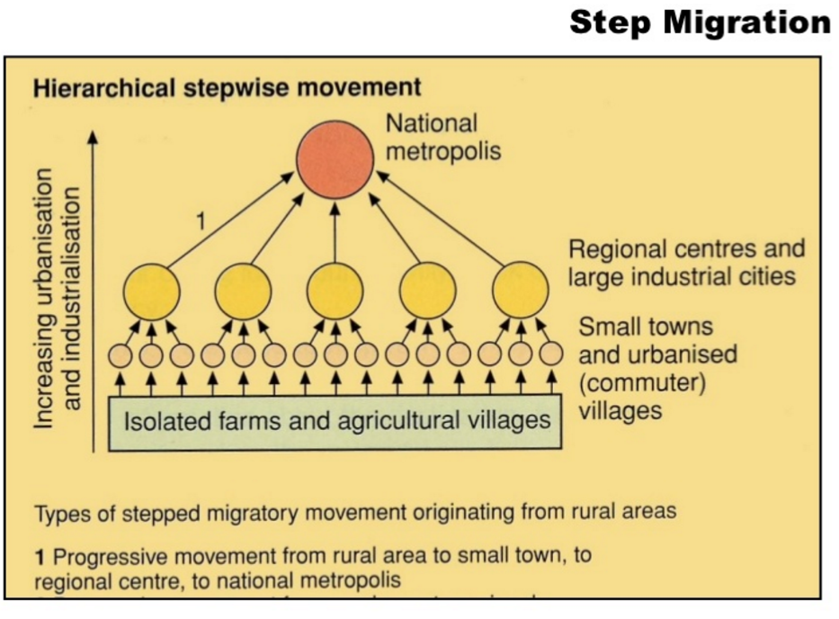
Migration Models 4 (Step Migration)

Slide 7
Migration Models 4 (Step Migration)

Slide 8
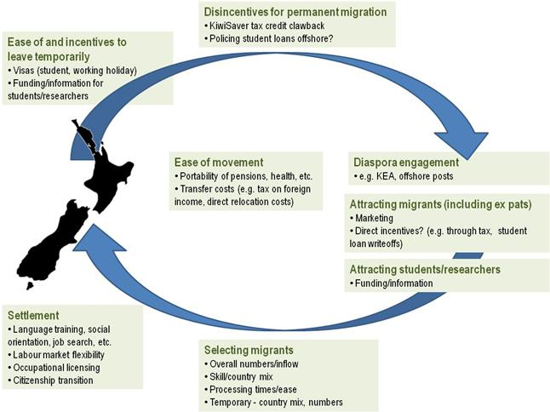
Migration Models 5 (Circular Migration)
Migrants do not settle permanently in their new homes. They tend to leave rural home at time of unemployment retuning periodically with money.

