Slide 1
Over populated vs Overpopulated
Learning objective: To examine the named case studies for overpopulation and under population.
Starter: Turn to page 10 in the Collins world watch and write a paragraph describing the Global population density
Mark scheme
AO1 Defined population Density (1 mark)
A02 Used named Examples (1 mark)
A03 Used Quantification (1 mark)
A04 SPAG (1 mark )
Language for Learning:
Overpopulated: When there are too many people in an area relative to the resources and the level of technology available.
Underpopulated: When there are too few people in an area to use the resources effectively

Slide 2
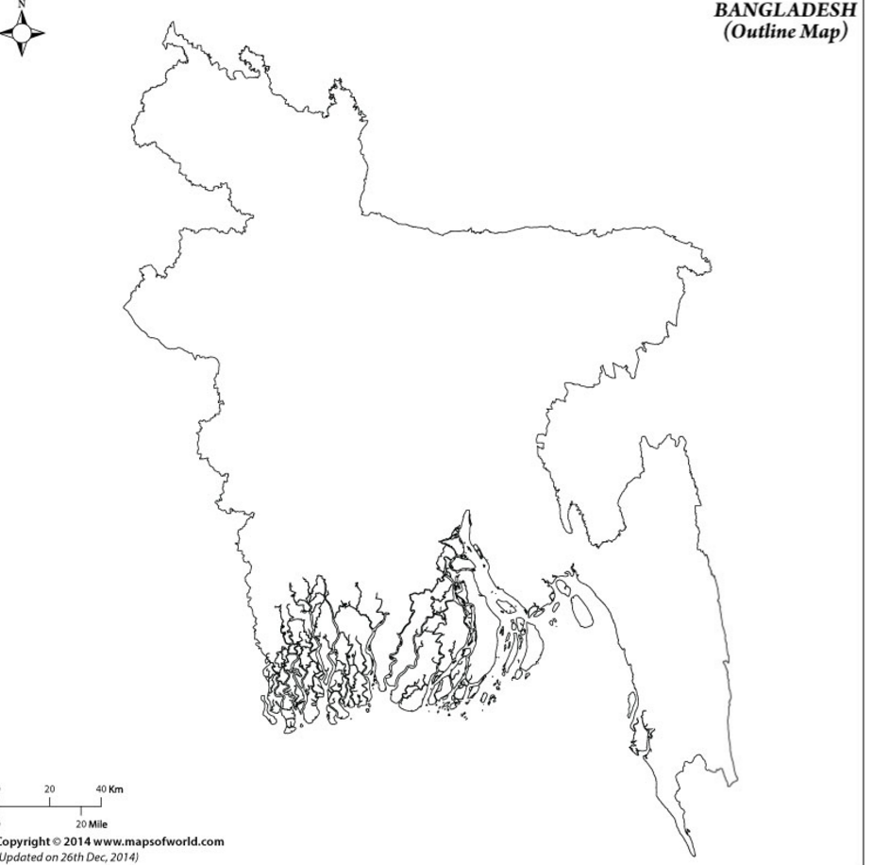
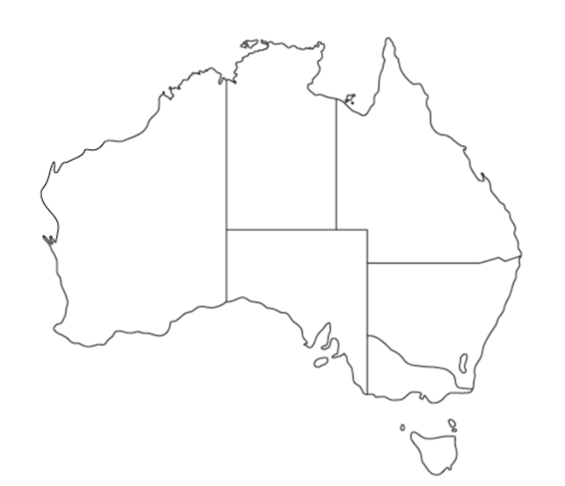
Starter: Turn to page 10 in the Collins world watch and write a paragraph describing the Global population density.
________________________________________________________________________________________________________________________________________________________________________________________________________
Language for Learning:
Overpopulated: When there are too many people in an area relative to the resources and the level of technology available.
Underpopulated When there are too few people in an area to use the resources effectively
Bangladesh
Australia
Demo: Ensure to label your map.
Demo: Use the Atlas to label and describe your map.
Place/Location:
________________________________________________________________________________________________________________________________________________________________________________________________________
Place/Location:
________________________________________________________________________________________________________________________________________________________________________________________________________
Question: How does the Physical Geography of the Country make life difficult for its people?
Question: What evidence would you produce to support the statement that ‘Australia is an underpopulated country’.
Demo: Use the Book to complete this box.
Demo: Use the Book to complete this box.

Slide 3
Plenary
Learning objective: To examine the named case studies for overpopulation and under population.
Plenary: Reflect on whether you have enough information to for fill the below learning Outcome.
Learning Outcome
Homework
Students should be able to:
AO1 Define key language and concepts
A02 Analyse and apply key concepts
A03 Evaluate how and why it might the two case studies be overpopulated and underpopulated.
A04 Be able to read and interpret population density graphs and maps.
What Learning Outcomes have you not for filled? Those need to be addressed and improved.

Slide 4
Plenary
Exam Question: For a named country which you have studied, describe the problems caused by overpopulation.
Name of country
.......................................................................................................................................................................... ............................................................................................................................... ..........................................................................................................................................................................................................................................................................................................
Mark scheme
Levels marking
Level 1 (1–3 marks)
Statements including limited detail describing problems caused by an ageing population.
Level 2 (4–6 marks)
Uses named example
More developed statements describing problems caused by an ageing
population.
Level 3 (7 marks)
Uses named example
Comprehensive and accurate statements describing the problems caused by an overpopulation, including some place specific reference.
Candidates are likely to refer to issues such as:
Place specific detail may include names of places within the country and appropriate
statistics.

