Slide 1
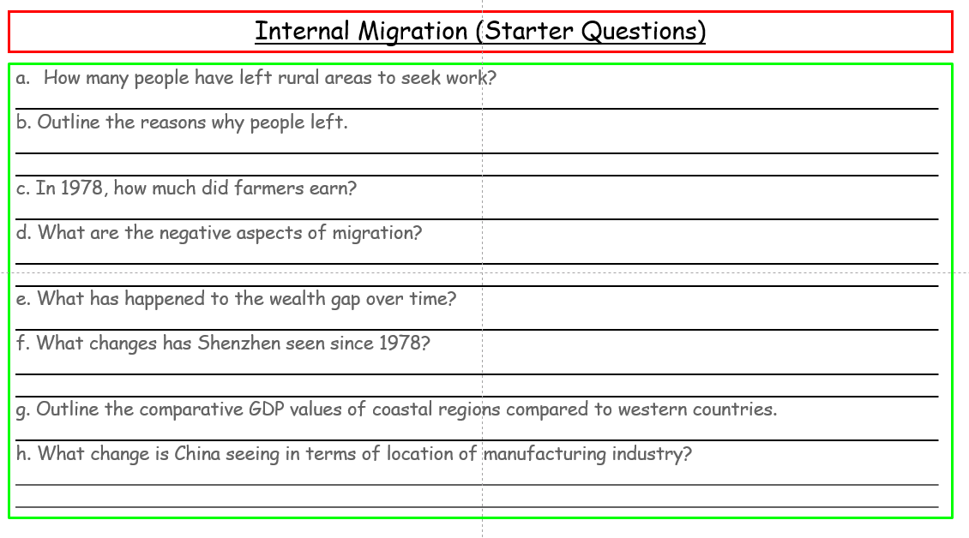
Internal Migration
Learning Objective: Evaluate internal (national) migrations in terms of their geographic (socio-economic, political and environmental) impacts at their origins and destinations.
Starter: Watch the Video and complete the starter sheet.
China: The largest migration in history | The Economist

Slide 2
Glossary
Migration: a movement of people from a source area to a receiving area
Emigrants: people who move from or out of an area
Immigrants: people who move into an area
Refugees: People who are forced to migrate owing to a well founded fear of being persecuted for reasons of race, religion, nationality, membership of a particular social group or opinion
Push Factor: those which encourage people to leave the source area
Pull Factors: those that attract people to go to the receiving area.

Slide 3
Internal Migration
Demo: Read the Telegraph newspaper story and answer the questions below in your book.
Questions:
Where are people moving to and from?
b. Why are the government moving them?
c. What is the comparative disposable income totals for rural and urban areas?
d. How many people live below the poverty line in Guizhou province?
e. What basic amenities are still missing or substandard in rural areas?

Slide 4
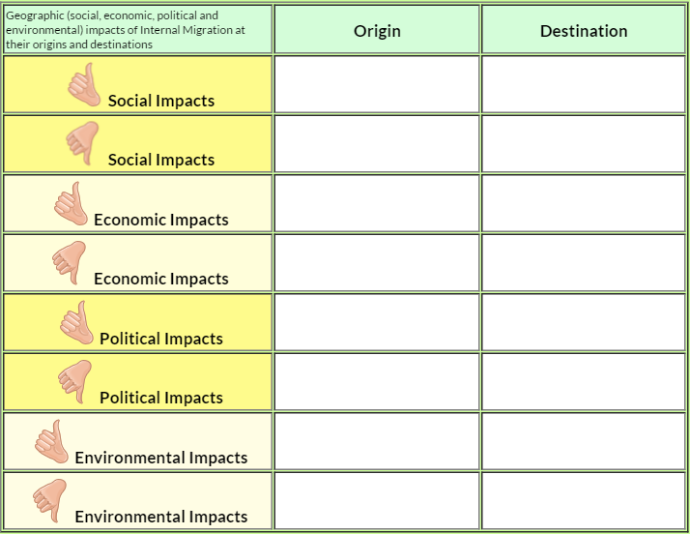
Internal Migration
Demo: Start to contemplate the impacts (both positive and negative) for both the origin and destination.
Exam style question:
Referring to a specific example, describe the positive | negative impacts that national (internal) migrations have at their origins | destinations. [6 Marks]
Extended response exam style question:
"Migrations within a county's borders have greater negative impacts at their origin than their destination.' Discuss this statement. [15 Marks]

Slide 5
Homework Task
Click here to be taken to a Guardian Online Podcast - It examines the scale of migration and what does this mean for developing countries?
Make notes on the effects of migration on development and the different arguments and viewpoints from the guest speakers.
What is "Brain Drain" and "Brain Gain"?
__________________________________________________________________________________________________________________________________________________________________

Slide 6
Internal Migration (Starter Questions)
How many people have left rural areas to seek work?
________________________________________________________________________________ b. Outline the reasons why people left.
________________________________________________________________________________________________________________________________________________________________ c. In 1978, how much did farmers earn?
________________________________________________________________________________ d. What are the negative aspects of migration?
________________________________________________________________________________________________________________________________________________________________ e. What has happened to the wealth gap over time?
________________________________________________________________________________ f. What changes has Shenzhen seen since 1978?
________________________________________________________________________________________________________________________________________________________________ g. Outline the comparative GDP values of coastal regions compared to western countries.
________________________________________________________________________________ h. What change is China seeing in terms of location of manufacturing industry?
________________________________________________________________________________________________________________________________________________________________

