Slide 1
Revision

Slide 2
Freshwater
Cryosphere- is the frozen water part of the Earth system. Beaufort Sea, north of Alaska. One part of the cryosphere is ice that is found in water. This includes frozen parts of the ocean, such as waters surrounding Antarctica and the Arctic.

Slide 3
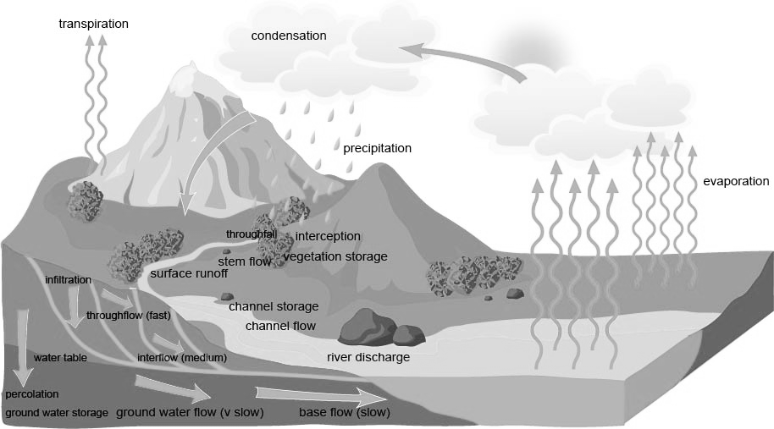

Slide 4
Freshwater
Erosion
Transportation
Deposition
Hydraulic Action
Abrasion
Attrition
Solution
Traction
Suspension
Saltation
Solution
Spatial and Temporal Factors
Seasonal

Slide 5
Freshwater
Waterfalls
Floodplains
Meanders
Levees
Deltas
Done
Diagram
Explanation

Slide 7
Hydrographs

Slide 8
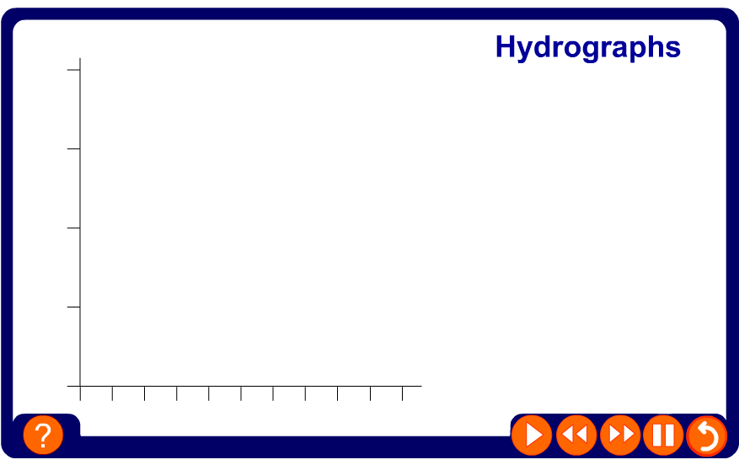
What is a flood hydrograph?

Slide 9
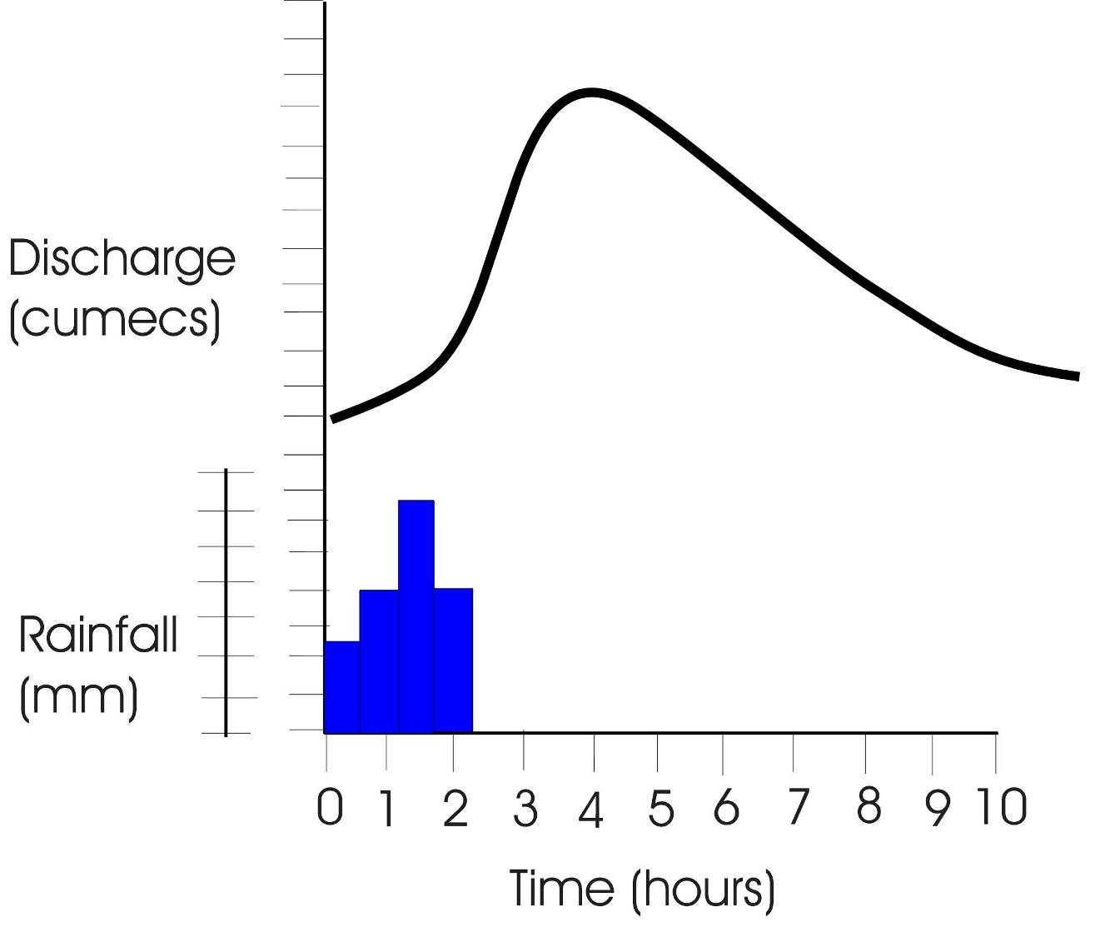
Hydrographs
Peak discharge
Falling limb
Rising limb
storm flow
normal (base) flow
I = Lagtime
Peak rainfall
1. Write a definition of lagtime.
2. Calculate the lagtime shown on this hydrograph.

Slide 10
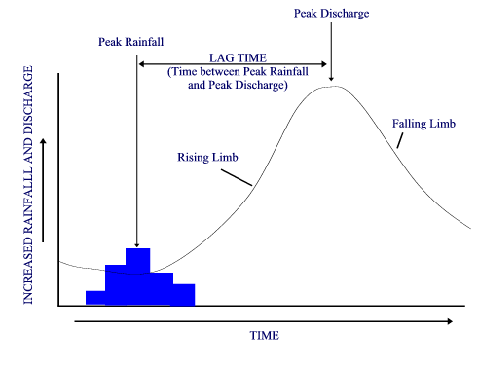
What is a flood HYDROGRAPH?
KEY TERMS MATCH UP
1. This is the amount of water in a river at any given point and time. Discharge is measured in cumecs (cubic metres per second)
2. A graph showing changes in river discharge over time in response to a rainfall event.
3. The time taken between peak rainfall and peak discharge
4. Shows the increase in discharge on a hydrograph
5. Shows the return of discharge to normal / base flow on a hydrograph
6. Maximum rainfall (mm)
7. Maximum discharge (cumecs)
Why is there a LAG TIME between Peak Rainfall and Peak Discharge?
What might affect LAG TIME?

Slide 11
3
2
Discharge (m³/s)
1
0 12 24 36 48 30 72
Hours from start of rain storm

Slide 12
Rainfall shown in mm, as a bar graph
3
2
Discharge (m³/s)
mm
4
1
3
2
0 12 24 36 48 30 72
Hours from start of rain storm
Notes:
Quickly go through the order of which you draw a hydrograph

Slide 13
Discharge in m³/s, as a line graph
3
2
Discharge (m³/s)
mm
4
1
3
2
0 12 24 36 48 30 72
Hours from start of rain storm

Slide 14
Base flow
Lag time
Normal discharge of the river
Peak flow
3
Rising limb
2
Falling limb
Discharge (m³/s)
mm
4
1
3
2
Base flow
0 12 24 36 48 30 72
Hours from start of rain storm

Slide 15
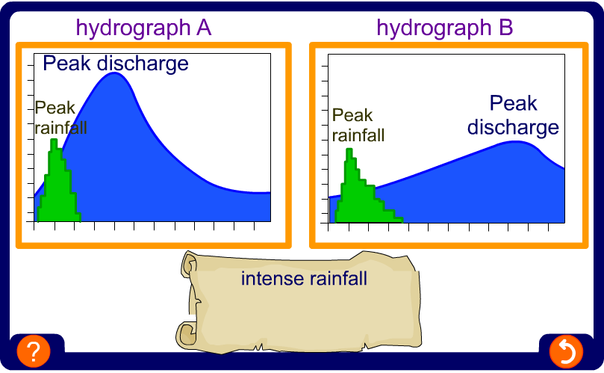
What factors influence the shape of a hydrograph?
The hydrographs ‘a’ and ‘b’ have been produced from the same storm event but from different drainage basins.

Slide 17
Freshwater
Physical Water Scarcity
VS
Economic Water Scarcity
Human Pressures on water
Water Quantity
Water Quality
Case Study Corner
Eutrophication
Salinization

