Slide 1
Superpower Index
Starter: What cab we infer from the source?

Slide 2
United States
China
Population of 320 million people (1-20th of the worlds population), they own more than 40% of global wealth. 500 largest global companies, ¼ are US- owned.
Has mass influence World Bank/IMF/ NATO/UN/
Driving power within global politics since WW2
Introduced a Free market philosophy ’the Washington consensus’
Mass US cultural influence McDonaldization, fashion, food, media
USA influences global interactions make it a true global superpower, ‘hyperpower’.
No other culture has a combination of geopolitical, economic, cultural.
The USA has a combination of overt military power and covert ops. It has intervened in over 50 states since 1945
Trump has turned the USA on a new path of isolationism
Prior to 1978 China was poor and isolated. Under Mao millions died of famine most people lived in rural poverty
In 1978 Deng Xiaoping began the ‘open door’ policy allowing it to globalise (1 party remained)
China today is the biggest economy, 400 million people have escaped poverty since the reforms began
FDI and TNC’s are predicted to total 1.25 trillion dollars between 2015-25
The average income in China’s population is still less than 1/3 of US-citizens. Economic growth is tailing off.
The country faces a growing problem of an ageing population (1 child policy)
China lacks the soft power of the USA, lacks internet freedom, open markets and lack of democracy

Slide 4
Student Friendly Markscheme

Slide 5
Example

Slide 6
Time Line
1944-45
World Bank Established, IMF and origin of the world Trade Foundation (WTO). The Bretton Woods conference allowed for free market trade, non protectionist world economy was born. Aid, loans became available to those countries that conformed to these ideals.
1970s
The oil crisis of 73 started to put pressure on Western industry. Rises in fuel cost caused a crisis of capitalism for the EU and America. As such the birth of out-sourcing and off- shoring began. The middle east starts to profit and develop from oil production. And China starts to reform.
1990s
India(1991) and China (1978) opened their economies. Trade agreements were created(EU1993) and NAFTA (1994). The late 1990’s Asia’s financial crisis showed the risks that international financial trade brought
Time Line
1960s
Heavy industry was threatened by the rise of production in South East Asia, Japan & South Korea. Due, to Unionized labour costs the cost of production was far higher in the west than in the east.
1980s
Financial regulation started to begin the UK/USA brought a new wave of globalisation. This lead to the rise of share dealing and portfolio investments. The fall of the Soviet Union also allowed for new markets to be accessed and changed the global geopolitical map.
2000s
Major flaws in the global banking sector emerges. During 2007-09 Global Financial Crisis. Unsecured loans undermined the banks. This brought a negative multiplier effect that caused a fall in global GDP.

Slide 7
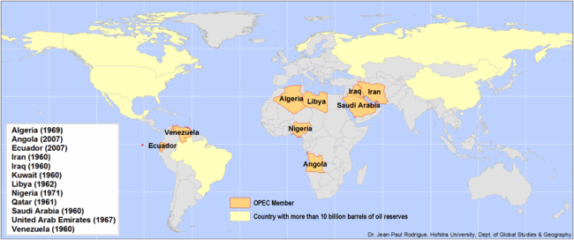
OPEC
The Organization of the Petroleum Exporting Countries (OPEC) is a permanent, intergovernmental Organization, created at the Baghdad Conference on September 10–14, 1960, by Iran, Iraq, Kuwait, Saudi Arabia and Venezuela.
Its aims:
To protect interests of the member nations
Stabilise oil prices
Ensure efficient, economic and regular supply of oil.
Notes:
Has 78% of the world’s oil reserves
Produces around 45% of crude oil and 15% of natural gas
Has the power to significantly affect oil prices by increasing or decreasing production.
OPEC is a cartel, with monopolistic and price controlling power.
Formed in 1960 in Baghdad, Iraq (Iran/Iraq/Kuwait/Saudi Arabia/Venezuela
Can increase production sharply if global economic conditions allow it.
In 1973 OPEC raised oil prices by 400% causing a wide spread economic crisis.

Slide 8
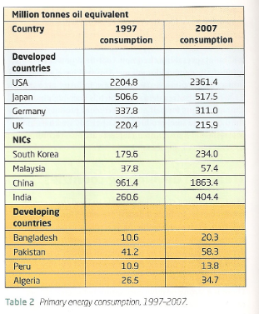
3. Resource Consumption
USA consumes almost one quarter of global oil output but has 2.5% of its reserves. 20 million barrels a day consumed in the USA, 25% is used for transportation.
NIC’s are increasing their energy demand by the fastest growth. China has accounted for 1/3 of the growth in global oil demand since 2000.China passed Japan as the world’s second largest user of oil in 2004. China will take over from the USA as the world’s largest consumer of oil in 2025.
Two factors that effect rate of economic development and the rate of population growth. There is a strong positive correlation between GNP per capita and energy use. 2 billion people lack access to household electricity. 1% of greenhouse gases will

Slide 9
Essay writing skills

Slide 10
Research Task
Demo: Read the information given. Go home and do further research on the global superpowers.

Slide 11
Glossary of Terms

