Slide 2
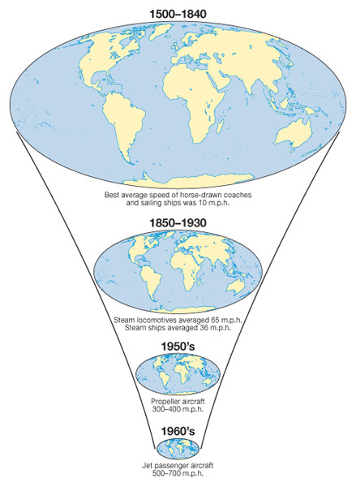
Changing Space- the shrinking world
Learning Objective: To be able to explain how a reduction in the friction of distance results in time–space convergence.
Starter: Explain the relationship between Idiot Abroad Series 2 and the reduction of friction of distance and resultant time space convergence.
Time-Space Convergence: This is when travel time between places decreases and distance declines in terms of its significance. It is generally brought about by transport innovations and improvements e.g. Airbus A380 can fly Paris to Adelaide in just 20 hours in 2013. (see first image on the left)

Slide 3
Lesson Glossary (Language for Learning)
Friction of Distance: This is the reduced likelihood of people using a service the greater the distance that they live from it. Distance is an issue due to the time and costs to overcome it. e.g. reduction in commuting to IST with increasing distance from Colomiers. Friction of distance is closely related to transportation and accessibility.
Time-Space Convergence: This is when travel time between places decreases and distance declines in terms of its significance. It is generally brought about by transport innovations and improvements e.g. Airbus A380 can fly Paris to Adelaide in just 20 hours in 2013. (see first image on the right)
Transnational corporation (TNC)- a firm that owns or controls productive operations in more than one country through foreign direct investment.

Slide 4
Success Criteria
Learning Objective: To be able to explain how a reduction in the friction of distance results in time–space convergence.
If you are going to achieve a 1 you will be able to:
If you are going to achieve a 3 you will be able to:
Give a developed and well-substantiated explanation of how information and communication technology and transport has helped form global interactions.
Analyse the effects this has had on the world.
Give an accurate,
Structured geographical description of how information and communication technology and transport has helped form global interactions.

Slide 5
Communications contribution to Economic Opportunities
Industrial Revolution
Mass Production
Globalization
Telecommunications
Roads
Air
Economic Opportunities
Railways
Canal shipping
Maritime shipping
Horses
1750
1775
1800
1825
1850
1875
1900
1925
1950
1975
2000
2025
2050
Time
Notes:
Source: adapted from HOP Associates. http://www.flexibility.co.uk/issues/transport/time-mobility.htm

Slide 6
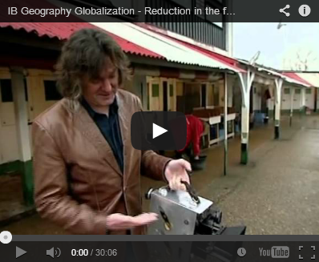
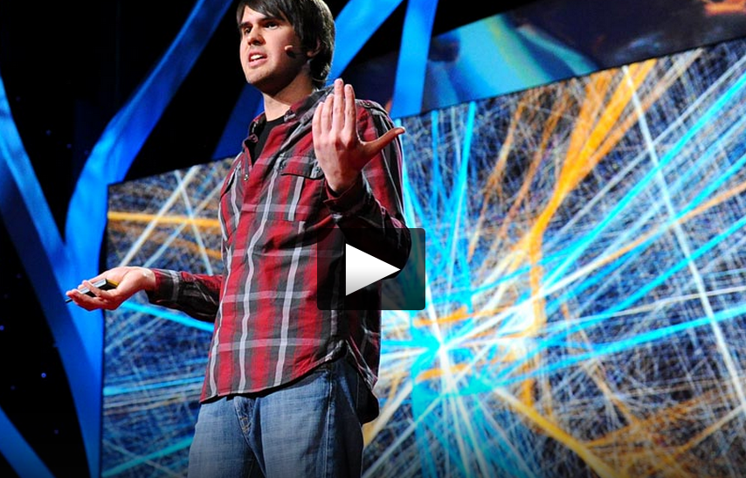
Group Task
Demo: Watch the video (IB Geography Globalization) to the right. Make notes on each of the factors that James May claims to have "made the world a smaller place".
Demo: Watch the 18 minute TED Talk video below and take notes on the issues discussed by Aaron Koblin in the lecture.
Notes:
https://www.youtube.com/watch?v=mLqmjJTbigU

Slide 7
Group Task
In your groups, investigate the relative changes (history and development) of your allocated transport method:
ROAD –
AIR –RAIL –
OCEAN –
PIPELINE –
Explain how their development links to the space-time convergence and reduced friction of distance.

Slide 8
Markscheme
Level | Knowledge and understanding / case studies | Organization
2 | Task has been completely misinterpreted. No relevant facts No examples | No structure, unprepared No citation system used
3 | Poor, ignores important aspects of the task. Little knowledge Irrelevant examples | Little attempt to organize material MLA not used but sources referenced
4 | Partially addresses the task Some relevant knowledge but there are significant omissions Relevant examples are included but limited | Few diagrams/photographs included, little organization MLA only used for limited sections
5 | Competent knowledge for all 3 areas Relevant knowledge but minor omissions Generalized examples | Some indication of structure and organization MLA for some parts
6 | Developed with all 3 areas covered and includes some examples Accurate knowledge with some minor omissions Some detail to the examples provided | Acceptable maps and diagrams; appropriate structure and organization MLA but some minor errors
7 | Developed examples Accurate, specific, well-detailed knowledge | Very well structured, clear maps and diagrams MLA throughout

