Slide 1
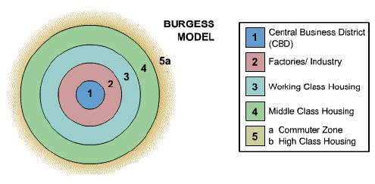
Burgess Model
Concentric Zones of land-use. 1925.
Challenge: What are the strengths and limitations of this model?

Slide 2
Burgess Model (Evaluation)
Against:
It does not take any physical features into account. Burgess' own case study - Chicago - does not follow the pattern because it is on the coast! The growth of any city will be influenced by the physical geography of the area.
Transport is much more readily available allowing more people to commute. This has meant that commuter villages have developed some distance from the edge of the urban area. Burgess could not have foreseen this.
Burgess could not have foreseen the changes in transport routes or society yet his model is still relevant when identifying the reasons behind the urban morphology of a city. Urban regeneration and gentrification has meant that some of the most expensive property can now be found in traditional 'low class' areas. Whilst council estates have built up on the edges of many large cities - these are now some of the most depressed areas in British cities.
The decentralisation of shops, manufacturing industry and entertainment does not follow his model.
For:
If taken as a very broad pattern, then a large number of towns and cities follow the pattern identified by Burgess.
It is good model because it is simple and easy to understand. Hopefully!
It helps us to understand the process involved in the growth of a city.

Slide 3
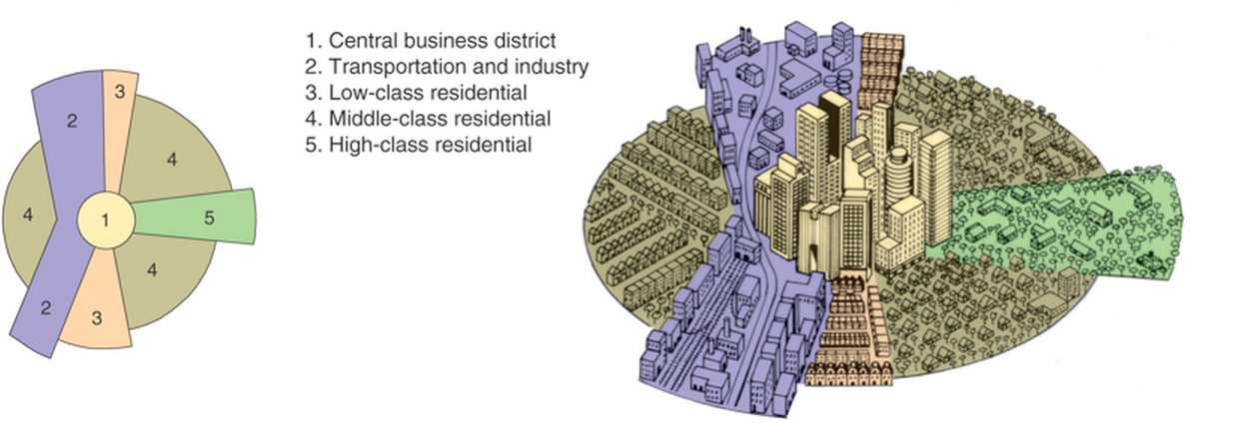
The Hoyt Model (1939)
The Hoyt model has land use concentrated in wedges or sectors radiating out from the city centre. For example, factories may be concentrated along a river, canal or road to form a zone of industry. This would attract low-class housing, but repel high-class residential land use.

Slide 4
The Hoyt Model (1939)
For:
Some cities seem to follow Hoyt's sectors. Bristol, for example, has a very clear industrial sector following a main rail line and the River Avon.
It provides us with an alternative set of explanations to Burgess.
Communication routes (Rivers, roads, railways) do often provide a very definite boundary to a sector/land-use. In addition, the division between land-uses in both models is far to clear-cut. Firstly, you would not suddenly walk from lower to middle to higher class housing. Also, all zones will have a mixture of land-uses. Residential zones will have shops and industry in amongst them.
They do, however, give us a bench mark for comparison and allow us to have a basic understanding of the complex set of processes that determine the distribution of land-use within a city.
Against:
Like Burgess' there is little reference to the physical environment.
The growth of sector can be stopped as land-use leapfrogs out of the old inner city. For example, out of town council estates have prevented large high-class sector developing in other areas of Bristol.
Again, like Burgess, there is no reference to out of town developments

Slide 5
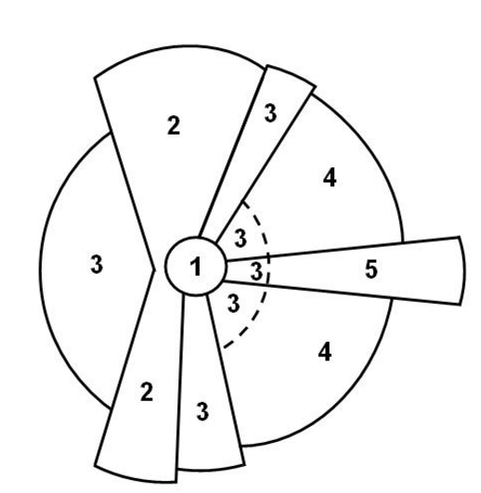
Burgess Model(1925)
The Hoyt Model (1939)
Key:
Key:

Slide 6
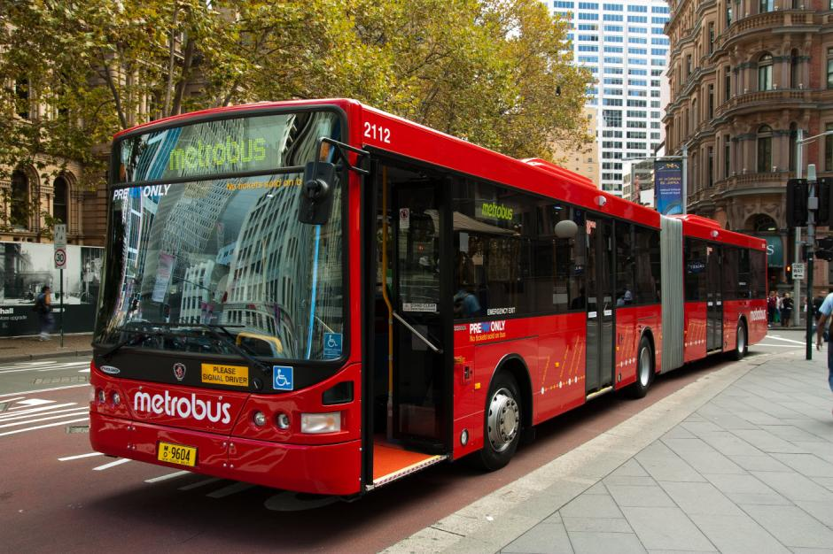
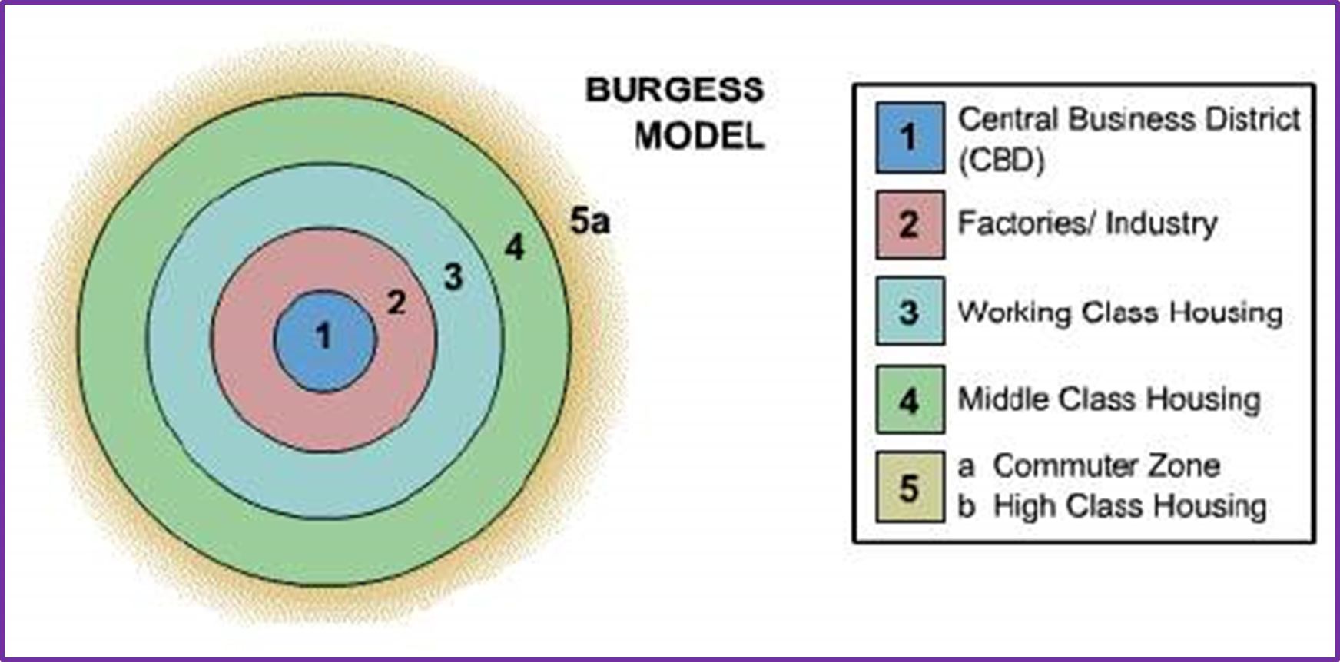
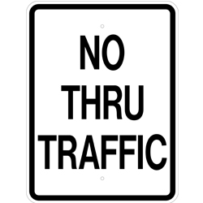
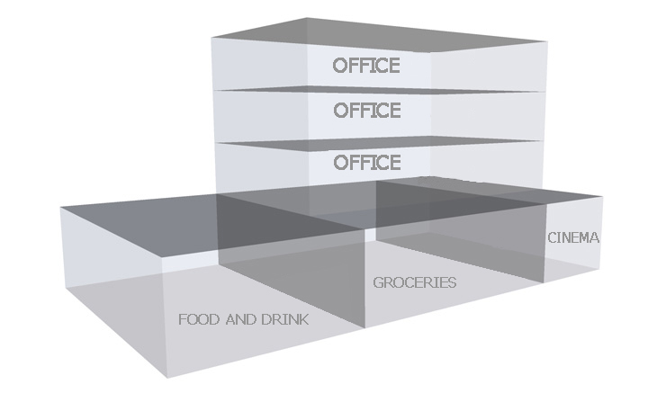
The Central Business District
Language for learning: The Central Business District is the commercial and economic core of the city, the area that is most accessible to public transport and the location with the highest land values.
Turn to page 45 in your books to check your answers
Demo: What characteristic features may the CBD have?

Slide 7
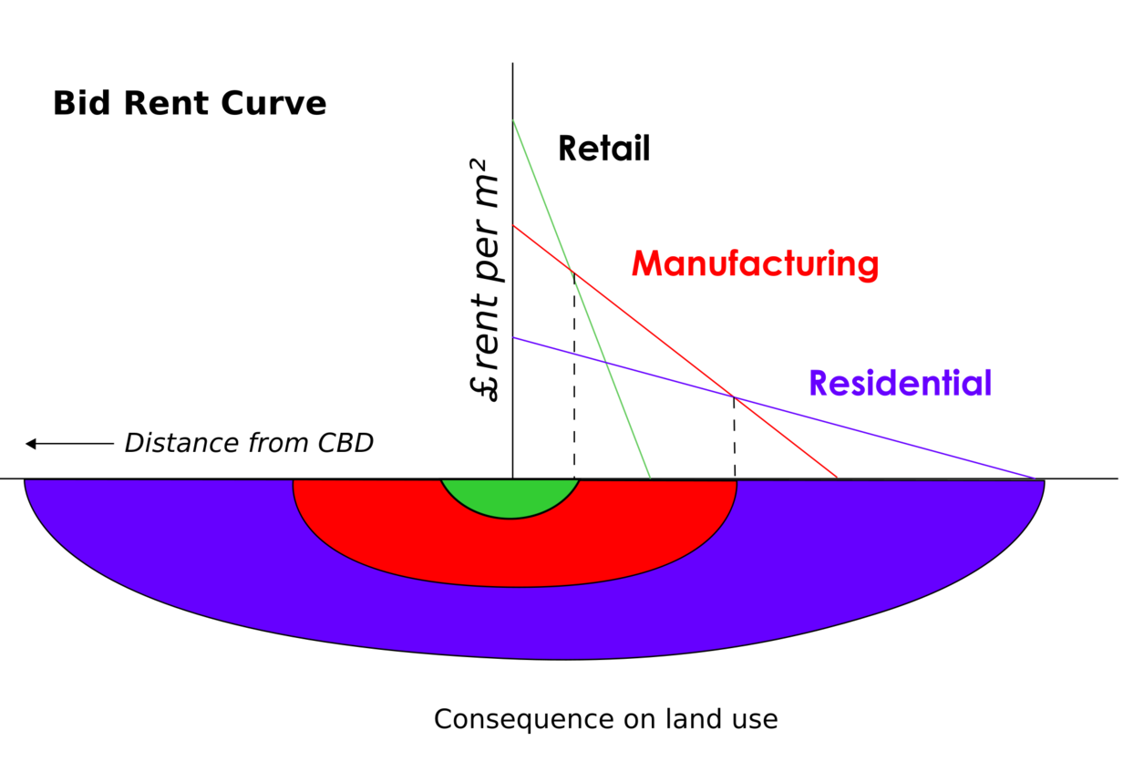
Bid Rent Model
Describe: Describe Hoyts Bid rent Model.

Slide 8
Bid Rent Model
The__________ of land varies with different land ___________. Retail land uses are_________ to more expensive central areas, due to ________ _______. Land at the centre of a city is the most expensive for two main reasons: it is the most accessible land to________ transport, and there is only a small amount of land_________. A large population is essential for department stores, which require a __________ turnover. As a result, they are willing and able to pay a __________ land rent value. They maximise the potential of their site by building many________.
Land prices generally decrease away from the_______ ________, as we move away from the CBD.
__________is, however, willing to pay to be on the outskirts of the CBD. There is_______ land available for their factories, but they still have many of the benefits of the CBD, such as a ______________and good _________________.
As you move further out, so the land is less attractive to industry and the householder is able to __________land. The further you go from the CBD, the cheaper the land. This is why inner city areas are very _______populated (terraces, flats and high rises), whilst the suburbs and rural areas are _________ populated (semi and detached houses with gardens).
Value public considerable sparsely Uses communications stories attracted densely easy access available very high central area Industry more market place purchase

Slide 9
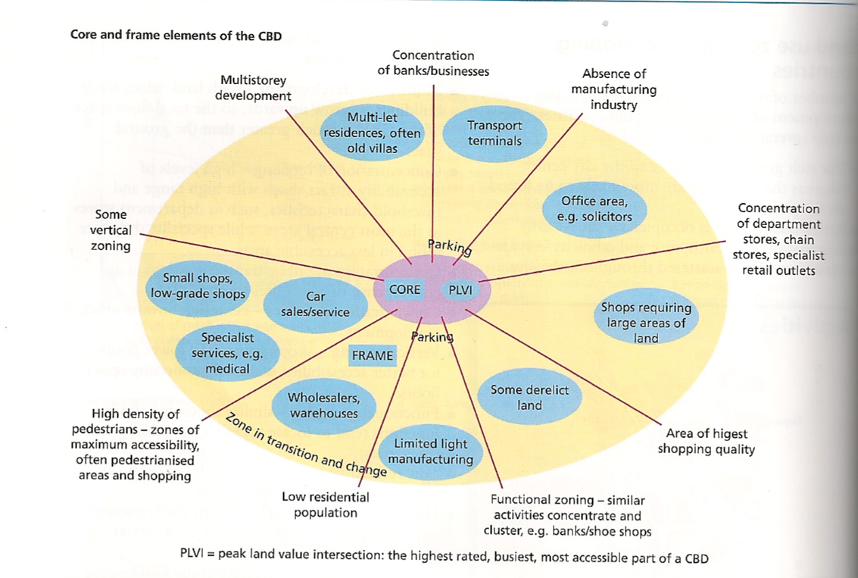
The Core-Frame Concept
Demo: How might this model be applicable to Darmstadt? Ensure to justify your answer.
Demo: How might this model be applicable to Darmstadt? Ensure to justify your answer.

Slide 10
GIS Coursework example

Slide 11
Gentrification in Cape Town, South Africa
Language for Learning: Gentrification is the process of renewal and rebuilding accompanying the influx of middle-class or affluent people into deteriorating areas that often displaces poorer residents.
Demo: Read through pages 47-49 and complete the 4 questions (case study analysis).
TIPS
Question 1:
Plenary
Site-Location
Situation- Relationship between a particular settlement and its surrounding area.
Learning Objective: Describe land use zones including the CBD
Learning Objective: To give reasons for land use in urban areas.

Slide 12
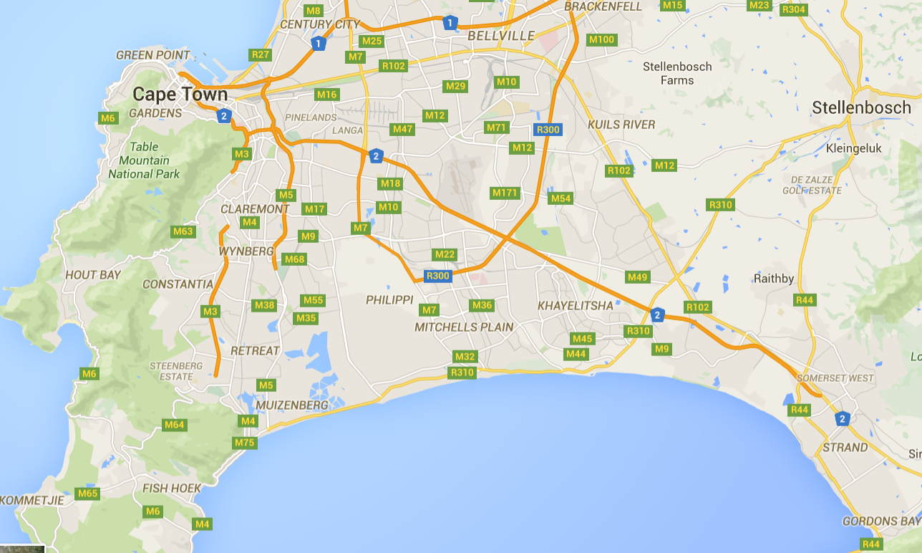
Cape town

