Slide 1
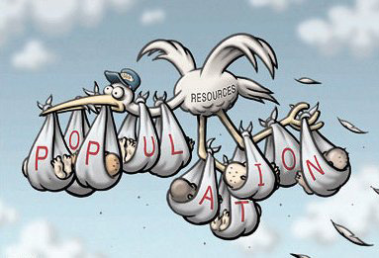
Starter:
Discussion:
What could the impact of a rapidly increasing population have on the land?
What are the impacts of the increasing use of MARGINAL sites (e.g. Favelas/ slum dwellings)?
Key word-
Marginal site:
These are places that people avoided living in the past but are now used with people with few other choices i.e. areas vulnerable to flooding or landslides.

Slide 2
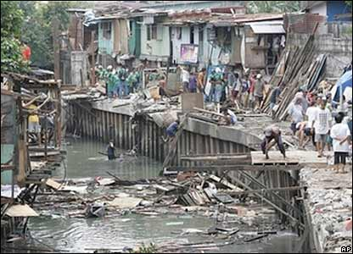
Housing- Manila Shanty town

Slide 3
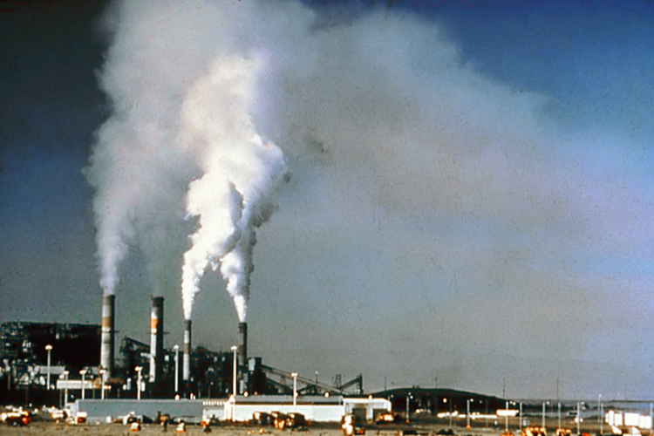
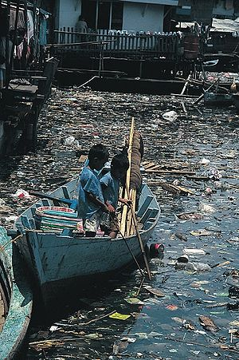
Pollution
Air & Marine

Slide 4
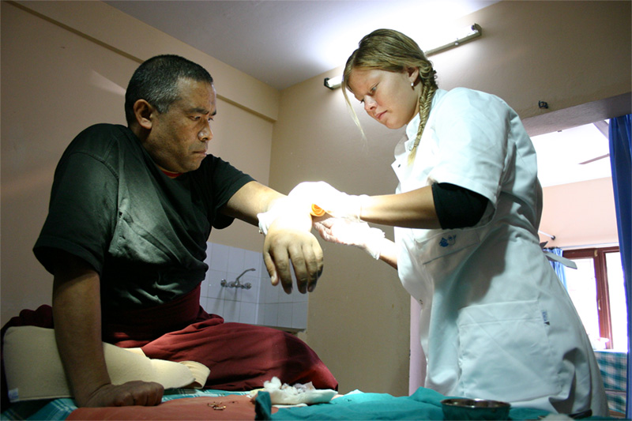
Medical care

Slide 5
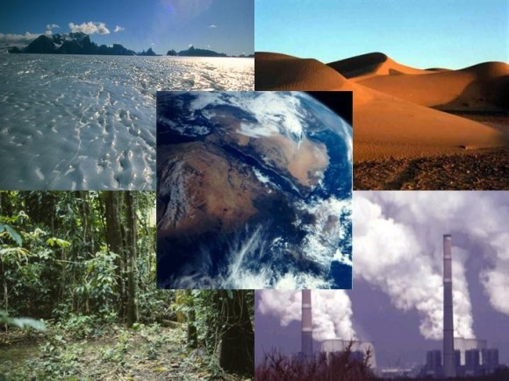
Natural Resources

Slide 6
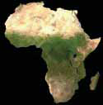
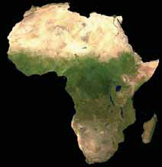
Population Pressure on land in Africa Over 100 years
2050
1.5 ha/person
Demo: If land were shared equally
among its population, each individual’s share
of land would decrease with the increase
in population.
What are the pressures that this would place on resources in Africa? Write down your answer in full in your book.
1990
4.7 ha/person
1950
13.5 ha/person

Slide 7
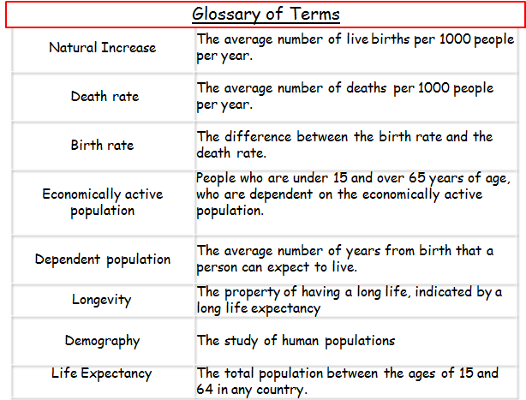
Step 1: Pop Quiz Exam Question: 15 min
What are the possible problems of an increasing population?
-How are people effected?
-include problems with land and resources
-remember this piece of work is getting marked so you must include as much detail as possible.
Step 2 Have you????:
A01 Use Geographical Language
A02 Use detailed explanation and reasoning.
Check Spelling, Punctuation and Grammar
Step 3: Swap with your partner and check their work

Slide 8
Plenary
Plenary: Using the key words that you have learned and used today answer the following question:
Identify reasons for increasing populations.
EXPLAIN the problems of an increasing population.
Natural Increase | The average number of live births per 1000 people per year.
Death rate | The average number of deaths per 1000 people per year.
Birth rate | The difference between the birth rate and the death rate.
Economically active population | People who are under 15 and over 65 years of age, who are dependent on the economically active population.
Dependent population | The average number of years from birth that a person can expect to live.
Longevity | The property of having a long life, indicated by a long life expectancy
Demography | The study of human populations
Life Expectancy | The total population between the ages of 15 and 64 in any country.

Slide 9
Homework: Effects of overpopulation
Homework: Create a spider diagram to help you plan an to answer your IGCSE question.
Children’s needs
Effects of overpopulation
Cheap labour
Benefits from growth
10 mins

Slide 10
Pop Quiz Exam question
Using the data for Kenya (see table). Explain why population change is likely to have caused problems for the country?
[5 Marks]
Total Population | 34,700,000
Aged 0-14 (%) | 42
Birth rate (per 1000) | 39
Death rate (per 1000) | 11
Fertility rate (per 1000) | 4.8
Annual rate of increase (%) | 2.3
Urban population (%) | 39
Rural population (%) | 61
10 mins

