Slide 1
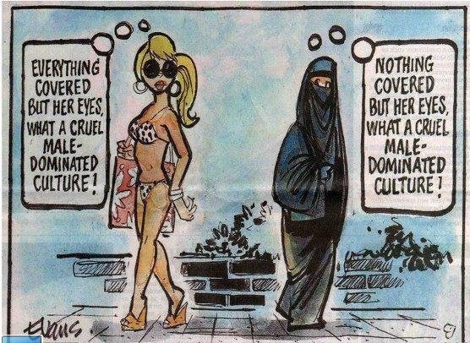
Starter: What might the main message be of the Source? What Geographical topics might Source A be part off?

Slide 2
Unit 5: Human Development and Diversity

Slide 3
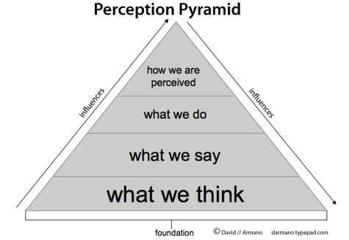
Gender and Change
Learning objective: To examine gender inequalities in culture, status, birth ratios, health, employment, empowerment, life expectancy, family size, migration, legal rights, and land tenure.
Demo: What examples or predictions do you have regarding gender inequalities in culture regarding the following:
Language for Learning: Gender: The condition of being male or female. Inequalities: When people are treated differently and unfairly. Equality: When everyone is treated in the same way. Empowerment: To invest with power, this may be legal power to do something or social power and belief to do something. Emancipation: This means freedom, in geography people often refer to the emancipation of females, which means that they have the freedom to do whatever they want, including getting an education and a job.
TOK
Culture
status
birth ratios
health
employment
empowerment
life expectancy
family size
migration
legal rights
land tenure
Challenge: How might this be measured?

Slide 4
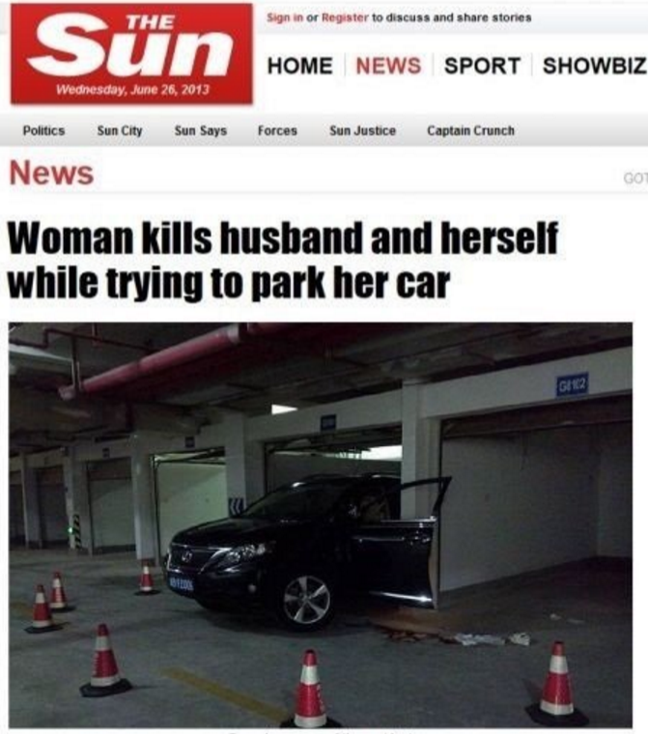
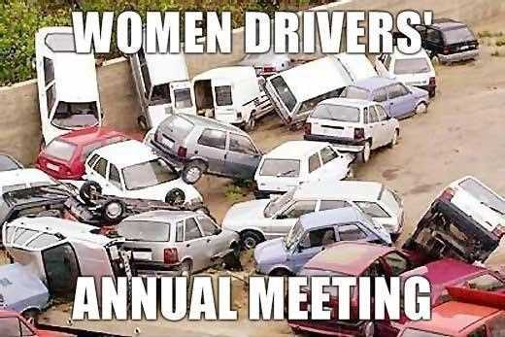
Discussion point
Global Gender Gap Index
Global Inequality Index
Learning Objective: To be able to explain how gender equality is measured and what changes have been made over time. Relate to place, process and power.
Starter: What is your view point of gender Equality?
Gender equality, also known as sexual equality, is the state of equal ease of access to resources and opportunities regardless of gender, including economic participation and decision-making; and the state of valuing different behaviors, aspirations and needs equally, regardless of gender.

Slide 5
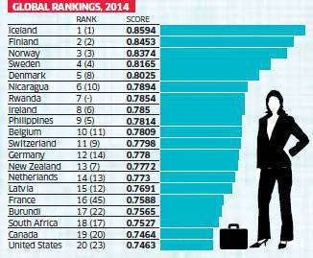
GLOBAL GENDER GAP INDEX 2015
Global Gender Gap Index
Demo: List the correct top 5 nations.
Notes:
Greater Equality
1
Launched 2006
Economic participation and opportunity
Educational attainment
Political empowerment
Health and Survival
Less
Equality
0

Slide 6
Gender Inequality
Problem:
Solution:

Slide 7
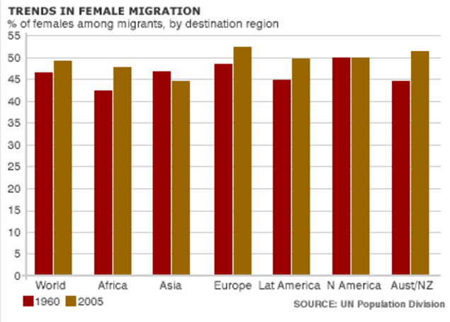
Migration
Demo: Read through your information sheet and highlight the key parts.
Although traditionally the majority of migrants have been male, in recent years females have almost equalled males in term of numbers and in some regions of the world actually exceeded them. Traditionally there have been few women for a number of reasons including:
The role of women has been to stay at home and look after the children. Traditionally women have married young and had children young.
When one member of the family has migrated it has been the male and he has sent remittances home.
Women traditionally have had a poorer education so have not known about the opportunities presented by migration and may not have been qualified enough to get a job.
Many migrant jobs have been manual and deemed unsuitable for females.
Many societies have deemed it inappropriate for females to travel alone.
However, more and more women are become emancipated, getting educated, finding a job, marrying later and making their own decisions about where they live and work. There has also been a growth in tertiary jobs that are possibly more suitable for female migrants.
However, there a few areas of the world where male migrants still significantly outnumber females, the most noticeable being Africa. This is probably because Africa still has the biggest education divide between males and females and many societies still maintain traditional beliefs about female roles.

Slide 8
Enquiry based learning
Demo: Choose a nation that is plagued by gender Inequalities. Research the problem and find viable solutions.
?
Place
Process
Power
Possibility
Scale
Spatial Interaction
Exam Question: Examine the view that gender inequalities are a major obstacle to development. (10)

Slide 9
Educational For All Morocco
Demo: Watch the Video and complete your case study sheet.
Educational For All Morocco
Place
Process
Power
Possibility
Scale
Spatial Interaction

Slide 10
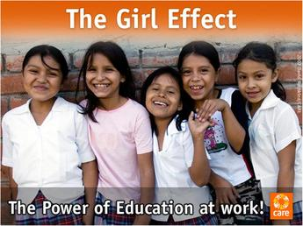
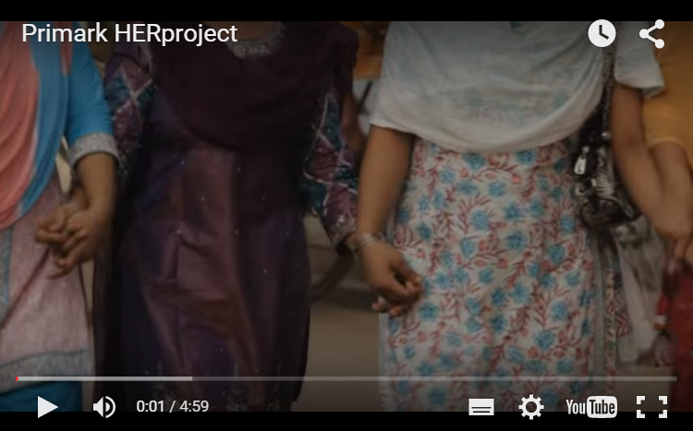
Small Research Task: Tackling Gender Inequalities
Demo: Click on the Link to be taken to a list of 10 forms of gender inequality that still exist . Make notes on what you consider to be the worst three forms of inequality.
Demo: Read through the document and make notes under the title 'Girl Effect - The Issues' using the following subheadings:
Child Marriage & Early Childbirth
Age at First Birth
Economic Empowerment
Education
Health & Safety
Demo:
a. Describe the inequalities that exist here.
b. Explain how the international clothing retailer - Primark - is using its influence to improve the health and nutrition of women in Bangladesh.
Case Study

Slide 11
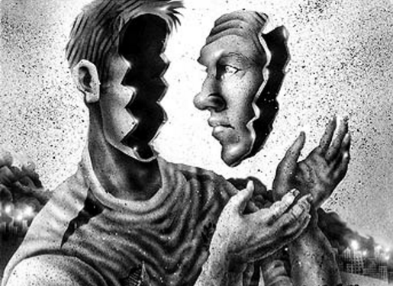
Plenary
Learning Objective:To examine gender inequalities in culture, status, birth ratios, health, employment, empowerment, life expectancy, family size, migration, legal rights, and land tenure.
Plenary: Reflect on whether you have enough information to for fill the below learning Outcome.
Learning Outcome
Application to Exam
Homework
Students should be able to:
AO1 Define key language and concepts
A02 Analyse and apply key concepts
A03 Evaluate how and why it might the two case studies be overpopulated and underpopulated.
A04 Be able to read and interpret population density graphs and maps.
"Gender inequality exists to some extent, in most areas of society, in all countries of the world." Geographically examine this statement. 15 Marks
Listen to the Podcast below and make notes on the issues discussed.

Slide 12
Plenary
Exam Question: Examine the view that gender inequalities are a major obstacle to development.
Markscheme
There are many possible approaches to this question.
Responses could explain what development is and successfully link the concept to increased gender equality.
Responses are likely to identify and discuss the relative importance of all the MDGs that in some way relate to gender empowerment (goals 1, 3, and 5 especially).
The answer should examine either how not addressing gender issues will hinder development or explain how addressing them will help nations and communities develop. Allow for broad interpretations of development. Candidates could also identify other factors (other than gender inequality) which are also obstacles to development – this would be a valid approach as long as gender inequality is examined and their reasoning is justified.
Responses that arrive at a clear conclusion either agreeing or disagreeing with the viewpoint, after a sound discussion, are likely to be awarded band E or above.
Marks should be allocated according to the mark bands.

Slide 13
Plenary
Examiners report
This question was popular and produced some quite excellent discussions on how gender issues hinder development. Some candidates also identified other factors as obstacles to development. In many of the good answers, examples and case studies were well chosen but occasionally generalized. There was plenty of evidence that the best candidates had very sound knowledge and understanding of gender inequalities in culture, status, education, employment, politics, legal rights and land tenure. Many responses had specific geographical examples to support their ideas/evaluations/analysis. In weaker answers the "obstacle to development" was often ignored. Most looked mainly at the causes of gender inequality and in some cases how it could be addressed.

