Slide 1
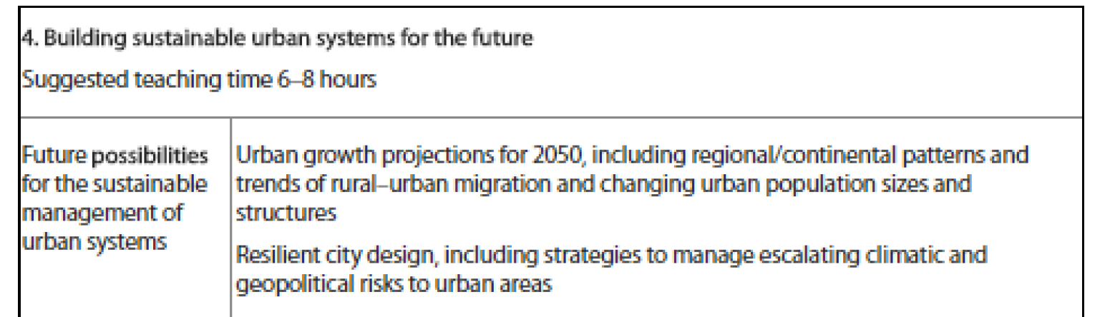

Slide 2
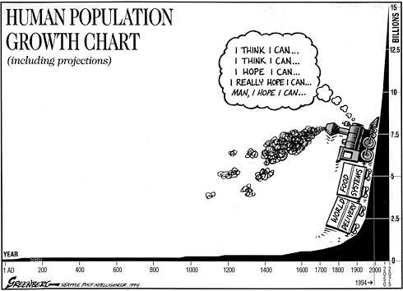
Geographical Source Work

Slide 3
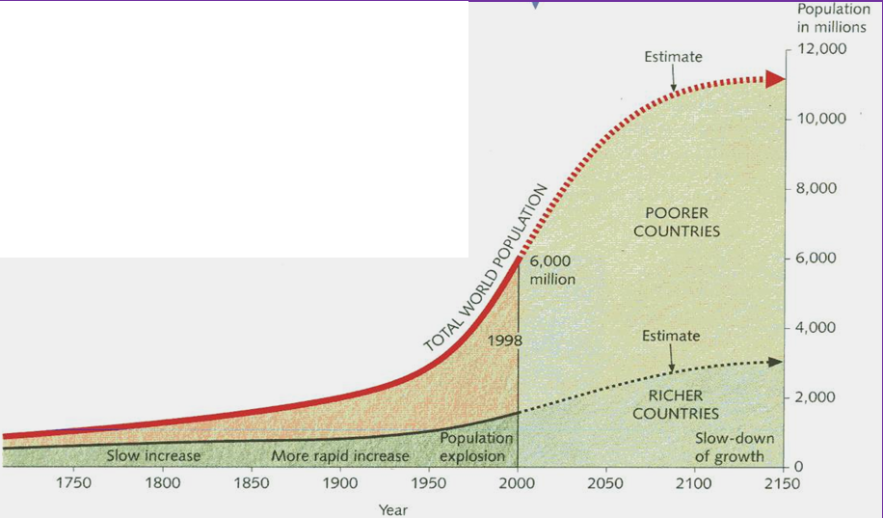
Graph Work
Demo: Describe the population graph. [4 marks]
Population growth was slow but steady until the early 19th century. Since then it has grown at a much faster rate. Estimates suggest that, at present, it is growing by just over 90 million people each year. Population growth has not been even throughout the world. It is more rapid in some countries than in others. The graph also shows that, the fastest growth has been in the world’s poorer countries. Growth in the richer countries is now very slow. Some nations in the north-west Europe even have a zero-population growth. That means neither an increase nor a decrease.
Model Answer

Slide 4
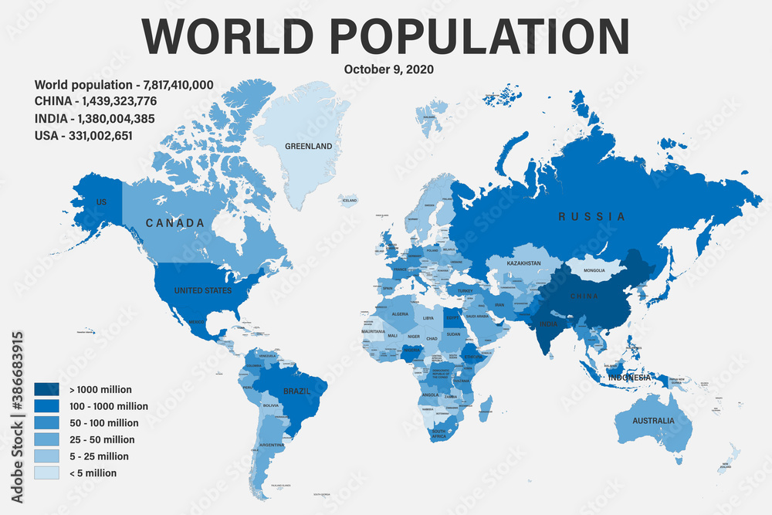

Slide 6
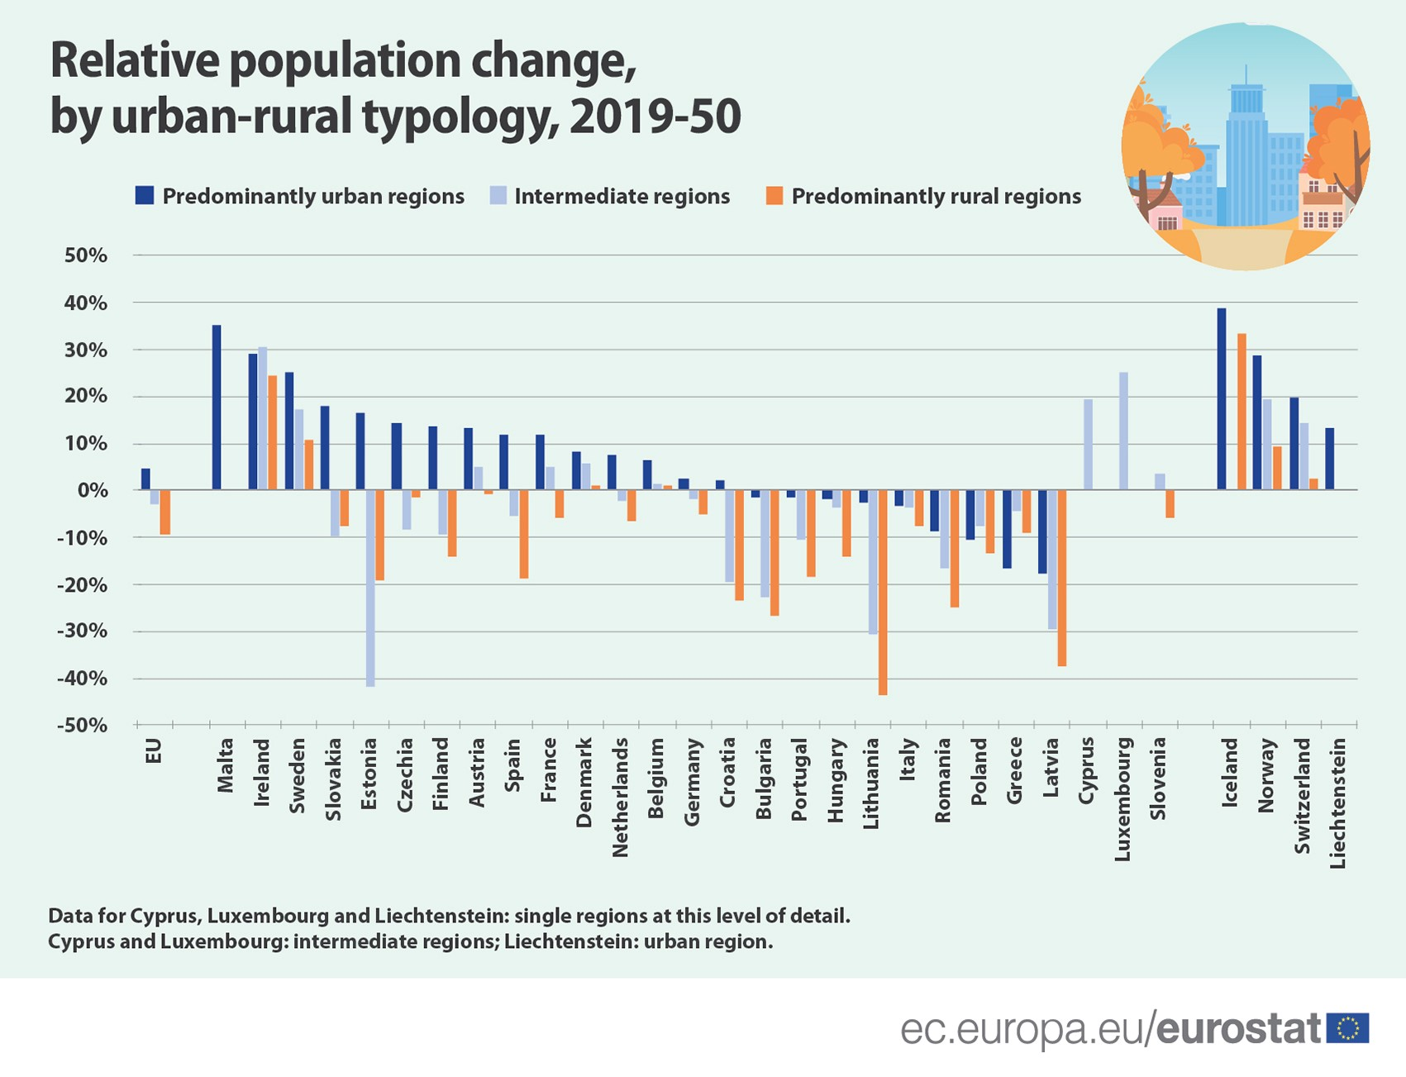
Regional Change in Europe

