Slide 1
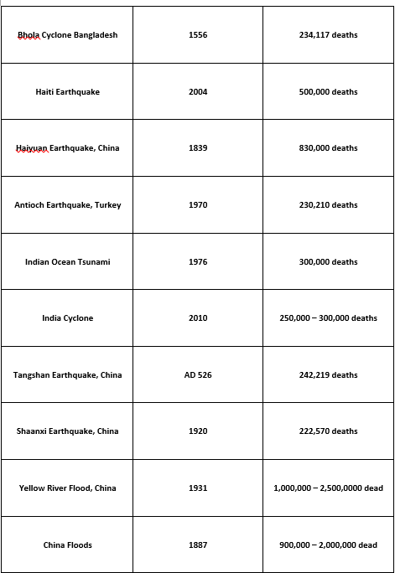
Hazards and disasters - risk assessment and response
1. Characteristics of hazards
Characteristics | Explain the characteristics and spatial distribution of the following hazards. Either earthquakes or volcanoes Hurricanes (tropical cyclones, typhoons) Droughts Any one recent human-induced (technological) hazard (explosion or escape of hazardous material) Distinguish between the chosen hazards in terms of their spatial extent, predictability, frequency, magnitude, duration, speed of onset and effects. | 7 hours
Starter:
In Pairs complete the card sort on your desk.

Slide 2
Language for Learning
Disaster = A major hazard event that causes widespread disruption to a community or region that the affected community is unable to deal with adequately without outside help.
Hazard = A threat (whether natural or human) that has the potential to cause loss of life, injury, property damage, socio‑economic disruption or environmental degradation.
Hazard event = The occurrence (realization) of a hazard, the effects of which change demographic, economic and/or environmental conditions.
Risk = The probability of a hazard event causing harmful consequences (expected losses in terms of deaths, injuries, property damage, economy and environment).
Vulnerability = The susceptibility of a community to a hazard or to the impacts of a hazard event.

Slide 3
Characteristics of hazards
Demo: When planning a response for any Hazards, geographers need to consider certain characteristics hazards. What are these, list below.
Spatial distribution-the distribution of the hazard, where it occurs.
Spatial extent- the size of the area covered by a hazard
Predictability- wo what extent is it possible to give a relatively precise statement about the time, place and ideally the nature and size of the hazard event.
Frequency- how often an event of a certain size occurs. Frequency is sometimes called the recurrence interval: the larger the event the less frequently it occurs
Magnitude- the size of the event
Duration- the length of time a hazard event will last or exist for.
Speed of onset- the time difference between the start and the peak of the event
Effects- what effects might this hazard have on both physical and human geographical elements

Slide 4
Exam Tips
Demographic Factors
1. Size of vulnerable population – Check out the total population of the city, state or country.
2. Population Density – World Bank
Socio Economic Factors
3. A Country's level of development - HDI Ranking through CIA World Fact Book
4. An Individuals Wealth – GDP PPP $ – CIA World Fact Book
Community Preparedness
5. Public Education - School enrollment, primary
(% net) World Bank
6. Recent Hazard Events – Last time this hazard happened and the impacts.
7. Early Warning Systems – Research to find out.
8. Building Codes – Research to find out (not applicable to drought)
A community's ability to deal with a hazard event.
9. Governance – Government response and rate of response
10. Effective Lines of Communication - Media
11. Emergency Personnel – Specialist teams to deal with the hazard
12. Insurance Cover – Universal Healthcare provided by government
Hazard Vulnerability Tasks
What to look for ….
-

Slide 5
Types of hazards
Demo: Make a Catagorised list of all the types of hazards that you know.
Climatic/ Meteorological | Geological/ Geomorphological | Floral | Faunal
Snow and Ice | Avalanches | Fungal Diseases | Bacterial Diseases
Droughts | Earthquakes | Athlete’s Foot | Viral Diseases
Floods | Erosion (Soil and Coastal) | Dutch Elm Disease | Influenza
Frosts | Landslides | Wheat Stem Rust | Malaria
Hail | Shifting Sand | Infestations | Smallpox
Heatwaves | Tsunami | Hay Fever | Rabies
Tropical Cyclones | Volcanic Eruptions | Poisonous Plants | Infestations
Lightning and Fires |  |  | Rabbits/Termites
Tornados |  |  | Venomous Bites

Slide 6

Distribution of some Global Hazards
Demo1: Create a key for the 5 global hazards and splot them on your map.
Tropical Storms | Earthquakes | Drought | Tornadoes | Active Volcanoes
Mexico | Colombia | Central USA | Japan | Iceland
West Indies | Gulf Of Mexico | N & S Africa | Australia | Antarctica
Kenya | Florida | Brazil | South Africa | Africa
Australia | Argentina | Australia | Gulf Of Mexico | India
China | Peru | Afghanistan | India | Japan
India | Alaska |  | Germany | New Zealand
Colombia | California |  | France | Indonesia
 | San Francisco |  | Spain | Peru
 | Los Angeles |  |  | Colombia
 | Turkey |  |  | USA
 | China |  |  | Alaska
 | Indonesia
Demo2:Describe the distribution of Natural Hazards found on your map.
HINT

Slide 7


Why do people live in hazardous areas?
Why do people live in hazardous areas?
Vulnerability as a function of demographic & social, economic factors and of a community’s preparedness & ability to deal with an event?
Why some sectors of a population are more vulnerable than others?

Slide 8
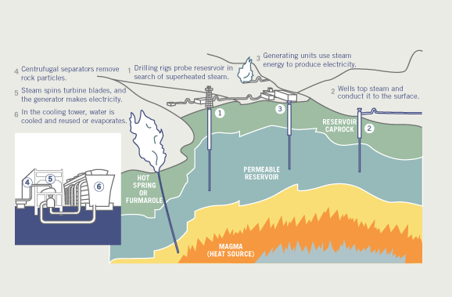
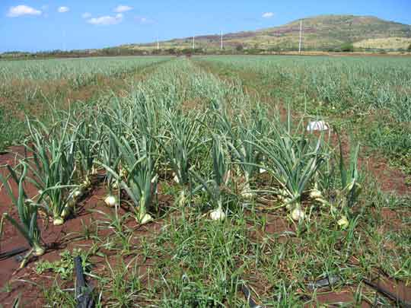
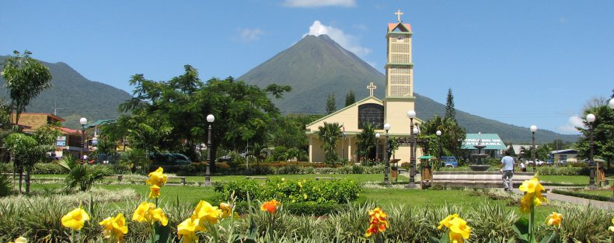

Slide 9
Why do people live in hazardous areas?
Fertile soil – deltas such as NOLA and Myanmar
Cultural heritage
Slums built on land susceptible to landslides
Cheap housing in areas that are at risk
Access to water for trade and other reasons
Raw materials – metals in eruption-prone areas, geothermal energy
Cant afford to leave
Tourism – can earn a revenue from landforms/disasters (C Rica)
Forced migration – have to move to an area
Comfort zone
Pull factors – e.g. job, education opportunities, climate
Lack of awareness – people do not have a clue about a hazard
Long time since the last hazard event
Faith in the government / emergency services / prediction
Spiritual ties
Nuclear – employment, perceived to be safe

Slide 10
