Slide 1
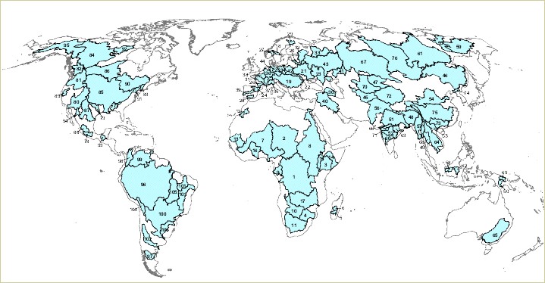
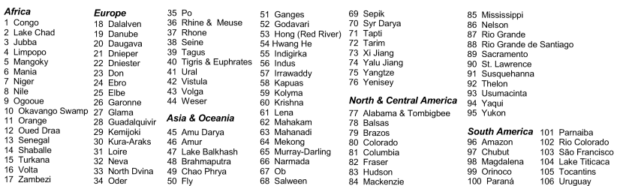
Drainage basins - World

Slide 2
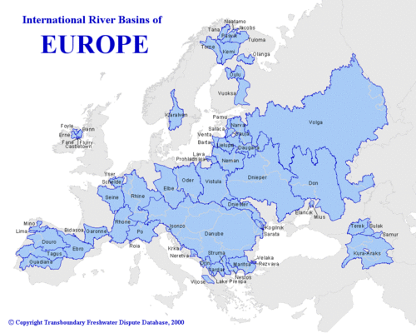
Drainage basins - European

Slide 3
Drainage basins - patterns
The land around us is rarely flat. There are nearly always differences in height and slope. Sometimes the slope may be steep and sometimes it may be gentle. There may be hills, mountains, or valleys, or areas that are quite level. The word relief is used by geographers to describe the shape of the land.

Slide 4
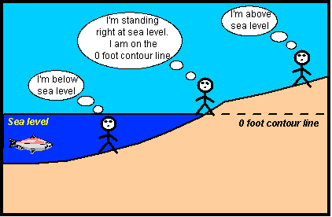
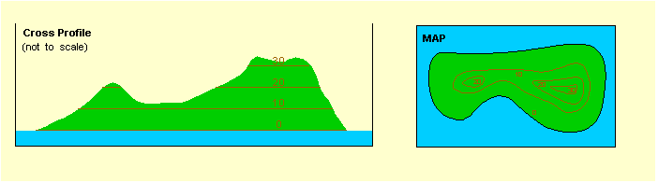
Heights on a Map
All height is shown from sea level.
The contours on the map below are shown at 10 metre intervals.
Where contours are far apart it means the ground is flat.
Where they are close together the ground is steep.
Far apart
Close together

Slide 5
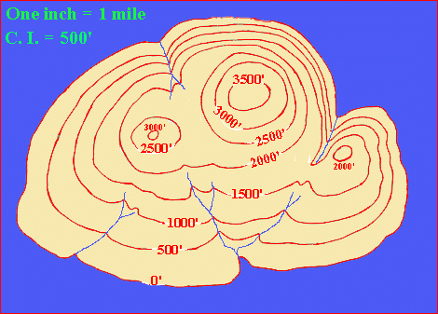
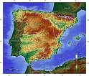
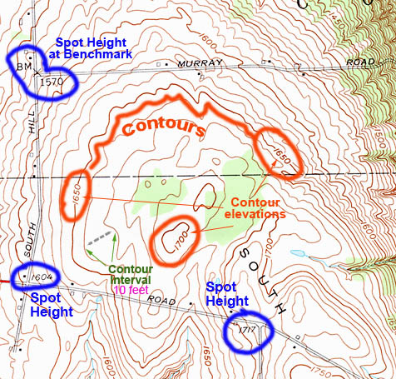
3 Ways to show relief
Contour lines join up places of the same height on maps. They are usually coloured brown and have their height marked on them.
Colours may be used to show areas of land that are different heights. Brown is usually used to show areas of high land and green for low ground.
Heights are shown on a map with a black dot with a number giving the exact height above sea level in metres.

Slide 6
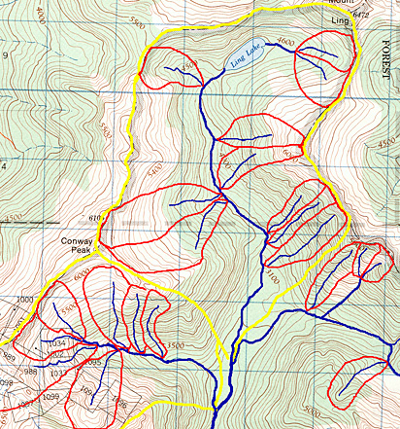
Drainage basins - patterns
Figure 10aa-1
Figure 10aa-1: The following image shows the nested nature of drainage basins as determined from a topographic map sheet. The red lines describe the watersheds for the drainage basins of first order streams. The yellow lines define the watersheds for two drainage basins from locations further upstream. Note that the first order basins are components of these much large drainage basins.
Demo: What do the red and yellow lines represent?

Slide 7
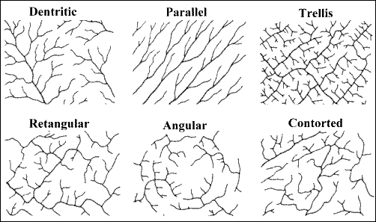
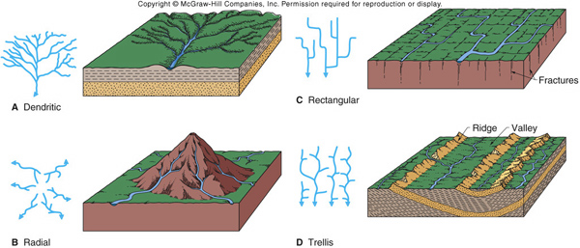
Drainage basins - patterns
Demo: Make notes on the 5 different types of drainage basin patterns.
Rectangular
Dendritic
Radial
Trellis

Slide 8
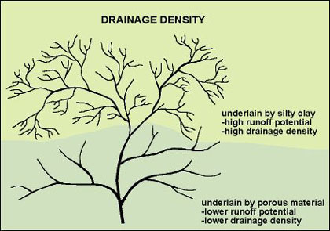
Drainage basins -Density
Drainage density = Sum of stream lengths / Basin Area.

Slide 9
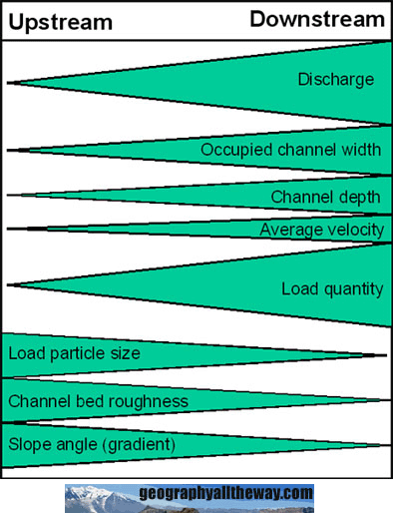
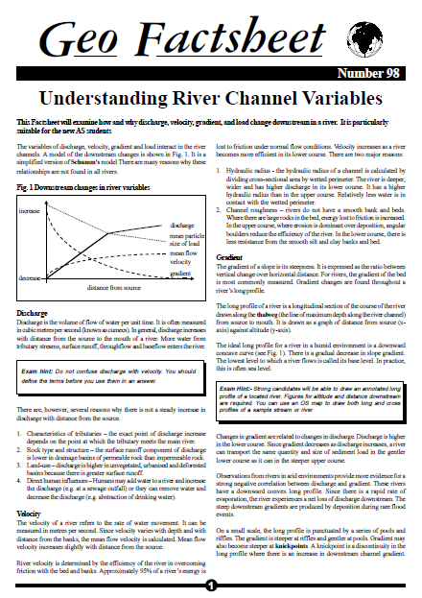
The Bradshaw Model
Demo: Read through your Geo Factsheet and complete the following question:
Describe and suggest reasons for the changes in velocity (6marks)

Slide 10
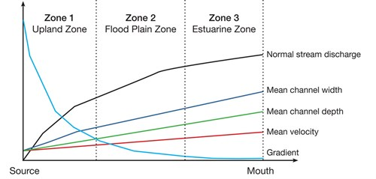
Schummm’s Model [Downstream changes in river variables]
Demo: What does Schumm’s model imply about downstream changes in river variables?
Plenary Exam question (10 minutes) Explain the relationship between stream discharge and channel shape. (5)

Slide 11
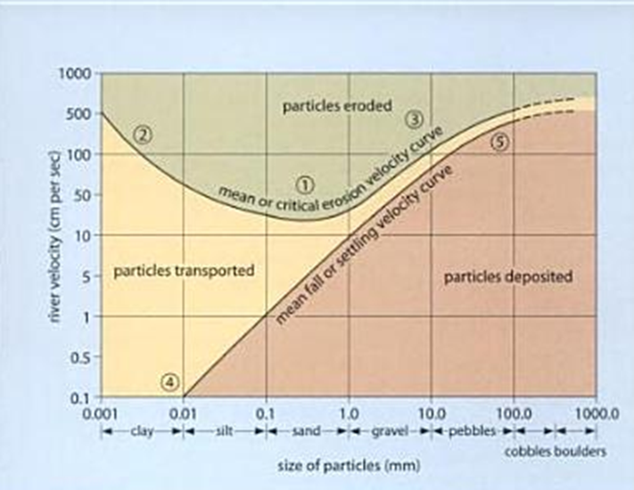
Hjulström curve (1902)
Demo: What does the Hjulström curve imply about particle size and river velocity?

Slide 12
Stream Discharge
Plenary: Check your understanding. Circle the correct of the two terms. Ensure to be able to justify your answer.
•A river in a deep, broad channel, often with a gentle gradient and small bedload, will have a greater/lesser velocity than a river in a shallow, narrow, rock filled channel – even if the gradient of the latter is steeper.
Justification:
__________________________________________________________________________________________________________________________
•The velocity of the river increases/decreases as it nears the sea
Justification:
__________________________________________________________________________________________________________________________
•The velocity increases/decreases as the depth, width and discharge of a river all increase.
Justification:
__________________________________________________________________________________________________________________________
•As the roughness increases/decreases, so does turbulence and the ability of a river to pick up and transport sediment
Justification:
__________________________________________________________________________________________________________________________

