Slide 1
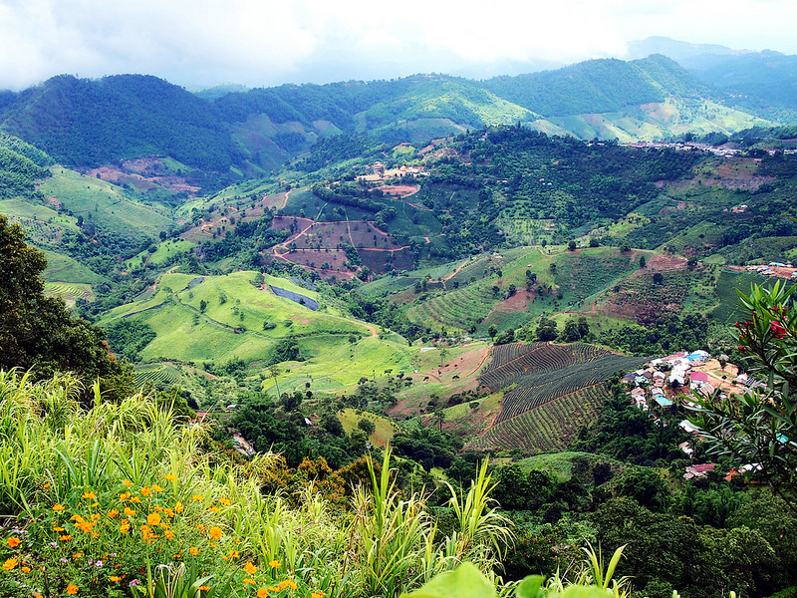
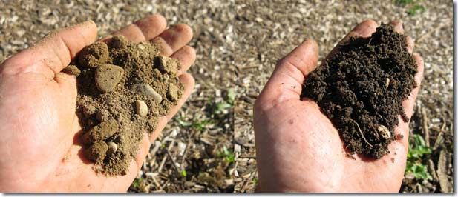
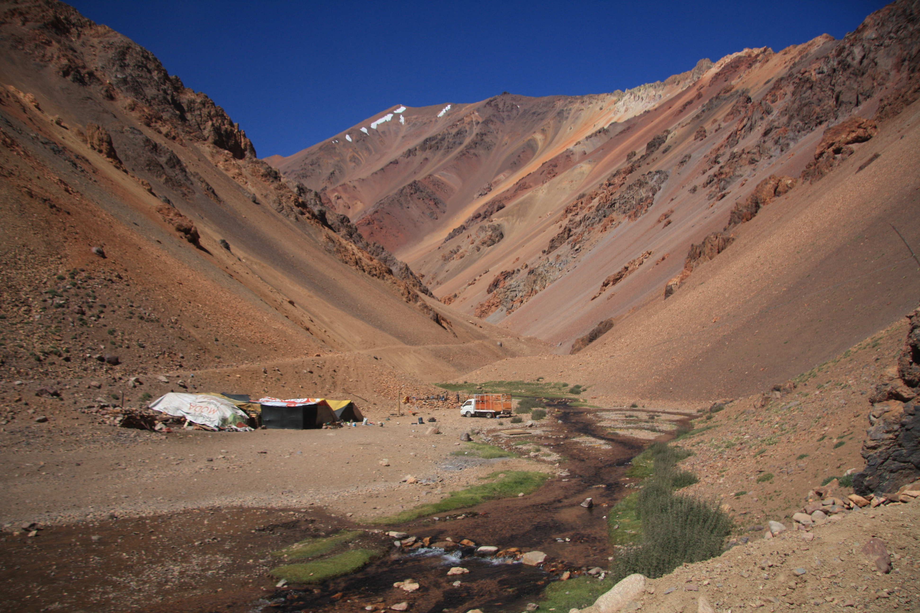
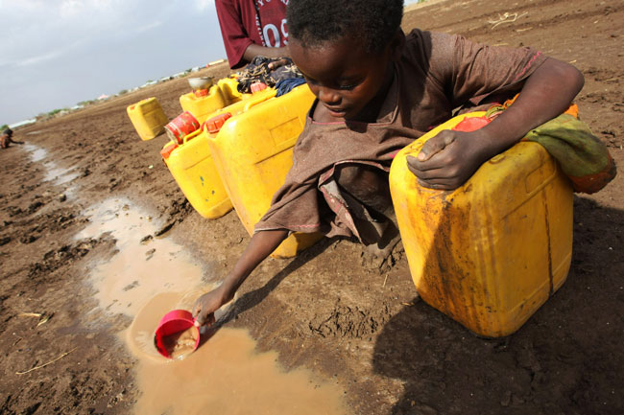
Factors influencing the sites and development
Learning Objectives: To be able to explain how physical factors (relief, soil, water supply, accessibility, resources) influence the sites and development of settlements.
Demo: Add your thoughts and ideas to the post it notes on your sheet. Focus question how do these 5 factors influence the sites and development of settlements.
Relief
Soil
Water Supply
Accessibility
Resources

Slide 2
Factors influencing the sites and development
Stage 1
Learning Objectives: To be able to explain how physical factors (relief, soil, water supply, accessibility, resources) influence the sites and development of settlements.
Demo: Add your thoughts and ideas to the post it notes on your sheet. Focus question how do these 5 factors influence the sites and development of settlements.
Relief:
……………………………………………………………………………………………………………………………………………………………………………………………………………………………………………………
Soil:
…………………………………………………………………………………………………………………………………………………………………………………………………………………………………………………………………………………………………………………………………………………………………………………………………………………………………………....
Resources:
…………………………………………………………………………………………………………………………………………………………………………………………………………………………………………………………………………………………………………………………………………………………………………………………………………………………………………....
Relief
Soil
Water Supply
Accessibility
Resources
Accessibility:
……………………………………………………………………………………………………………………………………………………………………………………………………………………………………………………………………………………………………………………………………………………………………………………………………………………………………………
Water Supply:
…………………………………………………………………………………………………………………………………………………………………………………………………………………………………………………………………………………………………………………………………………………………………………………………………………………………………………....

Slide 3
Factors influencing the sites and development
Stage 2
Learning Objectives: To be able to explain how physical factors (relief, soil, water supply, accessibility, resources) influence the sites and development of settlements.
Demo: Add your thoughts and ideas to the post it notes on your sheet. Focus question how do these 5 factors influence the sites and development of settlements.
Relief:
……………………………………………………………………………………………………………………………………………………………………………………………………………………………………………………
Soil:
…………………………………………………………………………………………………………………………………………………………………………………………………………………………………………………………………………………………………………………………………………………………………………………………………………………………………………....
Resources:
…………………………………………………………………………………………………………………………………………………………………………………………………………………………………………………………………………………………………………………………………………………………………………………………………………………………………………....
Relief
Soil
Water Supply
Accessibility
Resources
Accessibility:
……………………………………………………………………………………………………………………………………………………………………………………………………………………………………………………………………………………………………………………………………………………………………………………………………………………………………………
Water Supply:
…………………………………………………………………………………………………………………………………………………………………………………………………………………………………………………………………………………………………………………………………………………………………………………………………………………………………………....

Slide 4
Factors influencing the sites and development
Stage 3
Relief: This includes Altitude, gradient and aspect.
Altitude: alone is a rarely a factor influencing the site of settlements. Mountainous regions might be to cold to grow crops. They could also be covered in snow for much of the year. The lowest areas are sometimes sparsely populated because of poor drainage, disease and dense vegetation.
Gradient: Gentle slopes have the advantages of being well drained, easy to cultivate and easier to build on. Settlements are often located along valley floors
Aspect: is the direction the slope faces. East to west. The sun always rises in the east and sets in the west.
Soils: Areas with fertile soils are often more densely settled, because the greater productivity of the land can support a larger population. E.g. Alluvial soils (are soils deposited by running water and are often located in existing floodplains.) found in river valleys and the soils that develop on certain volcanic rocks, such as basalt.
Relief
Soil
Water Supply
Accessibility
Resources
Water Supply: Many settlements were first established next to rivers, springs and wells. Sites in otherwise dry areas, with reliable water supplies from rivers, springs and wells are called wet point sites.
In areas with large populations and a shortage of land (Bangladesh), flood plains are sometimes densely settled. Areas slightly higher than flood plains, with gentle well drained slopes, are good for farming and provide good sites for rural settlements. Higher points in otherwise poorly drained areas are known as dry point sites.
Resources(A resource is any physical material constituting part of Earth that people need and value. Natural materials become resources when humans value them. The uses and values of resources change from culture to culture and from time to time.)
Resources will determine whether a settlement can flourish or not.
Accessibility: The remotest settlements benefit from contact with other settlements to sell, buy and trade good and services. This falls in line with Linear settlements.

Slide 5
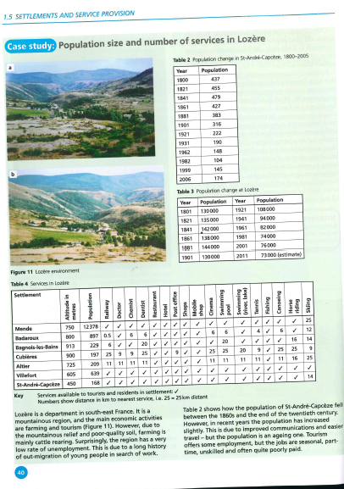
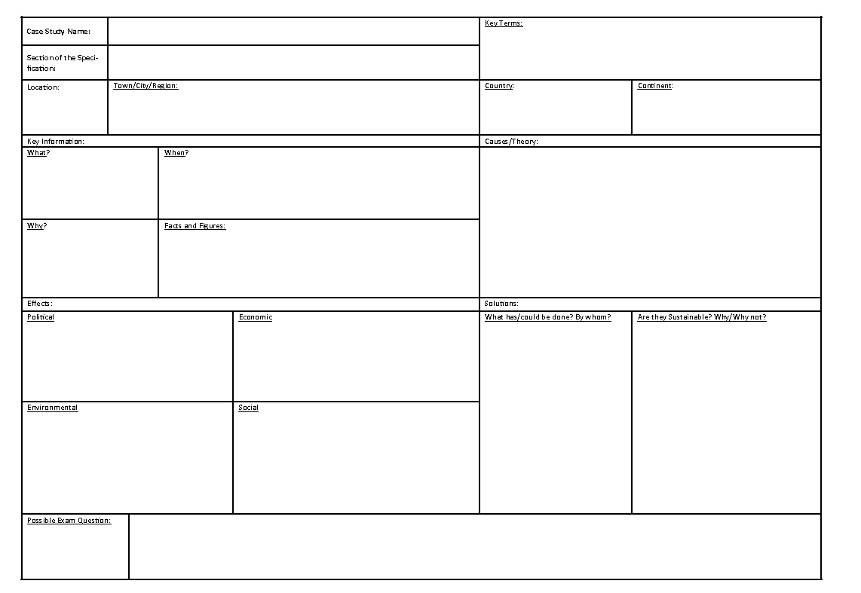
Case Study: Settlements and Services
Demo: Turn to page 40/41 and read through the case study. Complete the Activities.
Learning Objectives: To be able to explain how population size and number of services in Lozere have changed and to be able to develop geographical skills.
Geographical skills:
Map Reading up to 6 Figure References
Able to read map symbols
Interpretation of graphs
Interpreting data
Description of relationships
Interpretation of settlement patterns
Use Map Evidence
Yes
No
Challenge: Complete a Case Study Card on Lozere.

Slide 6
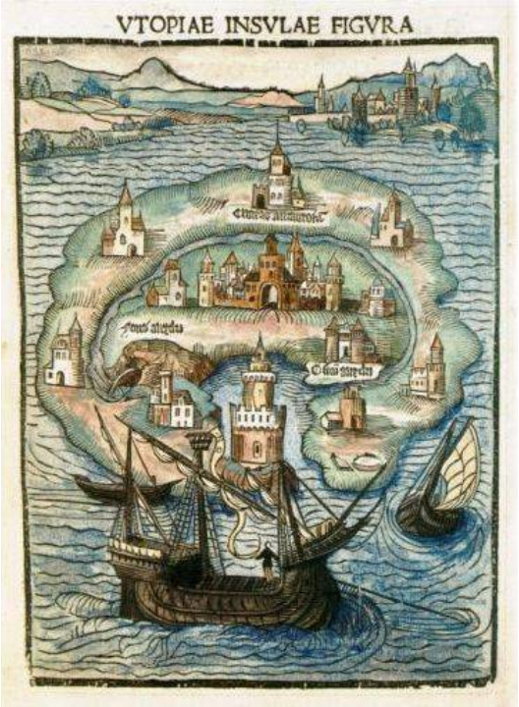
The island of Utopia as described by Thomas Moore

Slide 7
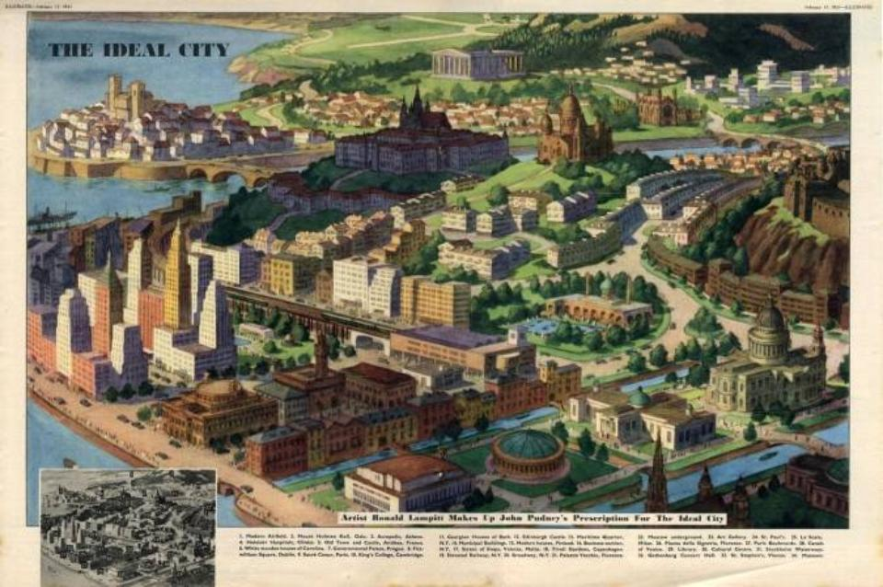

Slide 8
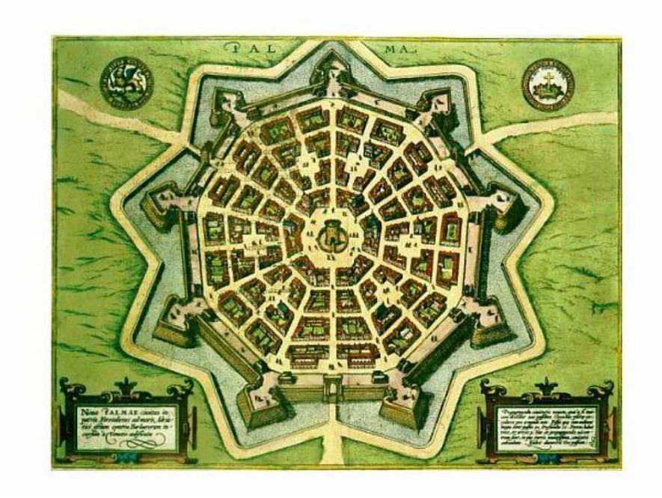
Palmanova - Italy

Slide 9
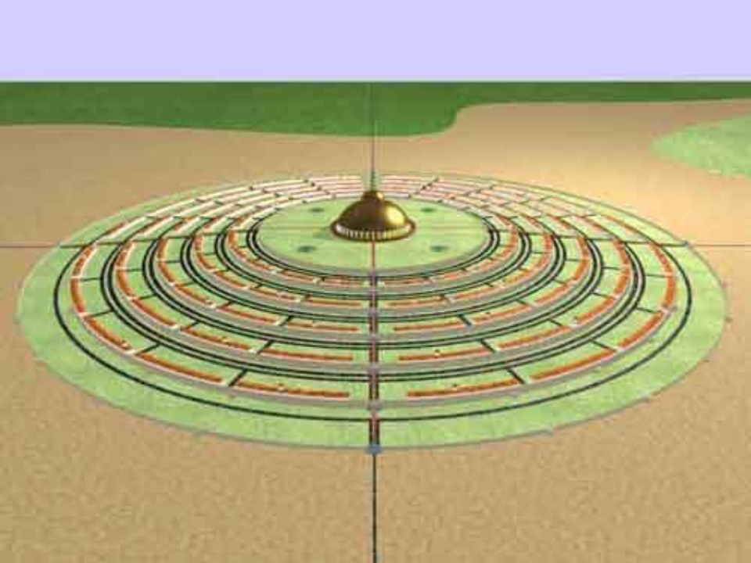
The City of the Sun as described by T. Campanella

Slide 10
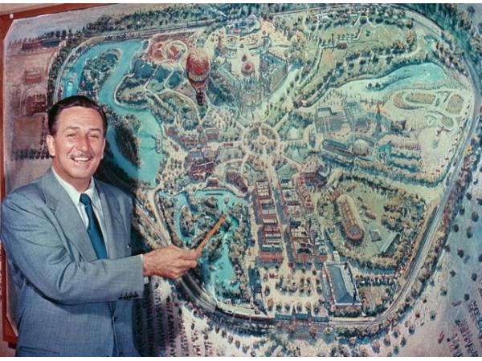
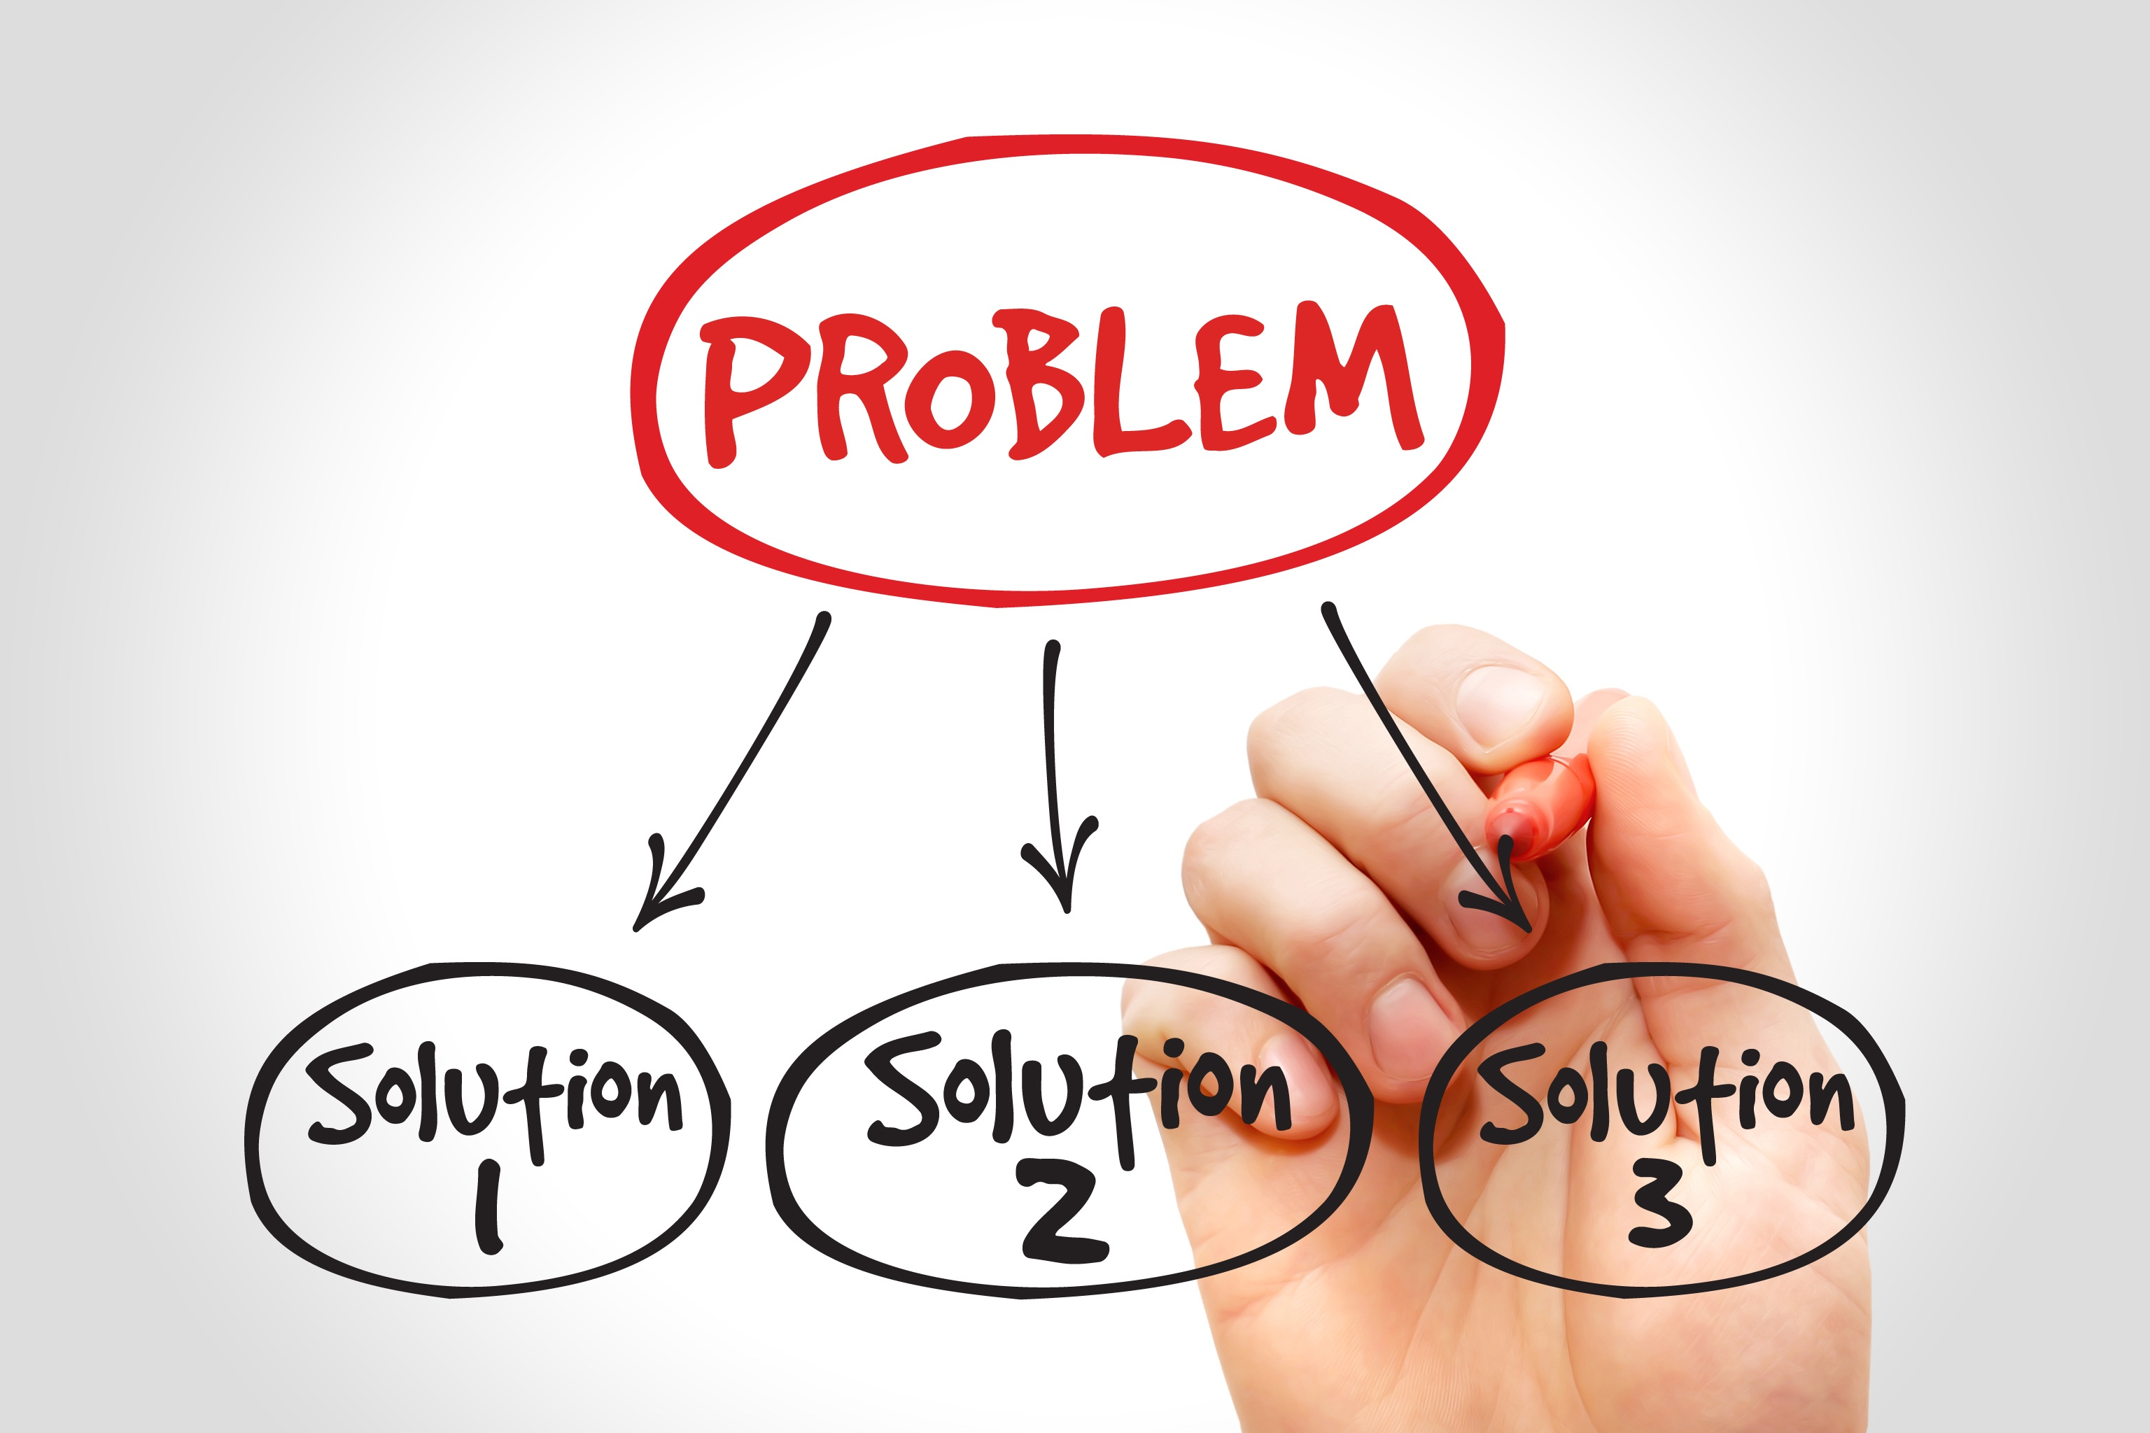
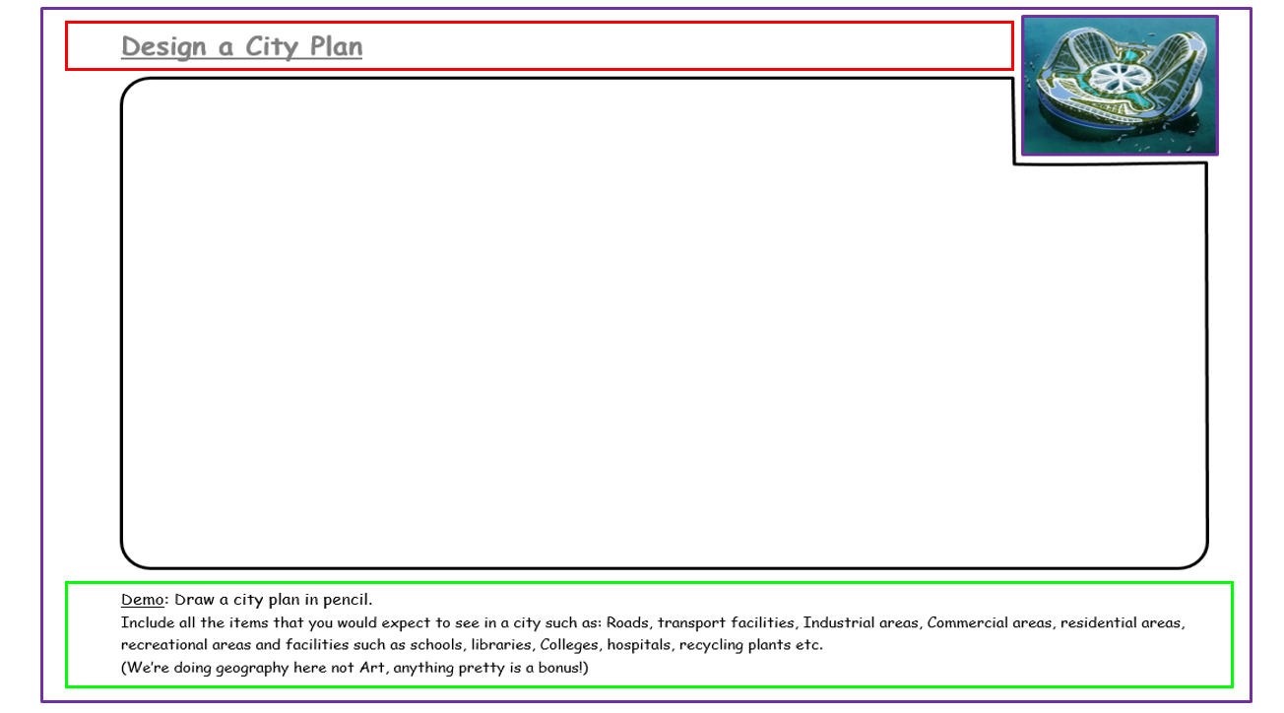
Starter:
Starter: An urban planner or city planner is a professional who works in the field of urban planning for the purpose of optimizing the effectiveness of a community's land.
The Problem
Urban Planner
More and more people are moving to urban areas. As such cities have started to sprawl solutions need to found. Ensure to design a city that solves this problem.
The Solution

Slide 11
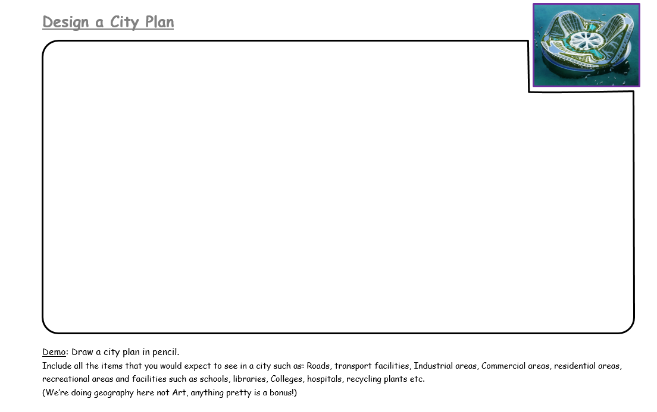

Slide 12
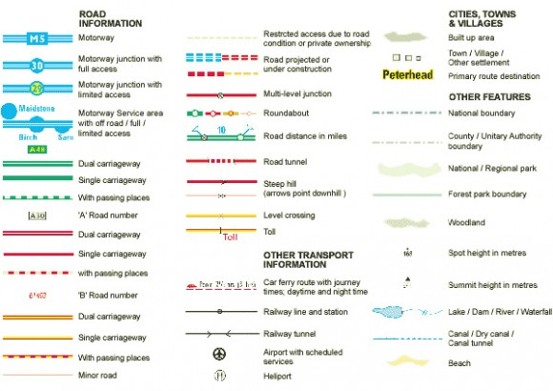
Creating a Key (Example)
Make sure to create a key and to use map symbols to help in the planning of your city.

Slide 13
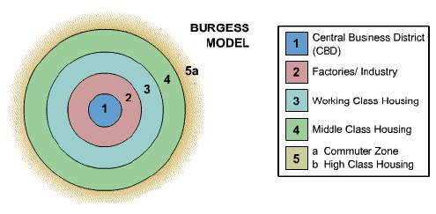
Burgess Model
Concentric Zones of land-use. 1925.
Challenge: What are the strengths and limitations of this model?

Slide 14
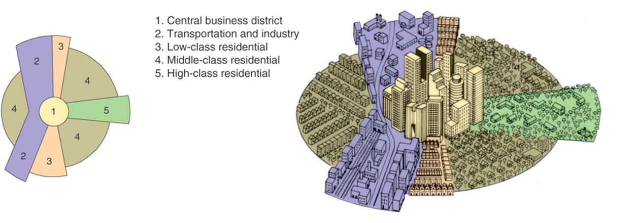
The Hoyt Model (1939)
The Hoyt model has land use concentrated in wedges or sectors radiating out from the city centre. For example, factories may be concentrated along a river, canal or road to form a zone of industry. This would attract low-class housing, but repel high-class residential land use.

Slide 15
Burgess Model(1925)
The Hoyt Model (1939)
Key:
Key:

