Slide 1
Mass Movements
Learning Objective: To be able to compare two case studies in regards to mass movement.
Nepal Landslide [2015]
Leyte Island Landslide 2006

Slide 2
Nepal Landslide [2015]
Demo: Fill out your case study sheet.
Effects
Social
Economic
Environmental
Political
Challenge: What mitigation Strategies might there have been?

Slide 3
Leyte Island Landslide 2006
Demo: Read the information and complete the case study sheet.

Slide 4
Management Techniques
Demo: Suggest how maps such as this are useful to:
Households
Businesses and organizations

Slide 5
Management Techniques

Slide 6
Vulnerability
Physical dimensions
Intensity
Exposed
population
Age of the
infrastructure
Frequency
Technology
Location
Exposure
Demo-
graphy
Age and
income of the
population
Exposed
res-
ources
Sensitivity
VULNERA-
BILITY
Number
Res-
ponse
Level of
education
Capacity
to adapt
Management
structure
Access to
information and
technology
Wealth and
well being
Information
services
Tax
revenues
Emergency
plans

Slide 7
Spectrum of vulnerability
Low Vulnerability
High Vulnerability

Slide 8
What’s a Risk?
Relationship between degree of risk posed and probability of event occurring, the predicted losses and a community’s preparedness
Why do individuals and communities underestimate events occurring
What factors determine an individual’s perception of the risk posed by hazards

Slide 9
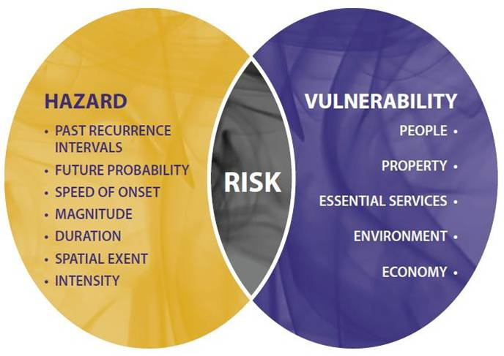
How do we measure risk?

Slide 10
Assessment Questions
1.Describe the distribution of the world’s main earthquakes.
2. Briefly describe the meaning of the term “Pacific Ring of Fire’.
3. Explain how hotspots cause chains of volcanoes.
4. Describe the distribution of landslide fatalities, 2006–2007.
5. Explain the term “recurrence interval”.
6. Explain the term “supervolcano”.
7. On average, how many earthquakes per year have a magnitude of over 8.0 on the Richter scale or the Moment Magnitude Scale?
8. State the range of annual deaths attributed to volcanoes, 2004–2014.
9. State the range of annual deaths attributed to mass movements, 2004–2014.
10. Identify the geophysical events that have had greatest impact in terms of loss of life, 2004–2014.

Slide 11
Assessment Questions

