Slide 2
Civil society = Any organization or movement that works in the area between the household, the private sector and the state to negotiate matters of public concern. Civil societies include non-governmental organizations (NGOs), community groups, trade unions, academic institutions and faith-based organizations.
Core and periphery = The concept of a developed core surrounded by an undeveloped periphery, applied at various scales.
Cultural imperialism = The practice of promoting the culture/language of one nation in another. It is usually the case that the former is a large, economically or militarily powerful nation and the latter is a smaller, less affluent one.
Food miles = A measure of the distance food travels from its source to the consumer. This can be given either in units of actual distance or of energy consumed during transport.
Globalization = “The growing interdependence of countries worldwide through the increasing volume and variety of cross-border transactions in goods and services and of international capital flows, and through the more rapid and widespread diffusion of technology” (IMF).
Globalization indices = The AT Kearney Foreign Policy index measures twelve variables, which are subdivided into four “baskets”: economic integration, personal contact, technological connectivity and political engagement. Nations are ranked according to a calculated globalization index. The KOF index measures three main dimensions of globalization: economic, political and social, and nations are ranked accordingly. It is designed by the Swiss Federal Institute of Technology on a yearly basis.
Glocalization = A term that was invented to emphasize that the globalization of a product is more likely to succeed when the product or service is adapted specifically to each locality or culture in which it is marketed. The increasing presence of McDonald’s restaurants worldwide is an example of globalization, while changes made to the menus of the restaurant chain, in an attempt to appeal to local tastes, are an example of glocalization. A term that was invented to emphasize that the globalization of a product is more likely to succeed when the product or service is adapted specifically to each locality or culture in which it is marketed. The increasing presence of McDonald’s restaurants worldwide is an example of globalization, while changes made to the menus of the restaurant chain, in an attempt to appeal to local tastes, are an example of glocalization.
GNI Gross national income (now used in preference to GNP) = The total value of goods and services produced within a country together with the balance of income and payments from or to other countries.
Outsourcing = The concept of taking internal company functions and paying an outside firm to handle them. Outsourcing is done to save money, improve quality or free company resources for other activities.
Time–space convergence = The reduction in the time taken to travel between two places due to improvements in transportation or communication technology.
Transnational corporation (TNC) = A firm that owns or controls productive operations in more than one country through foreign direct investment.

Slide 3
Global interactions part 1: Measuring global interactions
Learning Objectives: To evaluate the AT Kearney index or KOF index , as a measure of global interaction.
Definitions and history
Measuring and describing globalization
Evaluating indices
Data presentation

Slide 4
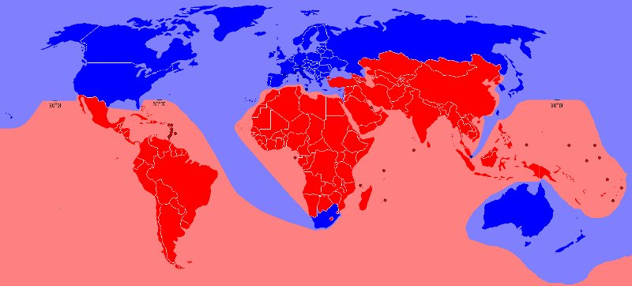
Cores (network hubs/nodes), peripheries and those areas in-between!

Slide 5
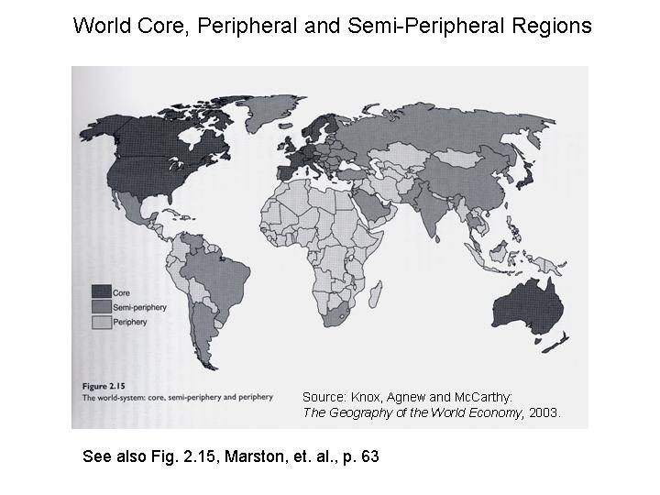

Slide 6
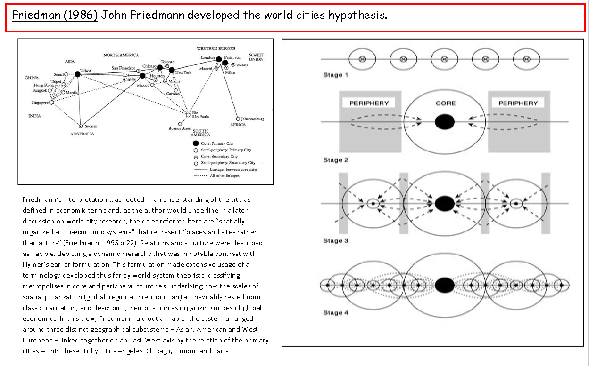
Cores (network hubs/nodes), peripheries and those areas in-between!
Friedman (1966)

Slide 7
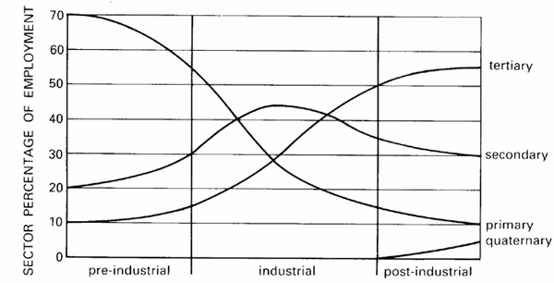
Clark-Fisher model
http://www.geographyinthenews.rgs.org/imageviewer.aspx?imgid=396

Slide 8
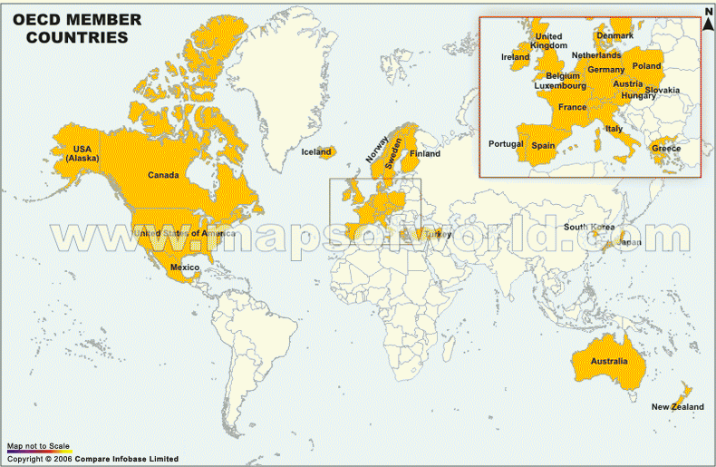

Slide 9
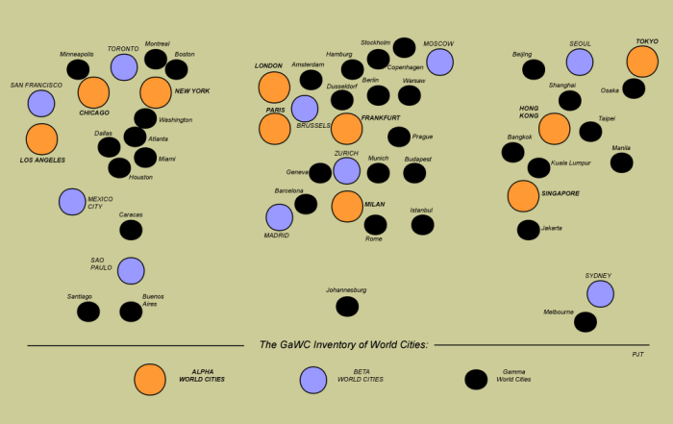
Cores (network hubs/nodes), peripheries and those areas in-between!

Slide 10
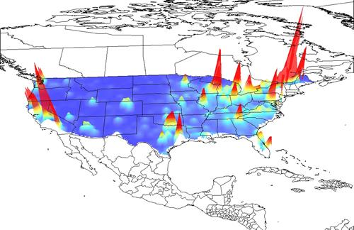
Gecon globe

Slide 11
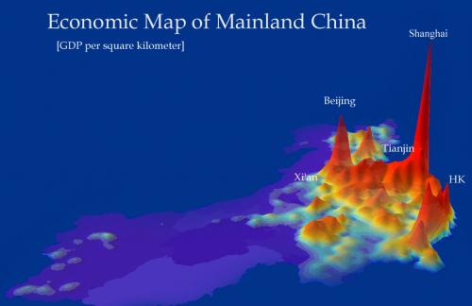

Slide 12
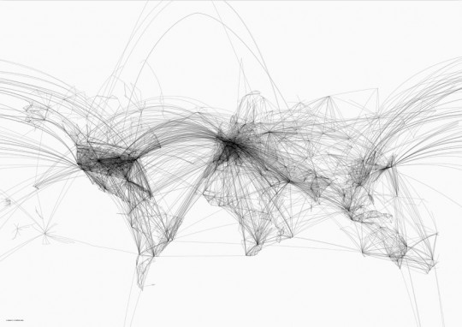
Air travel hubs
http://www.magicalurbanism.com/archives/3256

Slide 13
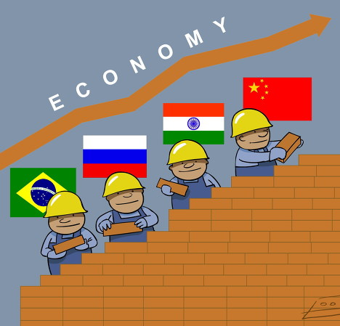
http://www.bbc.co.uk/news/business-15888749 - interactive
http://www.youtube.com/watch?v=wmS11HnNbk0

Slide 14
Why do some regions remain relatively switched off
Physical
Challenges
Human
Vulnerable to climate change and natural hazards
Low prices for food exports due to over production and trade rules
Ethnic clashes between tribes
Poor resources for agriculture
Politically isolated
Lack of coastline deters investment from TNCs seeking an import/export base
Resources controlled by foreign TNC
Infighting and civil war over resources
Resources controlled by a small elite
Lack of skills and literacy deters investors

Slide 15

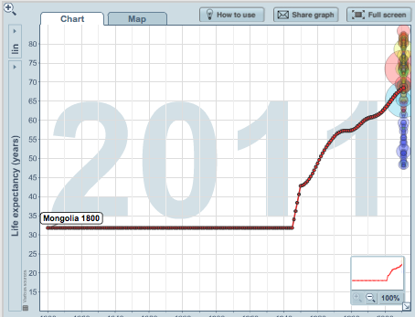
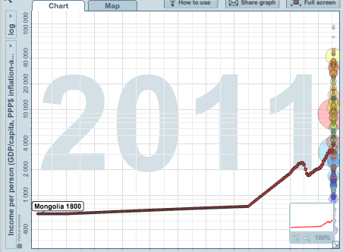
Mongolia – a peripheral country
http://www.ifitweremyhome.com/compare/listing

Slide 16
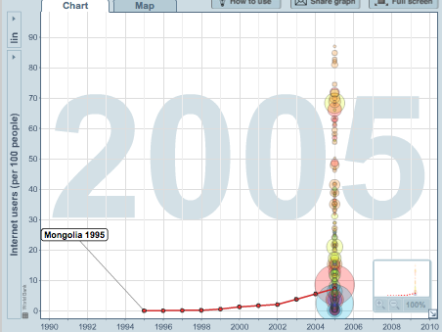
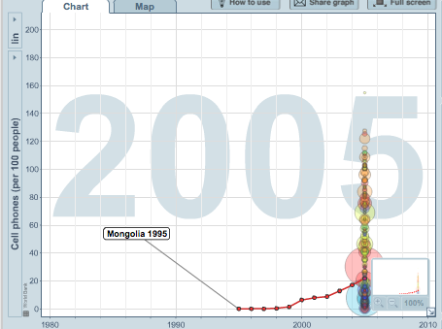
http://globalization.kof.ethz.ch/

Slide 17
Exam question
Learning Objectives: To evaluate the AT Kearney index or KOF index , as a measure of global interaction.
Describe and explain the location of global core and peripheral areas. (10 marks)

