Slide 1
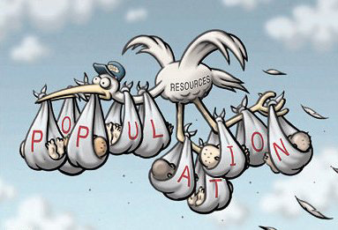
An Underpopulated World
Question for thought: What affects population fertility and what affects population mortality? Ensure to provide justification for your chosen answer.
Stage 1
Starter Instructions : Popcorn.
Try answering the question. Stand up and answer.
The next person may then proceed.
Stage 2
Key word-
Infant mortality
Death rates
Life expectancy
Fertility rate
Youth dependency ratio
Population growth rate

Slide 2
Pop Quiz Exam question
Using the data for Kenya (see table). Explain why population change is likely to have caused problems for the country?
[5 Marks]
Total Population | 34,700,000
Aged 0-14 (%) | 42
Birth rate (per 1000) | 39
Death rate (per 1000) | 11
Fertility rate (per 1000) | 4.8
Annual rate of increase (%) | 2.3
Urban population (%) | 39
Rural population (%) | 61
10 mins

Slide 3
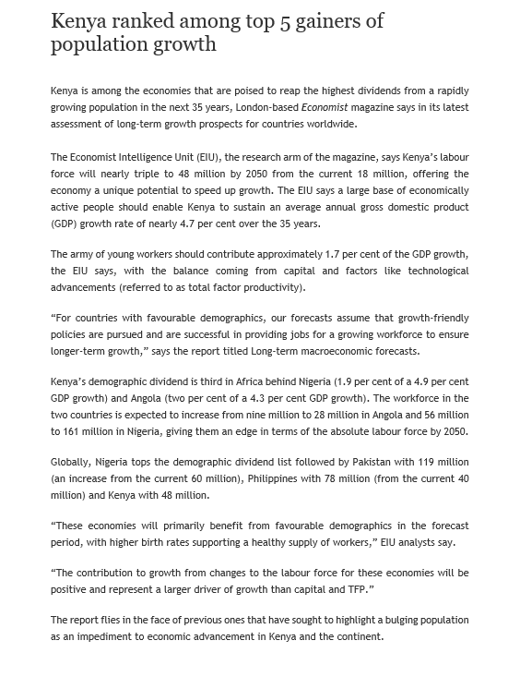
Kenya a country with a high rate of population growth
Learning Objective: To be able use a case study to provide a detailed explanation as to how Kenya is affected by having a high rate of population.
Demo: Read through the article and complete the following tasks.
Stage 1: Read the article
Stage 2: Highlight key data
Stage 3:Identify the economic impacts
Impacts

Slide 4
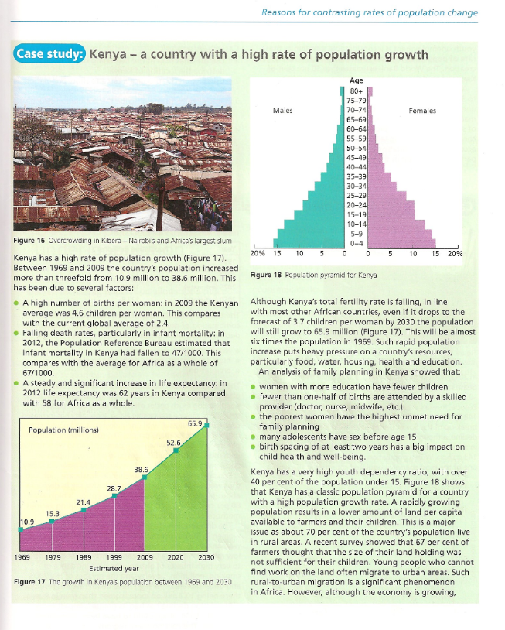
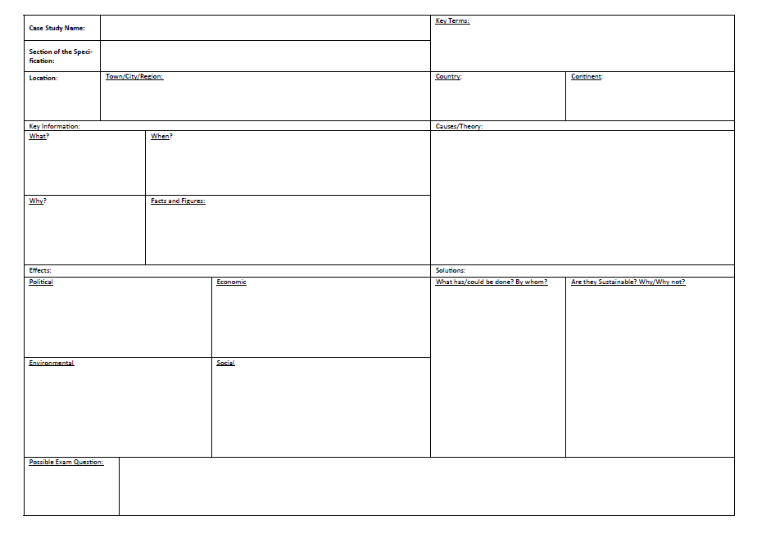
Case Study: Kenya a country with a high rate of population growth
Demo: Read through your Case Study information on pages 11 and transfer the information to your case study sheet.
Top tip: Ensure to use data as this will help you gain the top marks.
Exam Question:

Slide 5
Assessment for learning – end of lesson progress check
Learning Objective: To be able use a case study to provide a detailed explanation as to how Kenya is affected by having a high rate of population
Please complete the activity below reflecting on your learning in today’s lesson:
In this lesson, I have learnt:

Slide 6
Plenary
Demo: Complete your Honeycomb. What factors link together and what affects might there be.
Synthesis

