Slide 1
Geographical Skills (AO4)
Starter: What can you infer from the two statement below. Ensure to justify your answers
Prediction is very difficult, especially about the future.
Niels Bohr
The future, according to some scientists, will be exactly like the past, only far more expensive.
John Sladek

Slide 2
How to infer Sources
Demo: How do we use sources?
Exam tip: This is an important skill required for paper 1 and paper 2.

Slide 3
Deeper Qs
2nd
Question Grid | Is? Present | Did? Past | Can? Possibility | Would/Could? Probability | Will? Prediction | Might Imagination
What ? Event
Where? Location
When? Time
Which? Choice
Who? Person
Why? Reason
How? Meaning
1st
Question focus:- define, describe, analogy, explain, comment, classify

Slide 4
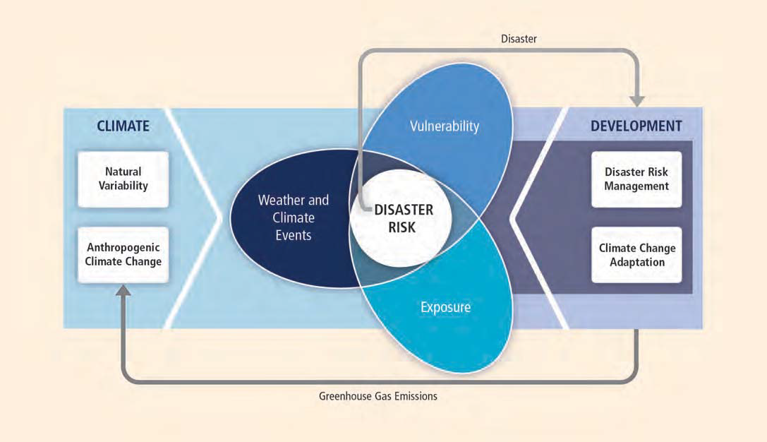
IPCC view of role of physical and social issues in hydrometeorological disasters

Slide 5
Number of natural hazard events and number of fatalities (EM-DAT data)
Flooding in China
Flooding in China
Fatalities

Slide 6
Number of natural hazard events and number of fatalities (EM-DAT data)
Fatalities
Events

Slide 7
Trends in total numbers are driven by hydrometeorological events
Total
Flood
Storm

Slide 8
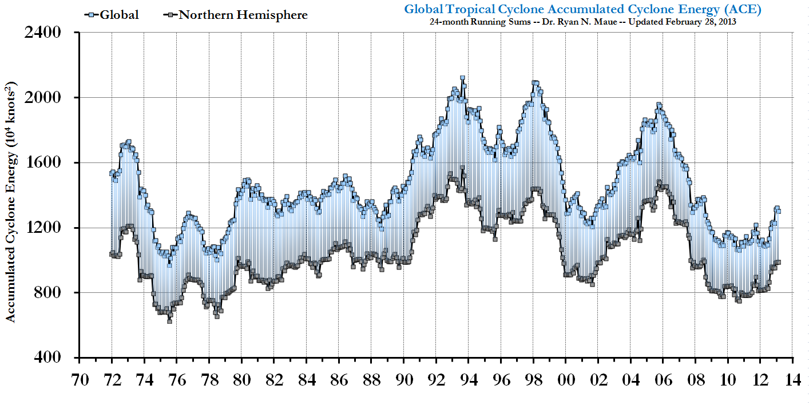
In the last decade Tropical cyclone energy has been unusually low
Ryan Maue: http://policlimate.com/tropical/

Slide 10
Or: international strategies?

Slide 11
Earthquakes and volcanoes

Slide 12
Simkin and Siebert (1994): number of active volcanoes
80
60
40
20
0
WW1 WW2
Reported number of active volcanoes per year
1800 1850 1900 1950 1990
Year

Slide 13
USGS data on occurrence of large earthquakes (M≥6.5)

Slide 14
USGS data on occurrence of large earthquakes (M≥6.5)

Slide 15
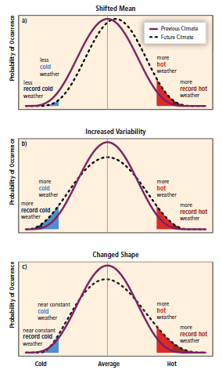
Future of hydro-meteorological hazards – IPCC SREX report
Mean temperature (or precipitation etc) might rise
Weather may become more variable
Change in shape – shift towards higher extremes

Slide 16
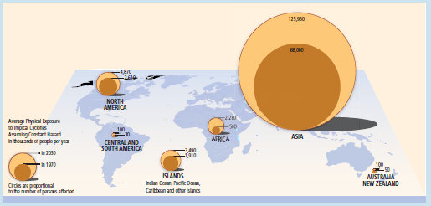
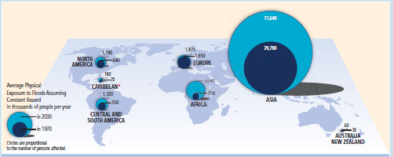
IPCC SREX report
Exposure to Tropical cyclones
Exposure to Floods

