Slide 1
Learning outcomes:
*Level 3: I can identify key features and processes in the water cycle.
*Level 4: I can describe the key features of a processes of the water cycle with accuracy and detail.
*Level 5: I can explain in detail how human activities impact upon the water cycle.
*Level 6: I can identify and explain ways of managing human interaction with the water cycle.
*Level 7: I can evaluate the environmental consequences of human interaction with water cycle.

Slide 2
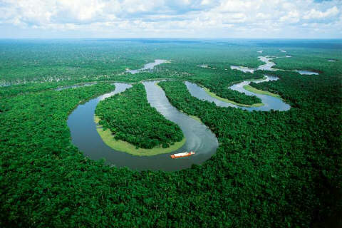
Scale: World water Region river
Hydrological cycle
Movement of water
River profile
River features
Drainage basin
Waterfalls
Oxbow lakes
River life
Influence on life
Human impacts
Notes:
2

Slide 3
The Water Cycle
Demo: Make a simple sketch of the water cycle.

Slide 4
The Water Cycle
How good was your water – cycle diagram? Self assess your cycle:
Have you managed to include all the key terms?
Have you included all the key features river, ocean, air, clouds, ground?
Can you explain what 3 key terms mean? E.g. I think precipitation means….

Slide 5
Define time:
Condensation –
Evaporation –
Transpiration –
Precipitation –
Exam Tip: It is really important to learn these definitions for the exam. They will also be needed for your IA.
Condensation – Change from gas to liquid.
Evaporation – Change from liquid to gas.
Transpiration – The flow of water form trees to trees the air.
Precipitation – Water falling from the sky.

Slide 6
Plenary
Learning Objective: To identify and explain what the what cycle is, and evaluate how it is affected by people.
Plenary: Look at the definitions below. Write down the matching key word.
Water falling from the sky.
The flow of water form trees to trees the air.
Change from gas to liquid
Change from liquid to gas

