Slide 1
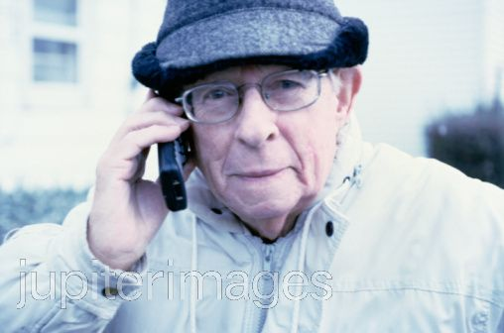
An ageing population
Learning Objectives: How can a country’s geography be changed by an increasing percentage of older people in the population?
Starter:
Starter: At what age do you think a person should retire from their work?
Do you think the same age should apply to everyone? Give reasons for your answer.
Challenge: Why is age such an important topic for geographers?

Slide 2
An ageing population
Demo: Match the terms with the definitions.
Key word | Definition
Counter-urbanisation | An increase in population when there are more births than death in a year.
Natural increase | A small settlement designed for elderly people.
Net migration | Movement of people away from a town or city.
Retirement village | When the birth rate and death rate in a country are about the same and the population is not increasing
Zero growth | The difference between people moving into a country and those who move out.

Slide 3
Check your Answers
Key word | Definition
Counter-urbanisation | Movement of people away from a town or city.
Natural increase | An increase in population when there are more births than death in a year.
Net migration | The difference between people moving into a country and those who move out.
Retirement village | A small settlement designed for elderly people.
Zero growth | When the birth rate and death rate in a country are about the same and the population is not increasing.

Slide 4
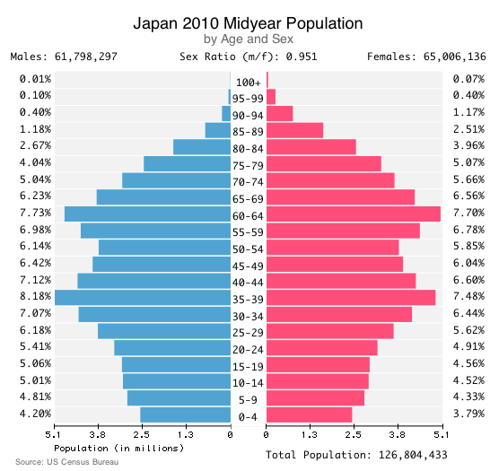
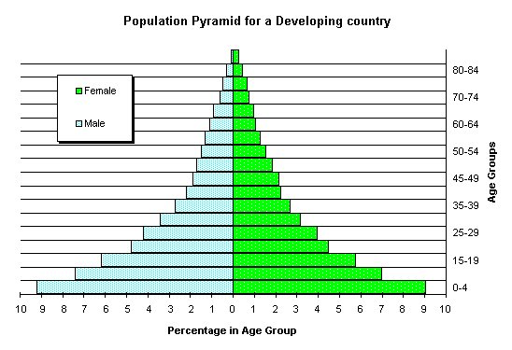
Compare the population statistics for Kenya and Japan.
Population pyramid for Kenya
Rate of natural increase:
2.3 %
Population pyramid for Japan
Rate of natural increase:
-0.09 %
Demo: Explain in your book at least two differences between these countries and their population.

Slide 5
BBC article
http://news.bbc.co.uk/1/hi/health/1569518.stm
The World Health Organisation (WHO) warns that the health impact could be enormous.
It predicts a big rise in cancers, coronary heart disease, diabetes, dementia and other illnesses related to ageing.
In the UK, heart expert Professor Michael Marmot has warned that there could be "a huge increase in the number of people suffering from coronary heart disease" in the next century.
Health experts are worried that as people get older, they could become prone to an increasing number of debilitating conditions if they do not keep active.
The WHO has launched a campaign to promote good health in old age.
Doctors in the UK say people have an over-gloomy picture of old age and that there is no reason why they should have a lower quality of life than other people if they keep healthy.
Dr Stephen Webster, a geriatric health expert at Addenbrooke's Hospital in Cambridge, said: "People do have anxiety that there will be a period of disability at the end of their lives.
"But there is no evidence that that is the case if they are encouraged to live a healthy life and this generation of elderly people are in better nick than the previous generation."

Slide 6
Decision making Exercise: Are these solutions?
Migration to another country
People might retire to another country i.e. Spain. What could the advantages and disadvantages be?
Retirement villages
These are secure supported environments for older people. But, not all older people want to be separated from the rest of their community. What are the advantages and disadvantages of retirement villages?
Demo: Write down in your own words what are the benefits and problems with these possible solutions to the individual and society.
DME Challenge: What better solutions might there be? Create a theory (using evidence) as to how you would solve the problem.

Slide 7
Prepare to answer the question
Housing- more retirement villages/counter-urbanisation more prevalent
Transport- needs to be made more elderly friendly
Employment- less people working/ less tax being paid
Social and leisure facilities- more elderly friendly facilities. Accessible for wheelchairs. Medical care needs to be better to deal with lots of health problems.
Migration- more people moving to other countries i.e. Spain where the climate is warmer.
Demo: Draw a mind map
Use these points above as headings to create your mind map, give examples of how these factors might be affected by an aging population.
Plenary Question: Explain 3 impacts of an ageing population.
Don’t answer the question yet this will be a timed activity.

Slide 8
Plenary
Demo: Explain 3 impacts of an ageing population.
One impact of an ageing population is…
This is because…
A second impact is…
This is because…
A third impact is…
This is because…
Overall, I think one way to reduce the impacts of an ageing population is…

