Slide 1
GLOBALIZATION SURVEY
Please answer the following questions honestly:
1.Have a look at the manufacturing location for the clothes that you are wearing and write down the amount of countries. _____________________________
2.How many bank accounts do you have in other countries? ______________________________
3.How many countries have you visited in your lifetime? ______________________________
4.How many countries do you have citizenship for? ______________________________
5.How many international contacts do you have on Skype or Whatsapp? ______________________________
6.How many Model United Nations meeting have you attended? ______________________________
7.How many charitable overseas CAS groups are you going to join?
_______________________________

Slide 2

What is Globalization?
DEFINITION: ‘globalization is the inexorable integration of markets, nation-states and technologies to a degree never witnessed before-in a way that is enabling individuals, corporations and nation-states to reach round the world farther, faster, deeper and cheaper than ever before’ (T. Friedman, The Lexus and the Olive Tree, 1999).
OR
Question: There are so many different types of definition of globalisation. Definitions can be considerably influenced by the perspective of the writer. On what basis can we choose between competing definitions and why might it be important to do so?
DEFINITION: ‘globalization is a deliberate ideological project of economic liberalization that subjects states and individuals to more intense market forces’ (P.Michael, Development and Social Change, 2000)
Notes:
2

Slide 3

What is Globalization?
Demo: In what areas of your life has Globalisation taken hold?

Slide 5
Civil society = Any organization or movement that works in the area between the household, the private sector and the state to negotiate matters of public concern. Civil societies include non-governmental organizations (NGOs), community groups, trade unions, academic institutions and faith-based organizations.
Core and periphery = The concept of a developed core surrounded by an undeveloped periphery, applied at various scales.
Cultural imperialism = The practice of promoting the culture/language of one nation in another. It is usually the case that the former is a large, economically or militarily powerful nation and the latter is a smaller, less affluent one.
Food miles = A measure of the distance food travels from its source to the consumer. This can be given either in units of actual distance or of energy consumed during transport.
Globalization = “The growing interdependence of countries worldwide through the increasing volume and variety of cross-border transactions in goods and services and of international capital flows, and through the more rapid and widespread diffusion of technology” (IMF).
Globalization indices = The AT Kearney Foreign Policy index measures twelve variables, which are subdivided into four “baskets”: economic integration, personal contact, technological connectivity and political engagement. Nations are ranked according to a calculated globalization index. The KOF index measures three main dimensions of globalization: economic, political and social, and nations are ranked accordingly. It is designed by the Swiss Federal Institute of Technology on a yearly basis.
Glocalization = A term that was invented to emphasize that the globalization of a product is more likely to succeed when the product or service is adapted specifically to each locality or culture in which it is marketed. The increasing presence of McDonald’s restaurants worldwide is an example of globalization, while changes made to the menus of the restaurant chain, in an attempt to appeal to local tastes, are an example of glocalization. A term that was invented to emphasize that the globalization of a product is more likely to succeed when the product or service is adapted specifically to each locality or culture in which it is marketed. The increasing presence of McDonald’s restaurants worldwide is an example of globalization, while changes made to the menus of the restaurant chain, in an attempt to appeal to local tastes, are an example of glocalization.
GNI Gross national income (now used in preference to GNP) = The total value of goods and services produced within a country together with the balance of income and payments from or to other countries.
Outsourcing = The concept of taking internal company functions and paying an outside firm to handle them. Outsourcing is done to save money, improve quality or free company resources for other activities.
Time–space convergence = The reduction in the time taken to travel between two places due to improvements in transportation or communication technology.
Transnational corporation (TNC) = A firm that owns or controls productive operations in more than one country through foreign direct investment.

Slide 6
Global interactions part 1: Measuring global interactions
Learning Objectives: To evaluate the AT Kearney index or KOF index , as a measure of global interaction.
Definitions and history
Measuring and describing globalization
Evaluating indices
Data presentation

Slide 7
Current positive aspects of globalization
Current negative aspects of globalization
Future positive aspects of globalization
Future negative aspects of globalization

Slide 8
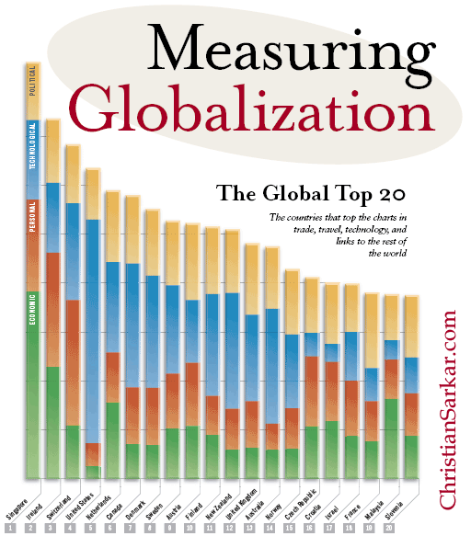
TOP 3 MOST GLOBALIZED COUNTRIES?????

Slide 9
Measuring globalization
A T KEARNEY INDEX
KOF INDEX
1.Political engagement
1.Economic
2.Technological Connectivity
2.Social
3.Politics
3. Personal Contact
4. Economic Integration

Slide 10
KOF INDEX
Indices and Variables Weights
A. Economic Globalization [37%]
i) Actual Flows (50%)
Trade (percent of GDP) (19%)
Foreign Direct Investment, flows (percent of GDP) (20%)
Foreign Direct Investment, stocks (percent of GDP) (24%)
Portfolio Investment (percent of GDP) (17%)
Income Payments to Foreign Nationals (percent of GDP) (20%)
ii) Restrictions (50%)
Hidden Import Barriers (22%)
Mean Tariff Rate (28%)
Taxes on International Trade (percent of current revenue) (27%)
Capital Account Restrictions (22%)
B. Social Globalization [39%]
i) Data on Personal Contact (33%)
Telephone Traffic (26%)
Transfers (percent of GDP) (3%)
International Tourism (26%)
Foreign Population (percent of total population) (20%)
International letters (per capita) (25%)
ii) Data on Information Flows (36%)
Internet Users (per 1000 people) (36%)
Television (per 1000 people) (36%)
Trade in Newspapers (percent of GDP) (28%)
iii) Data on Cultural Proximity (31%)
Number of McDonald's Restaurants (per capita) (43%)
Number of Ikea (per capita) (44%)
Trade in books (percent of GDP) (12%)
C. Political Globalization [25%]
Embassies in Country (25%)
Membership in International Organizations (28%)
Participation in U.N. Security Council Missions (22%)
International Treaties (25%)

Slide 11
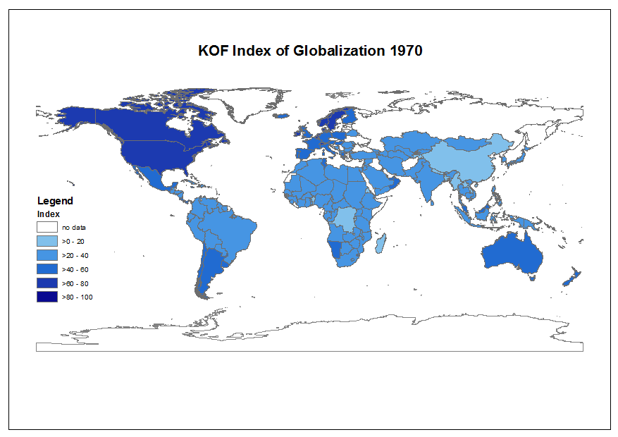
Demo: Describe what is happening over time. Focus upon particular regions of the world and you may wish to highlight particular countries.

Slide 12
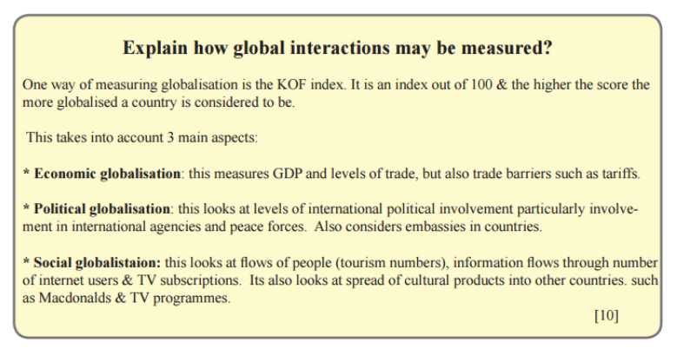
Exam question 1
Question: Describe how 1 prominent index measures global interactions. (10 marks)
Exam question 2

Slide 13
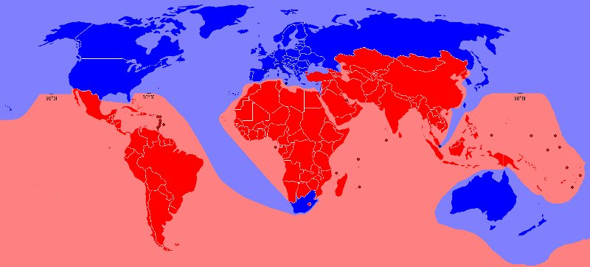
Cores (network hubs/nodes), peripheries and those areas in-between!

Slide 14
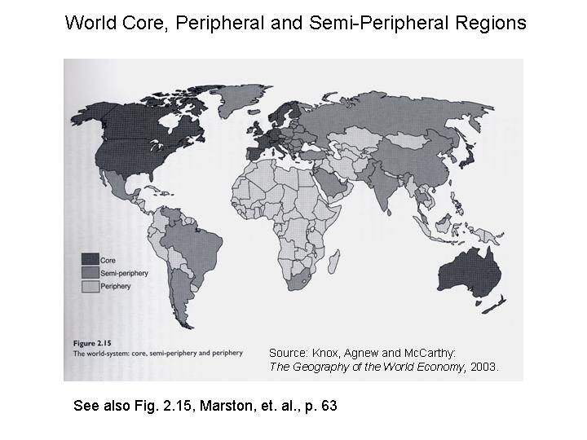

Slide 15
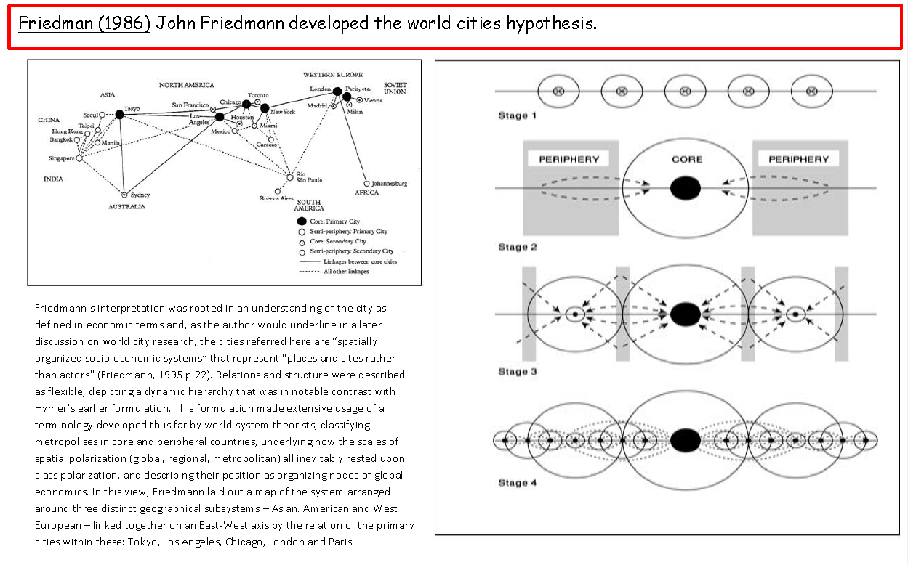
Cores (network hubs/nodes), peripheries and those areas in-between!
Friedman (1966)

Slide 16
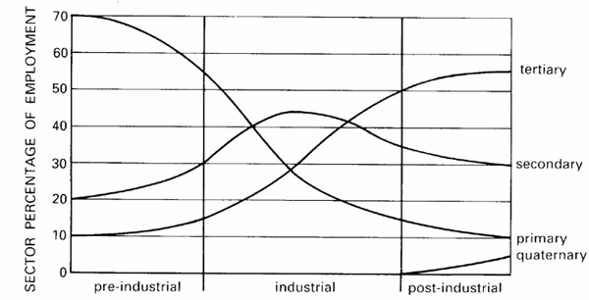
Clark-Fisher model

Slide 17
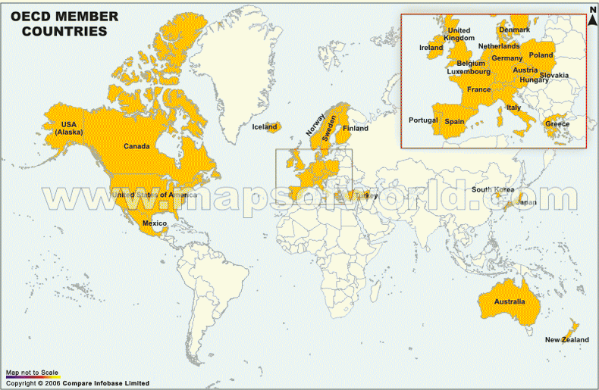

Slide 18
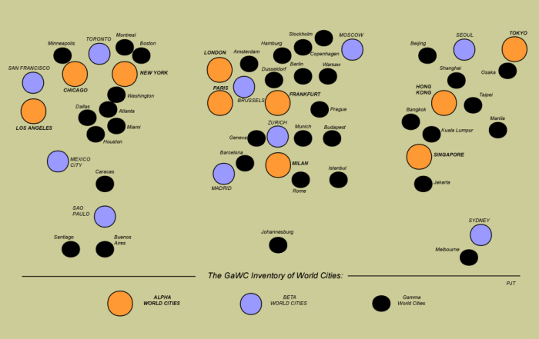
Cores (network hubs/nodes), peripheries and those areas in-between!

Slide 19
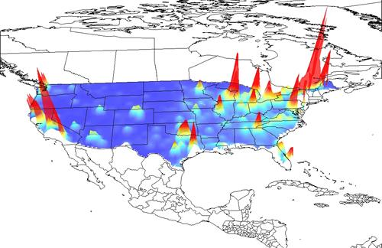
Gecon globe

Slide 20
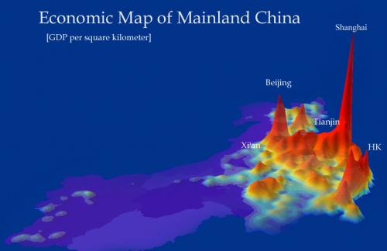

Slide 21
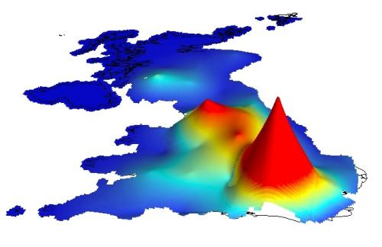

Slide 22
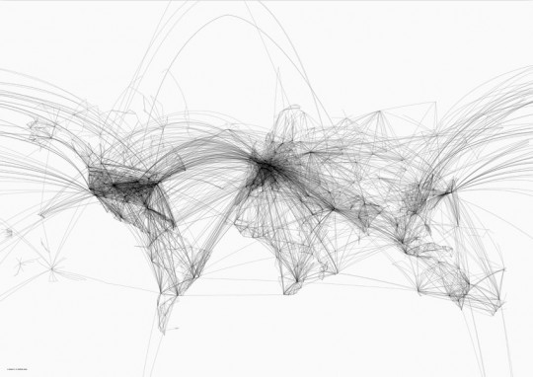
Air travel hubs
http://www.magicalurbanism.com/archives/3256

Slide 23
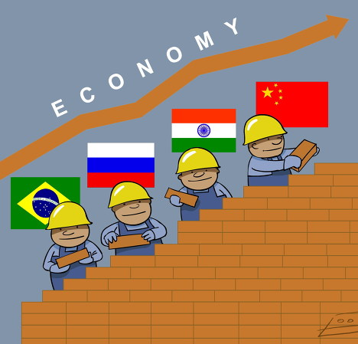
The BRIC Nations

Slide 24
Why do some regions remain relatively switched off
Physical
Challenges
Human
Vulnerable to climate change and natural hazards
Low prices for food exports due to over production and trade rules
Ethnic clashes between tribes
Poor resources for agriculture
Politically isolated
Lack of coastline deters investment from TNCs seeking an import/export base
Resources controlled by foreign TNC
Infighting and civil war over resources
Resources controlled by a small elite
Lack of skills and literacy deters investors

Slide 25
Exam question
Describe and explain the location of global core and peripheral areas. {10 mark}

