Slide 1
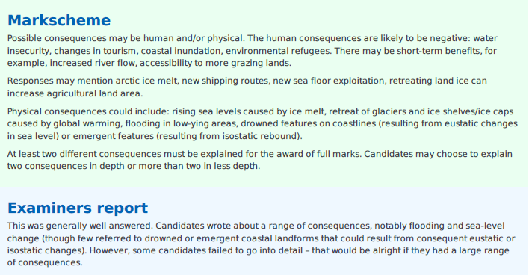
Starter Question
Explain the consequences of a decrease in the amount of water stored in ice in the hydrological cycle at any stage. (6 marks)

Slide 2
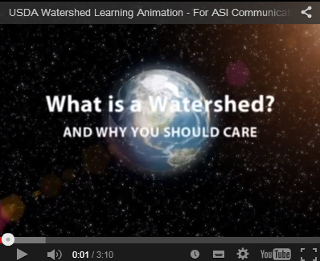
Drainage basins and flooding
Learning objective: To analyse the functioning of a drainage basin as an open system with inputs, outputs, transfers, stores and feedback loops.
Demo: Watch the following Video and makes notes on the following two factor:
i. main functions of a watershed/drainage basin ii. how human action can influence the functioning of the system.
main functions of a watershed/drainage basin
________________________________________________________________________________________________________________________ ii. how human action can influence the functioning of the system.
__________________________________________________________________________________________

Slide 3
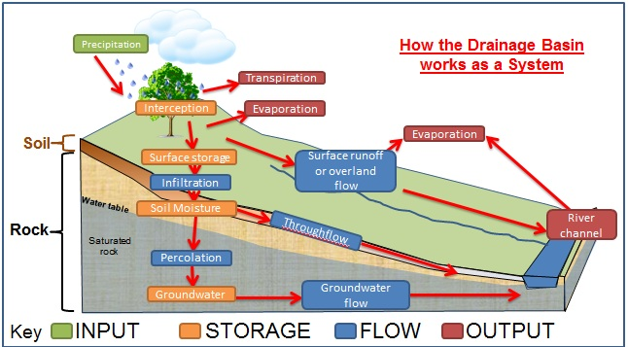
Drainage basins and flooding
Demo: Ensure to place the following words in the correct position.
Precipitation/River Channel/Evaporation/ Soil moisture/ Infiltration/Groundwater/ Groundwater flow / Percolation/Evaporation/ Interception/ Surface Storage/Throughflow/ Surface runoff or overland flow/Transpiration/
Challenge: Ensure to create a key and label Inputs/storages/flows and outputs.

Slide 4
Drainage basins and flooding
Demo: Ensure to place the following words in the correct position.
Precipitation/River Channel/Evaporation/ Soil moisture/ Infiltration/Groundwater/ Groundwater/ Percolation/Evaporation/ Interception/ Surface Storage/Throughflow/ Surface runoff or overland flow/Transpiration/
Exam Question: Explain how a drainage basin functions as an open system.

Slide 5
Feedback Loop
Language for learning: A system is a network of relationships among a group of parts, elements, or components that interact with and influence one another through the exchange of energy, matter, and/or information.
Feedback Loops: A system is always trying to maintain a balance (equilibrium). Feedback loops explain when a system (drainage basin) loses and attempts to regain its balance. Negative feedback attempts to regain the equilibrium by reducing inputs or possibly increasing outputs. Humans can alter feedback loops by changing the amount of water released from dams, changing the amount of water used or even increasing run-off through deforestation.
Non Geographic example
Demo: Write a theory as to what positive feedback loop. Ensure to give a geographical example.

Slide 6
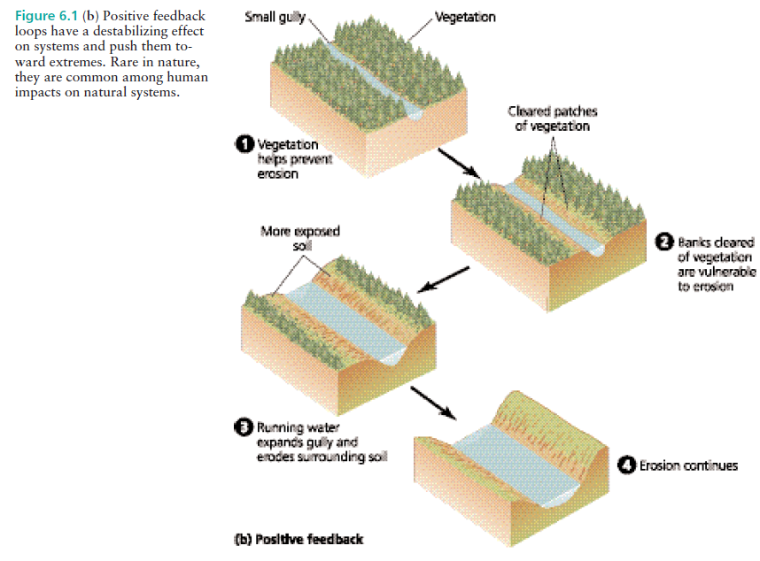
Feedback Loop
Positive feedback loops have the opposite effect. Rather than stabilizing a system, they drive it further toward one extreme or another. This can occur with the process of erosion, the weathering away of soil by water or wind. Once soil has been exposed by removal of vegetation, erosion may become progressively more severe if the forces of water or wind surpass the rate of vegetative regrowth.

Slide 7
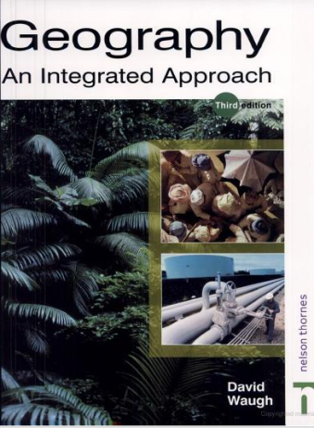
Stream Discharge
Learning Objective: Define stream discharge. Examine its relationship to stream flow and channel shape.
Discharge is the velocity (speed) of the river measured in Metres (m) per second, multiplied by the cross sectional area of the river, measured in metres2. This gives the volume in M3/sec or cumecs.
Demo: a - Outline the role played by friction in the flow of water b - Define the two types of water flow. c - Copy figure 3.15 (laminar flow) into your work book and label appropriately. d - What is the relationship between velocity and turbulence? e - Copy figure 3.15 (turbulent flow) into your work book and label appropriately. f - Outline and sketch the three main influences on river velocity. This will include diagrams 3.16, 3.17, 3.19 & 3.20.

Slide 8
Stream Discharge
Plenary: Check your understanding. Circle the correct of the two terms. Ensure to be able to justify your answer.
•A river in a deep, broad channel, often with a gentle gradient and small bedload, will have a greater/lesser velocity than a river in a shallow, narrow, rock filled channel – even if the gradient of the latter is steeper.
Justification:
__________________________________________________________________________________________________________________________ •The velocity of the river increases/decreases as it nears the sea Justification:
__________________________________________________________________________________________________________________________ •The velocity increases/decreases as the depth, width and discharge of a river all increase. Justification:
__________________________________________________________________________________________________________________________ •As the roughness increases/decreases, so does turbulence and the ability of a river to pick up and transport sediment
Justification:
__________________________________________________________________________________________________________________________

