Slide 1
Rapidly increasing population
Learning objective: Identify reasons for increasing populations.
EXPLAIN the problems of an increasing population.
Starter:
What does this quote mean?
Think back to the last lessons and suggest three reasons why we have ‘stopped dropping like flies’.
‘Rapid population growth has occurred not because human beings suddenly started breeding like rabbits, but because they finally stopped dropping like flies’
Nicholas Eberstadt
7 mins
Challenge:
Suggest one problem with rapid population growth. Explain your answer.

Slide 2
Glossary of Terms(Are they in the correct order?)
Natural Increase | The average number of live births per 1000 people per year.
Death rate | The average number of deaths per 1000 people per year.
Birth rate | The difference between the birth rate and the death rate.
Economically active population | People who are under 15 and over 65 years of age, who are dependent on the economically active population.
Dependent population | The average number of years from birth that a person can expect to live.
Longevity | The property of having a long life, indicated by a long life expectancy
Demography | The study of human populations
Life Expectancy | The total population between the ages of 15 and 64 in any country.

Slide 3
Sharing what we know
Demo:
Choose three of the key words you have just used in the sorting activity
Individually write down a sentence using the key words, you will have to think about what you have already learnt.
Make sure that your partner writes down different sentences using another three key words.

Slide 4
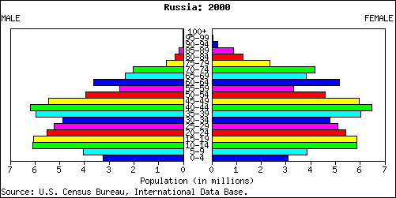
Key Geographical Skill: Population Pyramid (Russia)
Population pyramid: A diagram which shows the population structure of a
country or area, including the number of people (or sometimes the percentages) of different ages and genders. It is also called an age–sex pyramid.
Population structure: The proportions (or numbers) of males and females
in the young, middle and elderly age groups of a population.

Slide 5
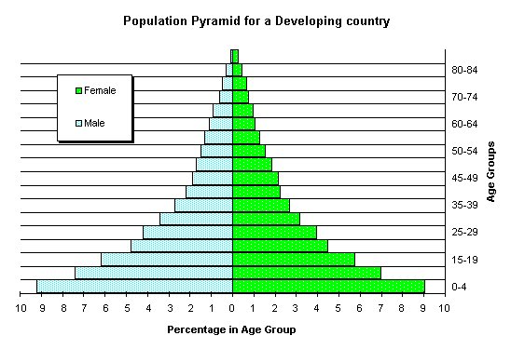
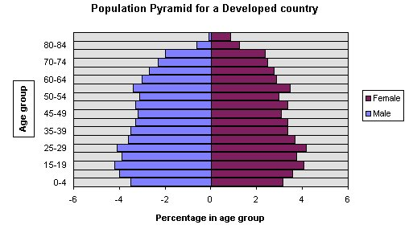
Rapidly growing population
A rapidly growing population is likely to have an annual increase in population of 2%. This is enough to double the population in as little as two years.
LEDC i.e. Kenya
MEDC i.e. UK
Demo: Look at the population pyramids of an LEDC and an MEDC.
Which population is growing rapidly? Use your key terms to DESCRIBE at least three differences in population between an LEDC and an MEDC. Explain the reasons for these differences?
7 mins

Slide 6
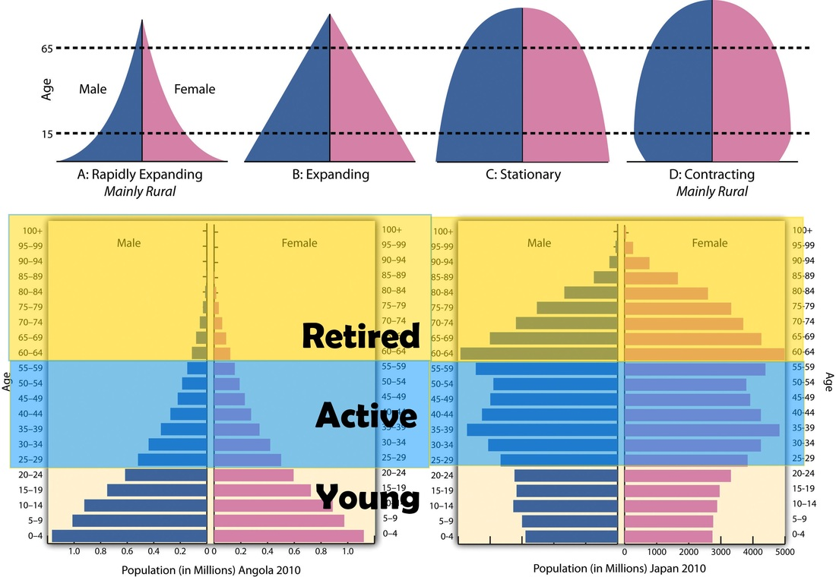
Population Pyramids
Demo Activity
Demo: Ensure to make notes on the different types of pollution pyramids
Notes:
Plenary go to Gapminder and show students population growth over urban population. Track Germany as a nation and students need to describe Germany’s population change over time.

Slide 7
Key Geographical Skill: Population Pyramid (Russia)
Demo: What can you decipher from the Graph. Are Birth Rates high? What is life expectancy like? Who take up the largest percentile of population.

Slide 8
(Check your Answer)Population Pyramid (Russia)
Higher death rates especially among working-age males due to poverty, abuse of alcohol and other substances along with disease and stress. Decline in healthcare also contributed.
Loss of young men and women who emigrate in search of a higher standard of living
No large baby boom post-war unlike many countries after the second world war
High abortion rates amongst young women in particular – fear of poverty, pollution, alcoholism

Slide 9
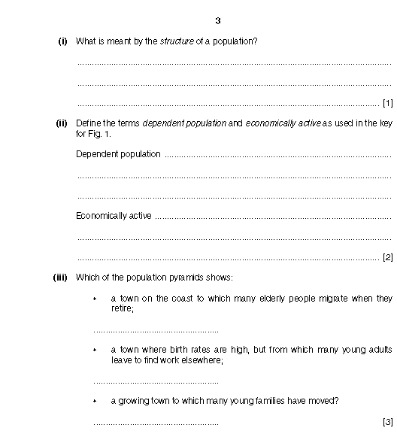
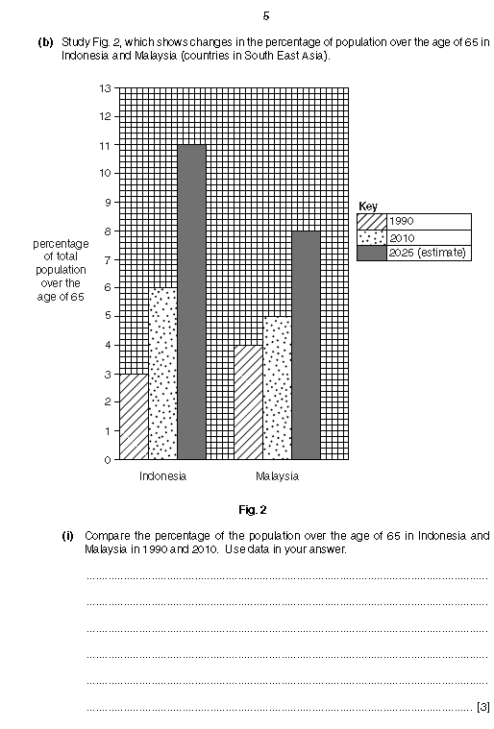
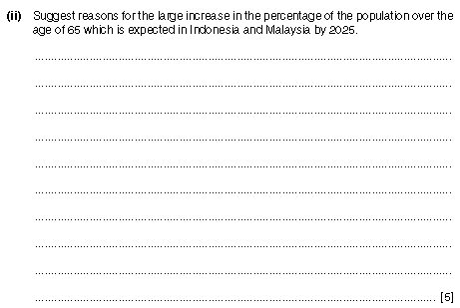
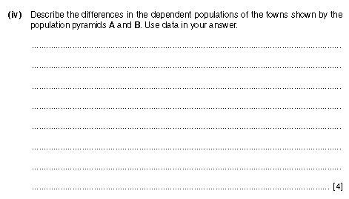
Exam Practice
Demo1: Complete the first 4 Questions. We will then check the answers together.
Demo 1
Demo 2
10 minutes
10 minutes

