Slide 1
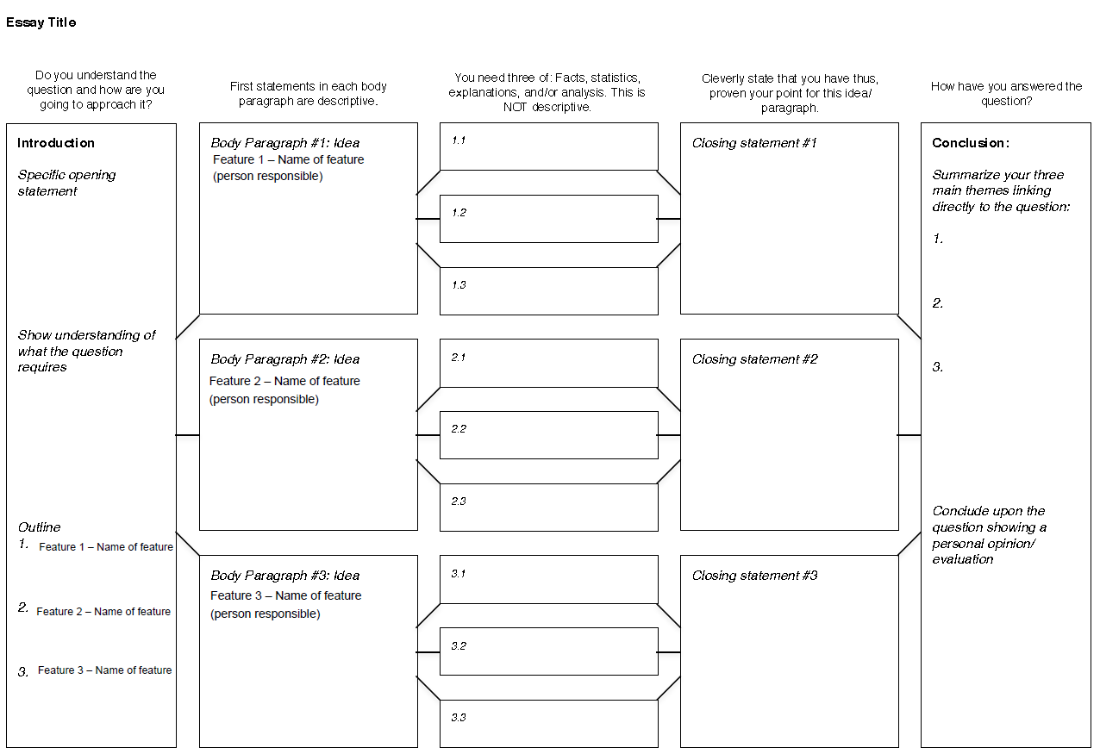
Climate Change
Practice Exam Question: explain the EFFECTS AND SOLUTIONS OF Global climate change. [10]
Starter: Complete the planning sheet with as much detail as possible for the above exam question.
Ensure to:
A01 Define you language
Ao2 explain you ideas

Slide 2
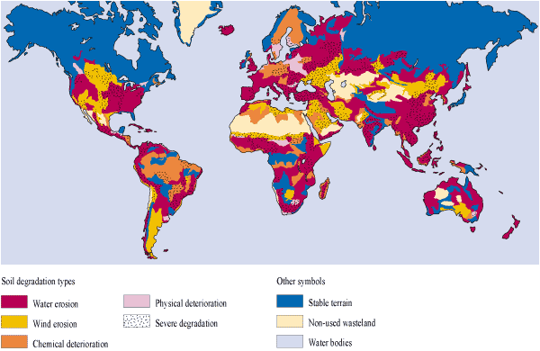
SOIL DEGRADATION
Starter: Describe the distribution of soil degradation.
Key Words
Local
Global
Linear
Random
Concentrated
3
Soil degradation is the decline in soil quality caused by its improper use, usually for agricultural, pastural, industrial or urban purposes. (AO1)

Slide 3
SOIL DEGRADATION
Human Causes
Physical Causes
Demo: Create a t-chart and list all the human and physical causes of soil degradation.
Soil Degradation- the physical loss (erosion) and the reduction in quality of topsoil associated with nutrient decline and contamination.
Human-the branch of geography dealing with how human activity affects or is influenced by the earth's surface.
Physical- the branch of geography dealing with natural features.

Slide 4
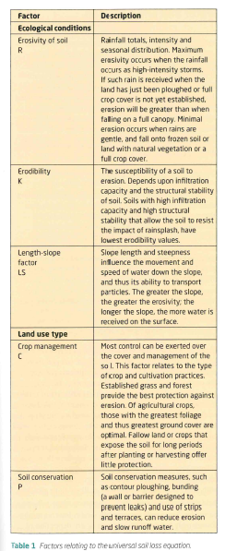
The Universal Soil loss equation
The equation is as follows A= RKLSCP
The Universal Soil loss equation- is an attempt to predict the degree of erosion that will occur in an area on the basis of certain factors which increase susceptibility to erosion.
The Universal Soil loss equation- uses the following factors:
Rainfall patterns
Soil type
Topography
Crop system
Management Practices

Slide 5
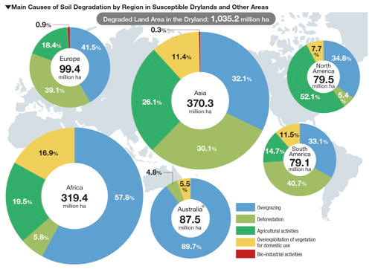
SOIL DEGRADATION
Learning objective - To be able to discuss the environmental and socio-economic consequences of soil degradation.
Examine the main causes of soil degradation globally and discuss to what extent they are human/physical in nature. (5)

Slide 6
Homework
Complete the following Exam question by Mar 18th 2016
“Of all the environmental challenges we face, soil degradation is the most serious.” Discuss this statement.
Complete the Soil Quiz on Edmodo. 7 questions-14minutes
Outline the most serious threats posed to the physical environment and vulnerable populations by soil degradation. (8)

Slide 7
Markscheme
A good response may define the term “soil degradation”, which includes erosion (wind, water), or nutrient depletion, salinization, duricrust growth, loss of soil structure, and others.
There are a number of possible responses as the environmental challenges in the syllabus relate to soil and also to climate change, water, biodiversity and sustainability in general. The focus of the answer should be on assessing the importance of soil degradation, but reference to other issues is needed as well in discussing the statement as it calls for some evaluation. However, a candidate cannot dismiss soil and write an essay on climate change; they must answer the question posed and use their knowledge of soil degradation to explain why it is serious or why it is less serious than other challenges we face.
Responses must develop a substantiated argument that agrees or disagrees with the statement (either by saying other challenges are more important or that soil degradation does not prevent all forms of food production, for example, aquaculture).
Responses demonstrating a thorough knowledge and understanding of soil degradation with specific and accurate case study material and offering some evaluation of the statement will reach levels E and F.
Marks should be allocated according to the markbands.

