Slide 1
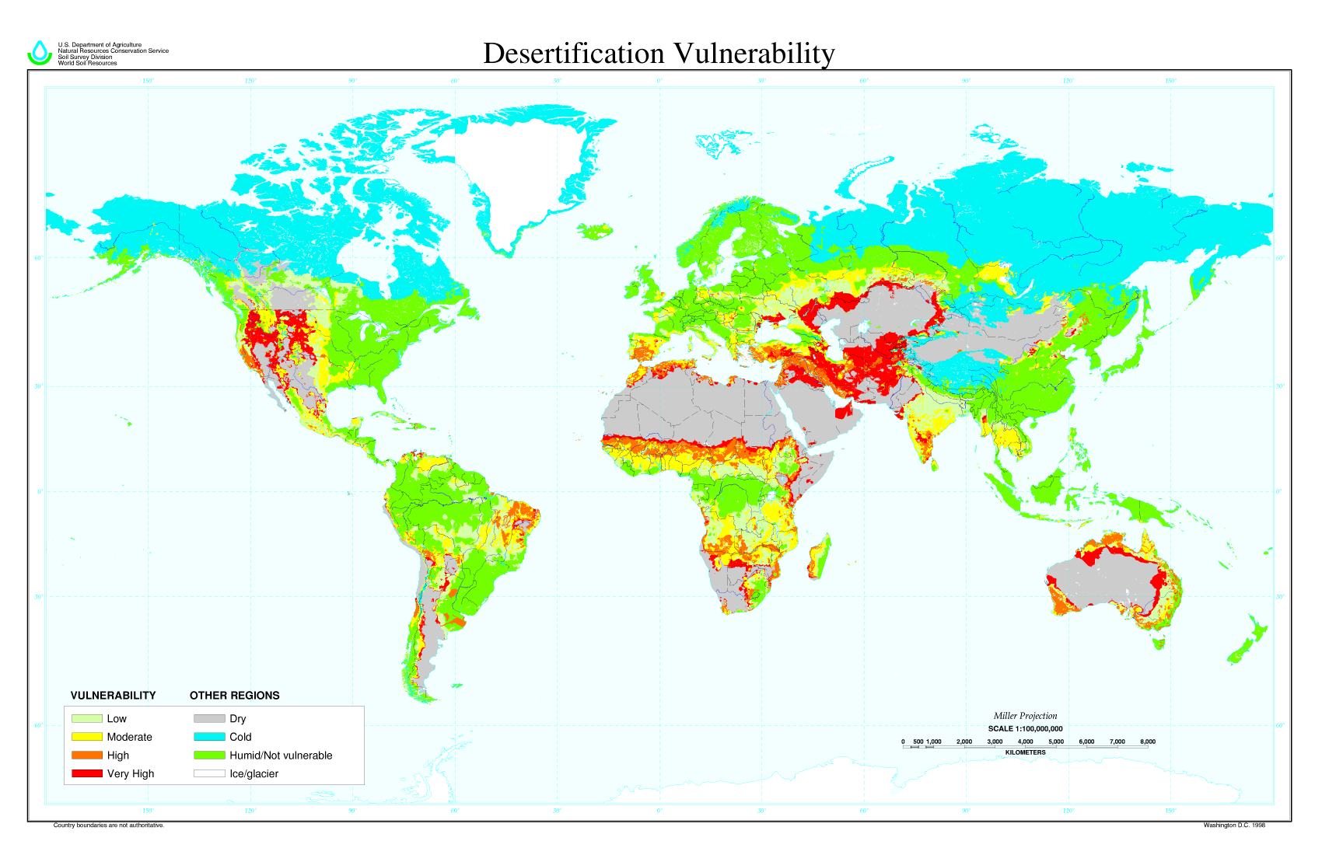
Environmental and socio economic consequences
Starter: Define desertification and define Socio-economic.
Challenge: What is the distribution of Desertification Vulnerability? (5 marks)

Slide 2
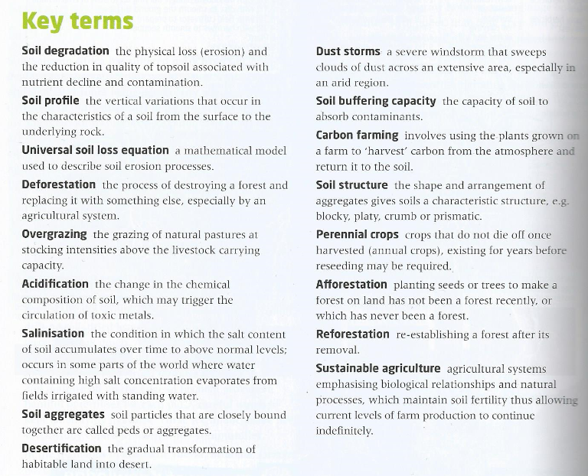
Glossary
Success Criteria
Learning Objective: To be able to discuss soil degradation management strategies.
Learning Outcome:
If you are working at an A grade you will:
Be able to give a range of reasons as to why soil degradation takes place.
Be able to explain what Environmental and socio economic consequences it causes
Through the use of case studies discuss the management what management strategies there are and evaluate their effectiveness.

Slide 3
Making the Links
Demo: On your sheet to make links between Soil degradation and other geographical topics. Think about everything we have studied so far.
Soil degradation
Challenge: How are the following factors linked to soil degradation:
a. Desertification (fertile land turning into desert)
b. Dust storms
c. Soil buffering capacity
c. Topsoil erosion
d. Famine & starvation
e. Conflict

Slide 4
Classification of links
Demo: If we were to put these links into groups what would they be?
Groups:

Slide 5
Mock Exam Practice

Slide 6
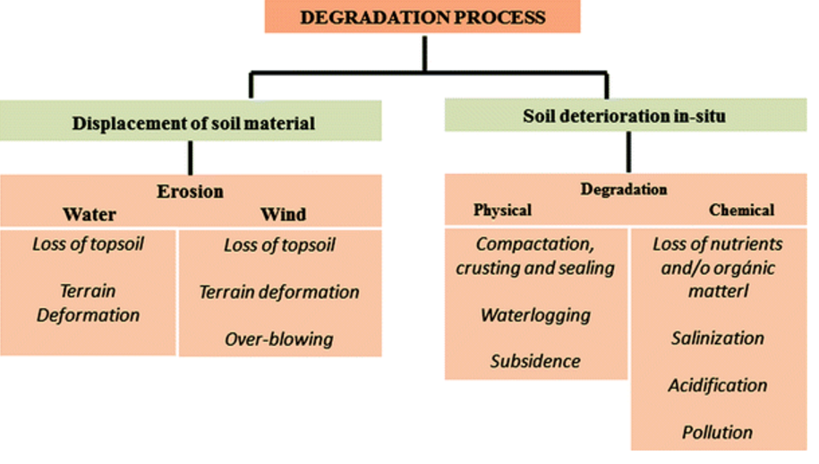
Soil Degradation
Outline the most serious threats posed to the physical environment and vulnerable populations by soil degradation. (8)

Slide 7
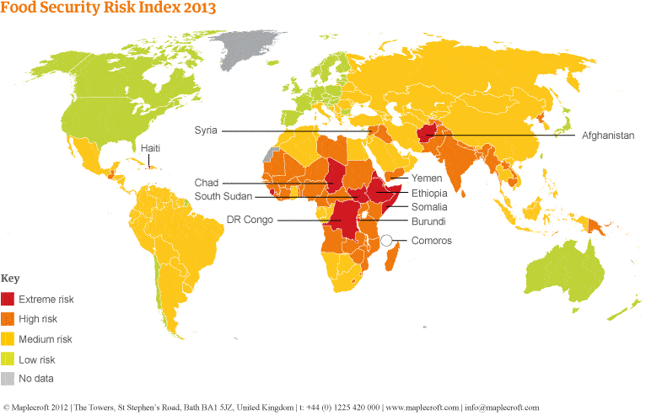
Soil degradation: A threat to Food Security?
Farmland that has been seriously degraded
75% in Central America’s
11% in Asia
20% in Africa

Slide 8
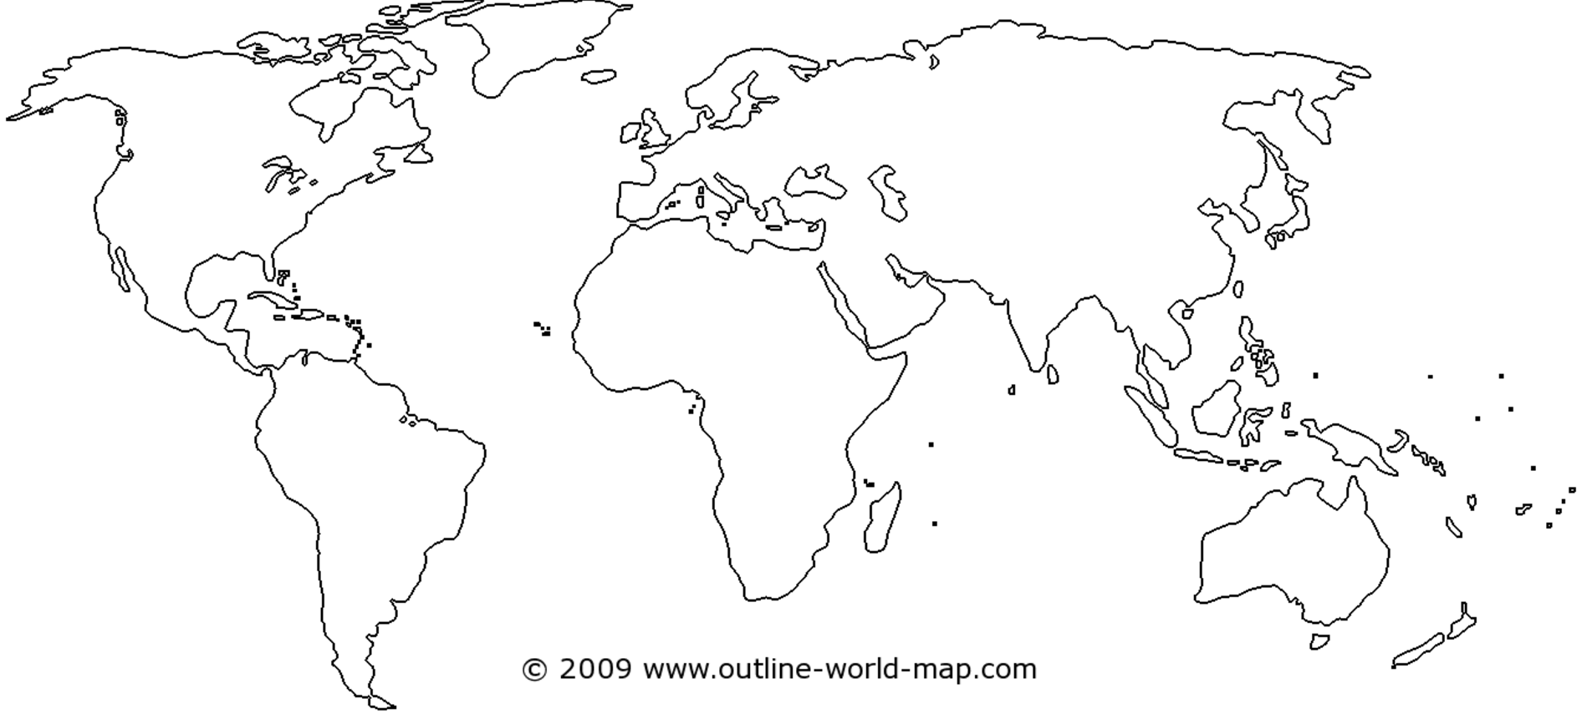
Soil degradation: A threat to Food Security?

Slide 9
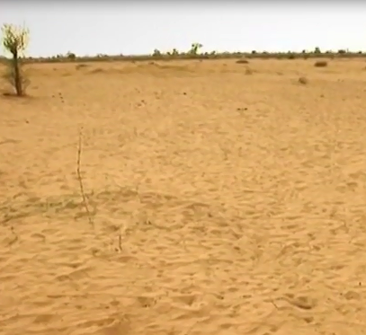
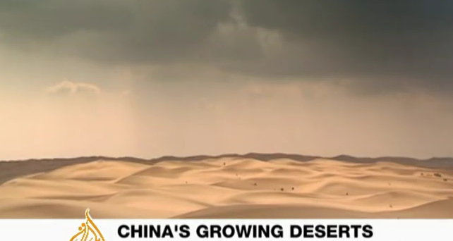
Case study sustainable farming in Sub-Saharan Africa
Demo: We are going to watch the two videos, make notes of the successful strategies in China and Africa.
Challenge: What solutions may there be for both of the highlighted problems?

Slide 10
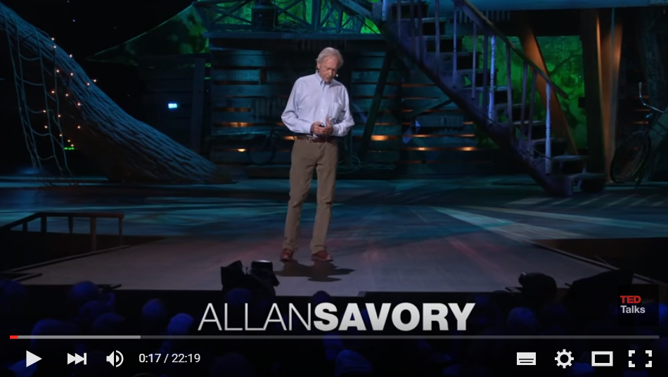
Finding solutions to desertification
Demo: What solutions may there be to minder soil degradation?

Slide 11
Case Studies: Approaching your Case Study
Tip: Ensure to focus on these areas when covering any case study.
A01 Knowledge
Where?
A02 Analysis
When?
How?
A03 Evaluation
Geographical
language
What has changed over time?
Case Study
Can it be managed?
Facts & Figures
Why?
What?

Slide 12
Assessment for learning – End of lesson progress check
Learning objectives:
To be able to discuss soil degradation management strategies.
Please complete the activity below reflecting on your learning so far in today’s lesson:
So far in this lesson, I have learnt:

