Slide 1
Consequences of global climate change

Slide 2
Sea Level Rise
Demo: Is ’Sea Level Rise’ the biggest threat to developing nations and to mankind?
Synthesis: What effect might rising sea levels have on population and/or population density?
Synthesis: What effect might this have on global development?

Slide 3
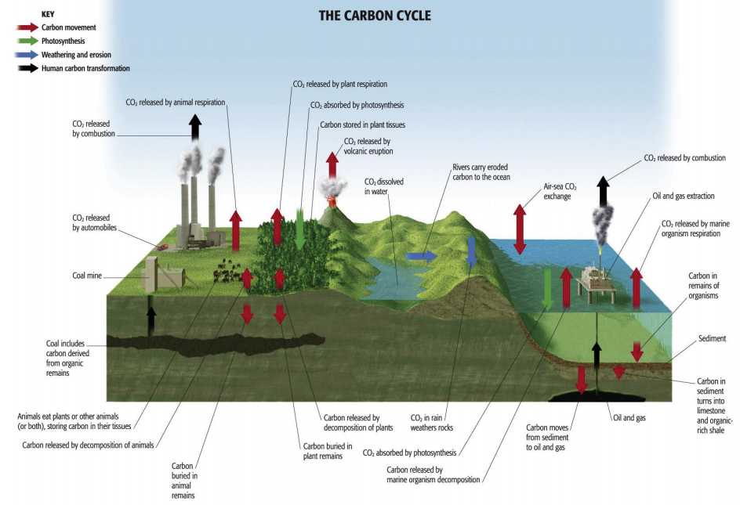
Discussion Point: Why should we care about Carbon?

Slide 4
Carbon
Stored(Arctic)
Demo: What will happen with Arctic warming?
Negative
Positive
Atmosphere
• ~750 Pg globally and ~125 Pg north of 60°N
Ocean
• Cold temperatures in the Arctic increase the efficiency of carbon transfer from the atmosphere to the ocean
• Arctic Ocean is 3% of the Earth’s oceans, but removes 5 to 14% of the Earth’s ocean carbon uptake
Land
• Boreal forest store carbon as plant material
• Sequester about 1.3±0.5 Pg/yr
• Arctic tundra stores carbon as soil carbon
• ~1672 Pg in northern permafrost regions
Making Links
petagram (plural petagrams) A unit of mass equal to 1,000,000,000,000,000 (10¹⁵) grams. Symbol: Pg. Sometimes used in Carbon Dioxide numbers, it is equivalent to Metric Gigatons (Giga) 10⁹ x (Ton) 10³ x (Kg) 10³ = 10¹⁵.

Slide 5
Changes of the Carbon cycle in the Arctic

Slide 6
Arctic warming Feedback Loops
Photosynthesis
Acclimation
Acclimation
Respiration
Nutrient Availability
Diminishing
Decomposition
Length of growing seasons
Drought
Warming- or nutrient prone species
Stress Tolerant Species
Negative Feedback
Neutral
Positive Feedback

Slide 7
Methane
Notes
• Methane produced by decomposition of dead plant material in wet soils (mires and tundra ponds)
• Methane is released to atmosphere when temperature and precipitation are increased
• Methane can be absorbed by forest and tundra soils in very dry conditions
Questions to Consider for Video:
What are Methane Hydrates?
Why might they contribute to future global climate change?
What might they provide for the future?
Methane hydrates: a solid icy form of methane that is trapped in permafrost and at shallow depths in cold ocean sediments
As air and water temperatures increase, the hydrates start to decompose and release methane to the atmosphere
An alternate energy source.

