Slide 1
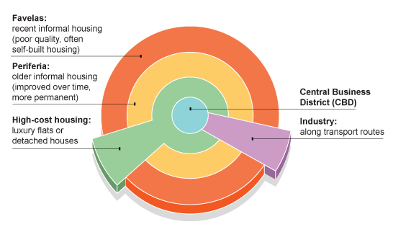
Comparative Case study: Brazil
Learning Objective: To explain how Land use zones, CBD’s, Residential area’s, industrial areas and rural to urban fringe vary in in different economically developed nations.
Demo: Look at the images and describe in the boxes, what you can see and the level of development.
Challenge: To what extent does the model conform to that of an MEDC?
CBD:
Favelas:
MEDC:
MEDC:
Industry:
Periferia:
High-cost housing :
MEDC:
MEDC:
MEDC:

Slide 2
Comparative Case study: Brazil
Learning Objective: To explain how Land use zones, CBD’s, Residential area’s, industrial areas and rural to urban fringe vary in in different economically developed nations.
Demo: Look at the images and describe in the boxes, what you can see and the level of development.
Challenge: How would an MEDC’ settlement differ to that of the LEDC?
CBD:
Favelas:
MEDC:
MEDC:
Industry:
Periferia:
High-cost housing :
MEDC:
MEDC:
MEDC:

Slide 3
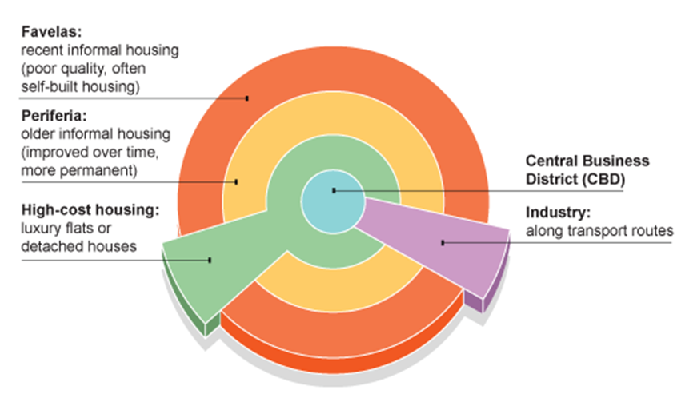
Land use model in LEDC’s
Demo: Look at the answer below, has it answered the question?
Main points to remember:
The rich generally live close to the city centre whereas the very poor are more likely to be found on the periphery.
Better quality land is occupied by the wealthy.
Segregation by wealth, race and ethnicity is evident.
Manufacturing is scattered throughout the city.
Describe the model of Latin American cities.
The CBD has developed around the industry and luxury flats and or detached houses. Industry is located near to the CBD as they are near to transport routes. Older and more improved housing, that has been improved over time is located further out. Finally the Favelas can be found on the very outskirts of the CBD. These are made up of recent informal housing.

Slide 4
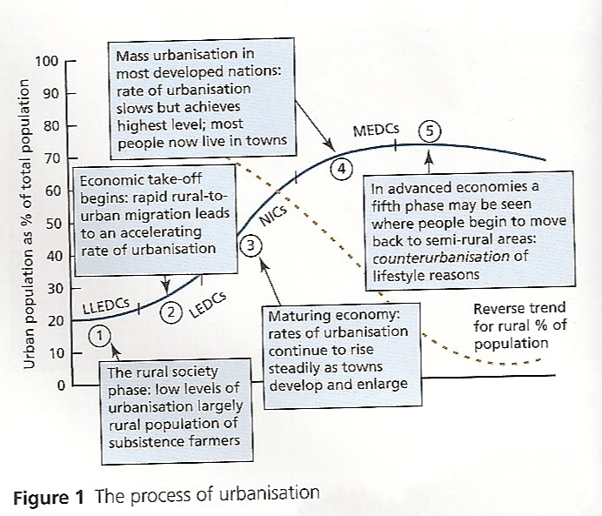
Urbanisation
Demo: Describe the process of urbanisation.
Language for learning: Urbanisation- is an increase in the percentage of a population living in urban areas.
Plenary
Key Learning Questions
What is Urbanisation?
What are the reasons for rapid urban growth?
What are the impacts of urban growth on both urban and rural areas?
What are the strategies to reduce the negative impacts of urban growth?

Slide 5
Megacities
Language for learning: What is a megacity?
A megacity is a city with a population of more than 8 million people
Switzerland and Austria both have populations of around 8 million
In 2010, there were about 25 cities falling into the megacity category
In the late 90s, the 8 million definition became common.
Changing definitions:
In the 80s ‘megacity’ referred to cities of over 5 million people.
Today 10 million is often used.
This change reflects the rapid urbanisation of the planet.
What was ‘big’ in 1980 does not seem very big at all today.
Both 8 and 10 are acceptable definitions in your exams.
Challenge: Turn to page 63 and create a table like below and ensure to add the examples.
1950 | 1975 | 2000 | 2015
1Example | 2 Examples | 3 Examples | 4 Examples

