Slide 1
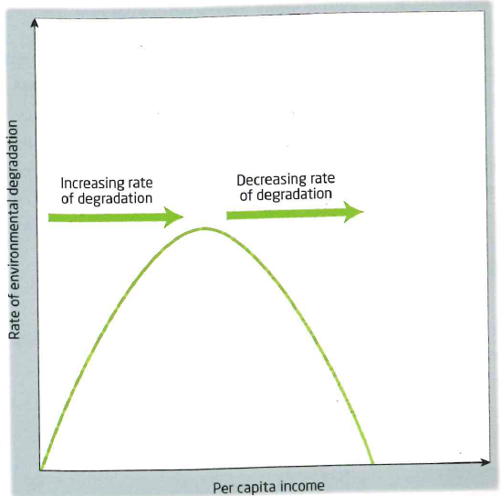
Kuznets Curve
Demo: The graph can be broken down into three stages. What are these stages?
Describe each stage.
The Kuznets curve
The Kuznets curve is a graph representing Simon Kuznets (economist) theory. It was originally developed to show how inequality in a country changes over time.
Writing Frame:
Stage 1
Stage 2
Stage 3
Early stages of industrialisation the focus is on economic development with little concern for the environment. Pollution increases rapidly
After a certain standard of living is reached and pollution is at its highest, attitudes to pollution change and there is now a general desire to tackle the problem.
With increasing environmental investment, pollution levels fall.

Slide 2
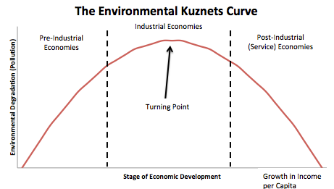
Kuznets Curve
Demo: What links can be made with the rest of the course/ topic areas/ other theories?

Slide 3
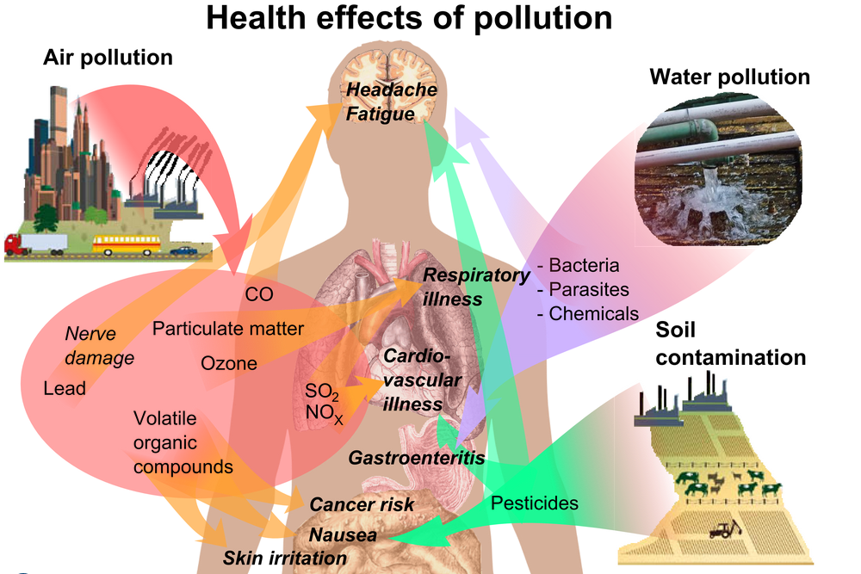
Health Effects
Demo: What health effects might there be as of pollution.

Slide 4
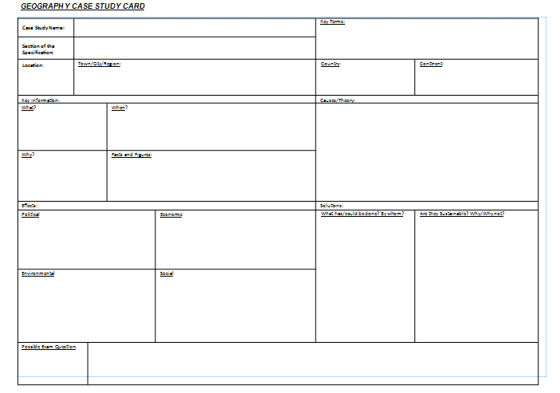
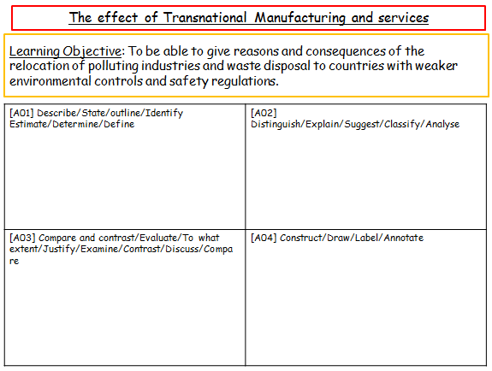
Polluting industries are relocated, away from developed nations, for purely financial reason's Discuss this statement [15 marks]
Case Study China
Plenary: Use the Video and your information sheets to fill in your Case study sheet.
Finished Complete your Evaluation of learning sheet
Possible Exam Question

Slide 5
Case Study China
Learning Objective: To be able to give reasons and consequences of the relocation of polluting industries and waste disposal to countries with weaker environmental controls and safety regulations.
[A01] Describe/State/outline/Identify Estimate/Determine/Define | [A02] Distinguish/Explain/Suggest/Classify/Analyse
[A03] Compare and contrast/Evaluate/To what extent/Justify/Examine/Contrast/Discuss/Compare | [A04] Construct/Draw/Label/Annotate

Slide 6
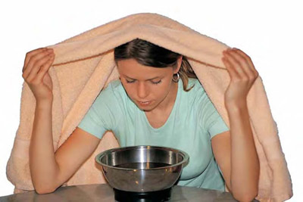
TRANSNATIONAL POLLUTION EVENT
Learning Objective: To describe significant major pollution event, affecting more than one country and analyse the consequences of and responses to this event.
Demo: Define Pollution. [2 marks]
Pollution
Challenge: What are the three methods exposed to pollutants?
Inhalation
Ingestion
Incidental Pollution a one-off pollution incident
Sustained pollution- pollution that occurs over a significant period of time.
Absorption

