Slide 1
Key Questions
How can the level of economic development of a country be measured?
What are the reasons for inequalities between and within countries?
How can economic production be classified into different sectors?
How do the proportions employed in each sector of an economy vary according to the level of development?
What is globalisation?
How important are technology, transnational corporations and other economic factors in the process of globalisation?
What are the impacts of globalisation at local, national and global scale?

Slide 2
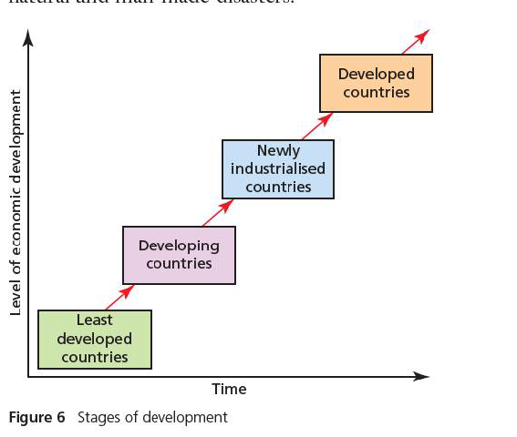
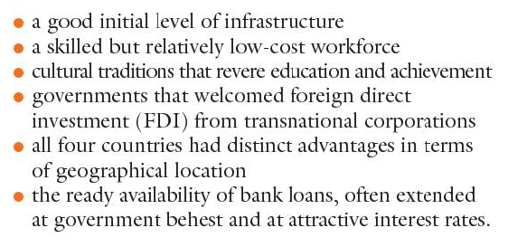
Explaining inequalities between countries
Starter: What characteristics does each stage of development have?
Characteristics
Draw Me!!!
Challenge: What explanations are there for the development gap?

Slide 3
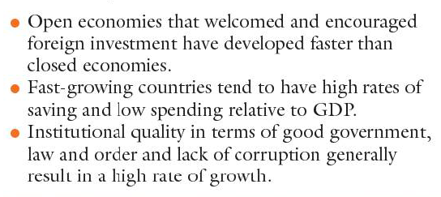
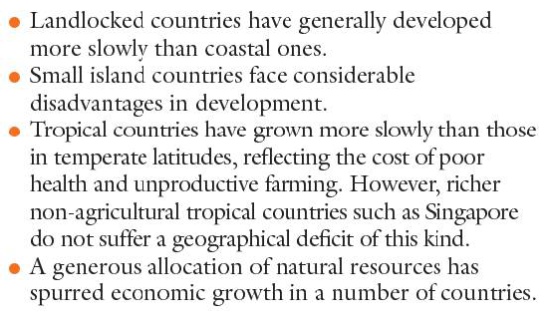
Explaining the development gap
Human Factors
Physical Factors
Demo: What factors might there be for variations in the development gap?

Slide 4
Consequences of the development Gap.
Demo: What is the DEVELOPMENT GAP and what consequences might there be?

Slide 5
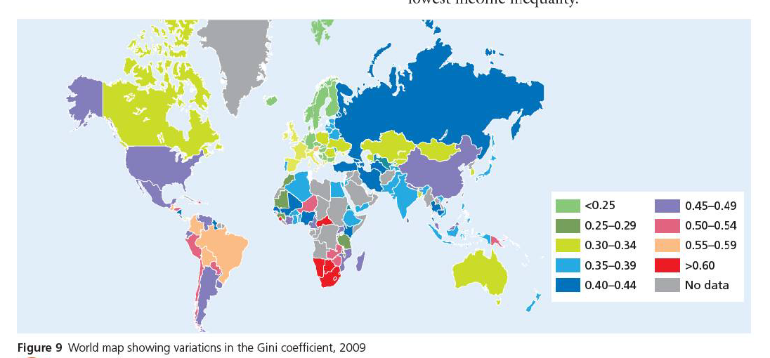
What is the Gini Coefficient?
The Gini Coefficient is a technique inequality used to show the extent of income inequalities. It allows for the analysis of changes in income over time in individual countries and comparison between countries.

Slide 6
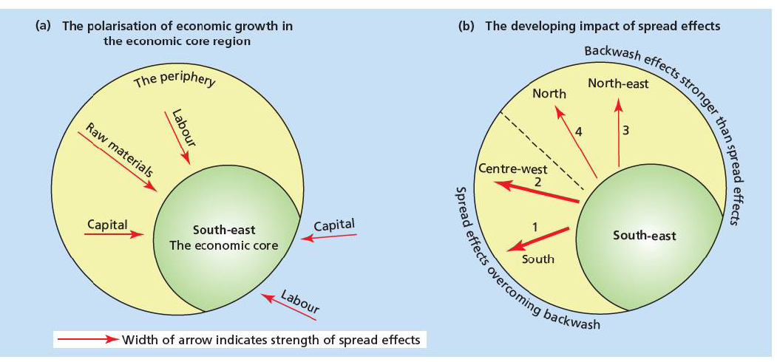
Core vs Periphery

Slide 7
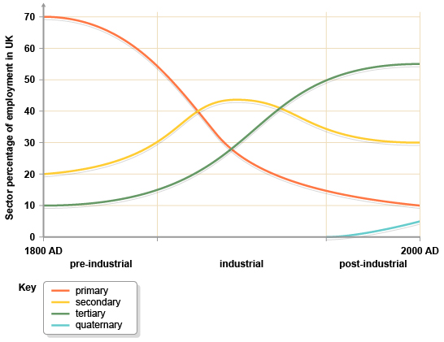
Sectors of Industry
Primary production: this involves acquiring raw materials. For example, metals and coal have to be mined, oil drilled from the ground, rubber tapped from trees, foodstuffs farmed and fish trawled. This is sometimes known as extractive production.
Secondary production: this is the manufacturing and assembly process. It involves converting raw materials into components, for example, making plastics from oil. It also involves assembling the product, e.g. building houses, bridges and roads.
Tertiary production: this refers to the commercial services that support the production and distribution process, e.g. insurance, transport, advertising, warehousing and other services such as teaching and health care
.

Slide 8
Starter sheet: Development Indicators
Name:_____________________ Date:___________
GDP per capita
Starter Sheet:
Using the development indicators opposite, match the fill in the gap by matching the development indicator to the definition.
In the box next to the indicator, draw an arrow showing whether it would increase or decrease as a country develops.
Adult literacy rate
People per doctor
Life expectancy
________________________ The % of people who own a car.
________________________ The % of people over 15 who can read and write.
________________________ The average amount of money a country earns per person.
________________________ The number of people for each doctor.
________________________ The number of children (under the age of 1) who die per 1000 babies born.
________________________ The % of people with a well or tap close to their home.
________________________ The average age that people can expect to live to.
________________________ The % of people living in towns and cities.
Population with access to safe water
Infant mortality
Car ownership
Urban population
Challenge: Which 3 indicators do you think are most important? Write a paragraph explaining why for each.
…………………………………………………………………………………………………………………………
…………………………………………………………………………………………………………………………
……………………………………………………………………………………………………………………......

