Slide 1
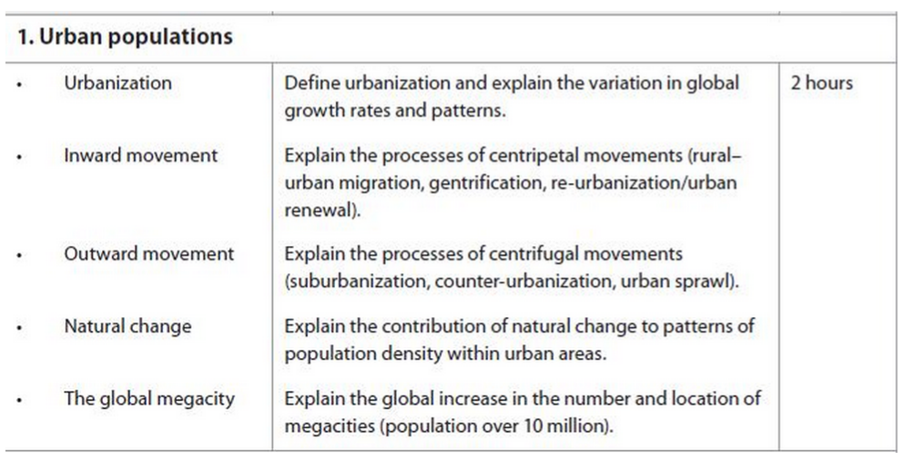
Self Evaluation
Can I?
Yes
No

Slide 2
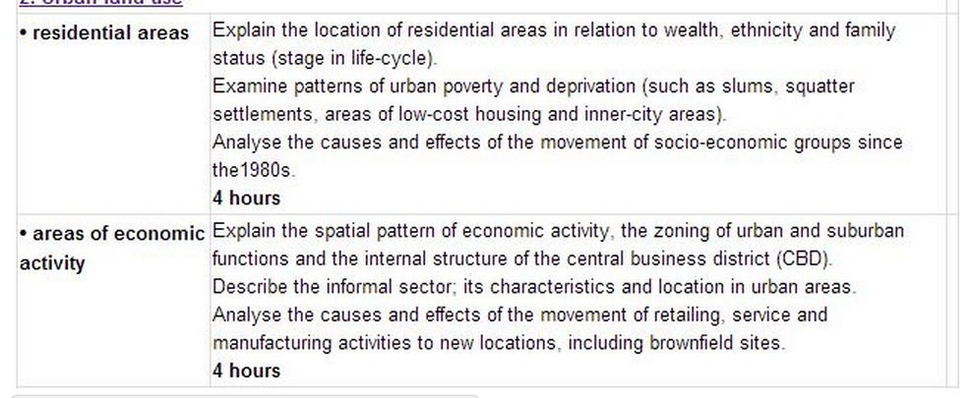
Urban Environments

Slide 3
Urban Residential Relocation Model: Types of Movement
Demo: Which urban movements are represented by these arrows A-D? Draw this diagram, and label the different land-use zones of this urban model. Make a note of WHO might be making these centripetal and centrifugal movements.
D
B
C
D
A
Markscheme:
A-Re Urbanisation/Gentrification
B-Counter urbanisation
C-Urbanisation
D-Suburbanisation
B

Slide 4
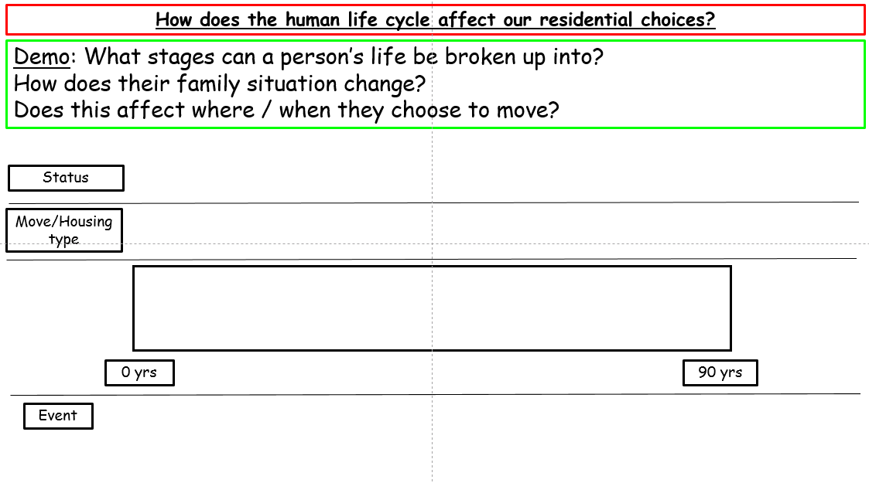
Urban Environments
Learning Objectives: Explain the location of residential areas in relation to wealth, ethnicity and family status (stage in life cycle).
Starter 1:Define residential Area. (2)
Markscheme: Residential Areas can be defined as a part of a town consists of private houses, with no offices or factories.
Starter 2: Complete your Starter Sheet.

Slide 5
How does the human life cycle affect our residential choices?
Demo: What stages can a person’s life be broken up into?
How does their family situation change?
Does this affect where / when they choose to move?
Status
Move/Housing type
0 yrs
90 yrs
Event

Slide 6
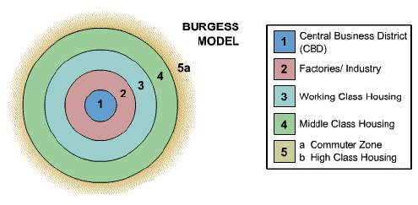
Burgess Model
Concentric Zones of land-use. Based on Chicago in 1950’S.
Challenge: What are the strengths and limitations of this model?

Slide 7
Burgess Model Evaluation……
Demo: Evaluate Burgess Model
For: | Against:
If taken as a very broad pattern, then a large number of towns and cities follow the pattern identified by Burgess. | It does not take any physical features into account. Burgess' own case study - Chicago - does not follow the pattern because it is on the coast! The growth of any city will be influenced by the physical geography of the area.
It is a good model because it is simple and easy to understand. Hopefully! | Transport is much more readily available allowing more people to commute. This has meant that commuter villages have developed some distance from the edge of the urban area. Burgess could not have foreseen this.
Burgess could not have foreseen the changes in transport routes or society yet his model is still relevant when identifying the reasons behind the urban morphology of a city. | Urban regeneration and gentrification has meant that some of the most expensive property can now be found in traditional 'low class' areas. Whilst council estates have built up on the edges of many large cities - these are now some of the most depressed areas in British cities.
It helps us to understand the process involved in the growth of a city. | The decentralisation of shops, manufacturing industry and entertainment does not follow his model.

Slide 8
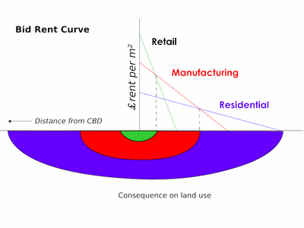
Von Thunen’s Bid-Rent Model
Rent – a profit resulting from some advantage such as capitalization and accessibility. The highest rent is for retail because it is the closest to accessibility.
Rent gradient – a representation of the decline in rent in distance from the center.

Slide 9
Von Thunen’s assumptions…
1. The city is located centrally within an "Isolated State" which is self sufficient and has no external influences.
2. The Isolated State is surrounded by an unoccupied wilderness.
3. The land of the State is completely flat and has no rivers or mountains to interrupt the terrain.
4. The soil quality and climate are consistent throughout the State.
5. Farmers in the Isolated State transport their own goods to market via oxcart, across land, directly to the central city. Therefore, there are no roads.
6. Farmers act to maximize profits.

Slide 10
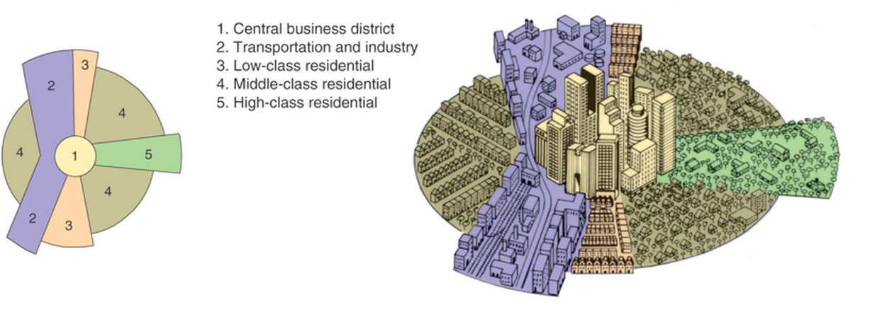
The Hoyt Model
The Hoyt model has land use concentrated in wedges or sectors radiating out from the city centre. For example, factories may be concentrated along a river, canal or road to form a zone of industry. This would attract low-class housing, but repel high-class residential land use.

Slide 11
The Hoyt Model 1939
There are three explanations for these land use patterns.
1 Historical
The urban area expanded outwards from the original site which is where the city centre is found today.
2 Economic
Rents and rates in the CBD became too expensive for people. In the suburbs there was more land and it was cheaper. Only businesses could afford to stay in the CBD, but even they needed to make the most of expensive land by building upwards.
3 Concentrations of similar land uses
One part of the urban area may have all the advantages for industrial location so that a lot of factories want to locate there; but few people want to live next door to a factory, so the residential areas are located elsewhere. Planners also prefer this segregation of land uses into definite zones.
Both the Burgess and Hoyt models can be applied to the land use patterns of Barcelona as shown in the simplified land use model below:

Slide 12
Hoyt Model Evaluation……
Demo: Evaluate Hoyt’s Model (1939)
For: | Against:
Some cities seem to follow Hoyt's sectors. Bristol, for example, has a very clear industrial sector following a main rail line and the River Avon. | Like Burgess' there is little reference to the physical environment.
It provides us with an alternative set of explanations to Burgess. | The growth of sector can be stopped as land-use leapfrogs out of the old inner city. For example, out of town council estates have prevented large high-class sector developing in other areas of Bristol.
Communication routes (Rivers, roads, railways) do often provide a very definite boundary to a sector/land-use. | Again, like Burgess, there is no reference to out of town developments.
In addition, the division between land-uses in both models is far to clear-cut. Firstly, you would not suddenly walk from lower to middle to higher class housing. Also, all zones will have a mixture of land-uses. Residential zones will have shops and industry in amongst them.
They do, however, give us a bench mark for comparison and allow us to have a basic understanding of the complex set of processes that determine the distribution of land-use within a city.

Slide 13
Vance’s Urban Realms Model (1964)
1. The terrain – mountains and rivers and other barriers will help to determine the extent and shape of a region.
2. The size of the metropolis – a larger metropolis may have more and larger realms.
3. The amount of economic activity within each realm – a determinant of the area it can serve and hence its
size.
4. The transport infrastructure available within each realm – an easily accessible economic core increases the area of influence and thus size of each realm.
5. Transport infrastructure between realms – e.g. circumferential links (such as freeways) and airports such that people no longer have to travel to the CBD and its central realm in order to travel to other realms and to other metropoli. If a realm can become more important in this manner then it may increase in importance. E.g. West Los Angeles is within easy reach of the LAX airport (along the freeway) but to travel by train residents have to travel to the CBD (by bus or car).

Slide 14
Urban Residential Relocation Model: Types of Movement
Notes:
__________________________________________________________________________________________________________________________________________________________________________________________________________________________________________________________________________________________________________________________________________________________________________________________________________________________________________________________________________________________________________________________________________________________________________________________________________________________________________________________________________________________
D
B
C
D
A
B

Slide 15
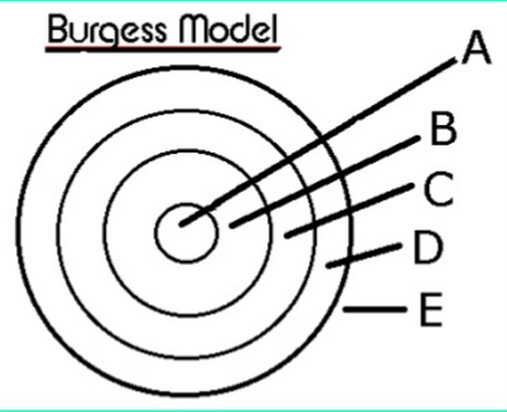
Burgess Model
Notes:
__________________________________________________________________________________________________________________________________________________________________________________________________________________________________________________________________________________________________________________________________________________________________________________________________________________________________________________________________________________________________________________________________________________________________________________________________________________________________________________________________________________________

Slide 16
Von Thunen’s Bid-Rent Model
Notes:
__________________________________________________________________________________________________________________________________________________________________________________________________________________________________________________________________________________________________________________________________________________________________________________________________________________________________________________________________________________________________________________________________________________________________________________________________________________________________________________________________________________________

Slide 17
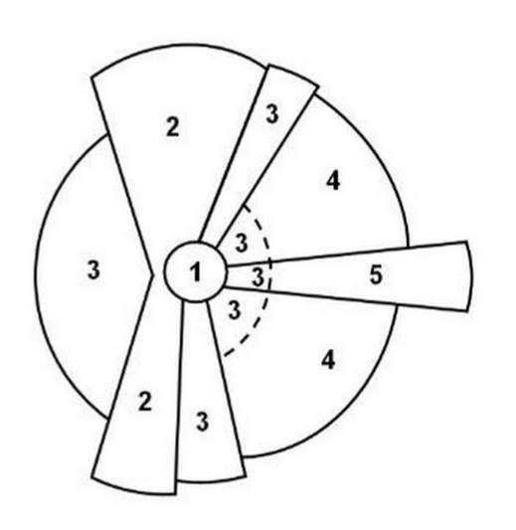
Hoyt Model
Notes:
__________________________________________________________________________________________________________________________________________________________________________________________________________________________________________________________________________________________________________________________________________________________________________________________________________________________________________________________________________________________________________________________________________________________________________________________________________________________________________________________________________________________

Slide 18
Vance Urban Realms Model
Notes:
__________________________________________________________________________________________________________________________________________________________________________________________________________________________________________________________________________________________________________________________________________________________________________________________________________________________________________________________________________________________________________________________________________________________________________________________________________________________________________________________________________________________

