Slide 1
Ib Freshwater
2. Drainage basins and flooding
Sub-topic | Development | Teaching hours | Reflection/Notes
Drainage basins | Examine the functioning of a drainage basin as an open system with inputs, outputs, transfers, stores and feedback loops. | 2 hours
Discharge | Define stream discharge. Examine its relationship to stream flow and channel shape. | 1 hour
Hydrographs | Describe the characteristics of a hydrograph. Examine the reasons for spatial and temporal (short term and long term) variations in hydrographs. Examine the role of hydrographs in forecasting the magnitude, spatial extent and timing of floods. | 3 hours
Floods | Discuss the natural and human causes and consequences of a specific river flood. | 3 hours

Slide 2
Flood Hydrograph
Demo: Using the Data below draw your own hydrograph.
TIME
12.00 | 12.30 | 13.00 | 13.30 | 14.00 | 14.30 | 15.00 | 15.30 | 16.00 | 16.30 | 17.00 | 17.30 | 18.00 | 18.30 | 19.00 | 19.30 | 20.00
0 | 4 | 3 | 10 | 4 | 6 | 13 | 15 | 9 | 3 | 0 | 0 | 0 | 0 | 0 | 0 | 0
1 | 1 | 2 | 2 | 6 | 10 | 20 | 50 | 52 | 55 | 90 | 98 | 100 | 90 | 55 | 22 | 10
PRECIPITATION
DISCHARGE
Discharge as a line graph
3
2
mm
Discharge (m³/s)
4
1
3
2
Rainfall shown in mm, as a bar graph
Challenge: Work out the lag time of your hydrograph.
0 12 24 36 48 60 72
Hours from start of rain storm
Notes:
Need graph paper for this
2

Slide 3
Interpretation of Storm Hydrographs
Demo: What does your hydrograph tell us about the river?
You need to refer to:
Lag time
Peak flow
Rising Limb
3
Rising limb
Falling Limb
Overland flow
Recession limb
Discharge (m³/s)
2
Lag time
mm
4
1
3
Rainfall Intensity
Base flow
2
Peak flow compared to Base flow
0 12 24 36 48 60 72
Recovery rate, back to Base flow
Hours from start of rain storm

Slide 4
What do you know about drainage basins?
Plenary: Get into two teams and lets check you understanding.

Slide 5
Past Exam Questions
[a]Draw a labelled diagram of a hydrograph. [4]
[b]Explain how hydrographs are used to forecast floods. [6]
[a]The hydrograph must include:
Labelled axes showing time and discharge [1 mark]
Line graph showing discharge [1 mark].
Any additional features or labels are worth 1 mark each, up to a maximum of 2 marks:
Labelled rainfall
Peak discharge
Base flow
Lag time
Rising or falling limb.
[b]There are many ways in which hydrographs are useful in forecasting floods. Answers could mention prediction of flood height and arrival time downstream using a study of lag times and stream response records. Hydrographs are also used to predict the return period of floods of different sizes through the use of hydrograph records over a long period of time. They may also be used to predict the extent of flooding and how long it will last.
At least two of these should be explained to gain 6 marks.
A strong account of one may compensate for a weaker account of another.

Slide 6
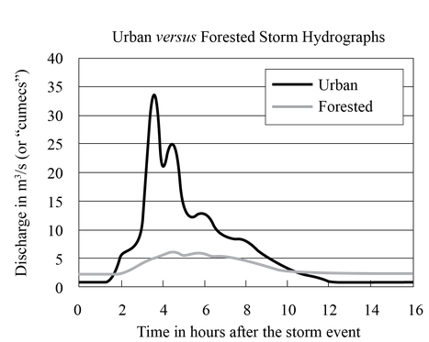
Past Exam Questions
[a]Describe four differences between the two hydrographs shown on the diagram. [4]
[b]Suggest reasons why the urban and forested hydrographs show different responses to the storm event. [6]
The diagram shows the response of a stream in an urban area compared with that of a stream in a neighbouring forested area after the same rainstorm event. (The basins are of similar size and drainage density.)

Slide 7
Past Exam Questions
[a]Describe four differences between the two hydrographs shown on the diagram. [4]
[b]Suggest reasons why the urban and forested hydrographs show different responses to the storm event. [6]
[a]Differences could include:
higher peak discharge in the urban area
shorter lag time in the urban area
steeper rising limb in the urban area
the longer peak discharge in the forested area
there may be other features e.g. differences in base flow, urban hydrograph has two peaks.
Award [1 mark] for each valid difference. For full marks there should be some quantification.
[b]Answers should refer to the reasons for the rapid response in the urban area due to lack of interception, impermeable surfaces (roads, roofs, paving), thereby reducing infiltration, and the presence of artificial and rapid drainage channels (drains, sewers, flood channels), explaining the rapid rising limb, high peak discharge and rapid falling limb on account of overland flow/runoff.
The slower and lower response in the forested area could be explained by higher interception, the retention of water by litter, absorption by root systems, high soil and bedrock permeability.
Award [1 mark] for each valid reason suggested and award additional marks for depth of explanation (of the operation of factors and associated processes).

Slide 8
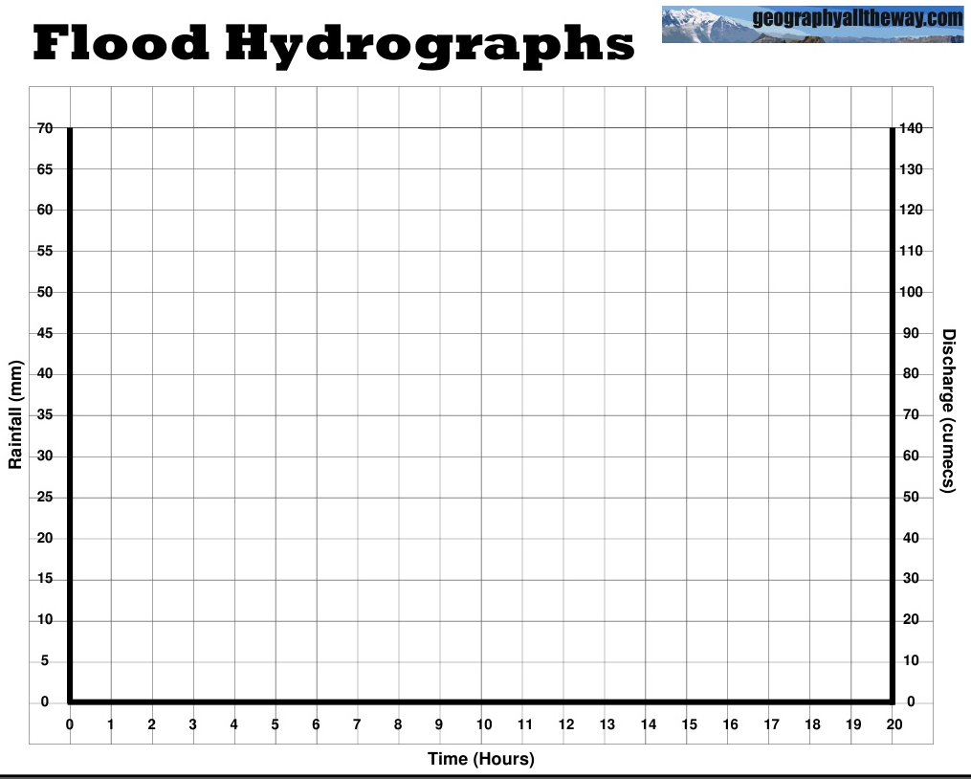
Flood Hydrographs

Slide 9
