Slide 1
3. Management issues and strategies
Sub-topic | Development | Teaching hours | Reflection/Notes
Dams and reservoirs | Examine the hydrological changes resulting from the construction of dams and reservoirs. Examine the costs and benefits of dams and reservoirs as part of multi-purpose schemes. | 2 hours
Floodplain management | Explain the stream channel processes (erosion, transport, deposition) and explain the resultant landforms found on floodplains. Examine the human modifications of a floodplain and their effect on the size and probability of floods. Evaluate the costs and benefits of alternative stream management strategies. | 3 hours
Ground water management | Explain the functioning and management of artesian basins and aquifers, distinguishing between natural and artificial recharge. Examine the environmental impacts of groundwater abstraction. | 2 hours
Freshwater wetland management | Describe the role of wetlands as a water resource. Evaluate the effectiveness of the management strategies that have been adopted in a major wetland. | 2 hours
Irrigation and agriculture | Examine the environmental impact of agriculture and irrigation on water quality: salinization, agro-chemical runoff, the pollution of groundwater and the eutrophication of lakes, rivers and wetlands. | 3 hours

Slide 2
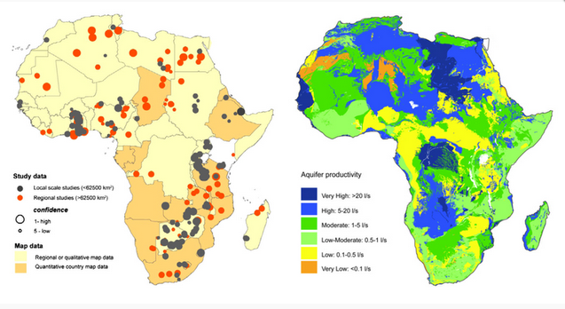
GROUNDWATER ABSTRACTION
Learning Objective: Examine the environmental impacts of groundwater abstraction.
A01 Defining Language:
Water extraction, water abstraction, or groundwater extraction is the process of taking water from any source, either temporarily or permanently. This water can be used for irrigation, industry, recreation, flood control or treatment to produce drinking water.
Starter: Describe the map. [4marks]

Slide 3
GROUNDWATER ABSTRACTION(Source work)

Slide 4
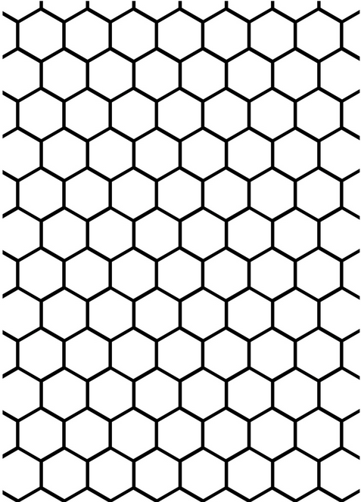
The Possibilities
Demo: Use your honeycomb to find the links between groundwater abstraction and the possibilities, changes and impacts it could have for the continent of Africa.
Impacts
Social
Environmental
Economic
Political

Slide 5
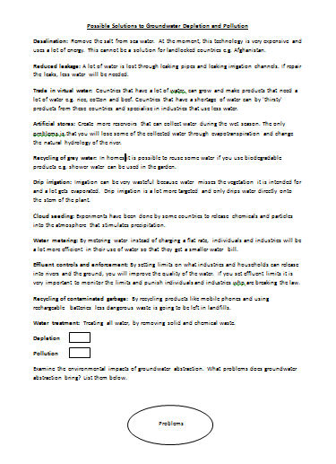
Solutions and problems
Learning Objective: Examine the environmental impacts of groundwater abstraction.
Demo: On your worksheet highlight the possible solutions for depletion and pollution.
Depletion
Solution
Challenge: Examine the environmental impacts of groundwater abstraction. What problems does groundwater abstraction bring? List them below.
Problem

Slide 6
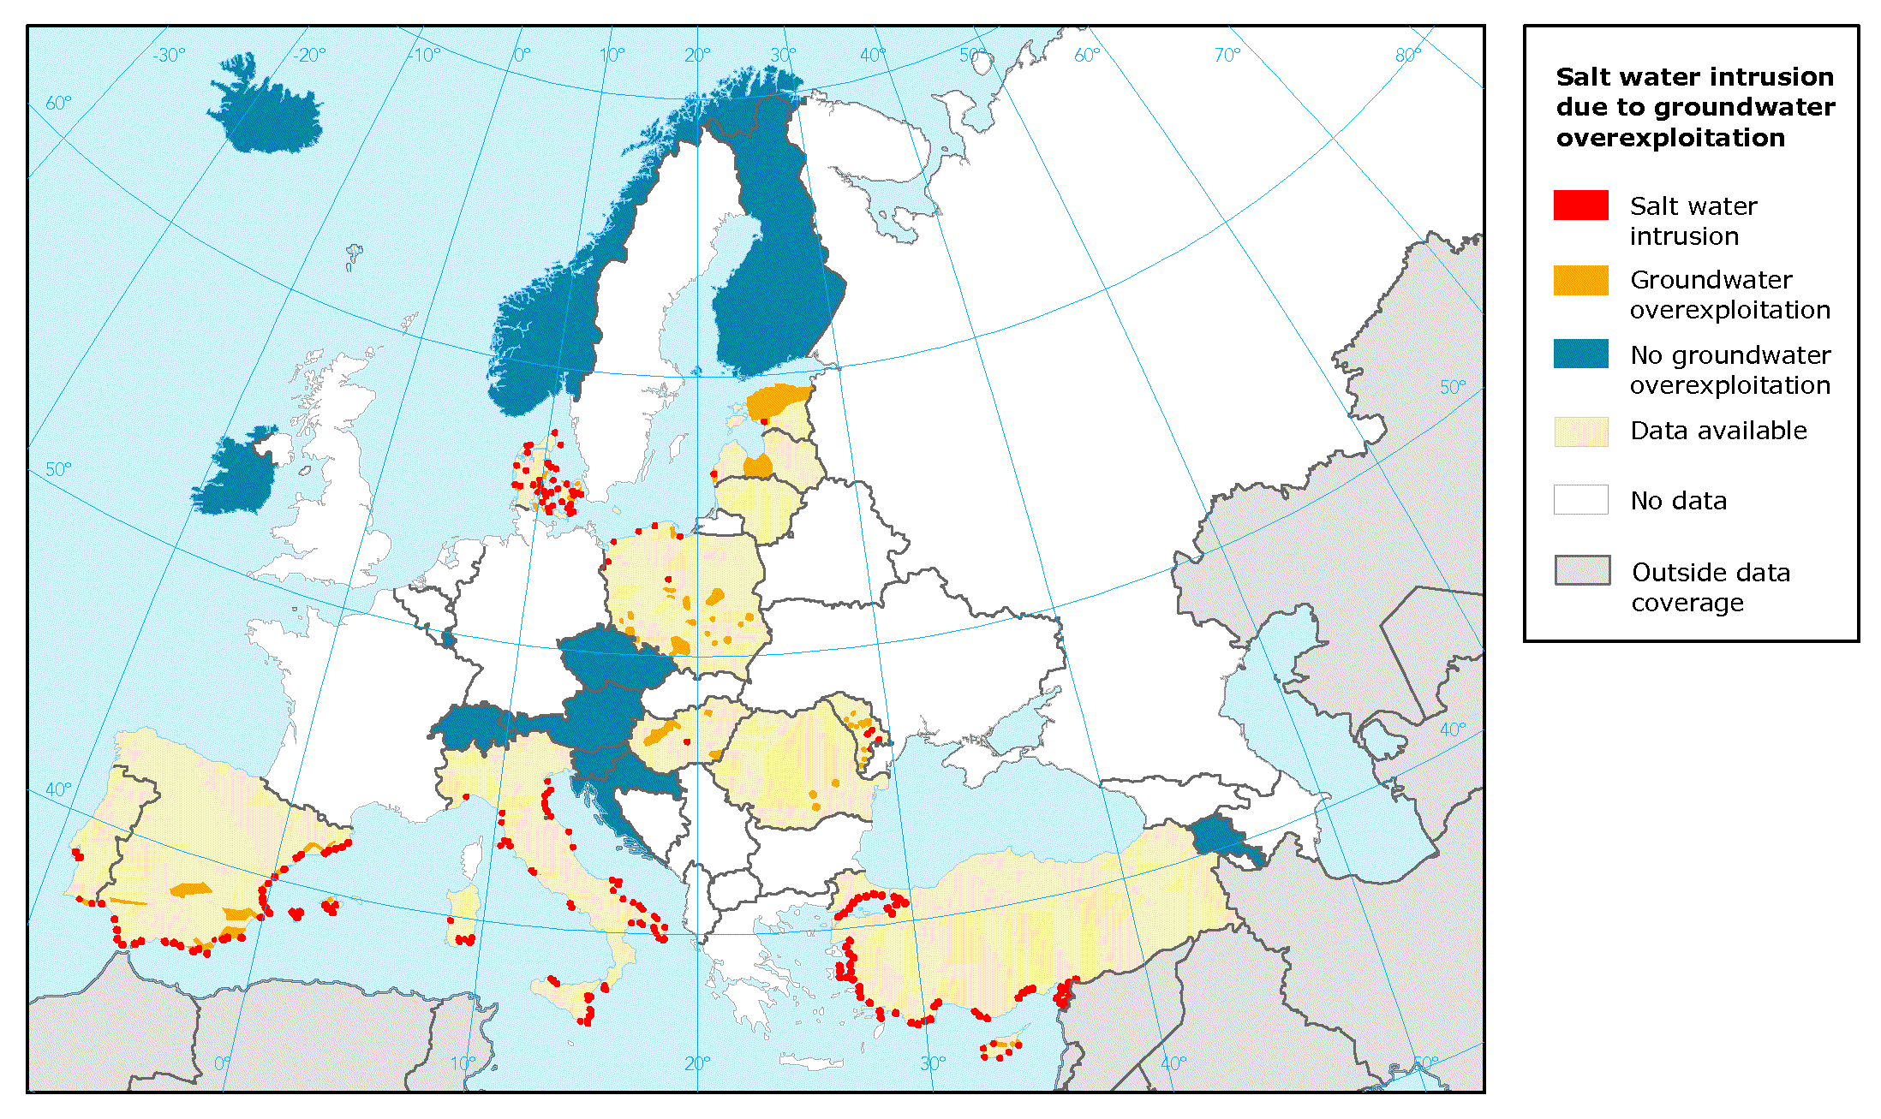
Global Problem

Slide 7
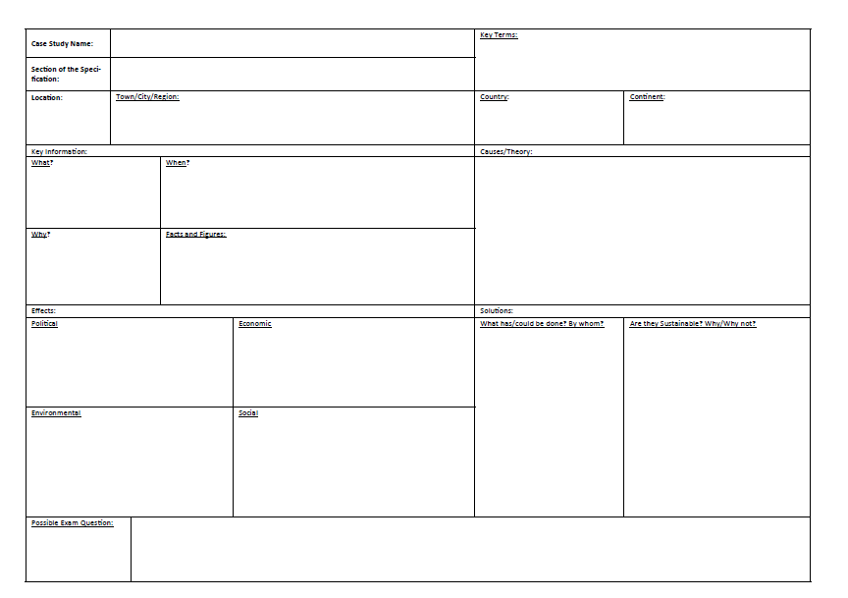
Possible IB Paper 2 - Exam Question - Referring to at least one example, examine the environmental effects of groundwater abstraction. [10 Marks]
A01 Defining Language:
Water extraction, water abstraction, or groundwater extraction is the process of taking water from any source, either temporarily or permanently. This water can be used for irrigation, industry, recreation, flood control or treatment to produce drinking water.
Plenary: Read through your booklet on Lake Naivasha and fill in your case study sheet with all the key details.

