Slide 1
Title: Geoengineering
Learning Objective: To be able to analyse the use of geoengineering and evaluate Environmental civil society action and their effectiveness at combating climate change.
Starter: Make a note of the key language.
Climate engineering
Climate engineering or climate intervention, commonly referred to as geoengineering, is the deliberate and large-scale intervention in the Earth's climate system, usually with the aim of mitigating the adverse effects of global warming.
Key Language
Environmental civil society action
Environmental governance refers to the institutions, policies, rules, and practices that mediate how governments, the private sector, and civil society interact with the environment at local, national and international levels.

Slide 2
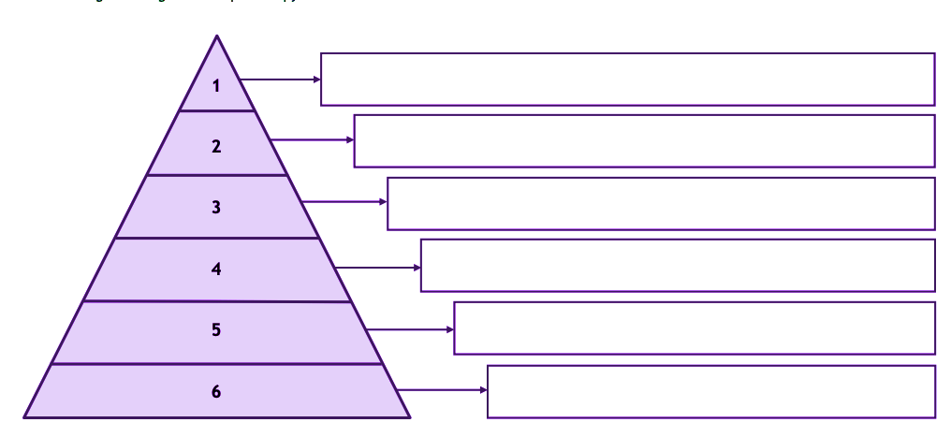
Climate Change Causes

Slide 3
Climate Change Effects

Slide 4
Climate Change Solutions

Slide 5
Title: Geoengineering
Environmental scientist David Keith proposes a cheap, effective, shocking means to address climate change: What if we injected a huge cloud of ash into the atmosphere to deflect sunlight and heat?
Demo: Write down some of the examples of Geoengineering.
Geoengineering Methods

Slide 6
International Civil Society organisations and Risks
Learning Objective: The success of international civil society organizations in attempting to raise awareness about, and find solutions for, environmental and social risks associated with global interactions
• Detailed examples of one environmental and one social civil society organization action
Demo:Read through the Summary information and transfer onto a case study sheet.
Social civil society organization action
Environmental civil society action
Challenge:
When compared what similarieties and what difference do these two organisations have?
Which one is more effective? Justify your answer.
Geoengineering Methods

Slide 7
International Civil Society organisations
Learning Objective:To be able to use a case study of the response to climate change in one country focusing on the actions of non-governmental stakeholders.
Environmental civil society action
Demo: Read through the Summary information.
?
Further Research: What are WWF doing in Germany? Ensure to research and provide detailed examples and explanation.

Slide 8
Plenary Revision
Learning Objective: To be able to analyse how disparities in exposure to climate change risk and vulnerability differ ( including variations in people’s location, wealth, social differences (age, gender, education), risk perception).
Plenary: Have we been able to complete the learning objective above? Review the progress that we have made.
Homework: Note down the link below and create a timeline with what you believe to be significant. This is important for your essay work that you might receive in paper 2.
Process
Power
Homework
http://unfccc.int/timeline

Slide 9
Evaluate your Learning
Demo: Analyse your learning by going through the syllabus:
1) Add examples and information to the syllabus. I.e. Case Studies/Definitions/strategies/causes and effects

