Slide 1
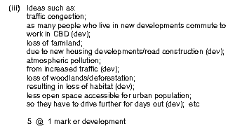
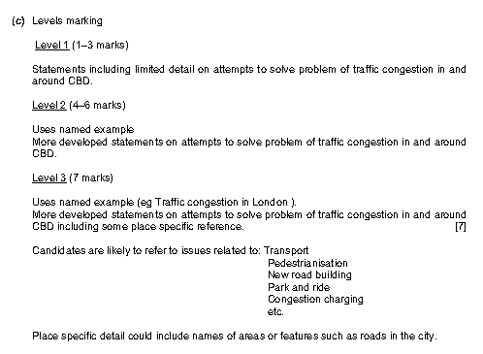
Starter
Exam Question 1
5
Markscheme
Exam Question 2
The next Assessment will be on the:

Slide 2
Markscheme
Level 1 | Marks 1-3 | Completed | Evidence
No Named Example. Statements including limited detail on attempts to solve problem of traffic congestion in and around CBD.
Level 2 | Marks 4-6
Uses Named Example. More developed statements on attempts to solve problem of traffic congestion in and around the CBD.
Level 3 | Marks 7
Uses Named Example. More developed statements on attempts to solve problems of traffic congestion in and around CBD including some place specific references (DATA).
Target: | Mark: /7 Teacher Signature: __________________________

Slide 3
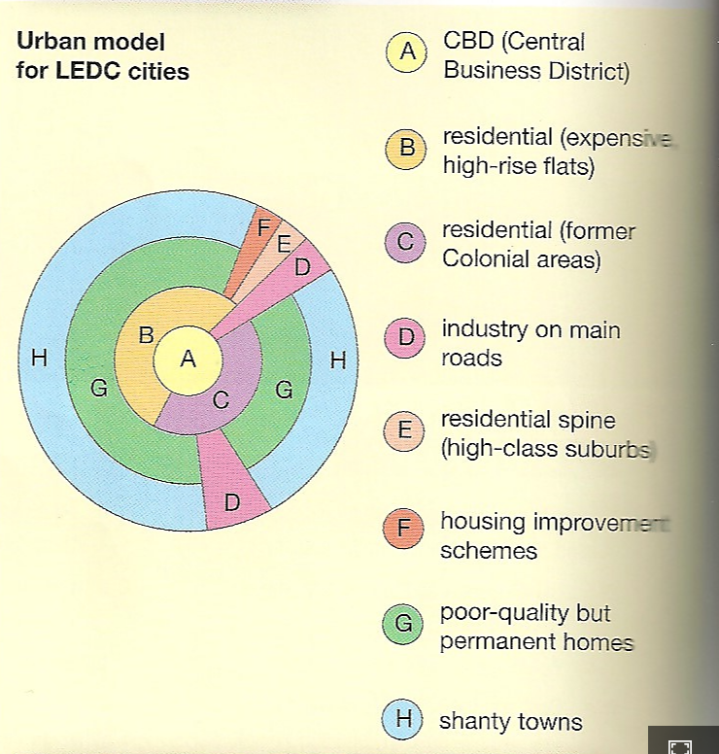
Urban land use model in LEDC’s
Demo: What reasons might there be, as to why urban models differ in different nations. List the reasons.
Reasons:
Gentrification (Social Segregation)
Spiral of Deprivation
Social Segregation
Slow rate of Development
Lack of Infrastructure
Poor settlement site and situation
Urbanisation and migration
High Crime rates
Environmental deterioration
Industrialisation

Slide 4
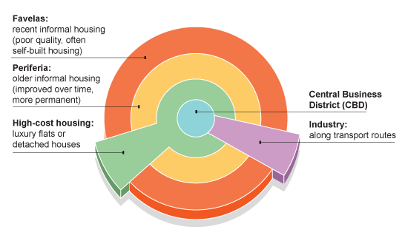
Comparative Case study: Brazil
Learning Objective: To explain how Land use zones, CBD’s, Residential area’s, industrial areas and rural to urban fringe vary in in different economically developed nations.
Demo: Look at the images and describe in the boxes, what you can see and the level of development.
Challenge: How would an MEDC’ settlement differ to that of the LEDC?
CBD:
Favelas:
MEDC:
MEDC:
Industry:
Periferia:
High-cost housing :
MEDC:
MEDC:
MEDC:

Slide 5
Comparative Case study: Brazil
Learning Objective: To explain how Land use zones, CBD’s, Residential area’s, industrial areas and rural to urban fringe vary in in different economically developed nations.
Demo: Look at the images and describe in the boxes, what you can see and the level of development.
Challenge: How would an MEDC’ settlement differ to that of the LEDC?
CBD:
Favelas:
MEDC:
MEDC:
Industry:
Periferia:
High-cost housing :
MEDC:
MEDC:
MEDC:

