Slide 1
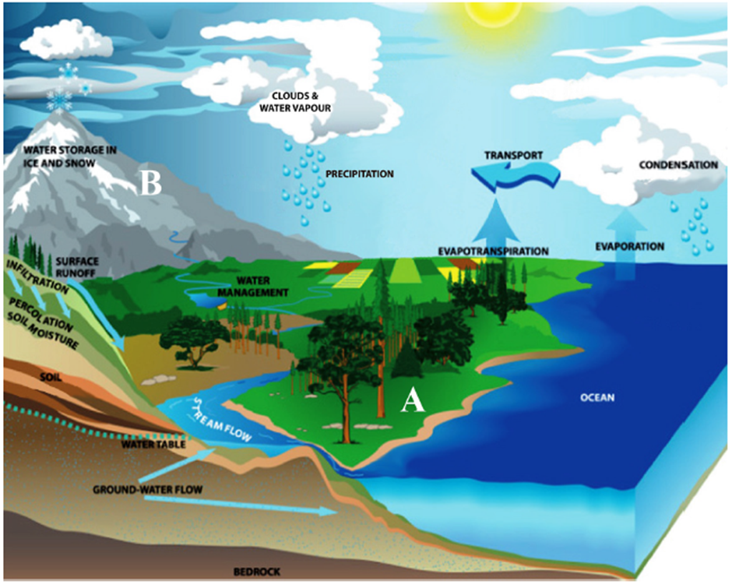
Starter Question
Starter: Complete the exam question:
Describe two conditions at point A which would make infiltration rates higher than at point B. (5marks)

Slide 2
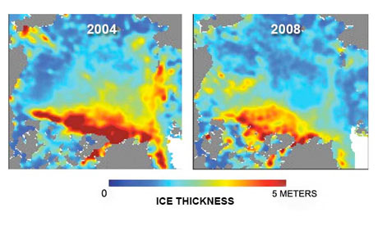
Water stored in ice and oceans
Learning objectives: To Examine the inputs, outputs, stores and transfers of the hydrological cycle. Discuss the causes and consequences of the changing balance between water stored in oceans and ice.
Starter: Complete the exam question:
Describe two conditions at point A which would make infiltration rates higher than at point B.

Slide 3
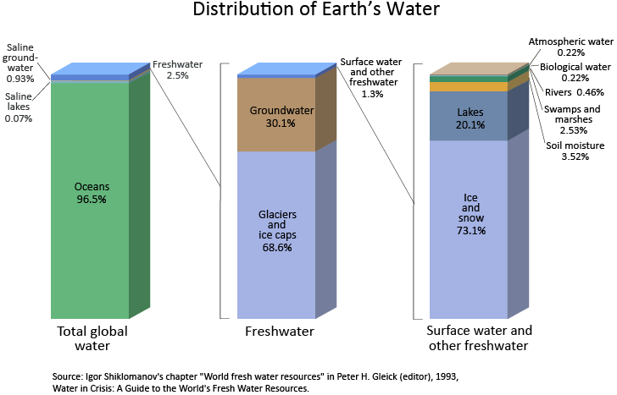
Water stored in ice and oceans

Slide 4
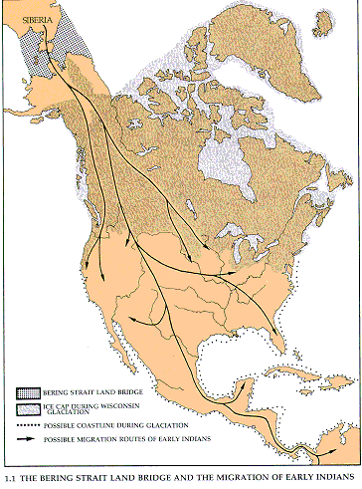
Water stored in ice and oceans
Land bridge between Siberia and North America

Slide 5
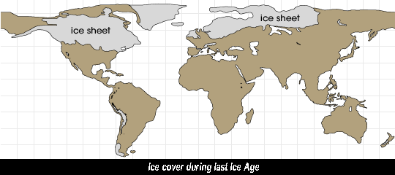
Water stored in ice and oceans

Slide 6
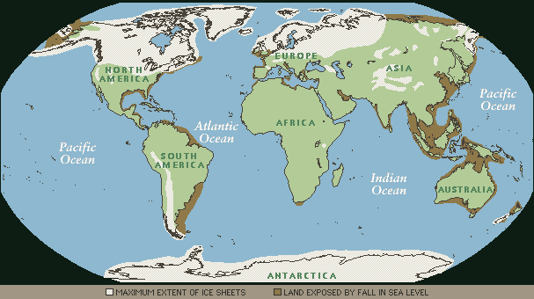
Water stored in ice and oceans

Slide 7
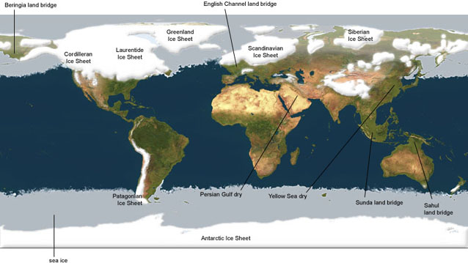
Water stored in ice and oceans

Slide 8
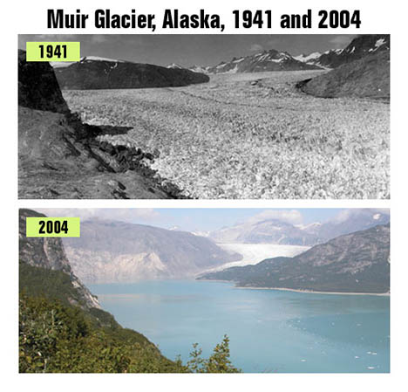
Example: Glacier retraction/melt

Slide 9
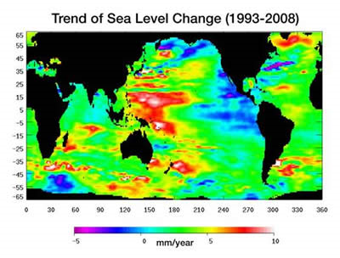
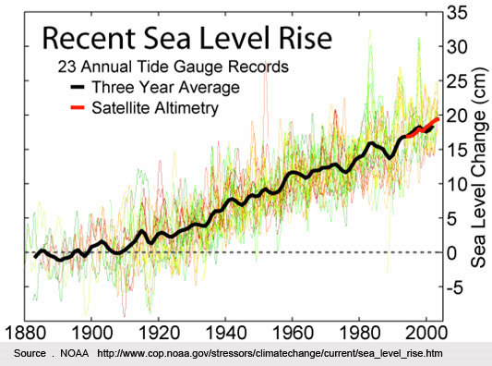
Water stored in ice and oceans
A strong correlation

Slide 10
Changes to sea level
Demo: So What 5 factors cause changes in sea level?
1.
Terrestrial water storage, extraction of ground water, building of reservoirs, changes in runoff, and seepage into aquifers.
3.
Surface and deep ocean circulation changes and storm surges.
5..
Exchange of water stored on the land by glaciers and ice sheets with ocean water.
4..
Subsidence in river delta region, land movement, and tectonic displacements .
2.
As the ocean warms, the water expands.

Slide 11
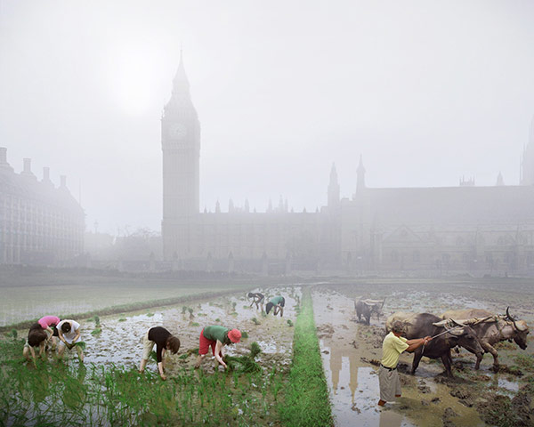

Slide 12
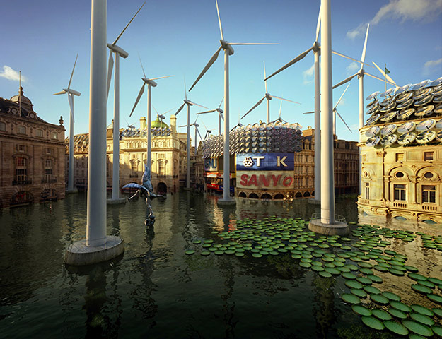

Slide 13
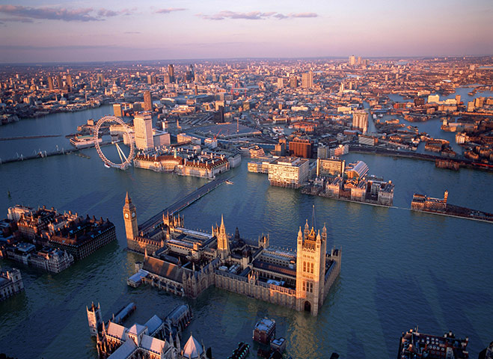

Slide 14
Water stored in ice and oceans –consequences
Physical
Human
BIOLOGICAL IMPACTS
Increased coastal erosion
More extensive coastal inundation
Higher storm-surge flooding
Landward intrusion of seawater in estuaries and aquifers
Changes in surface water quality
Reduced sea-ice cover.
SOCIOECONOMIC IMPACTS
Increased loss of property and coastal habitats
Increased flood risk and potential loss of life
Damage to coastal protection works/Infrastructure
Increased disease risk
Loss of subsistence resources
Loss of tourism, recreation, and transportation functions
Loss of non-monetary cultural resources and values
Impacts on agriculture and aquaculture through decline in soil and water quality.
Exam Question
Explain the consequences of a decrease in the amount of water stored in ice in the hydrological cycle at any stage. [6 marks]

Slide 15
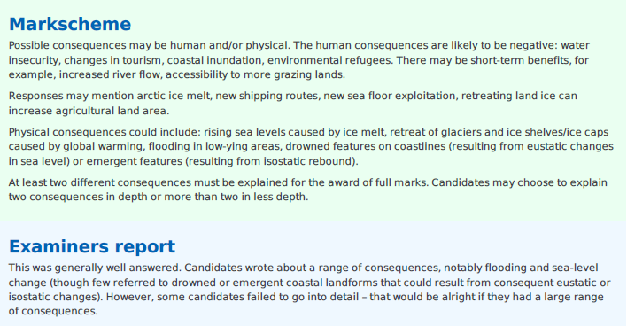
Plenary
Case Study: Carteret Island
Learning objectives: To Examine the inputs, outputs, stores and transfers of the hydrological cycle. Discuss the causes and consequences of the changing balance between water stored in oceans and ice.

Slide 16
Case Study: Carteret Island

