Slide 1
Impact of Coastal Retreat
Learning Objective: To distinguish the environmental, social and economic impacts of coastal retreat.
1. Backwash | 2. Longshore drift | 3. Wave
4. Hydraulic action | 5. Beach | 6. Corrasion
7. Headland | 8. Cave | 9. Bay
10. Deposition | 11. Swash | 12. Erosion
13. Wave cut platform | 14. Corrosion | 15. Groyne
16. Cliff | 17. Wave cut notch | 18. Spit
19. Attrition | 20. Arch | 21. Stack
Starter:
Guess the odd one out in each set.
Add in a fourth number from the table to match the other two.
Write in what the link is between the three numbers.
4 | 15 | 14
1 | 21 | 8
7 | 8 | 12
15 | 5 | 20
18 | 21 | 10
2 | 7 | 16
Challenge: Invent your own odd one outs

Slide 2
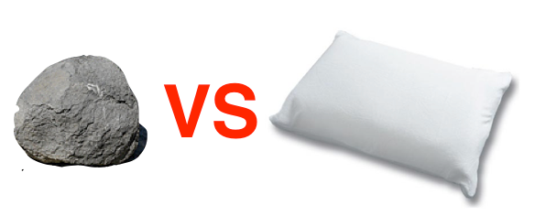
Coastal Management
Learning Objective: To explain what can be done to manage the impacts of coastal erosion.
Starter: What are the two types of coastal management?
Challenge:
Name 3 types of coastal defences.
Which coastal defence will prevent Long shore drift?
Hard engineering methods aim to stop the coastal processes from occurring. Soft engineering methods try to work with nature to protect the coast

Slide 3
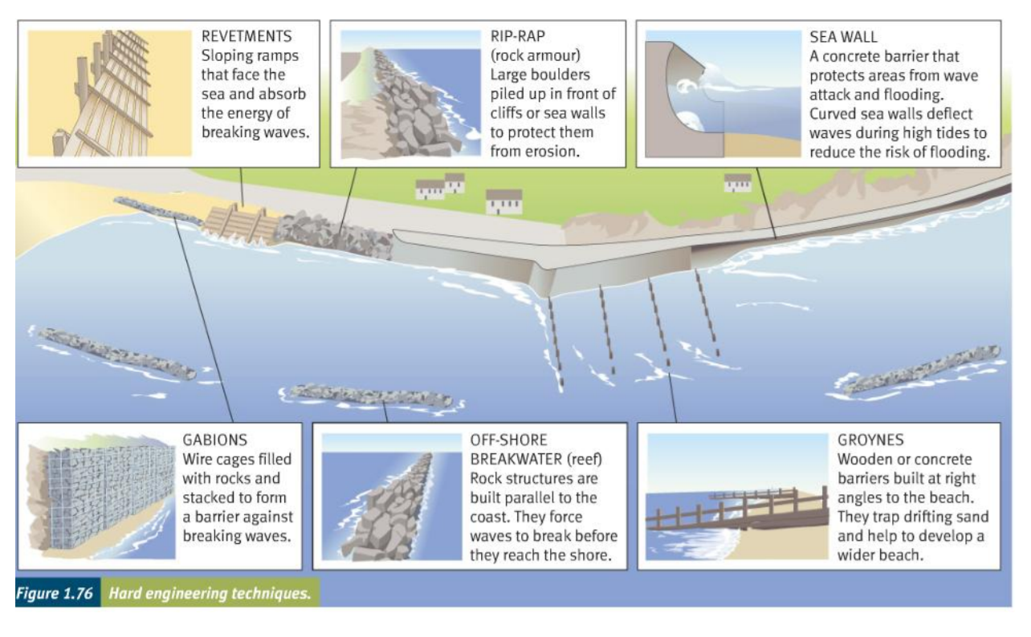
Coastal Management
Learning Objective: To explain what can be done to manage the impacts of coastal erosion.
Demo: Add a title, diagram and description to your worksheet.

Slide 4
Coastal Management techniques

Slide 5
What defence is this?

Slide 6
What defence is this?

Slide 7
What defence is this?

Slide 8
What defence is this?

Slide 9
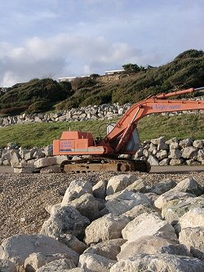
What defence is this?

Slide 10
What defence is this?

Slide 11
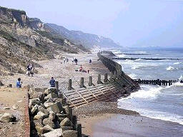
What defence is this?

Slide 12
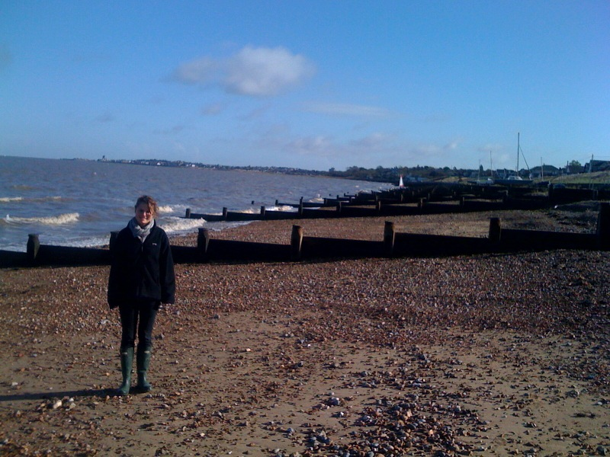
What defence is this?

Slide 13
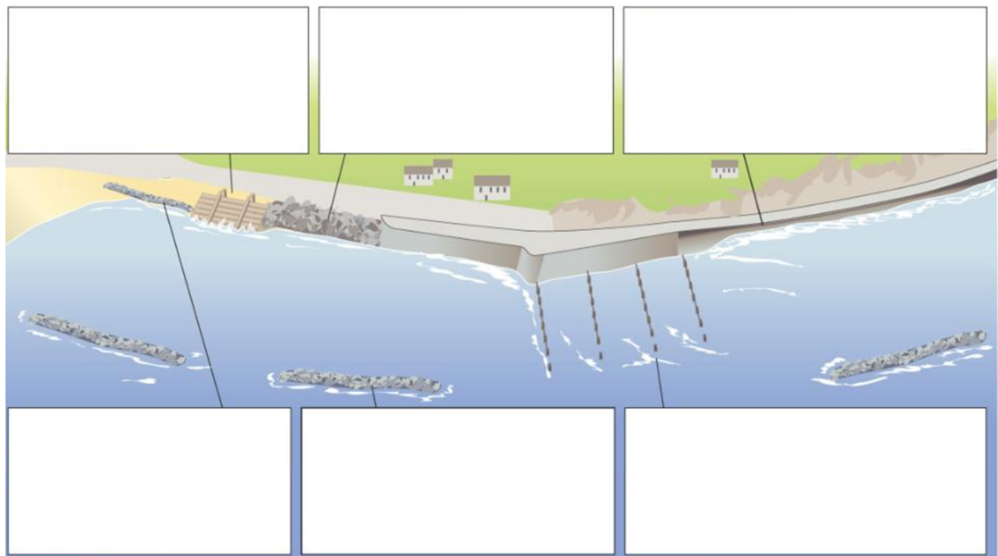
Coastal Management techniques

Slide 14
Revision (Mangroves)
What are mangroves and where do they naturally grow?
2. Explain what 'the roots also act as buffers' mean in terms of protection from flooding and tsunami's.
3. What 'death rate comparison' can be made over their effectiveness after the 2004 Asian Tsunami?
4. Outline what is being done to resolve the problem caused by mangrove removal.
5. How is the removal of mangroves also linked to coastal erosion?

