Slide 1
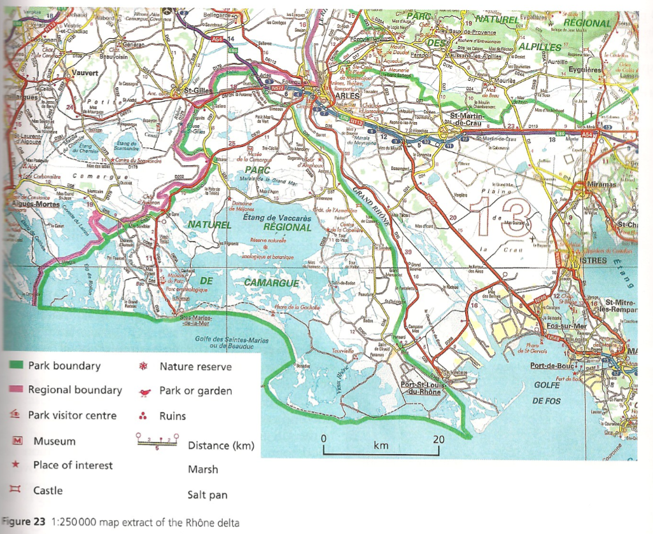
Map reading skills
Starter: What evidence might there be that conservation and tourism are important in the Rhone delta?

Slide 2
River hazards and opportunities
Learning Objective: Examine the opportunities and hazards that a river provides.
Starter: What hazards and opportunities does a river provide? Draw a t-chart and add you ideas to the chart.
Key Language:
Fertile alluvium-River deposits or silt.
Human causes- Man made
Physical causes- Naturally occurring.
Hazards
OPPORTUNITIES

Slide 3
Causes of FLooding
Fast Notes:
Physical Causes
Human Causes

Slide 4
Hard Engineering
Case Study: Yangtze River
Demo: Complete the Case study analysis questions 1-5.
Definition
Example
Advantages
Disadvantages

Slide 5
Soft Engineering
Case Study
Demo: Complete the Case study analysis questions 1-5.
Definition
Example
Advantages
Disadvantages

