Slide 1
Clothing
Vegetation and Terrain
Changes
Demo: 5
Demo: 1
Housing
Food and Farming
Tourism Impact
Weather
Population Size
Demo: 2
Location
The Xingu people of the Amazon
Demo: 3
History/ Pre-Contact
Colonization
First Contact (1938)
Social Structure
Ceremonies
Missionaries
Wealth and Transport
Demo: 4
Impacts
Religion
Warfare
Government Impact

Slide 2
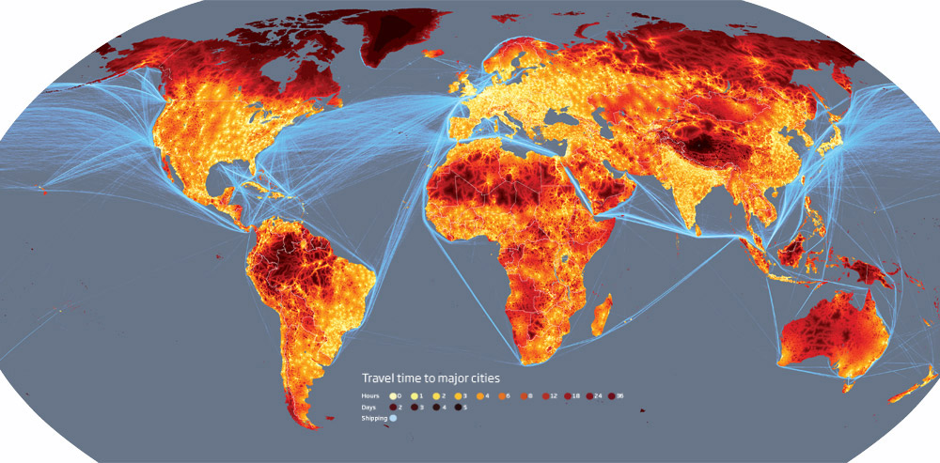
The remotest place on earth

Slide 3
