Slide 1
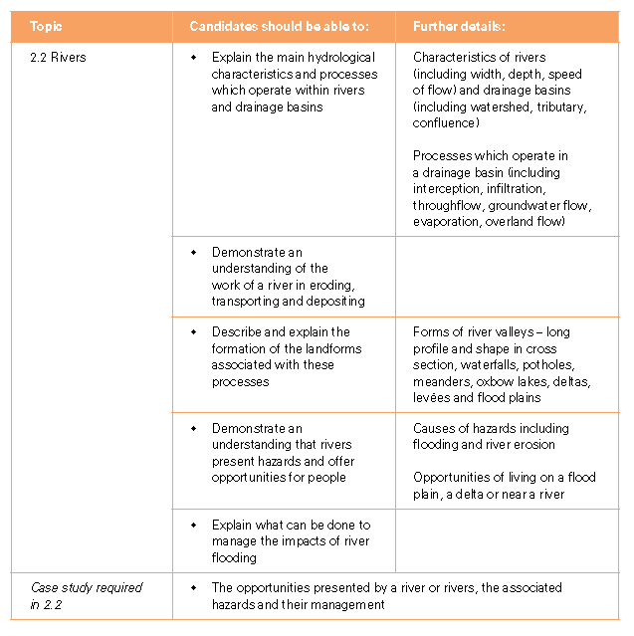
Today’s Aims

Slide 2
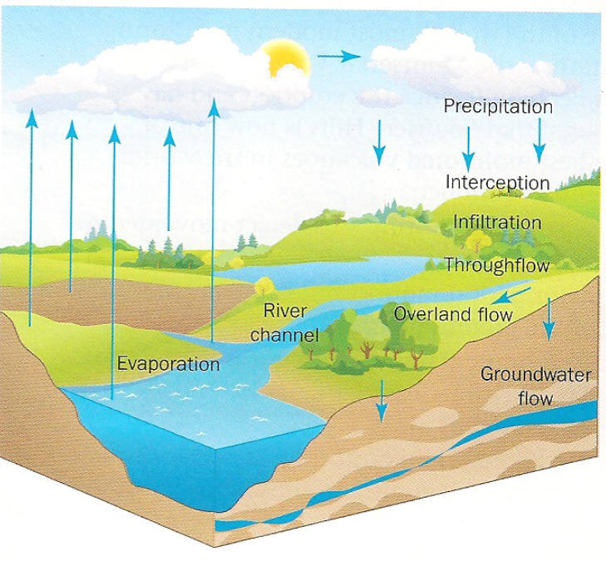
The hydrological cycle
Starter: Draw a diagram of the hydrological cycle.
Interception-Precipitation falling into the drainage basin can be intercepted by the leaves, trees and ground vegetation
Infiltration-some of the precipitation that reaches the ground continues downwards through the soil.
Overland flow-some of the precipitation reaching the ground flows over the surface until it reaches a river channel.
Evaporation-water on trees, leaves and vegetation or lying on the ground or in the river channel can be evaporated back into the atmosphere.
Throughflow-infiltrating water continues down slopes through the soil towards the river channel.
Groundwater flow-some infiltrating water continues into pores and crack in the underlying rock and flows towards the river as groundwater.

Slide 3
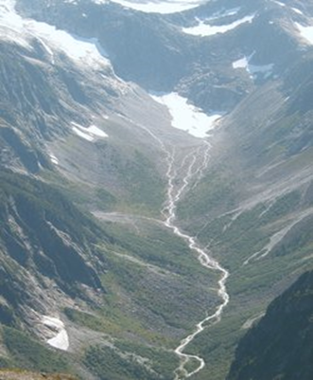
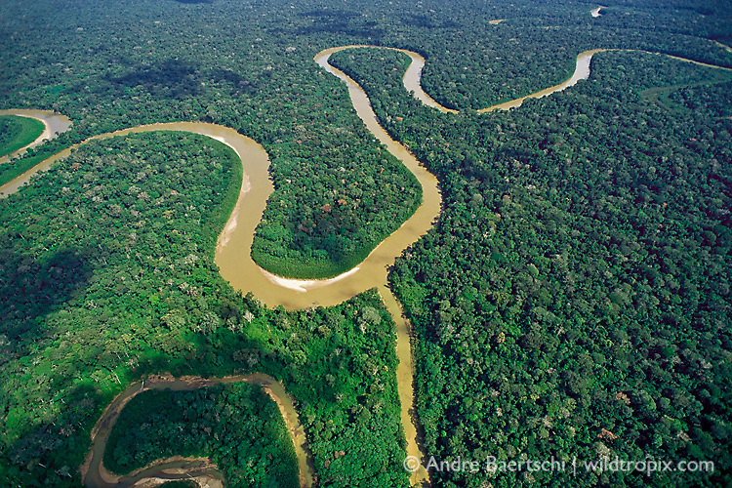
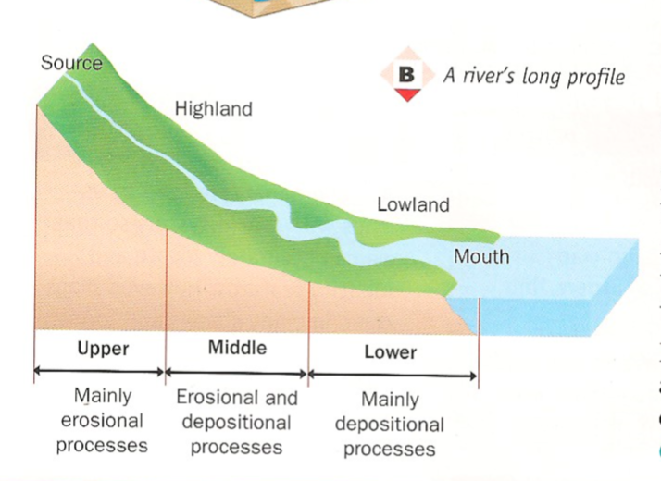
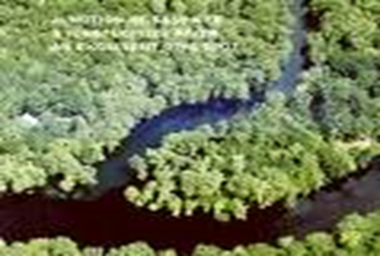
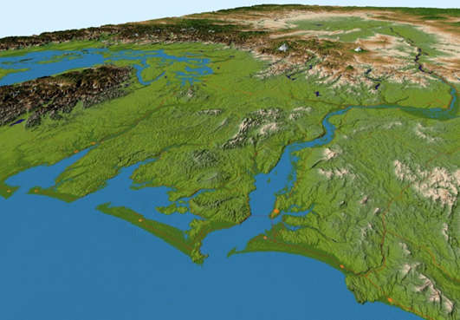
A rivers long profile

Slide 4
Key Terms Quiz
Demo: Match the term with the definition.
Source
The point where two rivers meet.
Tributary
Imaginary line that separates one drainage basin from the next.
Confluence
The starting point of the river.
Watershed
Land that gets flooded when the river overflows.
Flood plain
A bend in a River.
Mouth
The river flows into a lake or the sea.
Meander
A river which joins a larger river.

Slide 5
Key Terms Quiz
Demo: Match the term with the definition.
Source
The point where two rivers meet.
Tributary
Imaginary line that separates one drainage basin from the next.
Confluence
The starting point of the river.
Watershed
Land that gets flooded when the river overflows.
Flood plain
A bend in a River.
Mouth
The river flows into a lake or the sea.
Meander
A river which joins a larger river.

Slide 6
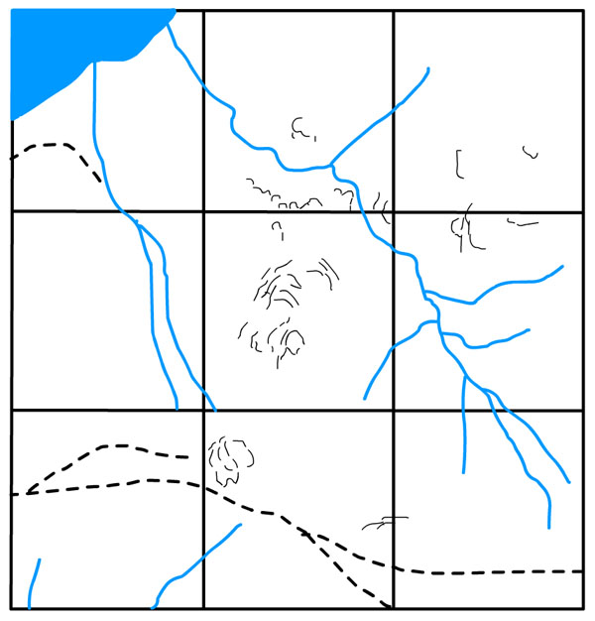
Spotting these on a Map
Demo: Label the following 6 geographical features found on the map. The Mouth/A Tributary/ The Watershed/The Catchment/ A confluence and the Source.

Slide 7
Spotting these on a Map
Tributary
A river which joins a larger river.
Mouth
Where the river flows into the sea, or sometimes a lake.
Catchment
The area from which water drains into a particular drainage basin.
Watershed
The boundary dividing one drainage basin from another- a ridge of high land.
Source
The upland area where the river begins.
Confluence
The point at which two rivers join.

Slide 8
Spotting these on a Map
Mouth
Tributary
Catchment
Watershed
Source
Confluence

