Slide 1
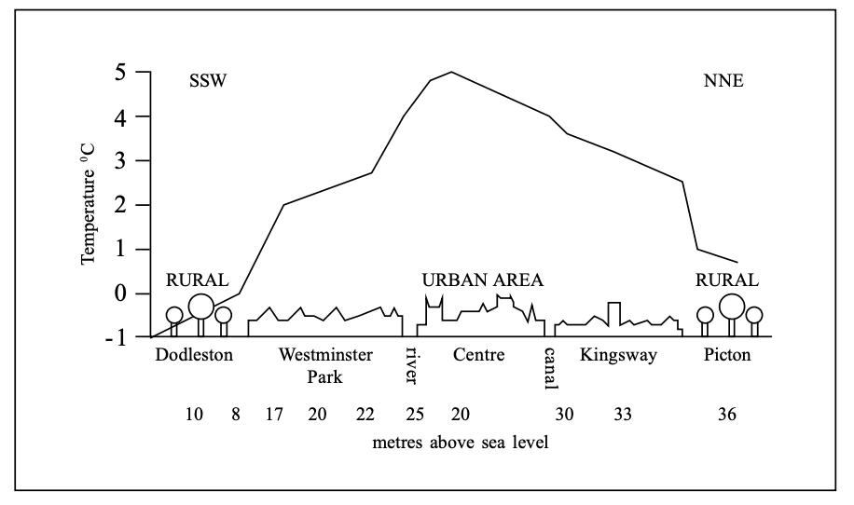
Urban Environments- Starter
Describe the temperature relationships shown in Fig 1.1. (2 marks)
(b) Explain the temperature relationships shown. In Fig 1.1 (2 marks)
(c) Suggest two advantages of the urban heat island effect. (2 marks)
Fig 1.1

Slide 2
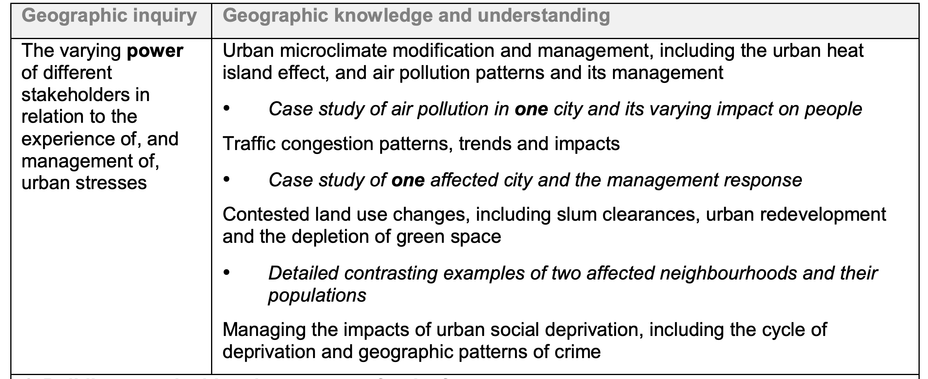
Urban Environments- Urban Micro-climates

Slide 3
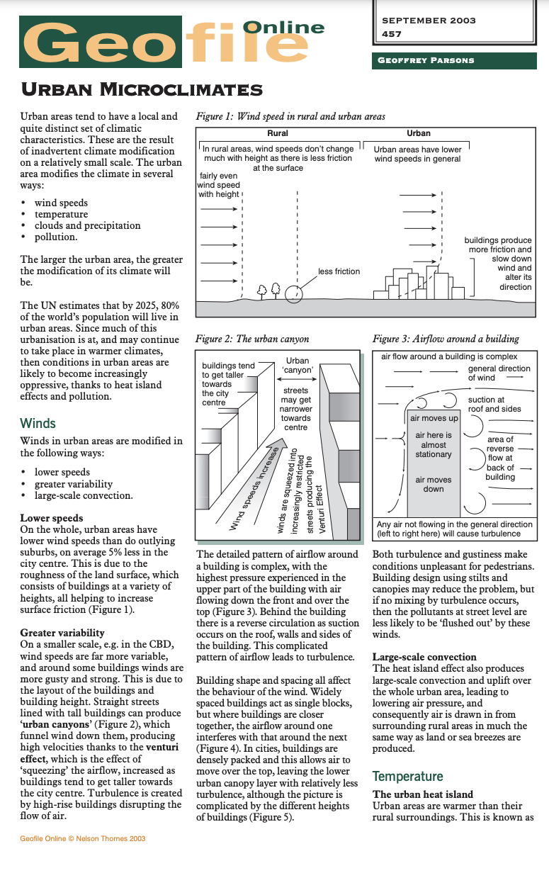
Urban Environments- Key Questions:
Demo: Read the Geofile and take notes on the concept of Urban Microclimates
Areas to Focus on:
Factors/ variables that Determine Urban Microclimates
Winds
Temperature
Clouds and Precipitation
Pollution
Transfer: How does this link to other areas of the Syllabus?
Paper 1 urban Environments
Paper 2 Climate Change and Vulnerability
Paper 3 Unit 6 Environmental Risk

Slide 4
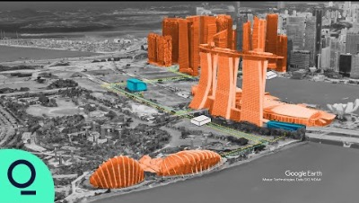
Urban Environments-Singapore
Demo: How does Singapore use Science to Stay Cool

Slide 5
Urban Environments- Key Questions:
Define the term ‘microclimate’. [1]
Identify three examples of natural microclimates. [3]
Define the term ‘urban heat island’. [1]
Define the term ‘urban heat island intensity (UHII)’. [1]
Suggest four features of a typical microclimate. [2]
Distinguish between the meaning of ‘weather’ and ‘climate’. [2]
Explain the impact of the colour of a surface on the amount of energy it absorbs. [3]
Describe the effect of low specific heat capacity on the ability of a surface to absorb heat energy. [2]
Explain how building height and building density affect wind patterns and wind speeds. [6]
Define the term ‘anthropogenic heat’. [1]
Identify the two main sources of anthropogenic heat. [2]
Explain how reducing the indoor temperature using air conditioning can contribute to the urban heat island effect. [3]
Do human changes to the amount of surface water usually cause the urban heat island intensity to go up or down? Explain your answer. [4]

