Slide 1
Movement responses - migration
What are the causes of migration, both forced and voluntary?
What are the geographical impacts of internal migration at their origins and destinations?
What are the geographical impacts of international migrations?
Key Language
Voluntary migration: They have a free choice as to whether to move or not
Push factors: Negative conditions at the point of origin which encourage or force people to move.
Forced migration: individuals have little choice or no choice but to move.
Pull factors: Positive conditions at the point of destination which encourage people to move.
Migration: the movement of people across a specified boundary, national or international, to establish a new permanent place of residence. Lasting for more than 1 year (UN)
Remittances: money sent back by migrants to their family in the home community.

Slide 2
Why was Enrique hiding in a car seat?
Learning Objective: To understand the challenges an undocumented person might face.
Starter:
What would you like to ask to find out more?
Write down five questions.
Challenge: What are the geographical impacts of Enrique’s migration at their origins and destinations?
Voluntary migration: They have a free choice as to whether to move or not
Forced migration: individuals have little choice or no choice but to move.

Slide 3
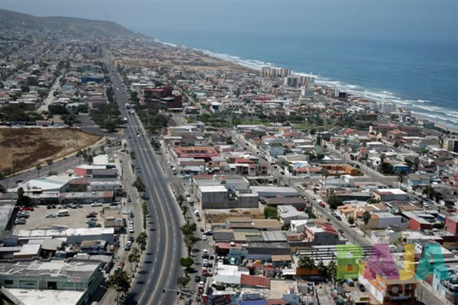
Where are we?
Here are some pictures from Enrique’s home town called Tijuana.
Demo:
1. Write down adjectives that describe what Enrique’s life might be like there.
2. What might this mean for Enrique and his family?

Slide 4
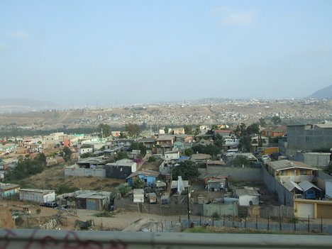
Independent enquirer
Notes:
There are some poorer areas, particularly on the edge of the city or in rural areas.

Slide 5
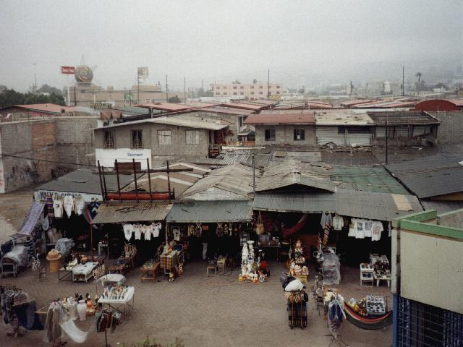
Independent enquirer
Notes:
There are some poorer areas, particularly on the edge of the city or in rural areas.

Slide 6
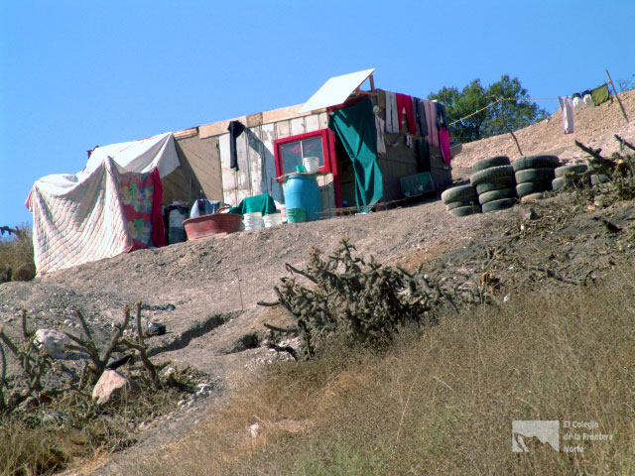
Independent enquirer
Notes:
There are some poorer areas, particularly on the edge of the city or in rural areas. The country also suffers a lot with drug problems.

Slide 7
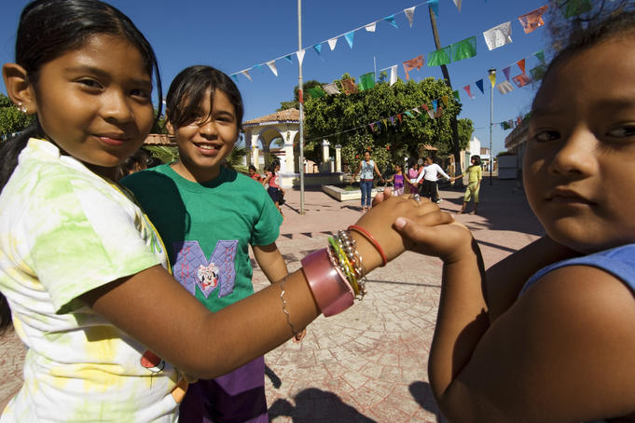
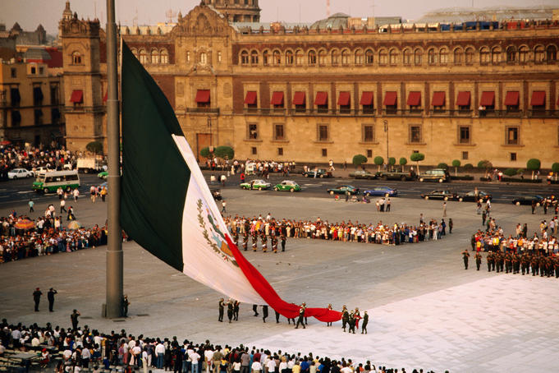
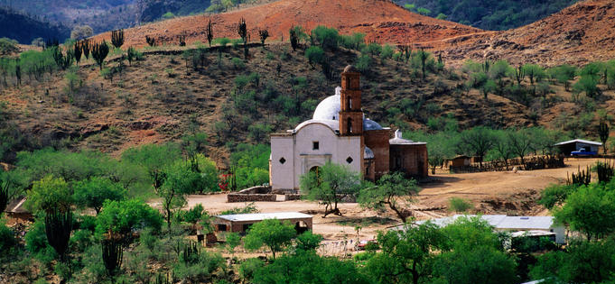
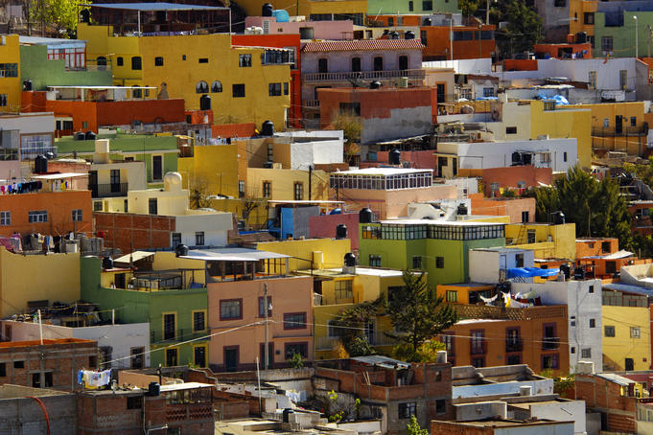
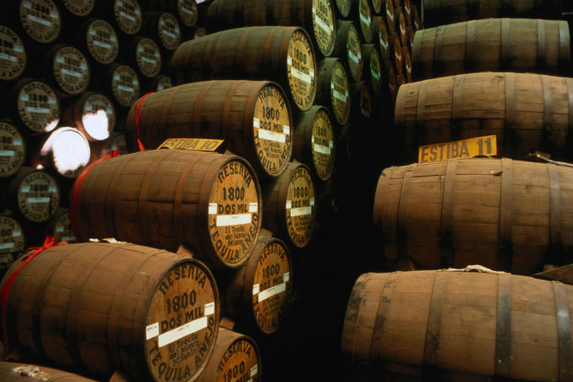
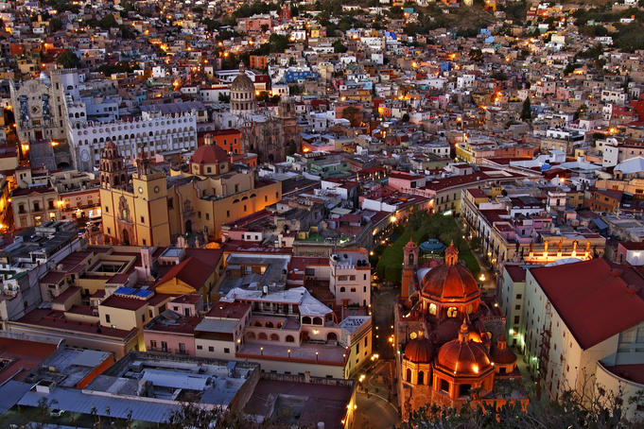
Which continent? Which country?
Demo: Give a detailed geographical description of Enrique’s home.
Name
Number
North
Notes:
Which continent? Which country?

Slide 8
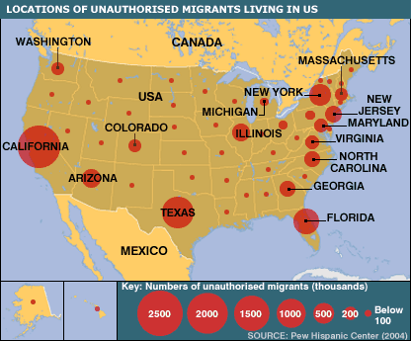
Where was Enrique trying to get to?
1. In pairs - what does this map show?
2. Where do you think Enrique was trying to get to?
Tijuana
Notes:
What are migrants?
What might unauthorised migrants mean
What do you think the US government thinks about this?

Slide 9
Independent enquirer
Demo: Use the data in the table to write a paragraph to compare at least three things about the USA and Mexico.
Challenge: Explain what this would mean for someone like Enrique.

Slide 10
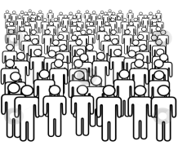
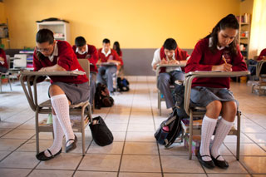
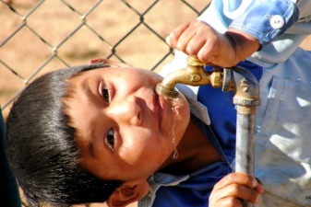
 | Data from 2009 | Mexico | USA
$ | The country’s income each year, divided by the number of people who live there. | $9,000 | $27,000
 | The percentage of the country’s income that is spent on healthcare. | 5% | 25%
 | The percentage of people who have been to secondary school. | 72% | 88%
 | The percentage of people who have access to running water in rural areas. | 68% | 99%
$ | The average amount of money a family earns in one year. | $4,700 | $31,000

Slide 11
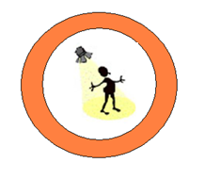
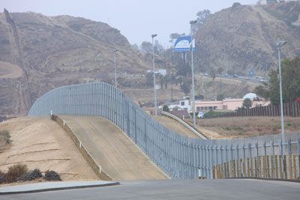
Confident individual
This is a picture of part of the border between the USA and Mexico.
Discussion: What does it make you think crossing the border is like?
Notes:
Strictly managed or unmanaged?
Welcome or not welcome?
Easy or difficult?

Slide 12
Why was Enrique hiding in a car seat?
Demo: Write a paragraph answering the question above.
The ____ controls its border with the Mexico very tightly.
People can only cross _______ if they have the right documentation.
In the past, getting a ____ to work or live in the USA for Mexicans was difficult, ________ and not guaranteed.

Slide 13
Independent enquirer
What would you do if you couldn’t get the right documents?
Have a look at one Mexican’s story.
From the video, write down what it is like to cross the border if you don’t have the correct documents.

Slide 14
Independent enquirer
Enrique didn’t have the necessary documents to enter the USA legally.
This meant that he was an ‘undocumented person’.
If you were Enrique, what would you do?
You have some very difficult choices to make!
Informal Sector: the part of the economy operating outside of official recognition. Employment is generally low-paid and often temporary and/or part time in nature.
Formal Sector: Jobs in the formal sector are known to the government department at is responsible for taxation. Such jobs provide better pay and greater security.
Notes:
People without the right information to migrate to another country are called ‘undocumented people’.
Undocumented people can come from any country.
You might sometimes hear these people also being referred to as ‘illegal immigrants’.
Some groups like the Red Cross don’t like the name ‘illegal immigrants’ and use ‘undocumented people’ instead.
Why do you think this is?

Slide 15
The situation between Mexico and the USA is changing...
Changes | This means that...
The number of good schools and universities in Mexico is growing.
Mexican families are having fewer children than before.
Healthcare in Mexico has greatly improved.
People traffickers charge very high prices to smuggle someone across the border.
The process to get a visa to work in the USA has been made fairer and simpler for Mexicans.
Demo: Explain how these changes will affect an undocumented person like Enrique.
Notes:
Make into pictures.

Slide 16
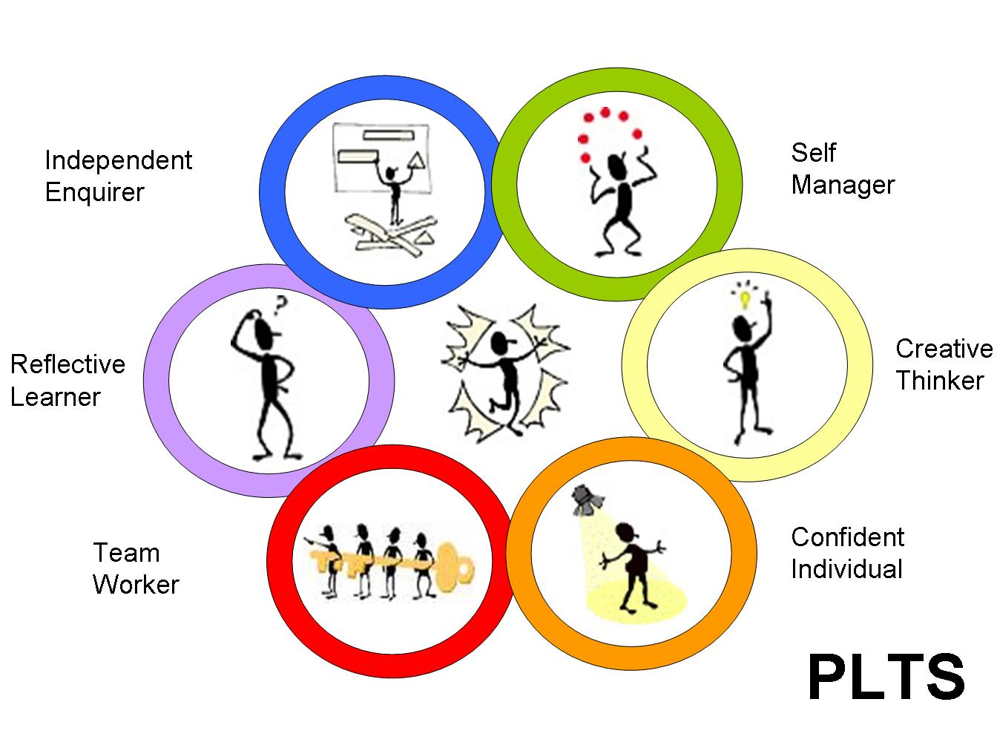
Movement responses - migration
Which do you
feel you
developed
today?
Plenary

Slide 17
Movement responses - migration
Learning Objective: To understand the challenges an undocumented person might face.
Demo: Explain how these changes will affect an undocumented person like Enrique.

Slide 18
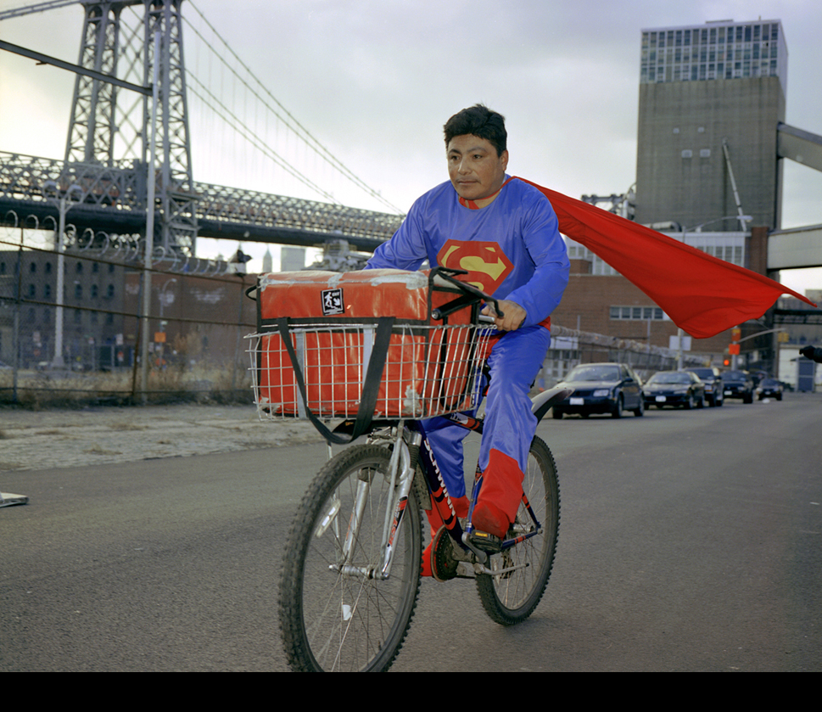

Slide 19
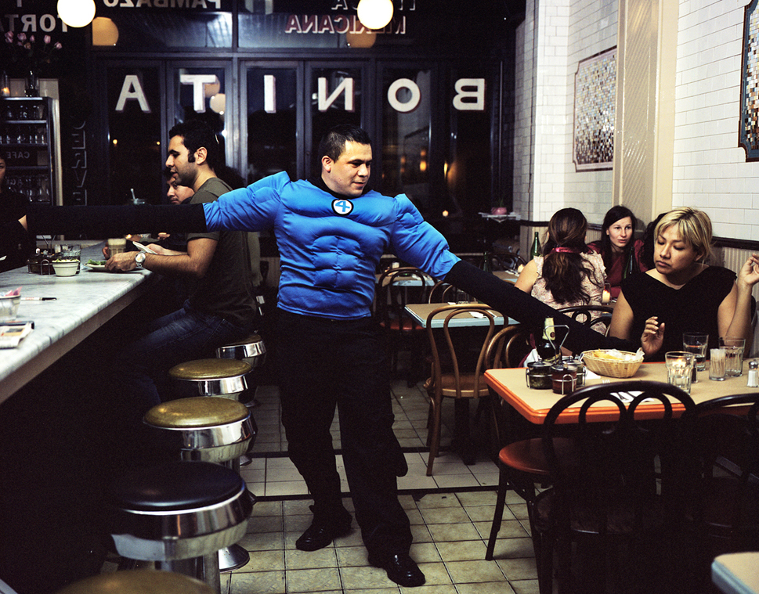

Slide 20
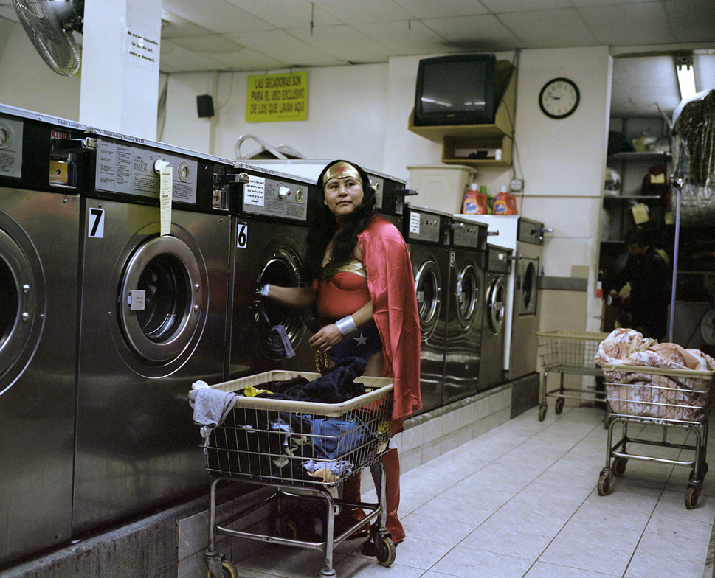

Slide 21
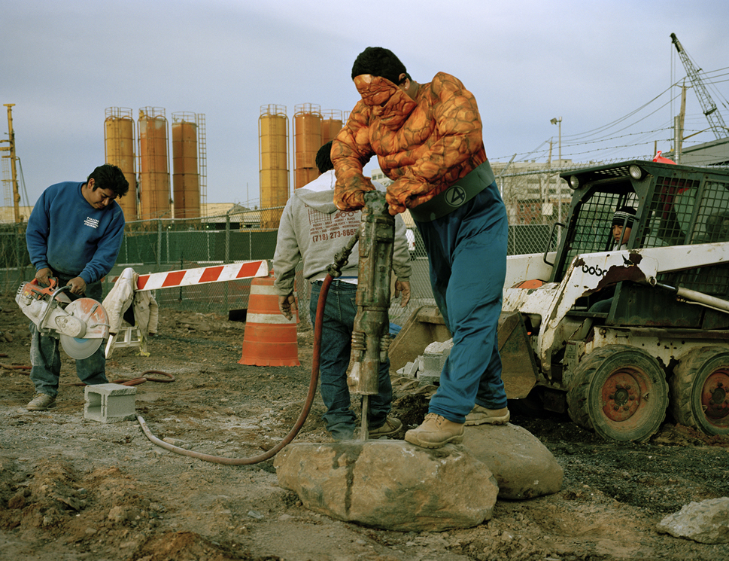

Slide 22
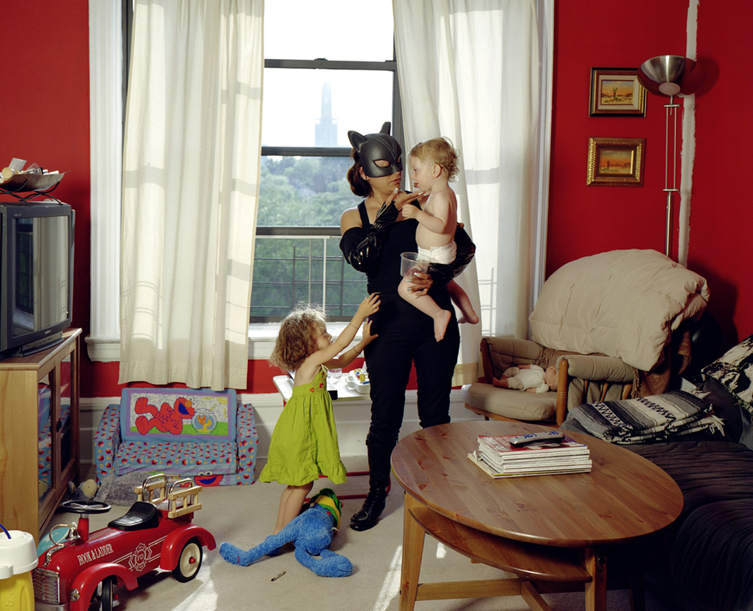

Slide 23
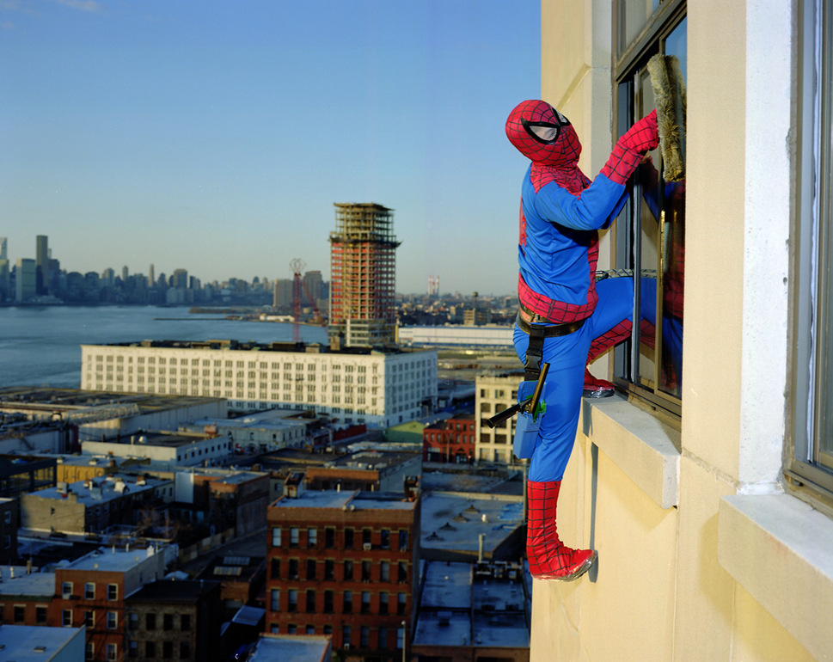

Slide 24
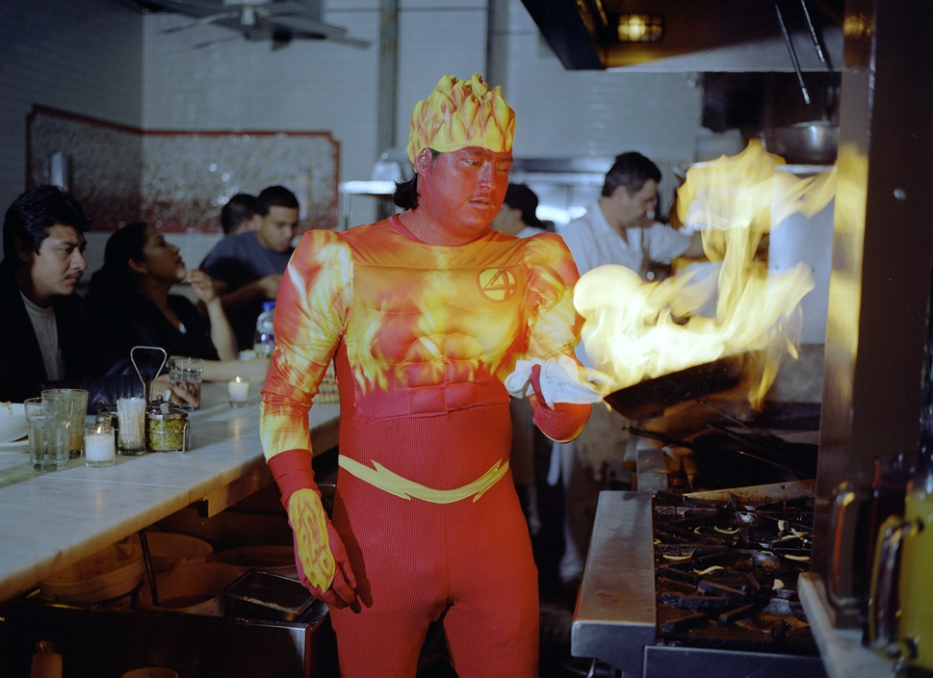

Slide 25
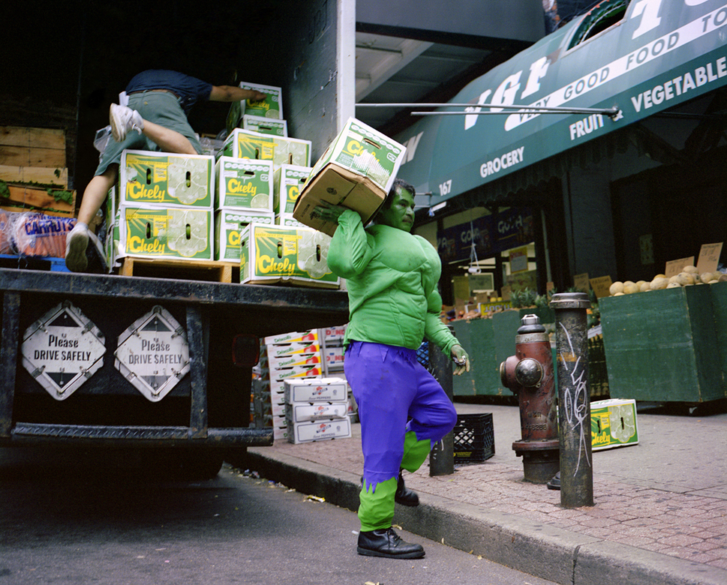

Slide 26
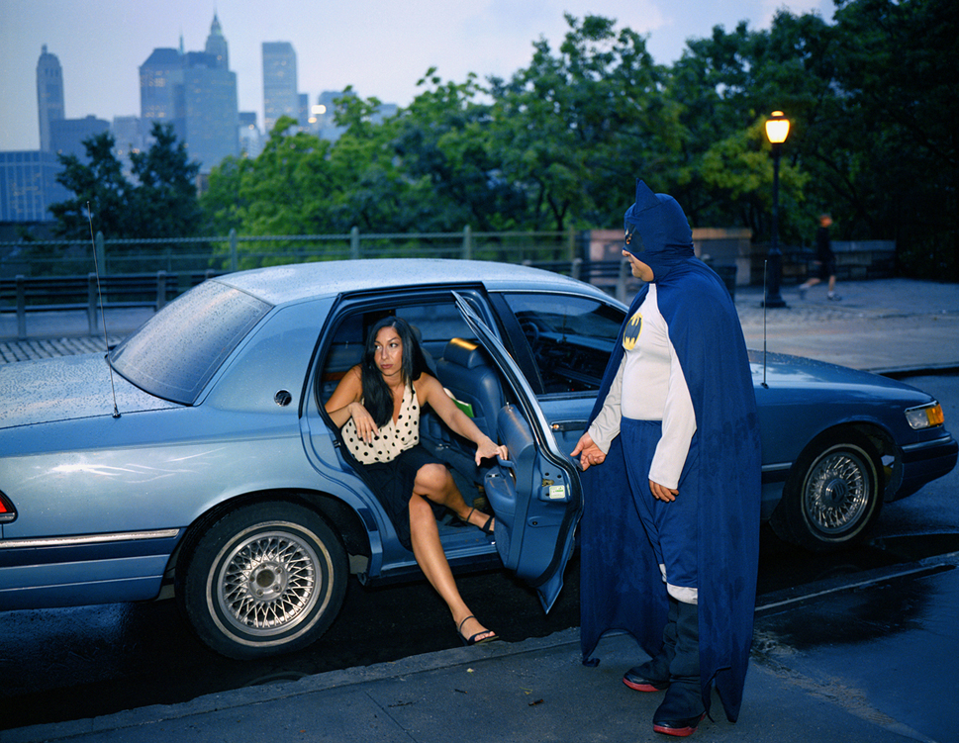

Slide 27
Plenary: What is the link between Enrique and the superhero's?

