Slide 1
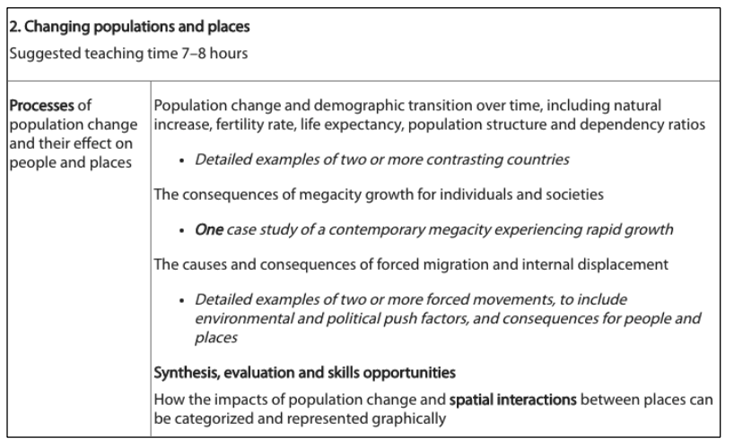

Slide 2
Forced Migration
Learning Objective: To research two detailed example of forced migration, ensure to focus on environmental and political push factors and the consequences for people and places.
Demo 1: In groups of four research two examples of forced migration. Ensure to provide two contrasting examples, one political and one environmental.
Demo 2: Complete a case study sheet with the information for the case Study.
Ensure to focus on the consequences for people and places at different scales. Also focus on origin and destination
Voluntary migration: They have a free choice as to whether to move or not
Forced migration: individuals have little choice or no choice but to move.

Slide 3
Forced Migration (Push and Pull)
Origin:__________ Destination_________
Origin:__________ Destination_________
Push
Pull
Push
Pull
Environmental
Political
Demo: Ensure to fill out the T-Charts for both destinations and see if there are any comparisons between the push and pull factors from different places.

Slide 4
Forced Migration (Consequences)
Origin:__________ Destination_________
Origin:__________ Destination_________
Origin
Destination
Origin
Destination
Demo: Ensure to fill out the T-Charts focusing on the consequences at each place. Focus on social/ economic/political factors at origin and destination.

Slide 5
Forced Migration
Learning Objective: To research two detailed example of forced migration, ensure to focus on environmental and political push factors and the consequences for people and places.
Plenary: So can comparisons be made between the two case studies?
Possible Exam Question: To what extent do migrations bring benefits to both their origins and their destinations?
“Forced international migrations bring more positive than negative impacts to recipient countries”. Referring to examples, discuss this statement.

