Slide 1
Population Challenges and Opportunities

Slide 2
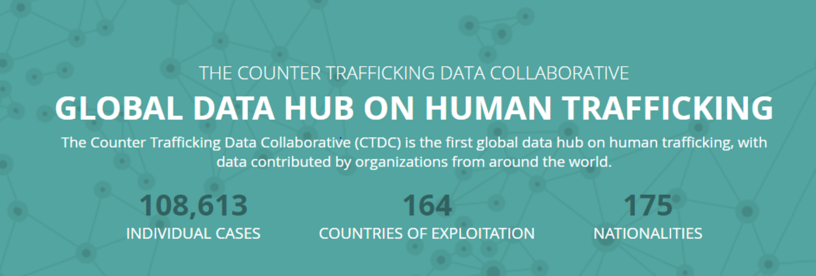

Slide 3
Population challenges and opportunities
Learning Objective: To be able to name and explain a strategy that is used to combat the trafficking of people.
Starter: What reasons might there be for a high influx of victims being sent to the Netherlands and the UK?

Slide 4
Population challenges and opportunities
Demo: Watch the Video and make Notes on How can banks be used to stop human trafficking?

Slide 5
Amsterdam
Demo: Do a little reasearch on the situation in Amsterdam?
To what extent is human trafficking a problem for the city.
Countries that are major sources of trafficked persons include Thailand, India, The Netherlands, Mexico, China, Nigeria, Albania, Bulgaria, Belarus, Moldova, Ukraine, Sierra Leone, and Romania.
According to figures obtained from the National Centre against Human Trafficking, there were 1,711 registered presumed victims of human trafficking in 2012, of whom 1,177 were women forced to work in the sex industry.However, an increase in identified presumed victims does not necessarily mean an increase in trafficking but can be caused by, for instance, better awareness and cooperation among the different agencies which come into contact with potential victims.
Within the Netherlands, victims are often recruited by so-called "loverboys" – men who seduce young Dutch women and girls and later coerce them into prostitution.
Many victims of human trafficking are led to believe by organized criminals that they are being offered work in hotels or restaurants or in child care and are forced into prostitution with the threat or actual use of violence. Estimates of the number of victims vary from 1,000 to 7,000 on a yearly basis. Most police investigations on human trafficking concern legal sex businesses. All sectors of prostitution are well represented in these investigations, but particularly the window brothels are overrepresented.

Slide 6
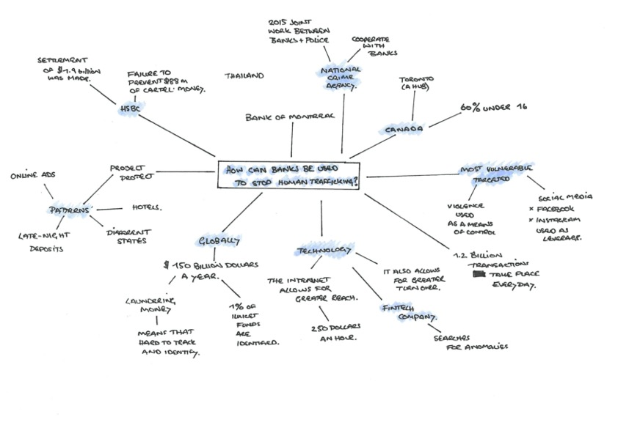

Slide 7
Human Trafficking
Demo: Complete your Case Study Sheet.

Slide 8
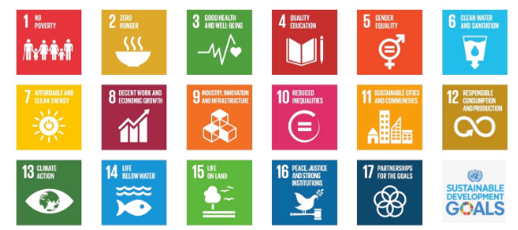
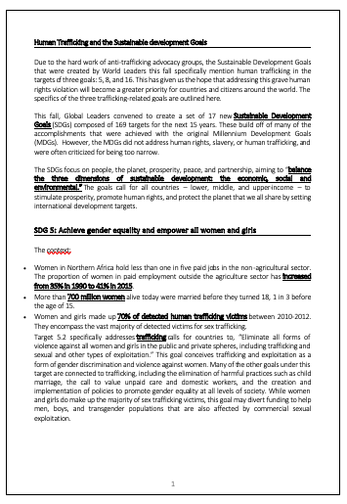
SDG‘s [Further Solutions]
Demo: What Goals aim to do to combat human trafficking?
Challange: What parts of the syllabus do the rest of the SDG‘s link too?

Slide 9
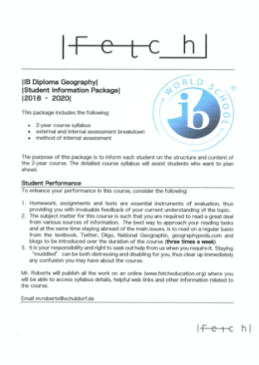
Synthesis
Challange: What parts of the syllabus do the rest of the SDG‘s link too?
Paper 2 Resource Consumption
Tip: Use your syllabus
Paper 2 Climate Change
Paper 1
Paper 2

Slide 10
Homework [Further Solutions]
Demo: What are the key concepts that the EU are folllowing to stop trafficking? Find this document and summarise the key concepts.
Evaluate:Which one of the covered ant-trafficking policies is the most effective. Ensure to justify your answer.

Slide 12
Skills [Infographic]
Demo: From your knowledge on how to answer Questions on Infographics, construct Questions and a markscheme for the Infographic showing Human Trafficking. These will be used next lesson.

