Slide 1
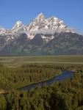
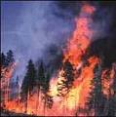
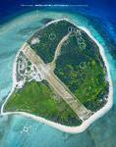
Starter Sheet: FACTORS AFFECTING BIODIVERSITY
Altitudinal Range
Habitat Destruction
Succession
Habitat Architecture
History and Age
Effective Conservation and Restoration
Size of an Area
Disturbance
Habitat Heterogeneity
Productivity
Isolation
Dispersal and Colonisation
Interaction between species
Hetero = different
Homo = same
Key:
GLOBAL and CONTINENTAL FACTORS
REGIONAL FACTORS
LOCAL FACTORS
HUMAN FACTORS

Slide 2
FACTORS AFFECTING BIODIVERSITY - Answers
Altitudinal Range
Habitat Destruction
Succession
Habitat Architecture
History and Age
Effective Conservation and Restoration
Size of an Area
Disturbance
Habitat Heterogeneity
Productivity
Isolation
Hetero = different
Homo = same
Interaction between species
Dispersal and Colonisation
GLOBAL and CONTINENTAL FACTORS
REGIONAL FACTORS
LOCAL FACTORS
HUMAN FACTORS

Slide 3
Biodiversity and change
Learning Objective: To explain the concept and importance of biodiversity in tropical rainforests.
Starter: Make sure to categorise each of the factors affecting biodiversity. Ensure to complete the key and complete the task.
Worksheet
Check your Answers
Biodiversity involves plants, animals and microorganisms. It refers to species diversity, genetic diversity and the interdependence of species within the ecosystem. Accept two valid points.

Slide 4
Glossary
Success Criteria
Learning Objective: To explain the concept and importance of biodiversity in tropical rainforests.
Learning Outcome:
Biodiversity – the variety of genes, species and ecosystems in an area.
Biosphere – the thin veneer of living material on the planet’s surface
Biome – a global scale ecosystem e.g. tropical forest
Biomass - the total weight of living matter per unit area (dry)
Biotic-the living components of an ecosystem such as plants.
Ecosystem- a dynamic complex of plant, animal and micro-organism communities and their non-living environment interacting as a functional unit.
Biodiversity Hotspot- area with particularly high level of biodiversity.
Recolonise- The re-establishment of organisms into habitats that they previously occupied.
For a D grade… identify human influences on biodiversity
For a C grade… identify and explain using geographical terminology to explain how humans influence biodiversity. You can back up you points with case studies
For an A grade...all of the above and evaluate the extent to which people influence biodiversity
Possible Exam Question: Examine the causes and consequences of reduced biodiversity in this biome.

Slide 5
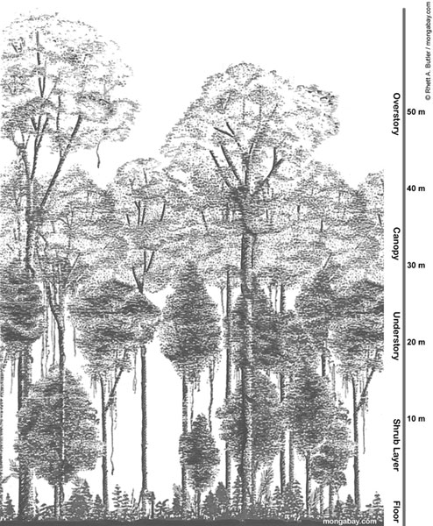
The Rainforest
This is the variety of all forms of life on earth e.g. plants, animals and micro-organisms. This includes variations, interdependence and habitat diversity. Biodiversity is so important in the rainforest because many of the different species depend on one another. It is important for the world because it allows for greater genetic variation, this stabilises ecosystems and makes them resilient to damage. Furthermore it expresses evolutionary potential that will be lost if species go extinct and their genes are removed from the gene pool. The Amazon rain forest covers 40% of South America
has 40,000 plant species, 1000 diff. trees
427 diff. mammals,
receives 160 to 400 inches of rain per year.
20% of the world’s oxygen is produced by the Amazon rainforest
Demo: Watch the YouTube TED Talks video (18 minutes) and annotate the rainforest structure diagram beneath with as much information as possible.
Worksheet

Slide 6
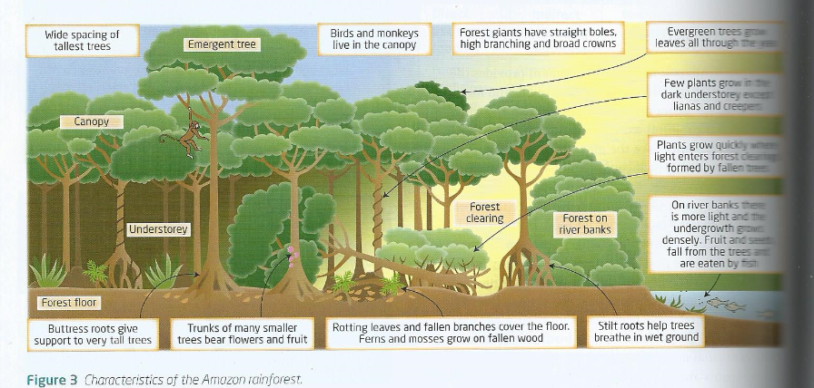
The Rainforest

Slide 7
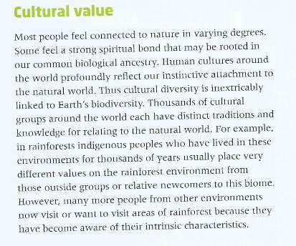
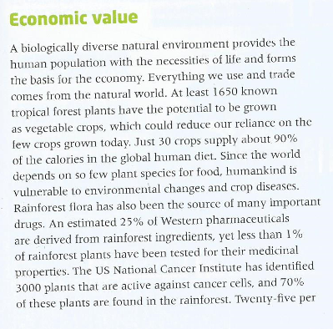
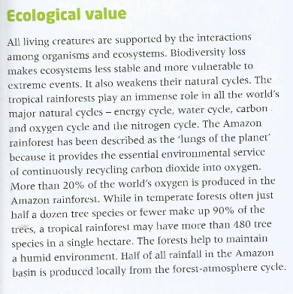
The Value
Demo: What are the values that the rainforest holds? Sort the following cards into:
Cultural Values
Economic Values
Ecological Values
Why are rainforests important?
Why are rainforests being destroyed?
What Problems Does Rainforest Destruction Cause?

Slide 8
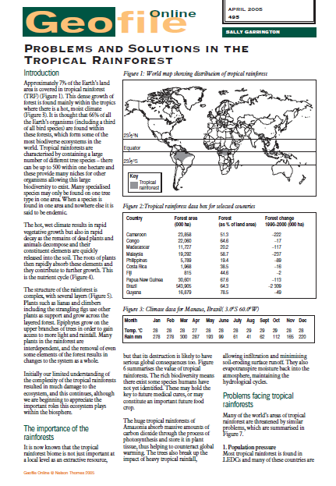
Problems and Solutions in the Tropical Rainforest
Demo: Read the Geofile on the rainforest and highlight:
Human influences on biodiversity
Natural influences on biodiversity
Plenary
Past Exam Question:
Suggest one social and one economic reason for conserving
tropical rainforest. [4 marks]
Worksheet
Social – the preservation of indigenous forest inhabitants.
Economic – conservation of gene pools for economic use as food
and medication and sustained yield of forest commodities such as
timber, rubber and fruit.
Homework

Slide 9
Direct drivers of change
Indirect drivers of change
Changes in local land use
Species introduction and removal
Technological adaption and use
Climate change
Harvest and resource consumption
Natural, physical and biological drivers
Demographic (characteristics of a population)
Economic (globalisation, trade etc)
Science and technology
Cultural and religious
Biodiversity
loss or gain

Slide 10
FACTORS AFFECTING BIODIVERSITY
Altitudinal Range
Habitat Destruction
Succession
Habitat Architecture
History and Age
Effective Conservation and Restoration
Size of an Area
Disturbance
Habitat Heterogeneity
Productivity
Isolation
Dispersal and Colonisation
Interaction between species
Hetero = different
Homo = same
Key:
GLOBAL and CONTINENTAL FACTORS
REGIONAL FACTORS
LOCAL FACTORS
HUMAN FACTORS

