Slide 1
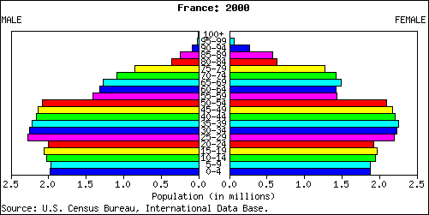
Population Pyramid (France)
Starter: Analyse the population structure of France. (Bullet Point Your Ideas)

Slide 2
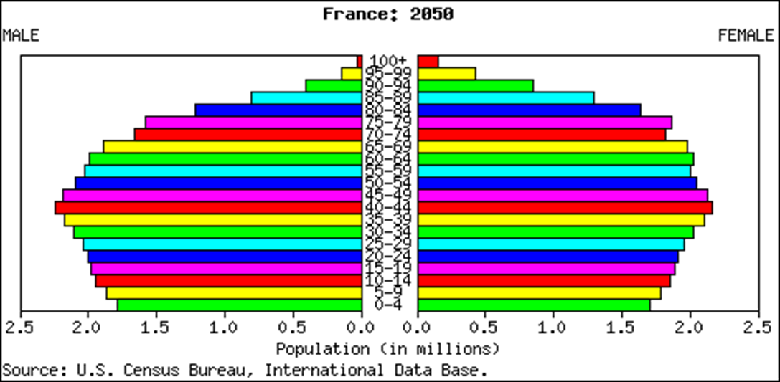
Population Pyramid (France)
Challenge: Further Evaluate the problems France faces. (Write out as a paragraph)

Slide 3
A temporary additional fertility (baby-boom) which first rejuvenates the population…
Population Pyramid (France)
Notes:
www.munich-economic-summit.com/mes_2007/speeches/sp_heran.ppt

Slide 4
…but 40 years later makes it older
Population Pyramid (France)

Slide 5
France Pro-Natalist Policy
Learning Objective: To evaluate the pro-natalist policy of our country of residence - France.
Language for Learning:
Demo: Read the Article on your desk.
Anti Natalist Policy- a population policy designed to limit fertility through the use both of incentives and deterrents.
Case Study: One Child Policy China
Pro Natalist Policy - A policy which aims to encourage more births through the use of incentives.
In most developed countries, the decline in fertility and the increase in life length has raised three concerns:
A decrease in the supply of labour.
The socioeconomic implications of population ageing.
The long term prospect of population decline and demise.
Case Study: Pro Natalist France

Slide 6
France Pro-Natalist Policy
How does the fertility rate of France compare with the average EU rate?
Outline how the French attitude to family values differ from that in eastern Asia
Which EU countries follow the Asian approach?
What is the link between fertility rate and women in work? Outline % figures in your response.
How does the Rabenmutter approach hinder fertility rates in Germany?
What is the link between welfare policies and fertility?
Outline the liberal approach of the French government to childcare .
How does day care for toddlers link with fertility and women in work?

Slide 7
Ageing population
Total fertility rates in France declined from the 1960s to the 1990s
1960 fertility rate 2.73 (children per woman)
1992 fertility rate 1.73
But…..2007 1.98 children born/woman
ALSO….
Ageing population (and associated problems)
Notes:
https://www.cia.gov/library/publications/the-world-factbook/geos/fr.html

Slide 8
France Pro-Natalist Policy
Demo: Referring to the graph, describe the demographic breakdown of France. (3)
Challenge: Referring to the data, suggest some problems that France may face in the future with the current population trend. (4)

Slide 9
Plenary Exams Questions Pro Natalist
Analyse the pro-natalist policy of a country you have studied. (5 marks)
A valid country and policy should be chosen as an example [1 mark]. Award additional marks for further description of the specific policy [2 marks]. The final 2 marks are reserved for some analysis where candidates break down the policy in order to bring out the essential elements or structure and/or provide some evaluation of the policy’s success/failure.

